Slide 1
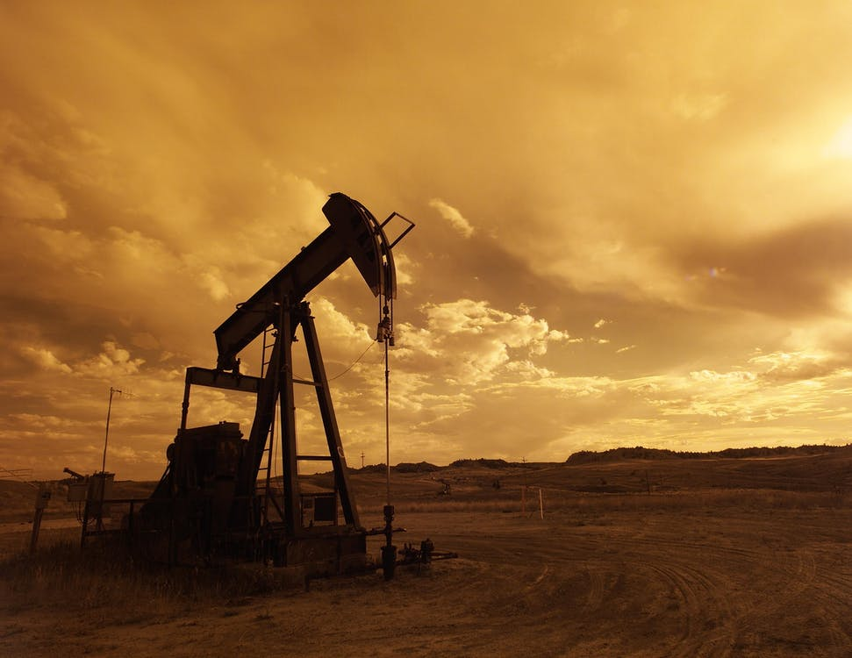
Updates to the 2017 Uinta Basin Oil and Gas Emissions Inventory
Based on UBCS and Produced Water White Papers
12/16/2020

Slide 2
Oil and Gas Emission Inventory Improvements
Ongoing inventory improvement process
Trying to move away from national emission factors to area specific
Bottom up emissions don’t match top down observations
DAQ and EPA have funded research projects and sampling campaigns to get improved scientific results
Improved modeling results to better planning and rule making
Leads to better air quality while minimizing economic impact

Slide 3
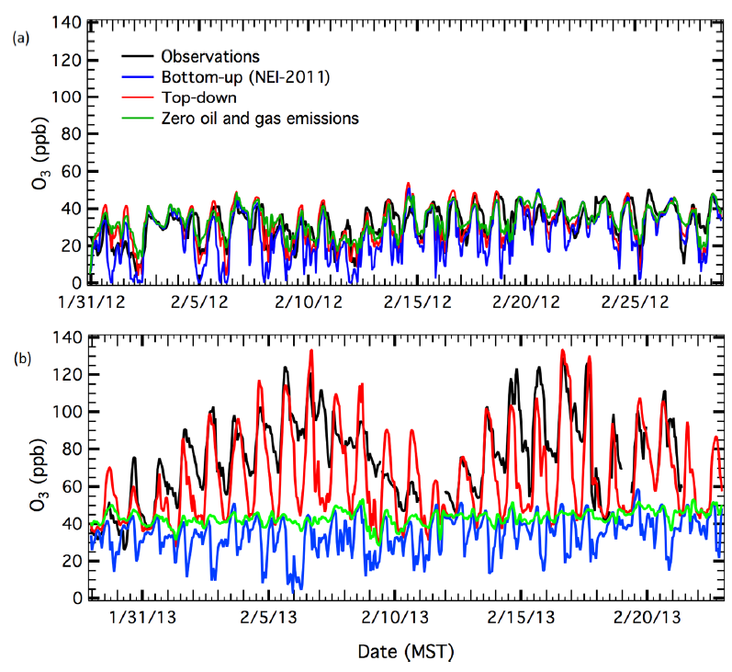
Top-down vs. Bottom-up
“There has been a discrepancy between top-down emissions measurements and bottom-up emissions inventories—with emissions inventories of
CH₄ and VOC lower by factors of 4.8 and 1.8 than measurements, respectively.”
Ahmadov, Ravan, et al. "Understanding high wintertime ozone pollution events in an oil-and natural gas-producing region of the western US." Atmospheric Chemistry and Physics 15.1 (2015): 411-429.

Slide 4
Overview
2018
2019
2020
UBEI2017 Operator workbooks provided
UBEI2017 Presented to Operators
UBCS Sampling
UBCS Report Published
EPA OWDF Sampling
S
UDAQ OWDF Sampling
Analysis & White Papers UBEI2017-Update

Slide 5
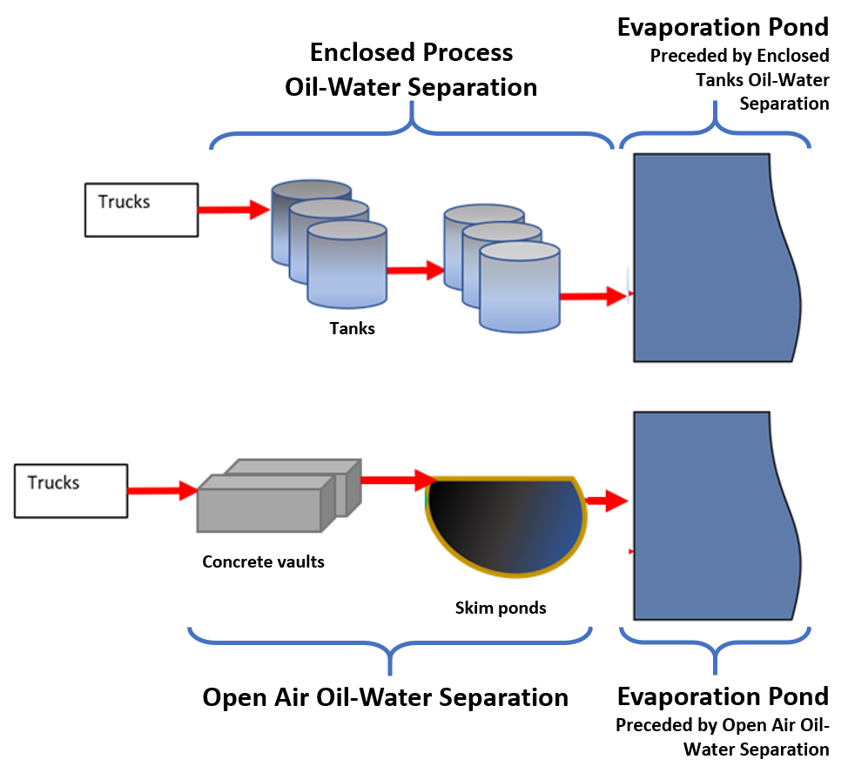
Produced Water Disposal Facilities
Original emission factors were based on only 6 water samples
New emission factors were based on nearly 500 water samples taken throughout the year

Slide 6
Produced Water Emission Factors
Concrete Vaults and Skim Ponds

Slide 7
UINTAH & DUCHESNE COUNTIES |  | UBEI2017 |  | UBEI2017-Update
 |  | Open-air oil-water separation (skim ponds) | Evaporation Pond | Open-air oil-water separation (skim ponds + concrete vaults) | Evaporation Pond (with open-air oil-water separation) | Evaporation Pond (with tanks)
# of samples EF was based on |  | 2 | 4 | 69 | 31 | 382
VOC Emission Factor |  | 5.292 lb/bbl | 0.166 lb/bbl | 47.27 lb/bbl | 0.729 lb/bbl | 0.355 lb/bbl
Included methanol |  | NO |  | YES
Total VOCs by process |  | 7,502 | 320 | 76,894 |  | 63.8
Total VOCs (TPY) |  | 7,822 |  | 76,957

Slide 8
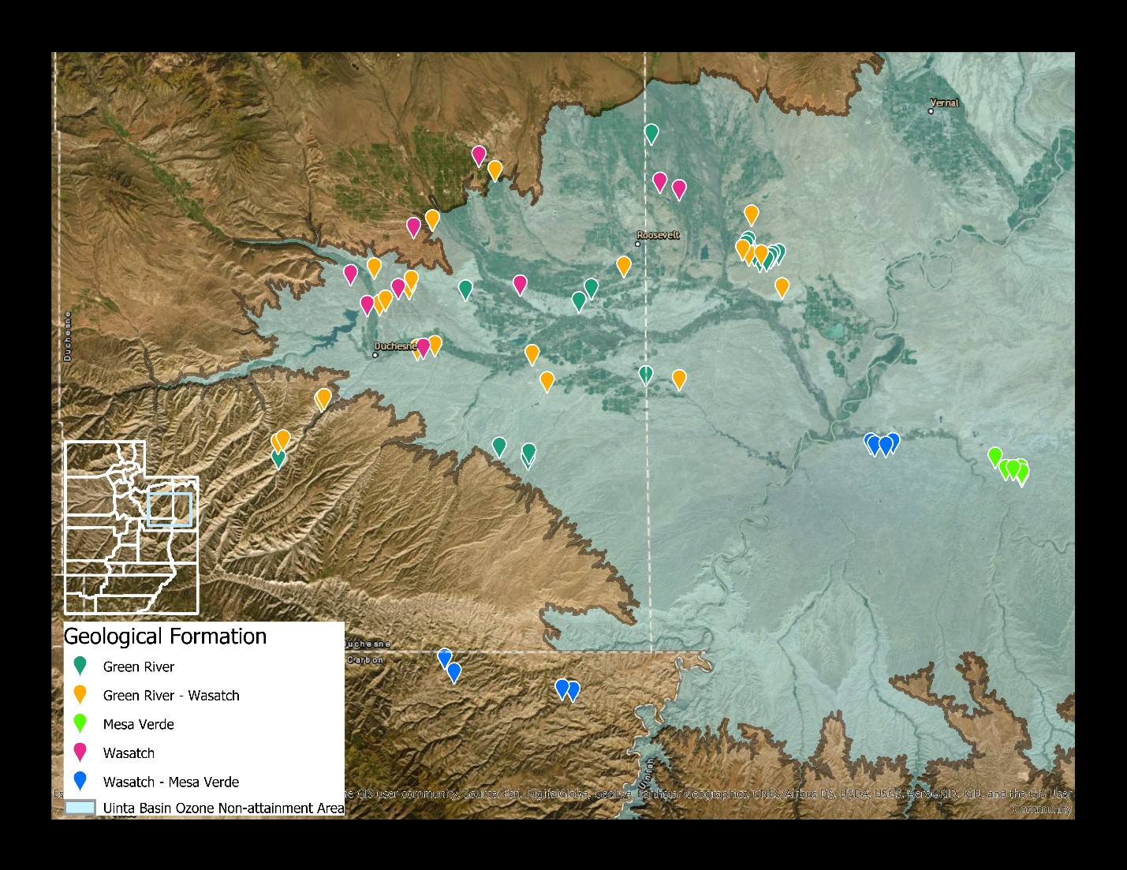
Uinta Basin Composition Study (UBCS)
78 wells across the Uinta Basin
Representing 7 companies (3 gas-producing and 4 oil-producing)
5 geological formations

Slide 9
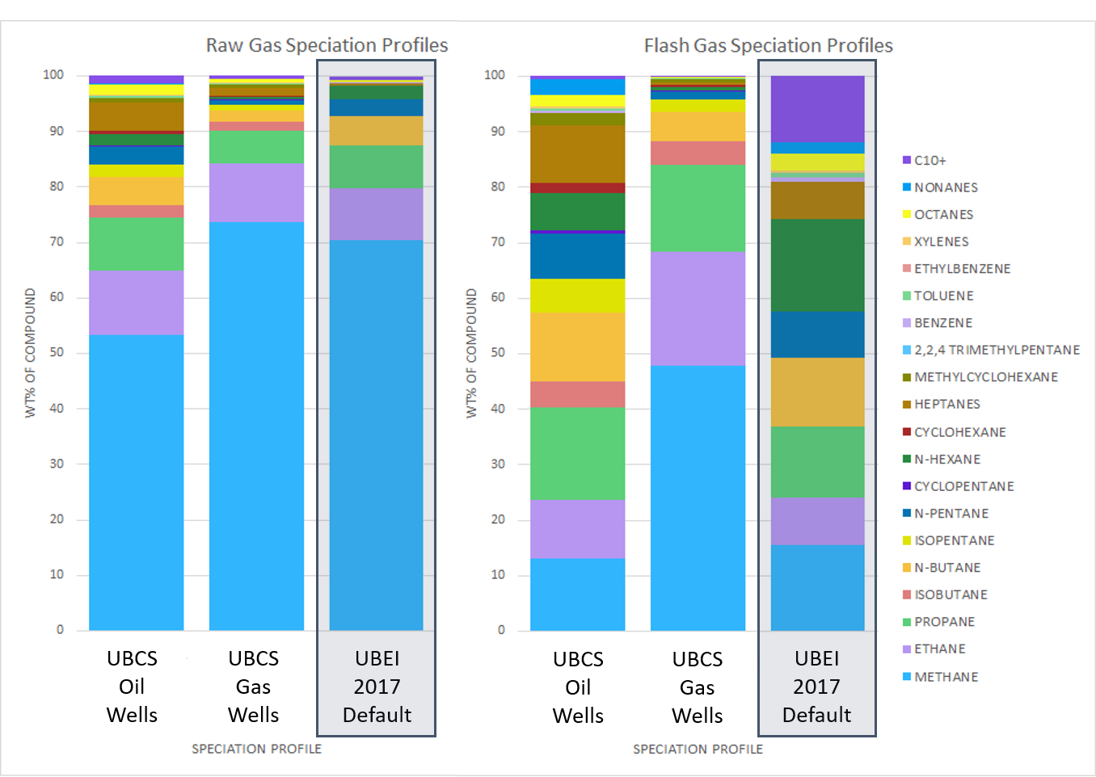
UBCS Profiles vs 2017 Default

Slide 10
UBCS Impacted Categories (VOC TPY)

Slide 11
Uintah & Duchesne Counties Description | VOCs (tons/year)
 | UBEI2017 | UBEI2017-Update
2017 Utah O&G EI (Operator Workbooks)
Dehydrators | 4,517 | 4,517
Dehydrator Combustors | 0 | 0
Fugitives | 17,751 | 18,248
Pneumatic Controllers | 3,881 | 5,474
Pneumatic Pumps | 8,734 | 11,590
RICE & Engines | 1,710 | 1,710
Separators & Heaters | 147 | 147
Tanks (Oil and Condensate) | 7,892 | 12,961
Tanks (Water) | 1,144 | 1,144
Tank Combustors | 1 | 1
Truck Loading | 1,175 | 1,175
Well Completions (Drilling) | 526 | 526
Centrifuges | 10 | 10
Solid Waste Disposal | 288 | 288
Produced Water | 7,820 | 76,957
SUBTOTAL Emissions Reported in Operator Workbooks | 55,596 | 134,747
Capture Effectiveness Adjustment for Tank Emissions
Control Effectiveness Adjustment (Water Tanks) | 0 | 0
Control Effectiveness Adjustment (Condensate Tanks) | 432 | 905
Control Effectiveness Adjustment (Oil Tanks) | 13,514 | 14,078
UDOGM Incident Reports
Midstream Vent (maintenance, startup/shutdown, malfunction) | 667 | 667
Pipeline Leaks | 166 | 166
Greenhouse Gas Emissions Reporting Program Additions
Gas Well Venting (Blowdowns) | 6,645 | 3,302
Pipeline Blowdowns and Pigging | 369 | 546
EPA National Oil and Gas Tool
Associated Gas Venting | 446 | 446
CBM Dewatering Pumps | 0 | 0
CBM Well Venting (Blowdowns) | 0 | 0
Mud Degassing | 545 | 545
Point Source Inventory (Reported in SLEIS)
Point Sources | 250 | 250
Combined Total (Duchesne + Uintah) VOC Emissions | 78,630 | 155,651

Slide 12
Uintah & Duchesne Counties Description | VOCs (tons/year)
 | UBEI2017 | UBEI2017-Update
2017 Utah O&G EI (Operator Workbooks)
Fugitives | 17,751 | 18,248
Pneumatic Controllers | 3,881 | 5,474
Pneumatic Pumps | 8,734 | 11,590
Tanks (Oil and Condensate) | 7,892 | 12,961
Produced Water | 7,820 | 76,957
SUBTOTAL Emissions Reported in Operator Workbooks | 55,596 | 134,747
Capture Effectiveness Adjustment for Tank Emissions
Control Effectiveness Adjustment (Condensate Tanks) | 432 | 905
Control Effectiveness Adjustment (Oil Tanks) | 13,514 | 14,078
Greenhouse Gas Emissions Reporting Program Additions
Gas Well Venting (Blowdowns) | 6,645 | 3,302
Pipeline Blowdowns and Pigging | 369 | 546
Combined Total (Duchesne + Uintah) VOC Emissions | 78,630 | 155,651
2013 UB flyover: 184,511 VOC (TPY)

Slide 13
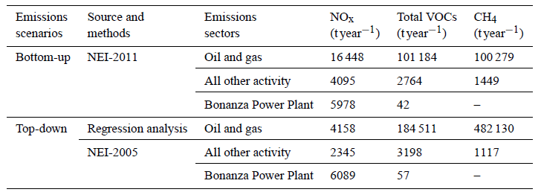
R. Ahmadov et al.: Understanding High Wintertime Ozone Pollution Events
Source: Ahmadov et.al. 2015 (https://repository.library.noaa.gov/view/noaa/20581)

Slide 14
Questions
ryangrant@Utah.gov
lexiewilson@Utah.gov
https://deq.utah.gov/air-quality/2017-statewide-oil-gas-emissions-inventory

