Slide 1
BLM Utah Air Resource Management Strategy (ARMS)

Slide 2
What is ARMS?
The Bureau of Land Management (BLM) authorizes activities that can affect air resources by releasing pollutants to the atmosphere.
Federal Land Policy Management Act (FLPMA)
manage the public lands in a manner that protects air and atmospheric values (Sec 102(8))
Prevent unnecessary or undue degradation of lands (Sec 302(b))
National Environmental Policy Act (NEPA)
Requires federal agencies to evaluate environmental impact of major actions in order to adequately inform decisions
ARMS – Strategy for meeting the intent and requirements of guiding legislation
Four main elements of the ARMS: airshed management, NEPA analysis, air monitoring, and public education and awareness.
The BLM utilizes regional air quality modeling to assist in all of these elements.

Slide 3
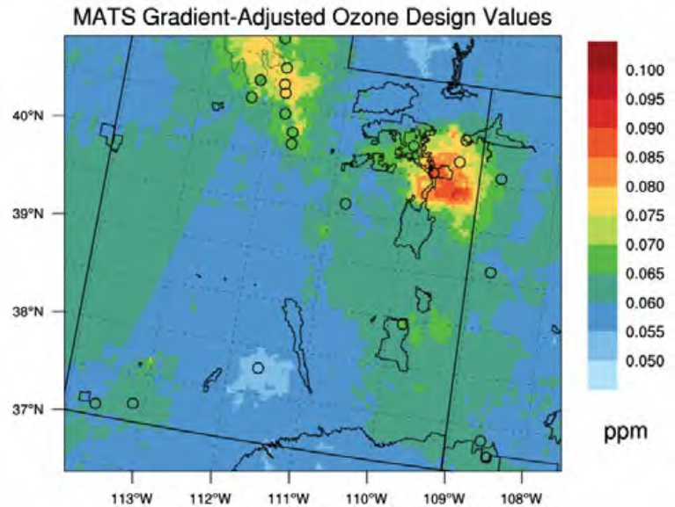
ARMS 2014
Emissions based on Field Office reasonably foreseeable development scenarios (RFDS).
Projected exceedances of the ozone NAAQS in the Uinta Basin
Suggested VOC emission controls would have greatest effect.
Impact assessment report

Slide 4
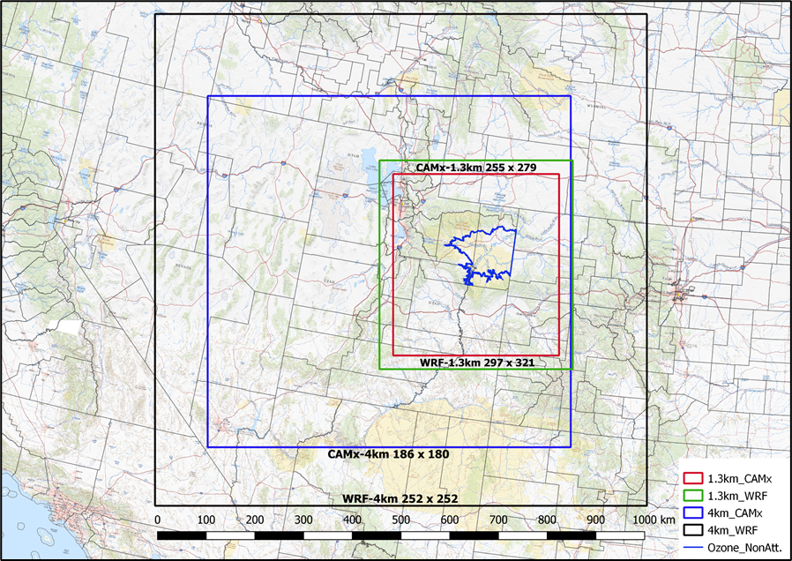
ARMS 2017 Updates
Incorporate model improvements, CAMx 6.5
Meteorology (Western Air Quality Study (WAQS2011b))
Base year emissions inventory derived from 2014 NEI.
Future year emissions based on UDAQ O&G Emissions Growth and Decline Model instead of RFDS.

Slide 5
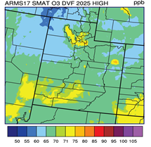
ARMS 2017 Results
Uinta Basin Absolute Max 4th High Concentration
Impacts from oil and gas development in the Uinta Basin were confined to the basin and not subject to long-range transport.
Only mitigation considered were New Source Performance Standards (NSPS).
Also evaluated PM, NO₂, SO₂, visibility, and deposition.
Impact assessment report
O₃ Concentration | O&G Contribution
74.2 pbb | 27.8 pbb | 37.5%

Slide 6
Regional Streamlining Air Modeling Study
Projects supported – Federal Coal Leasing Program, RMPs (WY, ND, NM), general NEPA analysis.
Leverage WRAP/WAQS Regional Haze modeling work (meteorology, emissions)
Updated waste-water emissions for Uinta Basin
Source apportionment (existing/new Federal and non-federal) of impacts to air quality and air quality related values (AQRV’s) from Federal coal, oil, and gas emissions.

