Slide 1
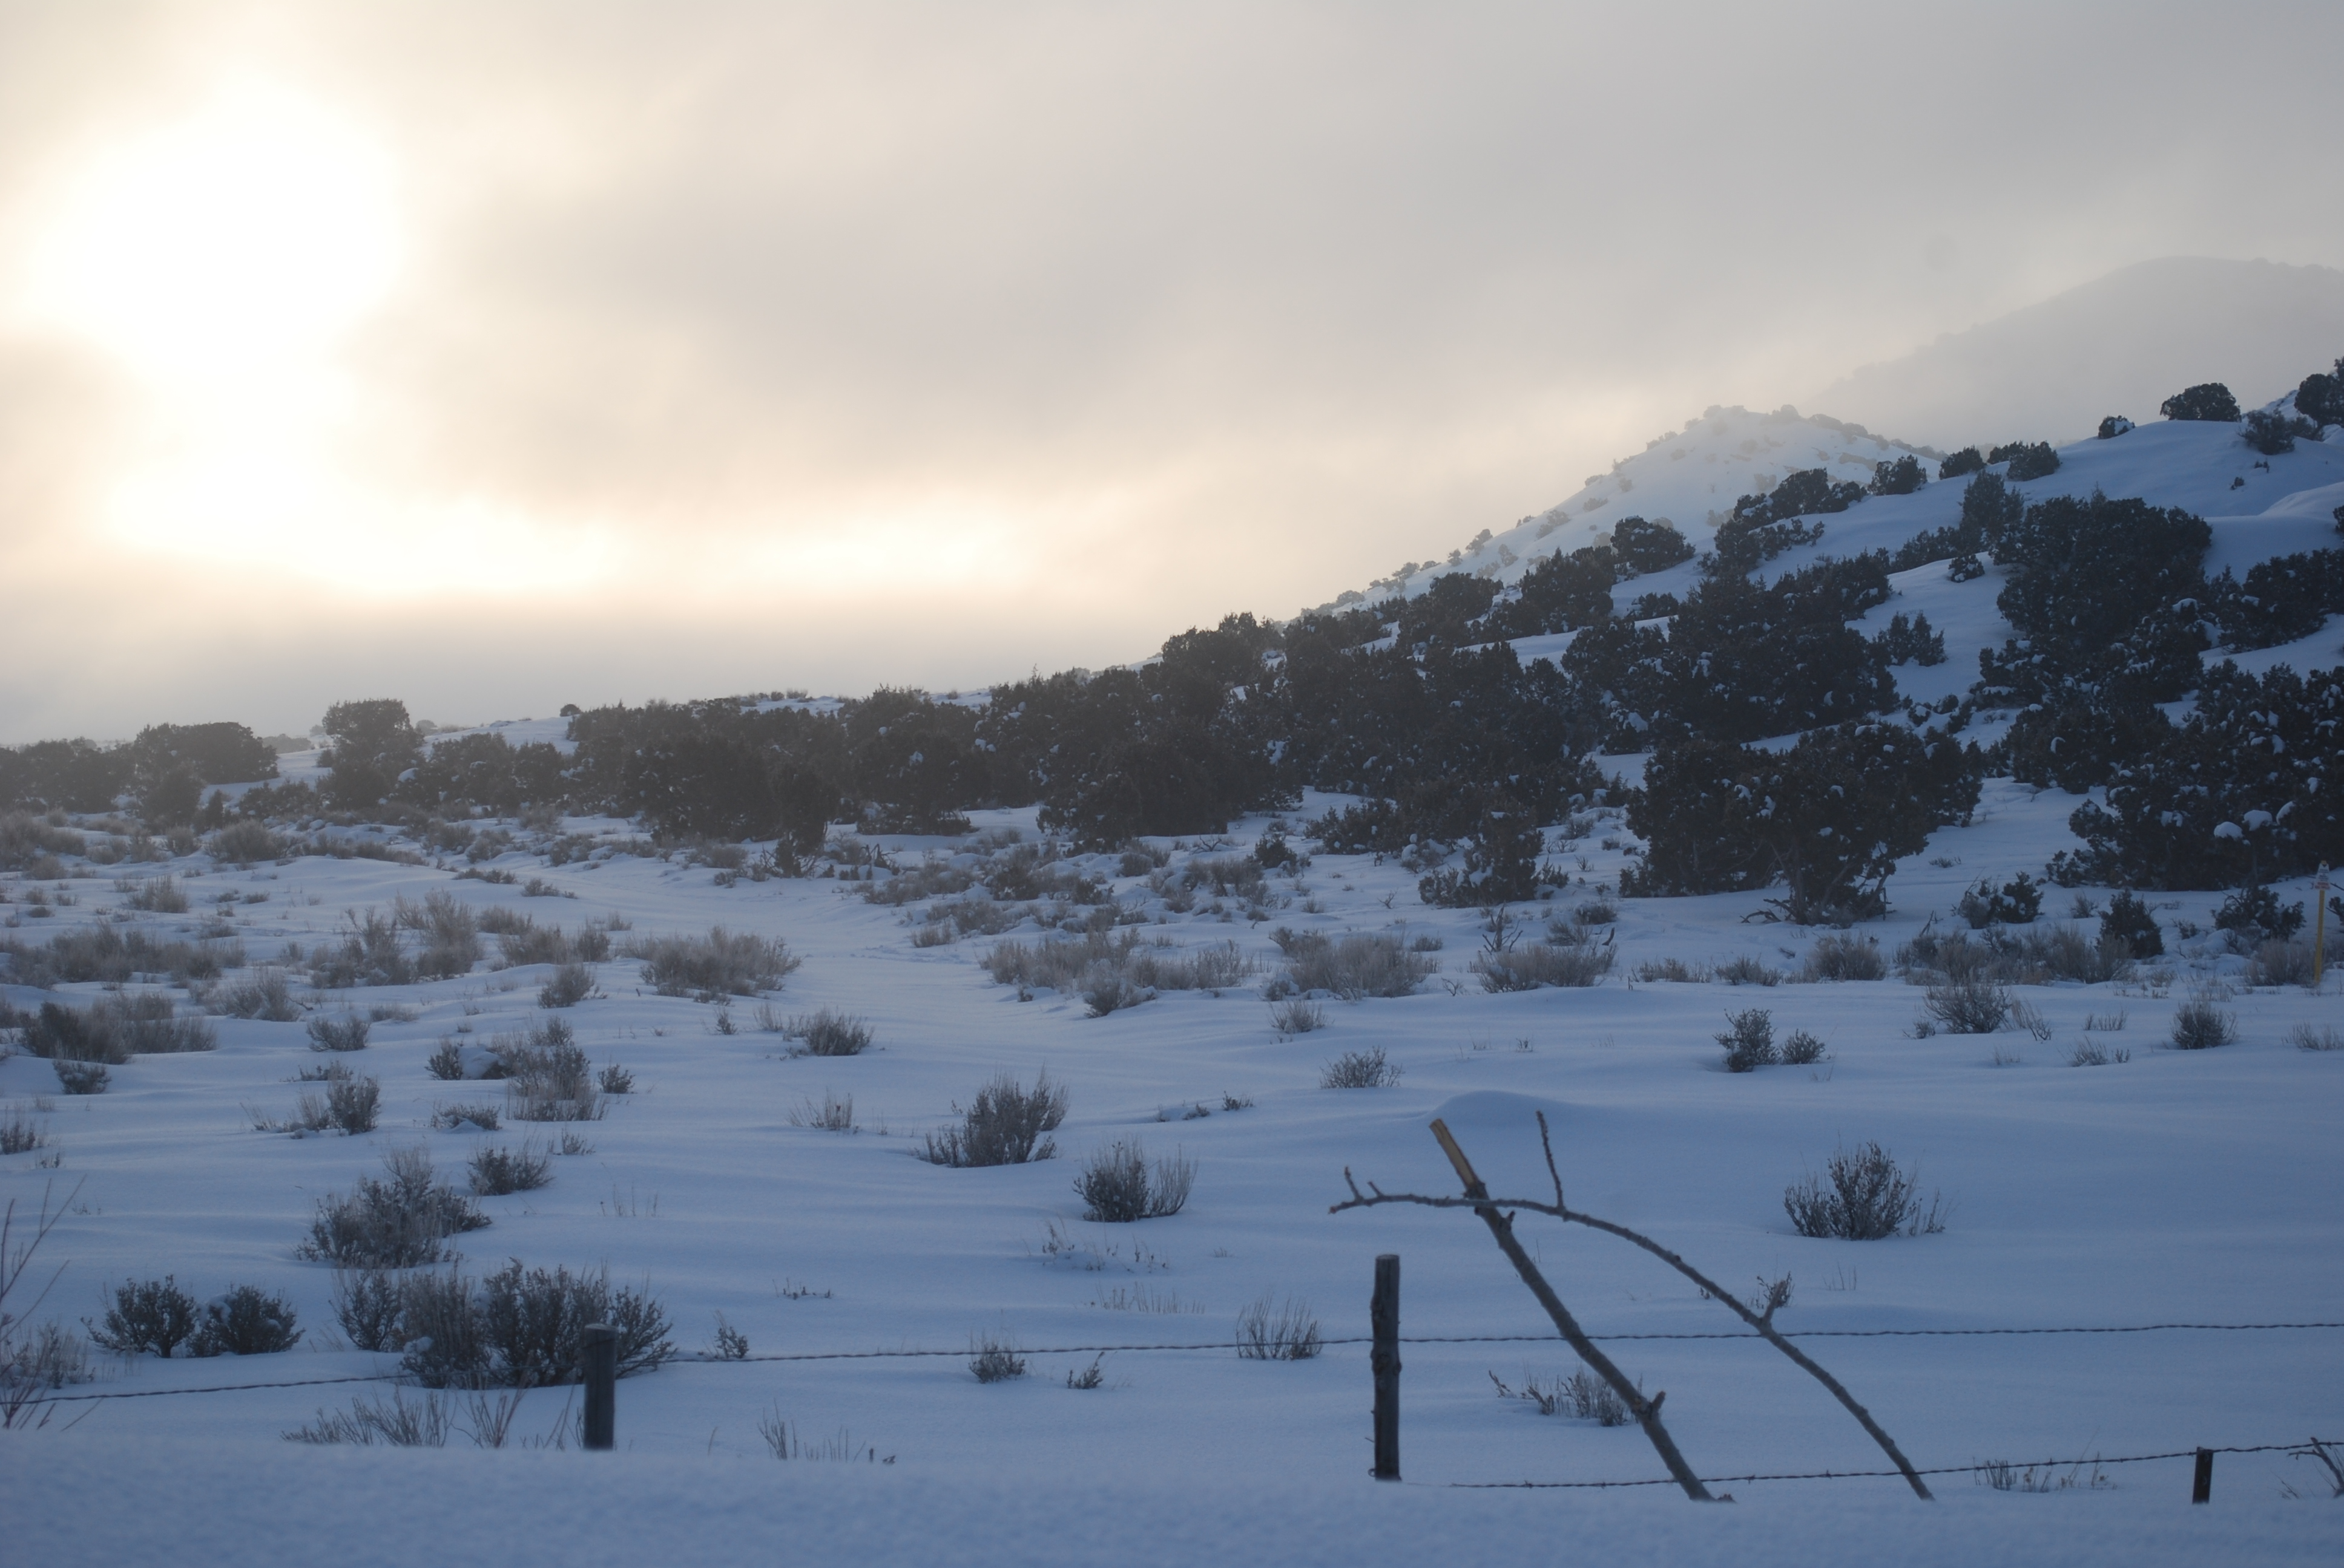

Leak Detection Techniques and Sources
Studies in the Uinta Basin

Slide 2
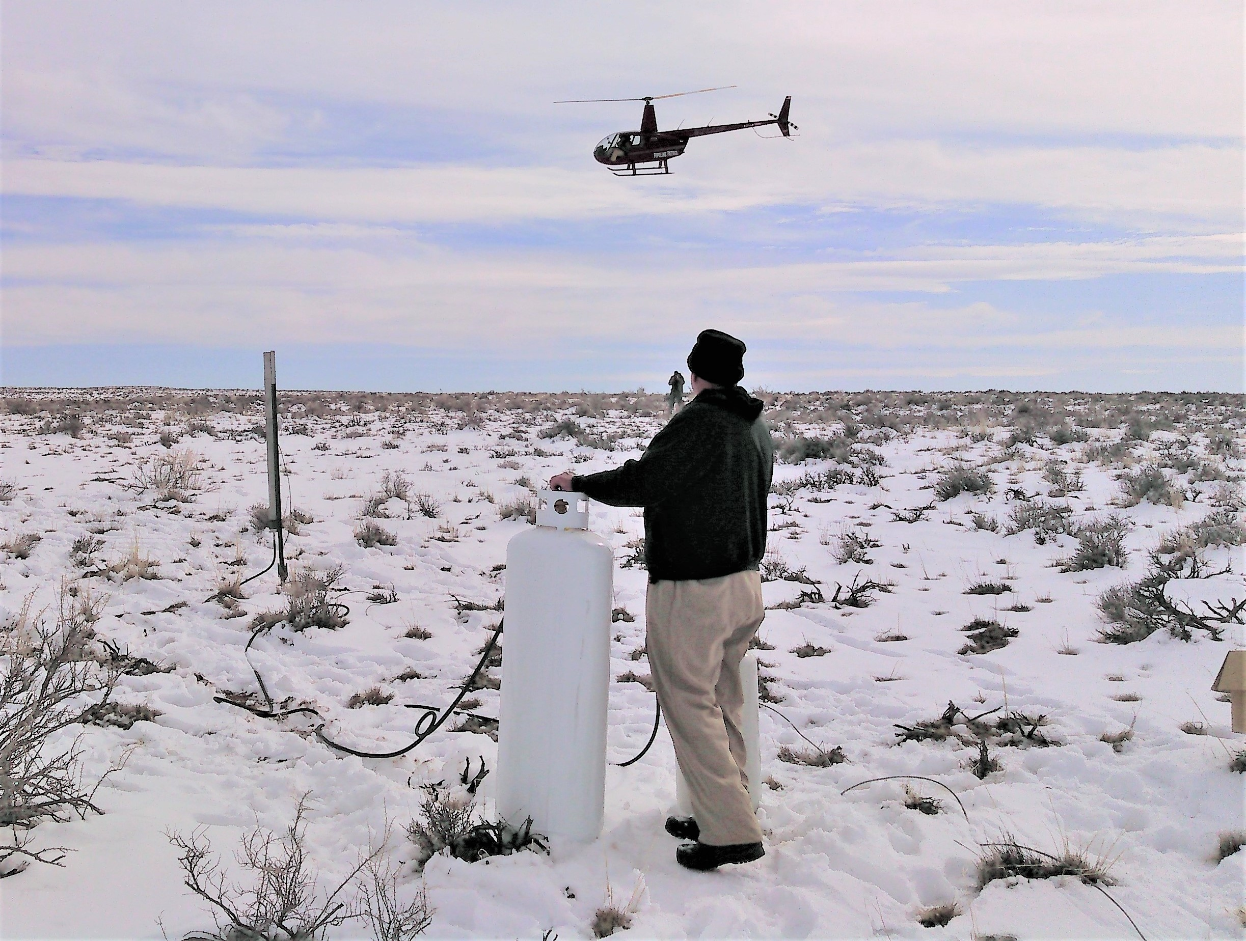
Ground and aerial optical gas imaging studies
Notes:
2

Slide 3
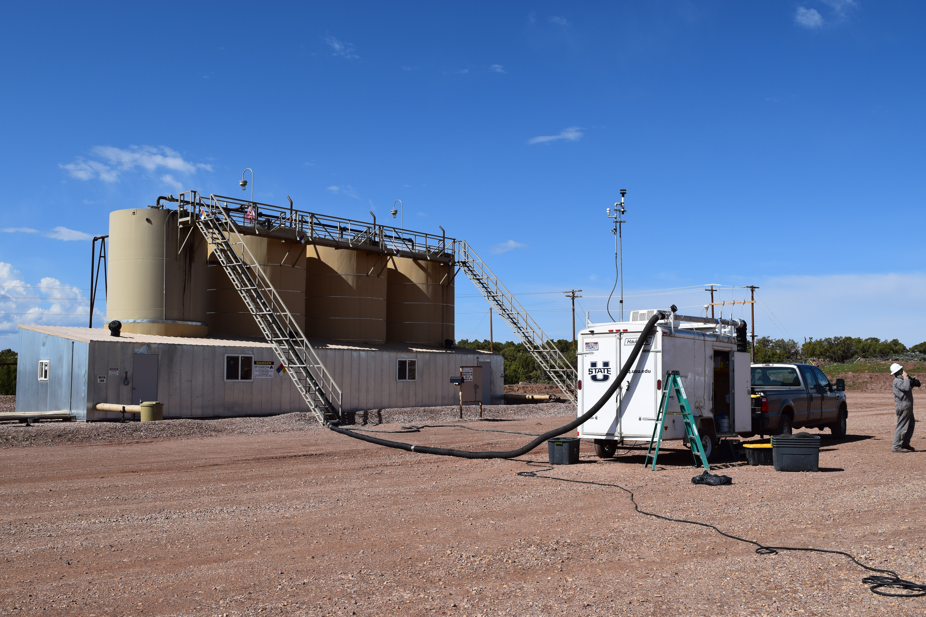
Emissions quantification studies
Notes:
3

Slide 4
Topic 1: Lessons about effectiveness of
optical gas imaging in different conditions
Notes:
4

Slide 5
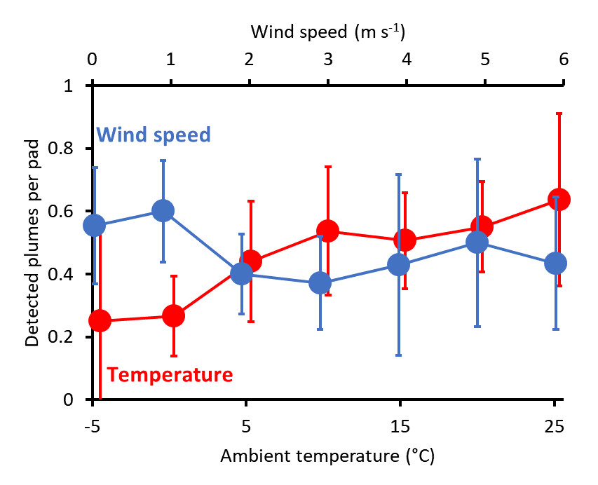
Optical gas imaging cameras detect fewer leaks
in cold weather
Notes:
5

Slide 6
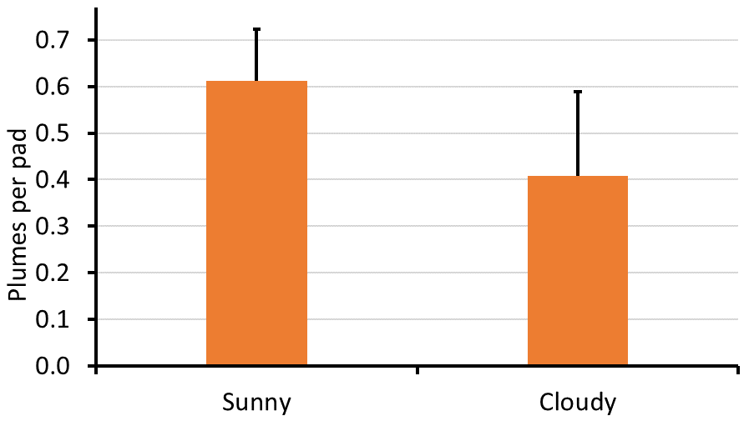
Optical gas imaging cameras detect fewer leaks
in cloudy conditions
Notes:
6

Slide 7
Optical gas imaging cameras detect fewer leaks
with more distance from the source
Large
plume
Medium
plume
Small
plume
No plumes
detected
Distance of camera from tanks on well pad
Notes:
7

Slide 8

High-sensitivity mode makes a big difference
Notes:
8

Slide 9
Takeaways:
OGI cameras detect emissions less well when it is cold and/or cloudy
Users can compensate for non-ideal conditions by:
Getting closer
Stabilizing the camera
Using high sensitivity mode
Notes:
9

Slide 10
Topic 2: Important sources of organic compound emissions at well pads
Notes:
10

Slide 11
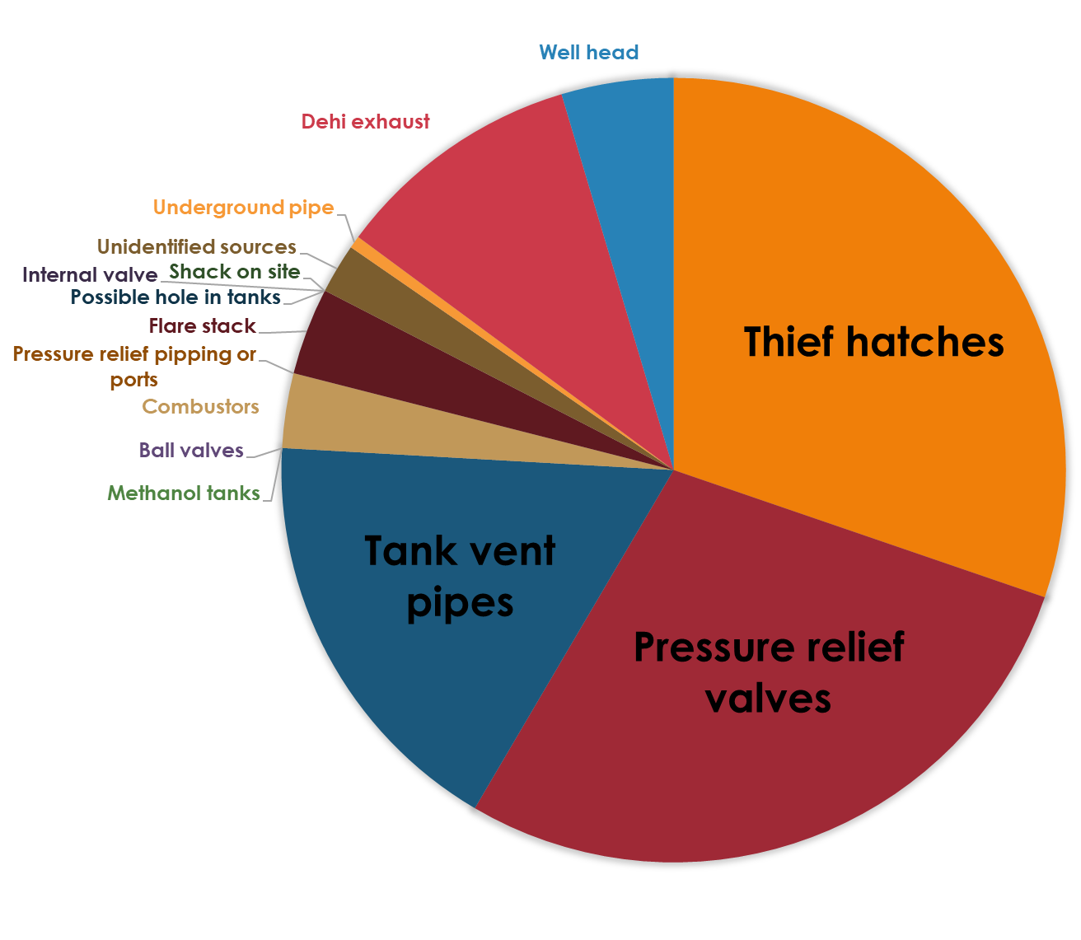
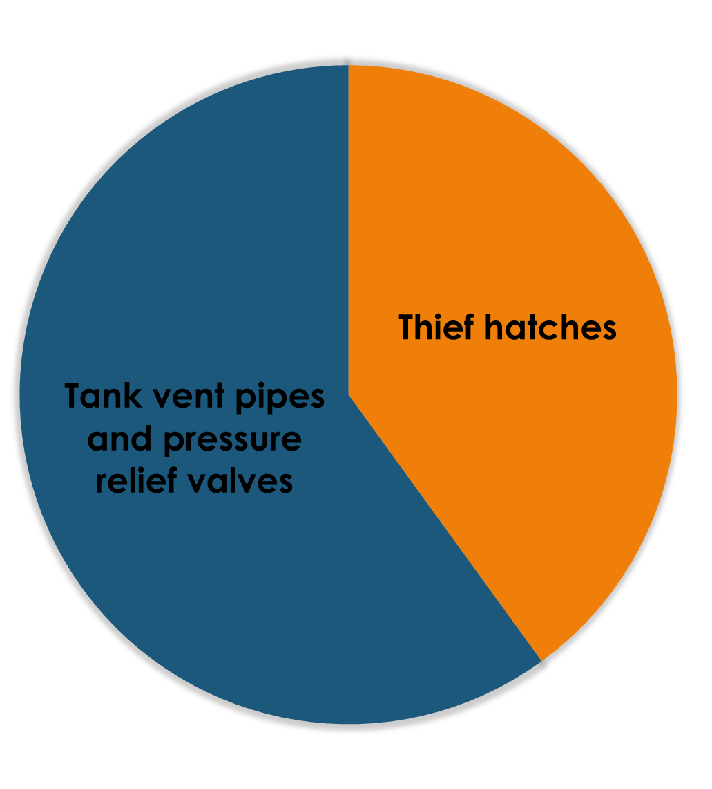
Most emissions detectable from off-pad
come from tanks
Aerial
Ground
Notes:
11

Slide 12
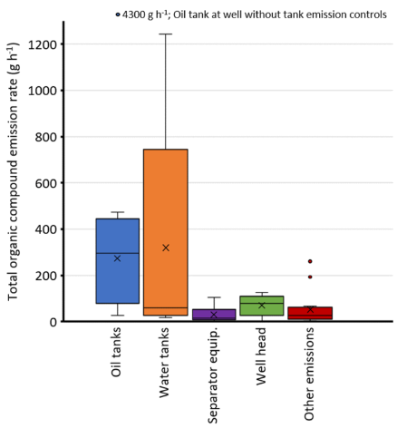
Tank emissions are highest, even when tank vents are routed to combustors
Notes:
12

Slide 13
Significant differences were observed by company
Notes:
13

Slide 14
Significant differences were observed by company
Scores for company F before tank improvements (pads with controlled tanks only): 0.60 plumes per pad, severity score of 2.2
Notes:
14

Slide 15
Takeaways:
Tanks are typically the largest emission sources on well pads
This is true even for tanks with combustors
Tank emissions make more ozone than other emission sources
Investment in better equipment to reduce leaks from tanks makes a big difference
Notes:
15

Slide 16
Additional thoughts:
Efforts to reduce emissions when conditions are right for winter ozone are extremely valuable
Thus the ozone alert program
Automated tank malfunction detection would be a lot more effective, and less expensive, than manual OGI surveys
Notes:
16

Slide 17
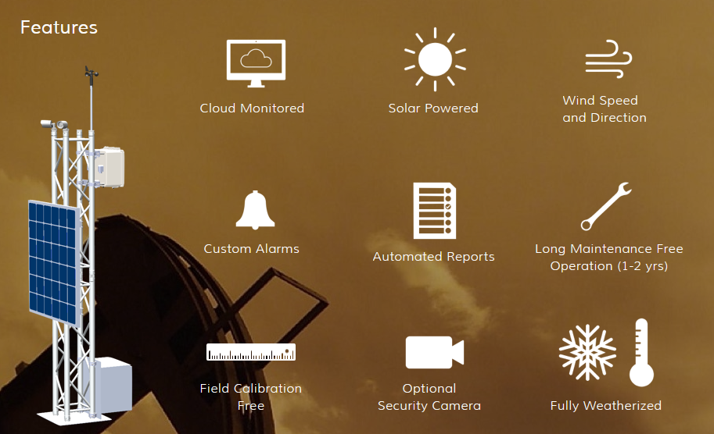
Real-time methane detection works,
but up-front costs are high
https://www.quanta3.com/products.html
Notes:
17

Slide 18
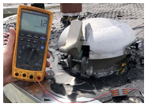
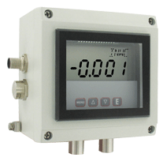
On-tank sensors with telemetry
may be cheaper and more effective
Thief hatch closure sensor
Tank pressure sensor
https://oleumtech.com/oleumtech-products/thief-hatch-switch
https://www.dwyer-inst.com/Product/HazardousRated/PressureTransmitters/SeriesISDP
Notes:
18

Slide 19
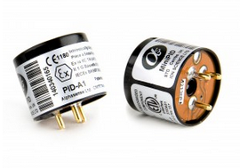
On-tank sensors with telemetry
may be cheaper and more effective
Low-cost, high-sensitivity non-methane organics sensor
https://www.alphasense.com/index.php/products/pid-air/
Notes:
19

Slide 20
Final takeaways:
OGI isn’t a magic bullet. Use it prudently.
Tanks are the big well-level emission source to worry about. Action to prevent tank emissions makes a big difference.
In a time when fewer workers handle more and more wells, automation may be the Key.
Notes:
20

Slide 21
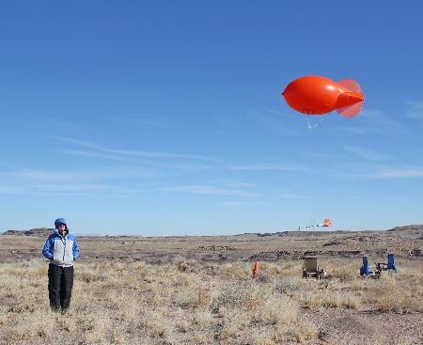
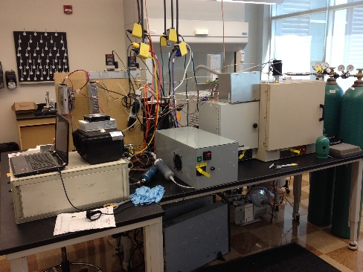
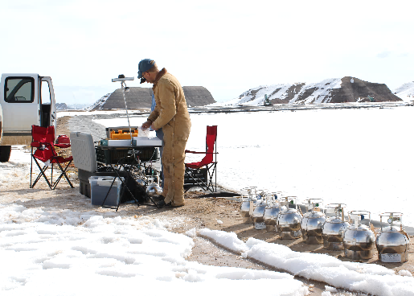
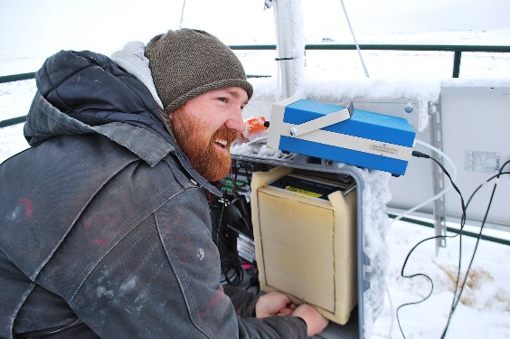
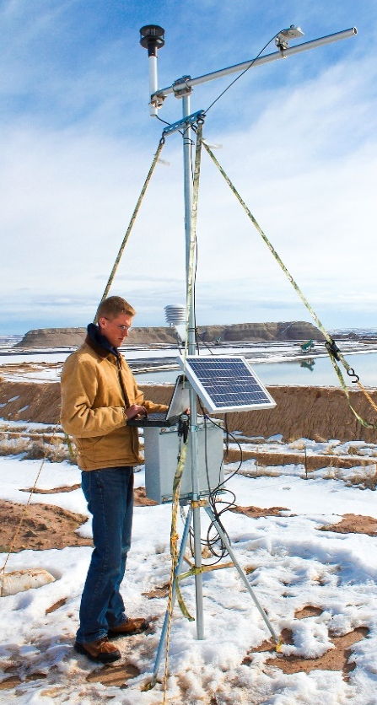
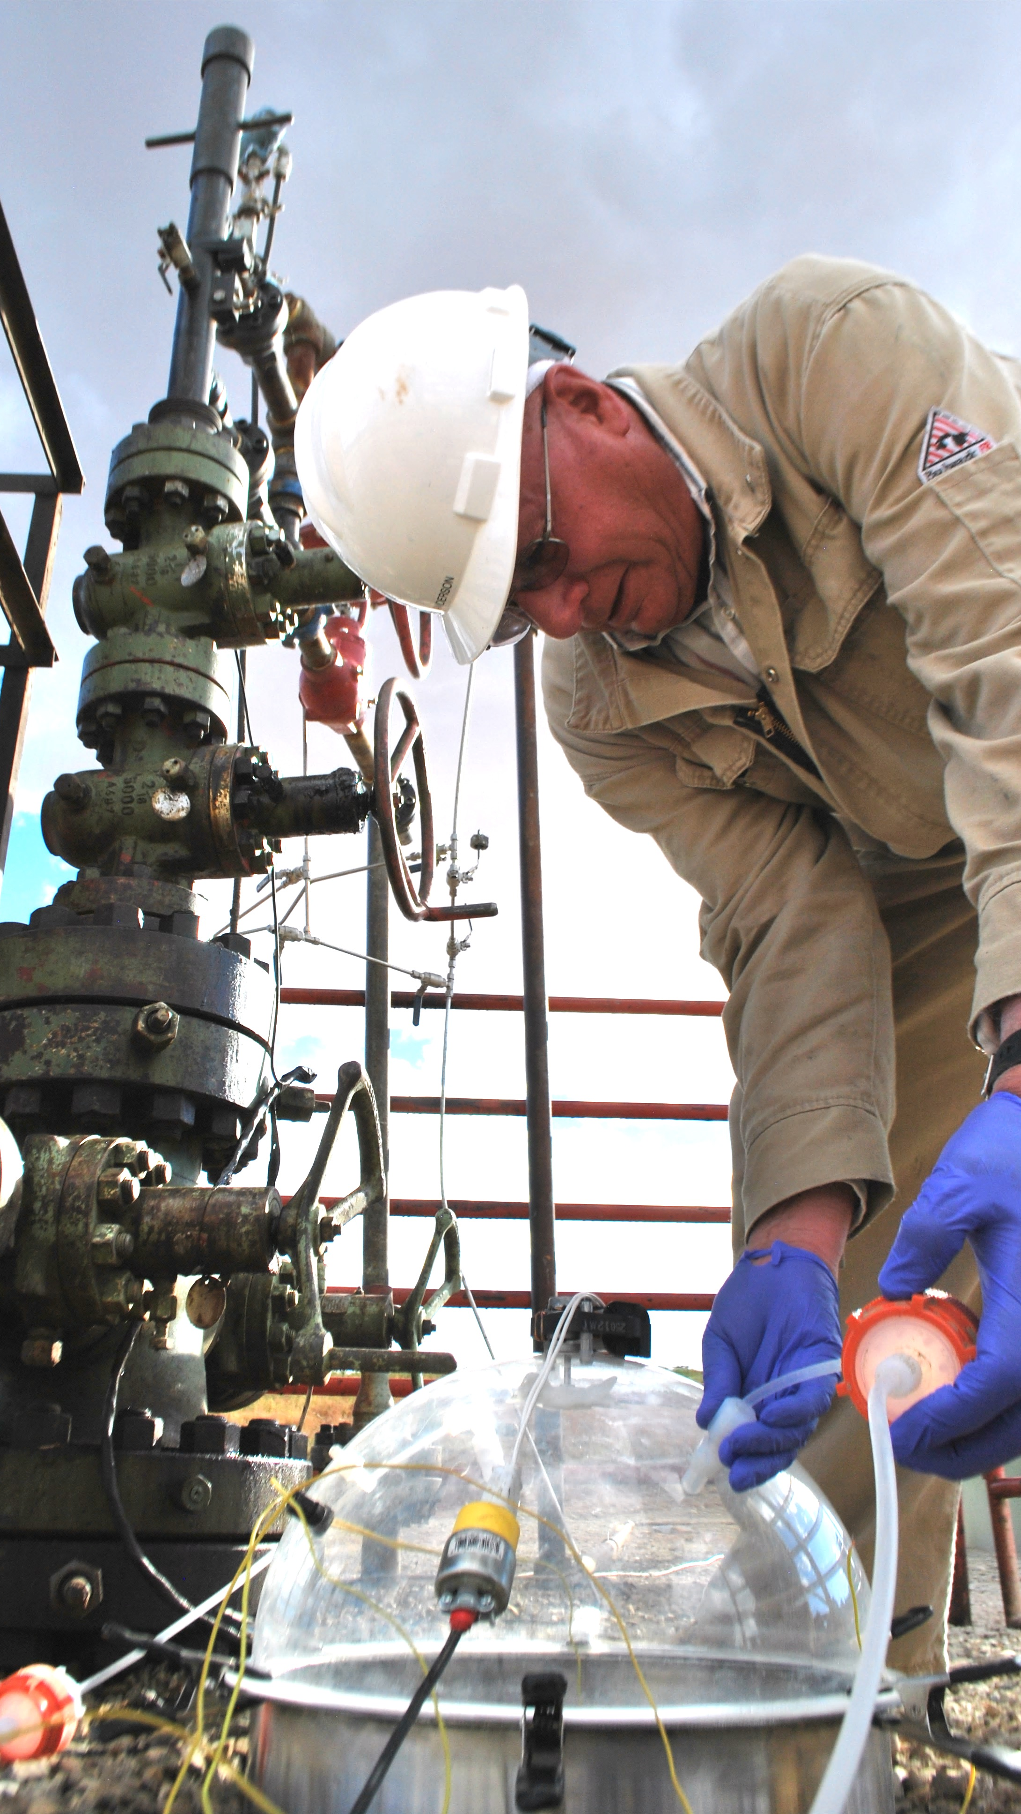
Thank You
Funding provided by:
Uintah Impact Mitigation Special Service District
Utah Legislature
Bureau of Land Management
Utah Division of Air Quality
Environmental Protection Agency
Thanks to:
Many oil and gas companies for providing information and site access
Contact us:
seth.lyman@usu.edu
Our website: binghamresearch.usu.edu

Slide 22
Notes:
22

