Slide 1
WINTER OZONE IN THE UINTA BASIN HAS BEEN ATTENUATING
M. Mansfield & S. Lyman
Utah State University Uintah Basin
Uinta Basin Ozone Working Group
January 20, 2021
Most of these results are in a peer-reviewed publication, already available at our website:
Mansfield & Lyman, “Winter Ozone Pollution in Utah’s Uinta Basin is Attenuating,” [2021].

Slide 2
STATISTICIAN-SPEAK:
“Statistically significant.”
means
“It’s hard to see how this could have occurred randomly.”
Statisticians devise some kind of “p-test” to estimate the odds that some occurrence was random. They often put the threshold at 1 in 20 odds. ( p = 0.05 )
(Corollary: One time in twenty, something reported to be statistically significant really isn’t.)

Slide 3
Average ozone concentration at any given site in any given season, assuming a moderately intense inversion.
Whiskers extend from maximum to minimum. Boxes show 25th, 50th, 75th percentiles.
Trend lines drawn using the 50th percentiles (medians).
Blue = snow years
Red = no-snow years
The downward trend of the snow line is statistically significant. Ozone has been declining at the rate of about 3 ppb per year.
With only three data points, the upward slope of the no-snow line is not statistically significant.
But they are both trending towards background ozone = 40 ppb.

Slide 4
Number of exceedance days per season.
Downward trend is statistically significant.
Trends to zero in 2021.

Slide 5
NOx vs. VOC control
Many ozone systems are under “VOC control” or “NOx control.” (Or “NOx-limited,” or “NOx-sensitive.”)
NOx control means you can dial ozone up and down by dialing NOx up and down, while turning the VOC dial has a weaker effect.
Determination of VOC vs. NOx control is very difficult.
A few results suggest the Uinta Basin might be under NOx control.
The next slide shows one result, for the others consult our paper.

Slide 6
NOx shows a statistically significant downward trend at the rate of 0.3 ppb per year.
VOC concentrations have trended downward since 2012 or 2013 but have since rebounded. Rebound not reflected in ozone data, suggesting VOC-insensitivity. But our VOC data is very sparse (only two sites).

Slide 7
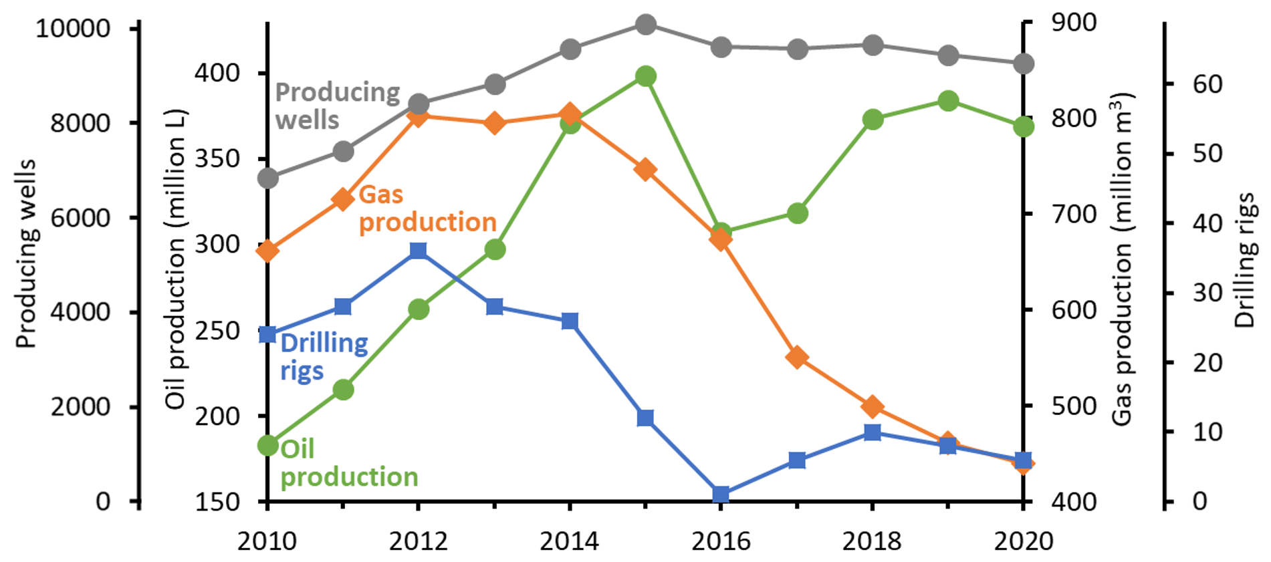
We have looked for smoking guns in the drilling and production data:
Drilling is way down, but according to 2014 & 2017 inventories, well completions account for about 6% to 10% of all NOx.
Wells are getting older, presumably producing less, so less energy is needed to pump them. But total oil production has been flat since 2018.
Quad-O and quad-Oa controls came online, but they control for VOC.
We haven’t identified a single cause, perhaps there are multiple causes. ANY IDEAS?

