Slide 1

Ute Indian Tribe Air Quality
2020 Exceptional Event Demonstration
Prepared by Mike Natchees and Trinity consultants

Slide 2
Exceptional Event Definition 40 CFR Part 50.1(j)
as an event(s) and its resulting emissions that affect air quality in such a way that there exists a clear causal relationship between the specific event(s) and the monitored exceedance(s) or violation(s), is not reasonably controllable or preventable, is an event(s) caused by human activity that is unlikely to recur at a particular location or a natural event(s), and is determined by the Administrator in accordance with 40 CFR 50.14 to be an exceptional event. It does not include air pollution relating to source noncompliance. Stagnation of air masses and meteorological inversions do not directly cause pollutant emissions and are not exceptional events. Meteorological events involving high temperatures or lack of precipitation (i.e., severe, extreme or exceptional drought) also do not directly cause pollutant emissions and are not considered exceptional events. However, conditions involving high temperatures or lack of precipitation may promote occurrences of particular types of exceptional events, such as wildfires or high wind events, which do directly cause emissions.

Slide 3
Summer 2020: Excessive heat and drought conditions across the Pacific Northwest, California and other areas of the western United States led to many wildfires throughout the region.
August 21-22, 2020: Ambient ozone concentrations measured at the Ute tribe’s four monitoring stations exceeded the 8 hour NAAQS of 70ppb.
August 21, 2020:
Redwash 76ppb
August 22, 2020:
Red wash 74 ppb
Ouray 74 ppb
Myton 71 ppb
Whiterocks 73 ppb

Slide 4
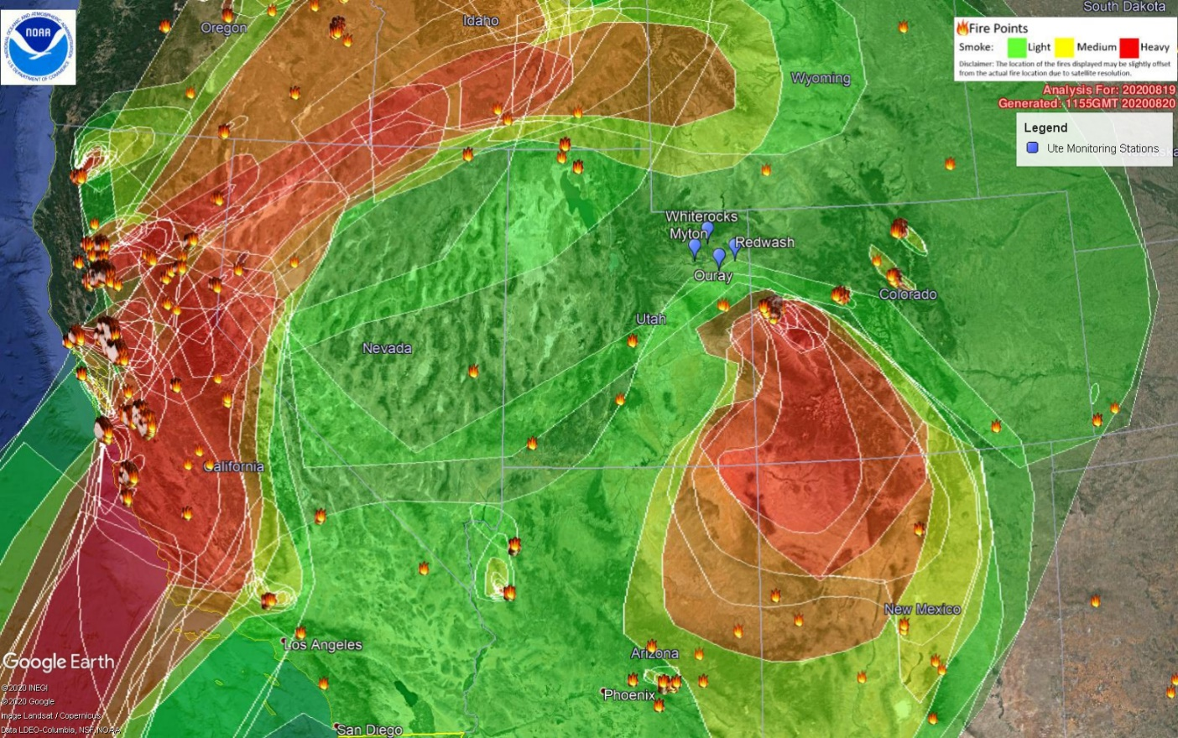
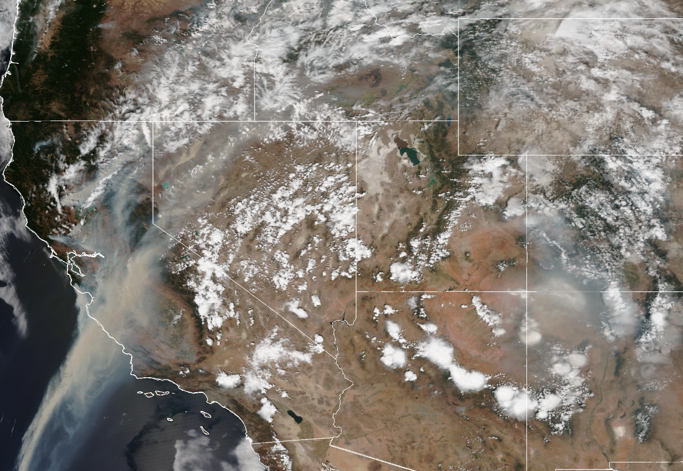
NOAA MODIS Wildfire Detection Map & NOAA Satellite Imagery 08/19/2020

Slide 5
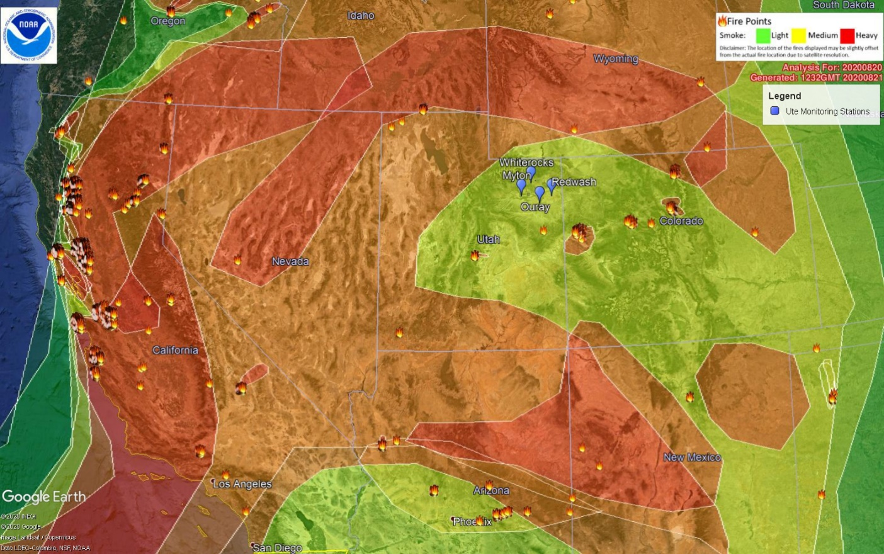
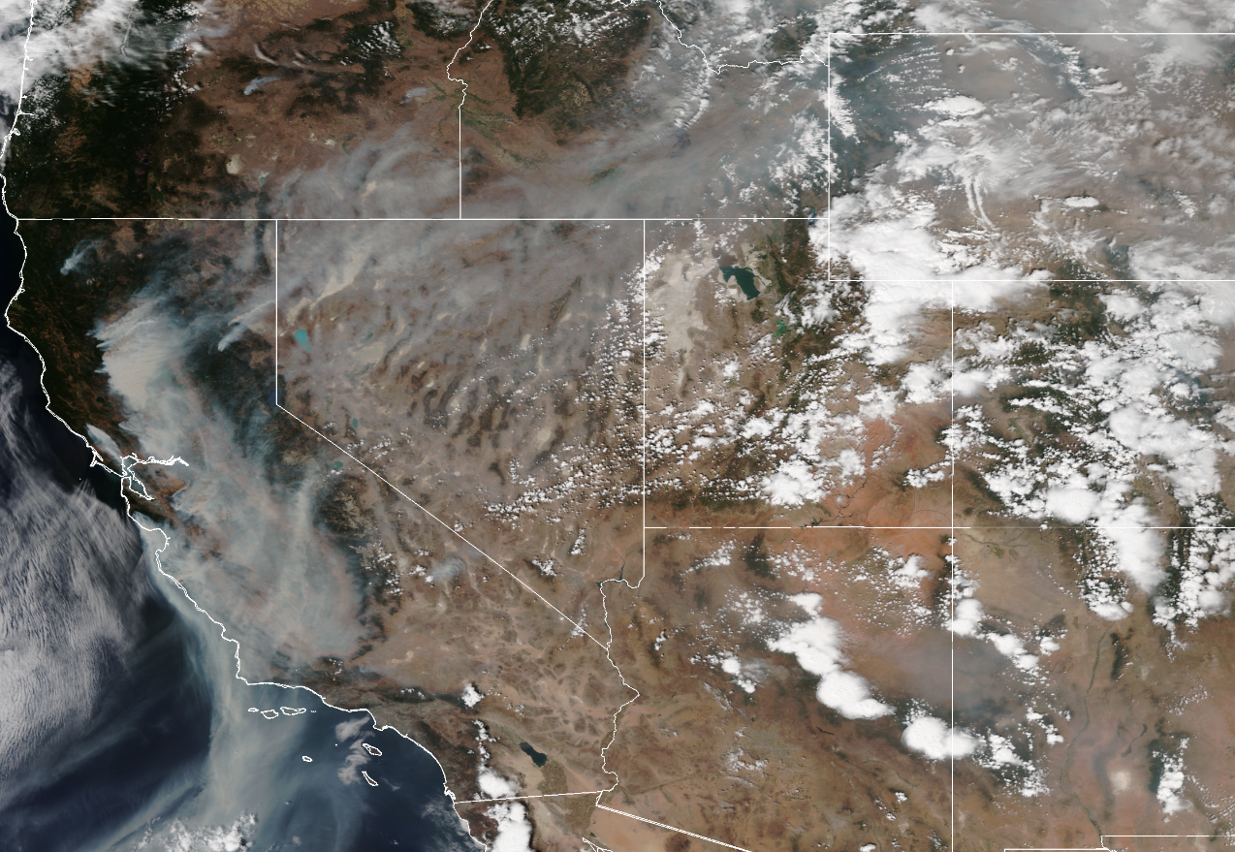
NOAA MODIS Wildfire Detection Map & NOAA Satellite Imagery 08/20/2020

Slide 6
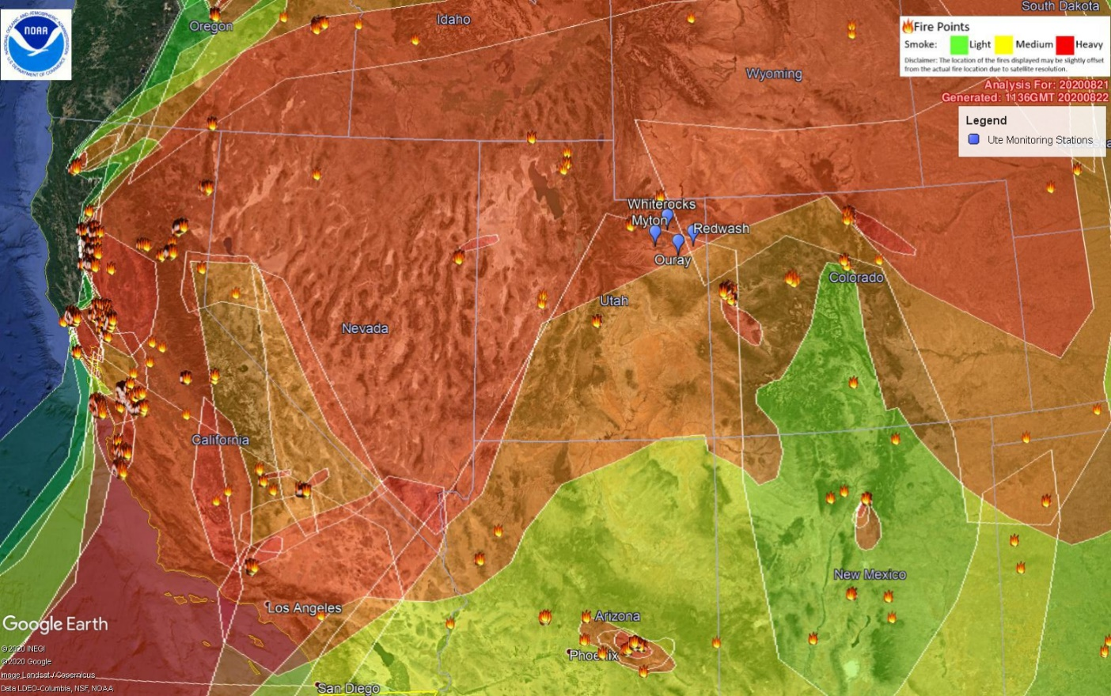
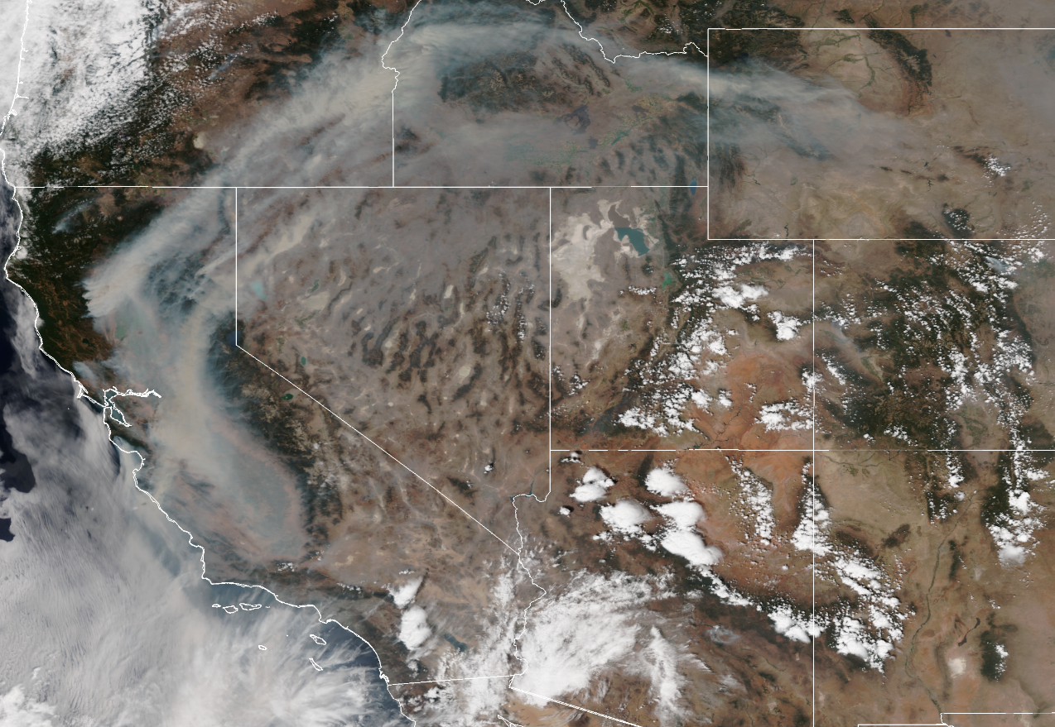
NOAA MODIS Wildfire Detection Map & NOAA Satellite Imagery 08/21/2020

Slide 7
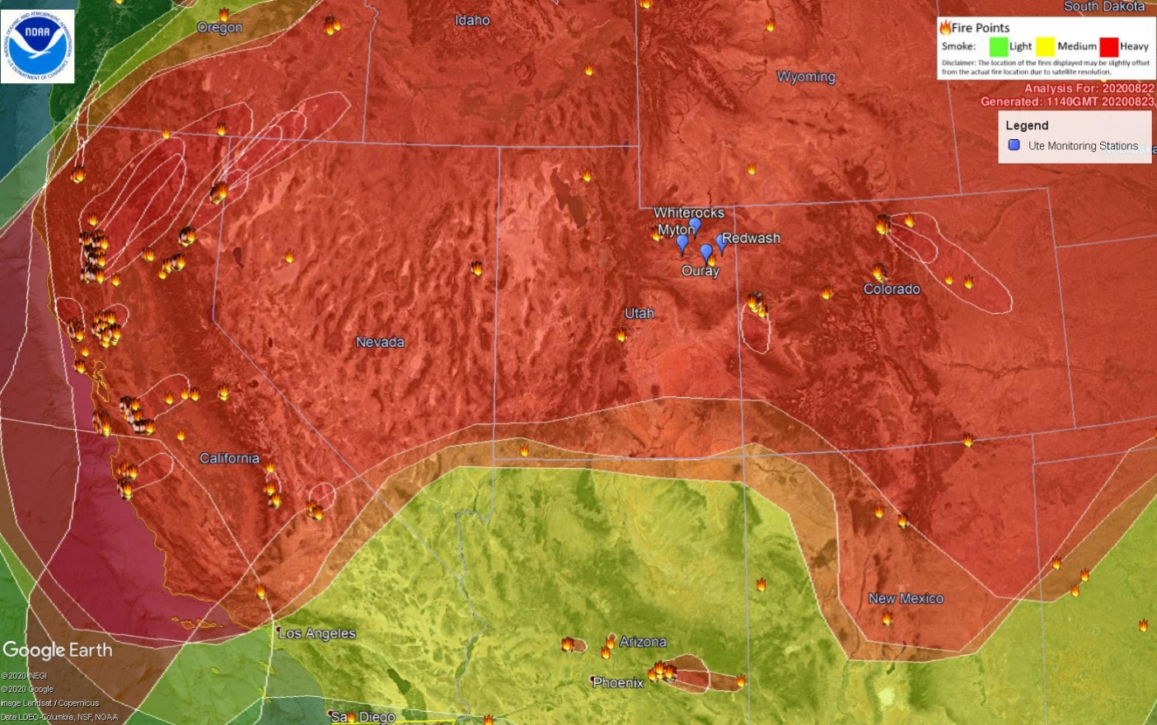
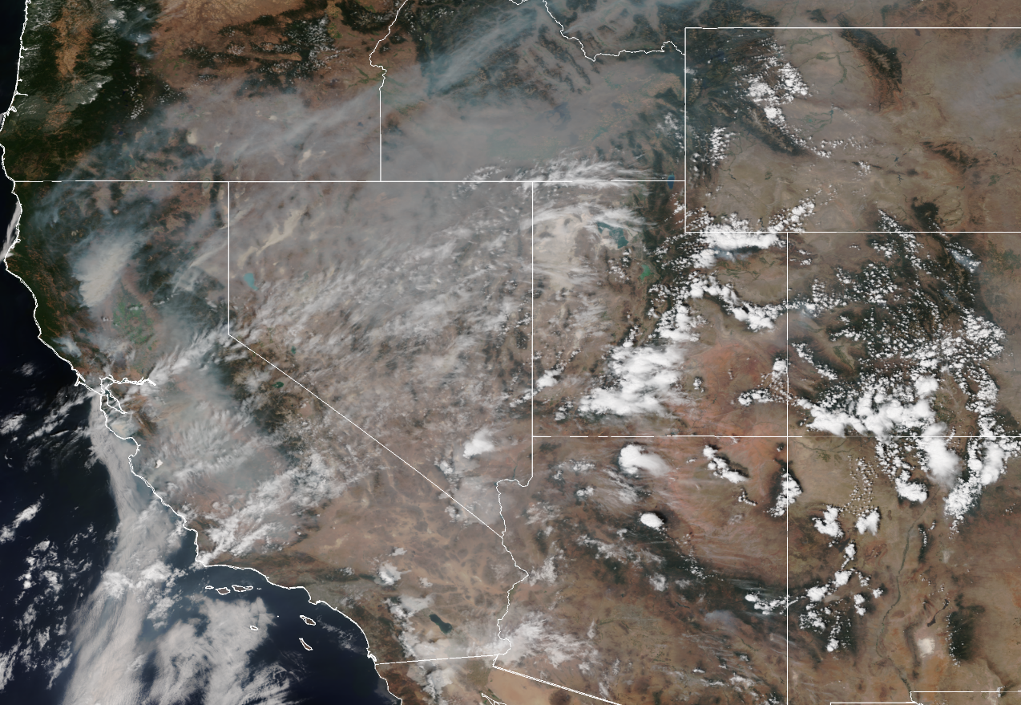
NOAA MODIS Wildfire Detection Map & NOAA Satellite Imagery 08/22/2020

Slide 8
Tiered Evidence Analysis
The amount of evidence needed, per EPA guidelines, is based on a three tiered analysis showing the relationship between the wildfire event and the ozone exceedance.
Tier 1 is based on concentrations that are evidently higher than what would be recorded during no wildfire events or is outside of a site’s normal ozone season.
Tier 2 is based on high concentrations that are not as clear as Tier 1 or do not fall outside of a site’s normal ozone season.
Tier 3 is for any situation that does not fit the scenarios for Tiers 1 or 2.
Based on the analysis of the ozone exceedances, it was determined that this event demonstration falls under a Tier 1 analysis.

Slide 9
For Tier 1, EPA guidance requires two critical pieces of evidence to satisfy the demonstration.
Time series plot that covers 12 months or the typical ozone season months with the event exceedances. This data is overlaid together for at least five (5) years or for the length of time that is available with the data.
Trajectory analysis is created to show transport in the atmosphere. This is used to help suggest the movement of wildfire smoke to a station where the ozone exceedance occurred. The trajectory analyses are created using online models from the National Oceanic and Atmospheric Administration (NOAA).

Slide 10
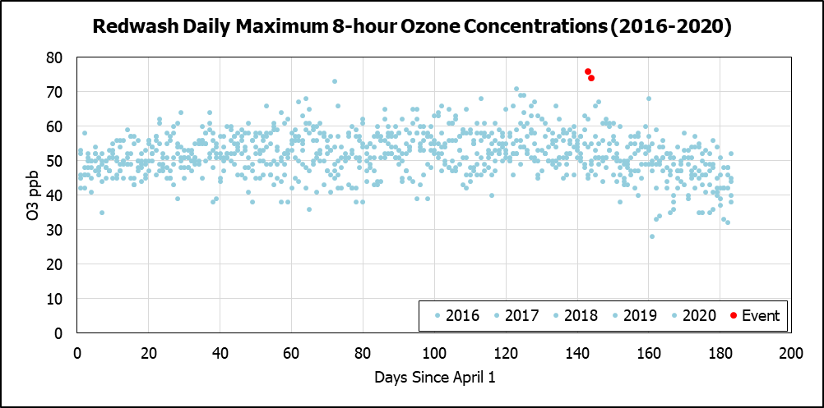
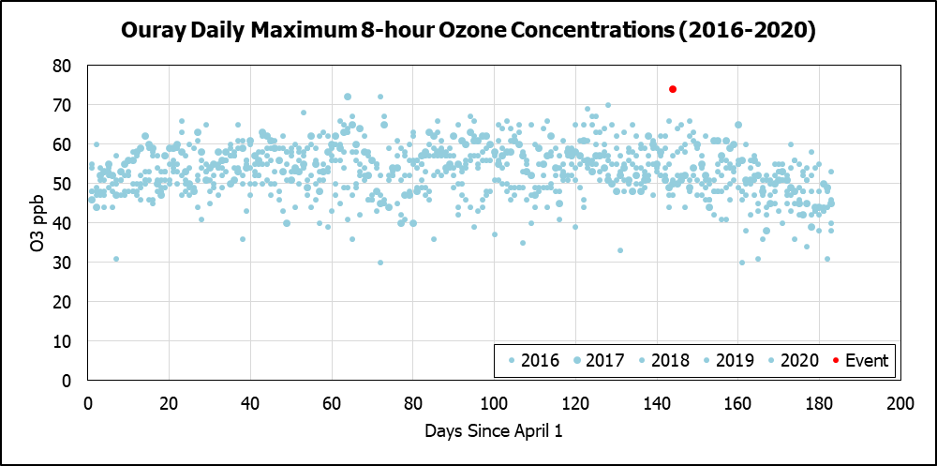
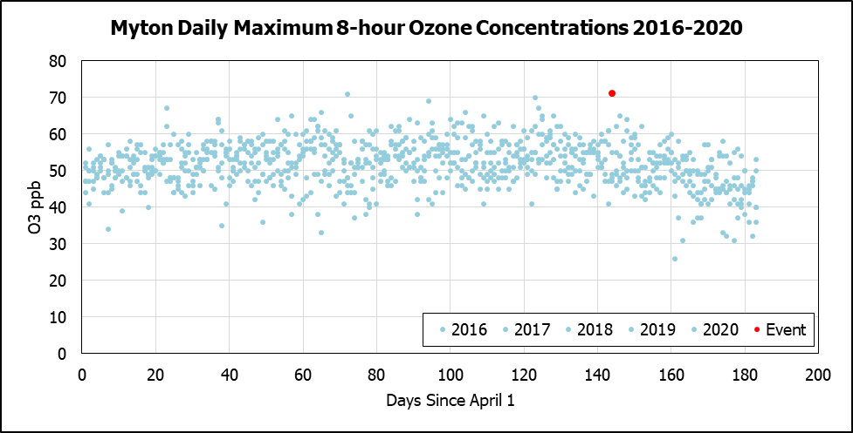
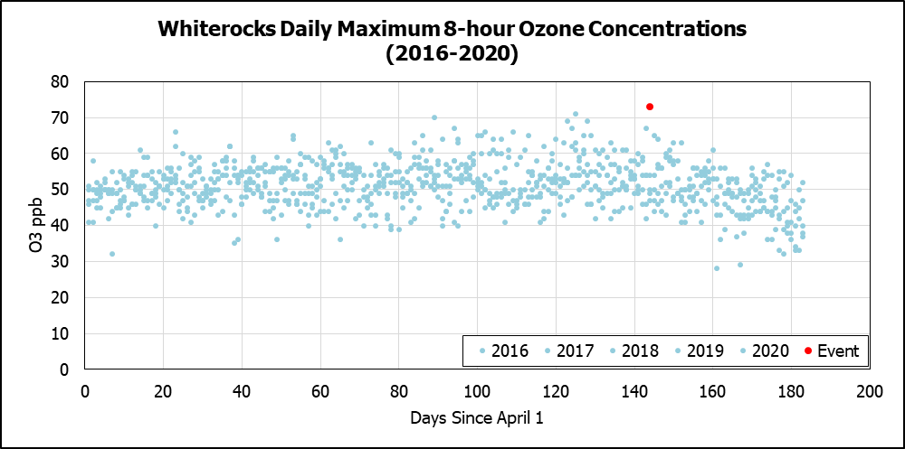

Slide 11
As seen in the figures, the 8-hour daily maximum ozone data during the period of August 21-22, 2020 exceeds that of similar data during previous years during that same time. EPA recommendations state that event exceedances should be at least 5-10 ppb higher than non-event concentrations. The average daily maximum ozone concentrations from 2016-2019 at each site for the specific day(s) that the event occurred in 2020 are:
Redwash: 50 ppb
Ouray: 51 ppb
Myton: 50 ppb
Whiterocks: 50 ppb
2020
Red wash; 76 & 74 ppb
Ouray: 74 ppb
Myton: 71 ppb
Whiterocks: 73 ppb

Slide 12
For the trajectory analysis, each of the four sites were plotted individually using HYSPLIT, with a backwards trajectory to show where sources of wildfire smoke came from days prior to the days of the exceedances. All four sites start on August 22 and are plotted back either 72 or 96 hours with three heights plotted for each of the trajectories (2, 10, and 50m).
All four trajectories show this transport from California and the western United States before settling at these locations. All of them show trajectories consistent where wildfire smoke both originates and where smoke spreads and is carried across the West. This includes areas from not only Northern/Central California, but also Southern California, Nevada, and Idaho.

Slide 13
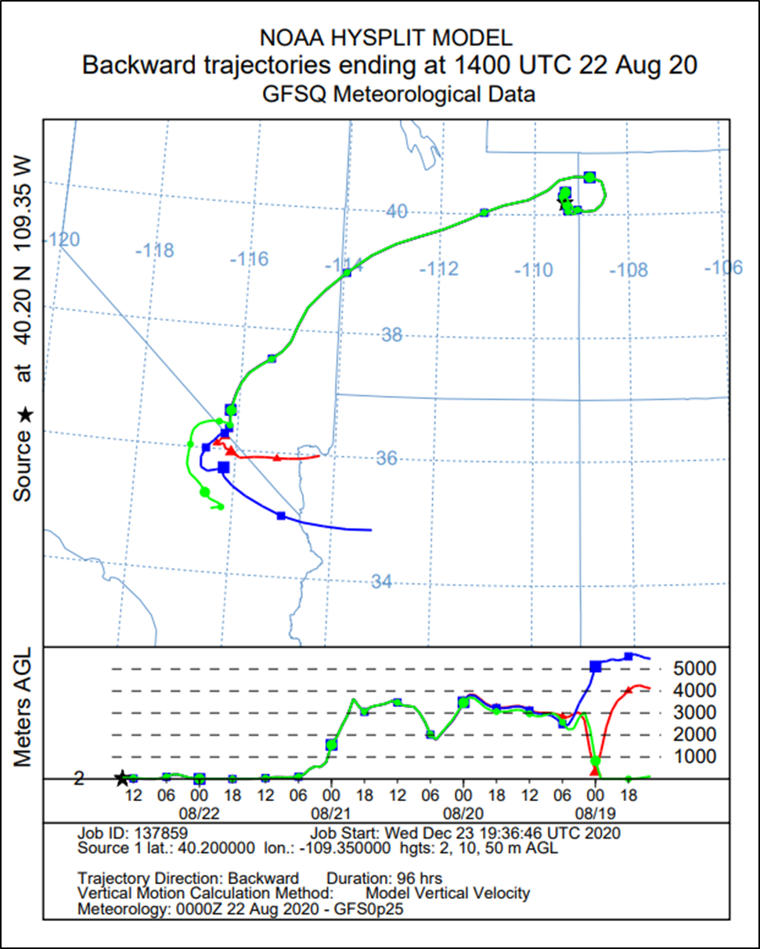
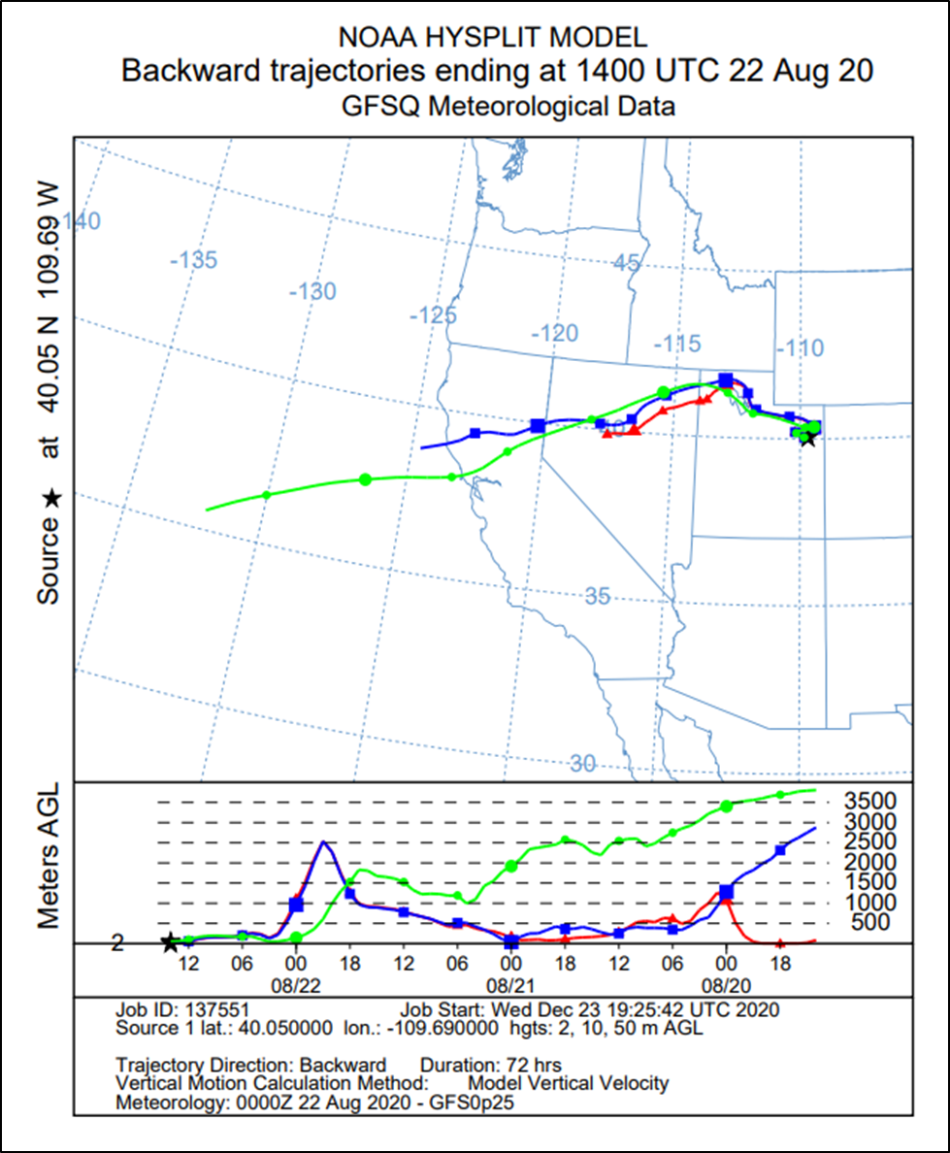
Redwash
Ouray

Slide 14
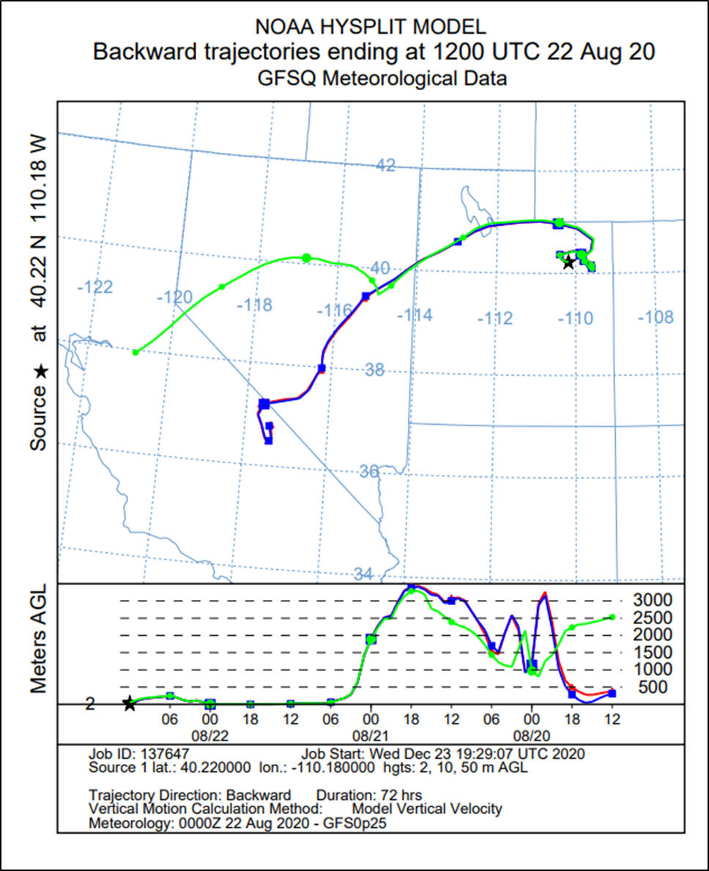
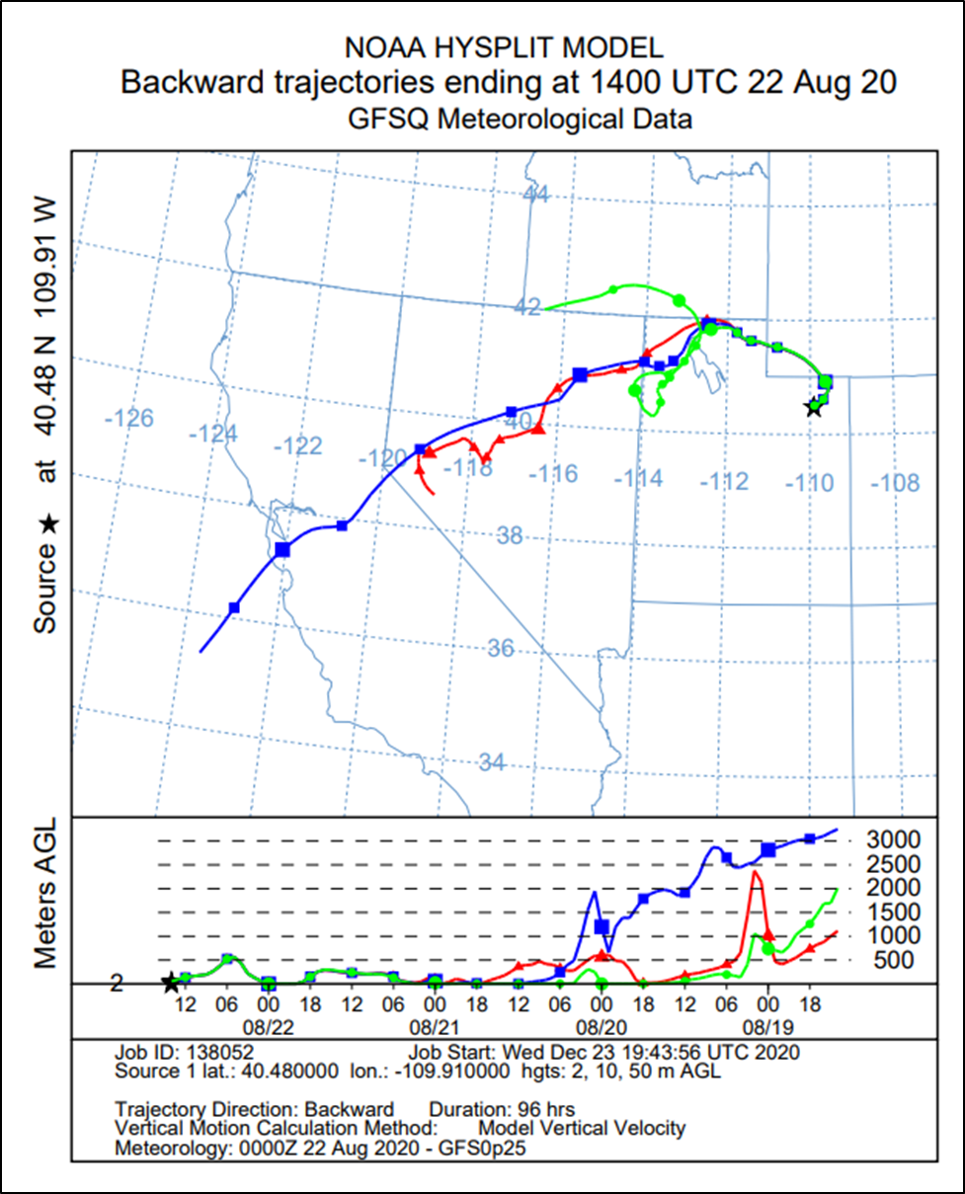
Myton
Whiterocks

Slide 15
Summary
This exceptional event demonstration shows a clear relationship between the documented NAAQS exceedance and the California wildfires in mid-August. The California wildfires were triggered by lighting which qualifies them as a natural event that is not reasonably controllable or preventable.
Historical monitoring data from each of the monitoring stations show that this event was exceptional as compared to 2016-2019 with daily maximum ozone concentrations over 20 ppb higher than the same timeframe. This exceeds the 5-10 ppb threshold as compared to non-event concentrations as recommended in EPA’s guidance for defining exceptional events.
The Ute Indian Tribe is requesting EPA flag ozone data collected on August 21 for Redwash and August 22, 2020 for Myton, Ouray, Redwash, and Whiterocks as exceptional, caused by a naturally occurring wildfire event.

