Slide 1
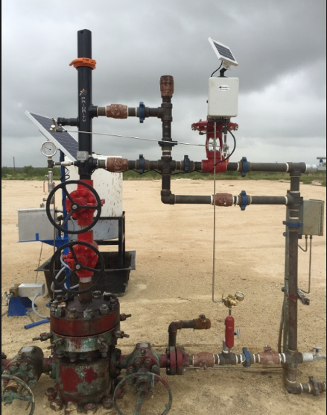
Well Maintenance
Common Practices/Activities

Slide 2
Common Activities to Maintain Well Production
Once a well is drilled, completed and flowback is complete it is considered in production.
Once in production, what can Operators do to maintain well production:
Install artificial lift (plunger lift, gas-lift, rod pumps)
For gas wells, this helps to maintain consistent production
Chemical injection into the wellbore (scale inhibition)
Well unloading
Well swabbing
Well optimization – adjusting plunger cycles, etc.
Operations Control Center - Eye in the Sky! This is critical

Slide 3
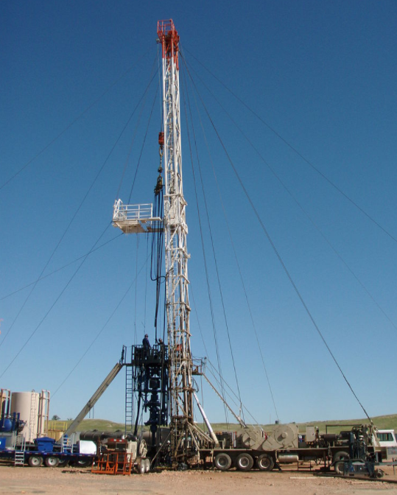
Well Workovers
Well Workover – process of pulling and replacing downhole completion or production equipment to extend the life of a well
Factors that could require a workover
Holes in production tubing may kill/damage a well
Paraffin buildup or blockage in the wellbore that restrict flow
Basically intended to bring a well “back around” and producing
Also, wells ultimately get P&A’d via a workover rig

Slide 4
Activities to Maintain Facilities
After a production facility is built what activities do we do to ensure safe and streamlined operation:
Operation Control Center! Set alarm thresholds
Audio, Visual, Olfactory (AVO) inspections
Optical Gas Imaging using IR cameras to find/fix leaks
Thief hatch & PRV maintenance annually
Combustor maintenance on facilities with tank vapor controls
Ultrasonic integrity testing on tanks and vessels
Heat trace pumps are typically installed at these facilities to prevent lines from freezing

Slide 5
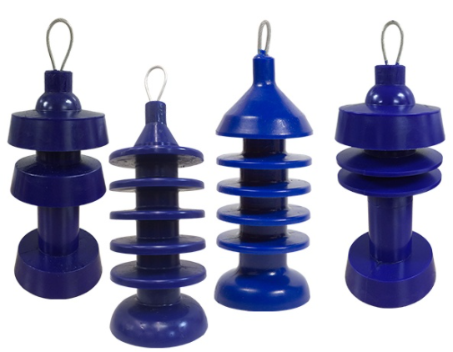
Activities to Maintain Pipelines
Methanol injection to prevent hydrate formation in pipelines
Pigging remove fluids from pipelines
Periodic pressure testing on lines
Operation Control Center!
More recently, using IR cameras or aerial surveys
to look for pipeline leaks

Slide 6
Questions?

