Slide 1
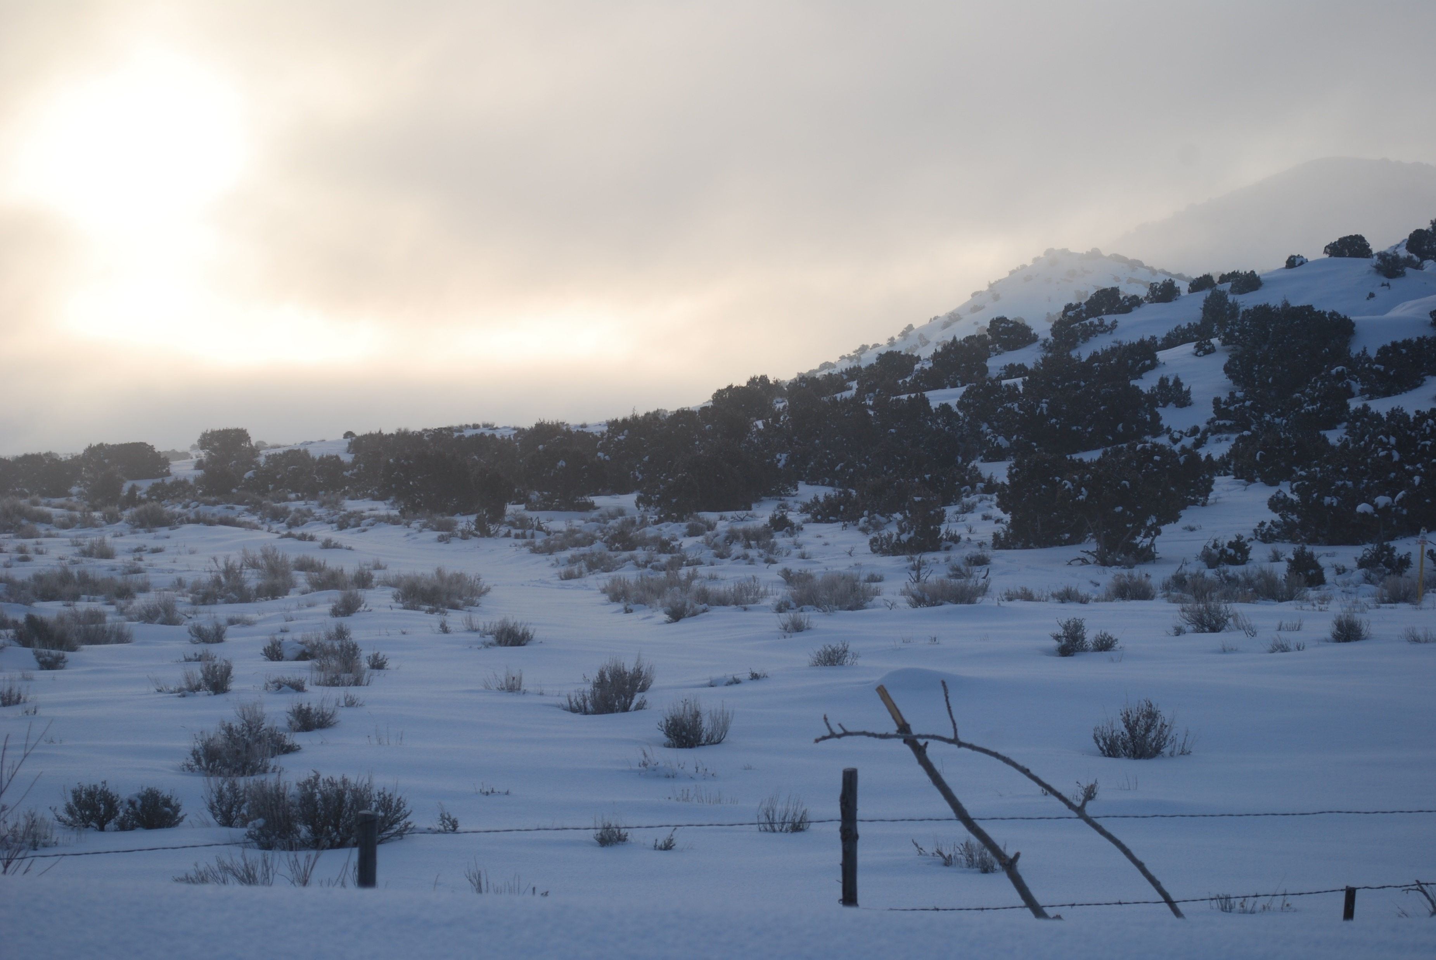

2023 Annual Research Plan

Slide 2
Utah’s Uintah Basin
What and why?
Our funding from the Utah Legislature and Uintah County SSDs is not for specific research tasks
Our annual plans guide how we use these funds
A stakeholder committee helps us ensure that our plan targets work that will have the most value

Slide 3
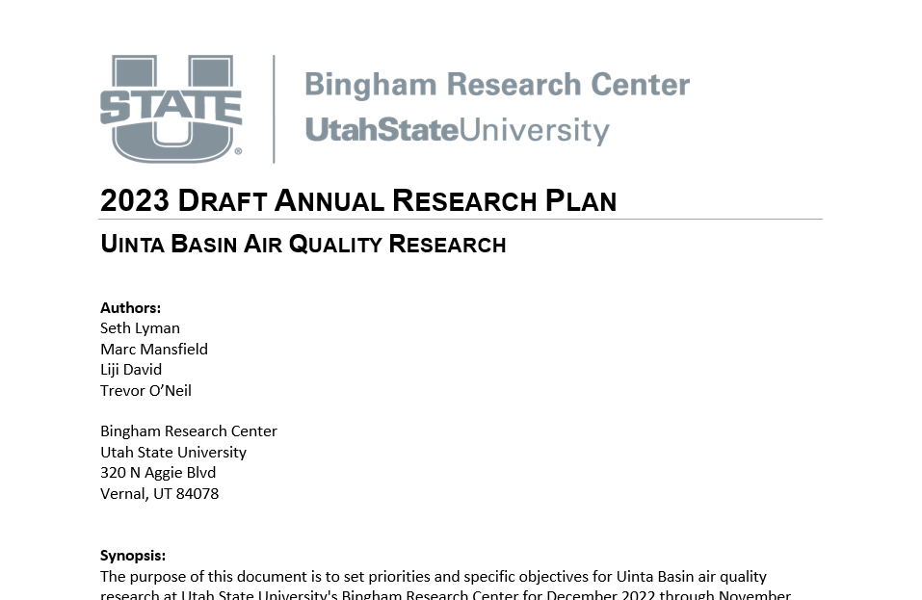
Utah’s Uintah Basin
Draft Plan
Find it at

Slide 4
Utah’s Uintah Basin
Research Priorities: General areas of research,
not specific projects
1. Air Chemistry
Changes spatially and over time
Influence of snowpack
Background influences on winter and summer ozone

Slide 5
Utah’s Uintah Basin
Research Priorities: General areas of research,
not specific projects
2. Air Quality Modeling
How to make the best 3D photochemical model?
What can models tell us about how to mitigate ozone?

Slide 6
Utah’s Uintah Basin
Research Priorities: General areas of research,
not specific projects
3. Emissions
How do inventories differ from reality?
Organic compound composition
Relative effectiveness of NO_{X} vs. organic compound emissions reductions

Slide 7
Utah’s Uintah Basin
Research Priorities: General areas of research,
not specific projects
3. Stakeholder Engagement
How can we make sure what we do has value to stakeholders?
How can we work with stakeholders to improve air quality?

Slide 8
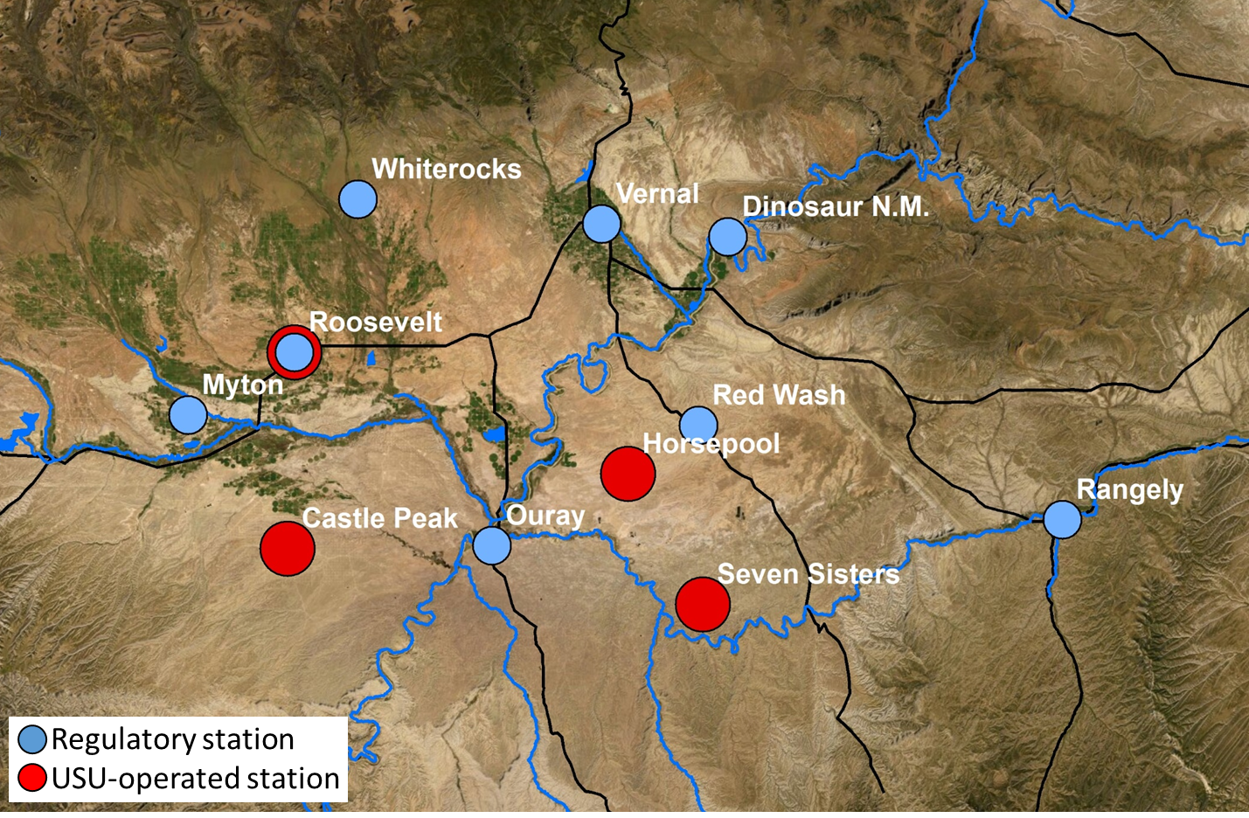
Utah’s Uintah Basin
Air Chemistry: Ambient Monitoring
Dec 1 through Mar 15
Speciated organics
Solar radiation/albedo
True NO_{X} and NO_{Y}

Slide 9
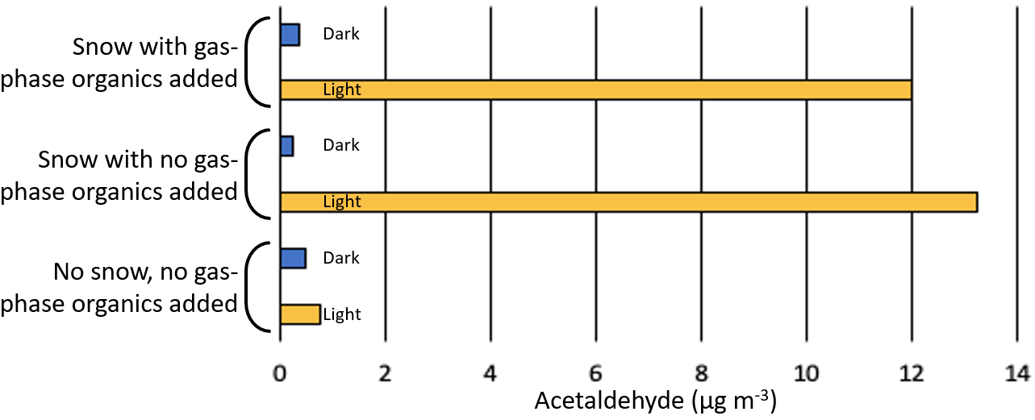
Utah’s Uintah Basin
Air Chemistry: Laboratory measurements
of carbonyl emissions from snow

Slide 10
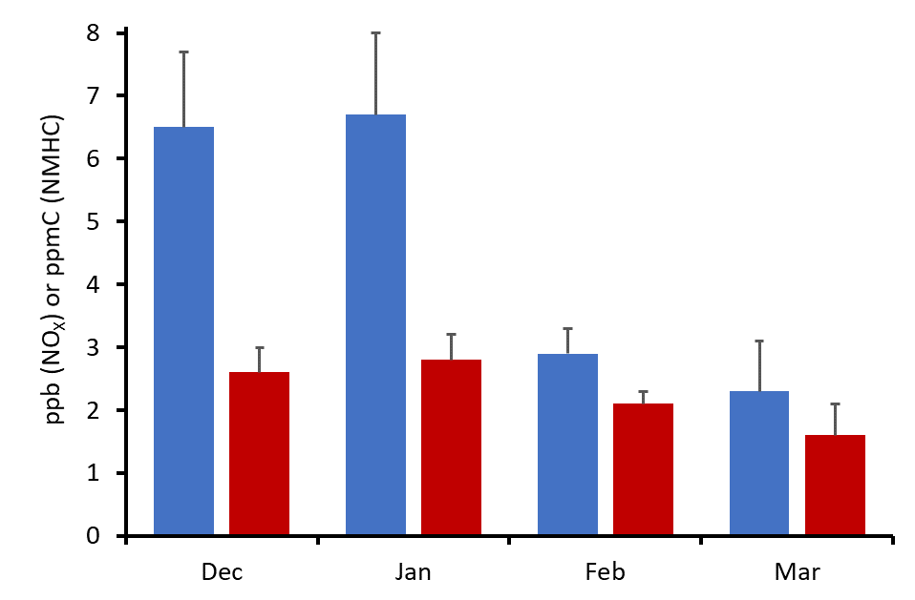
Utah’s Uintah Basin
Air Chemistry: Do NO_{X} and organics emissions differ in winter versus summer?
How much of the decline in ambient levels over the winter is due to better ventilation, and how much is due to lower emissions?
NO_{X}
Total NMHC

Slide 11
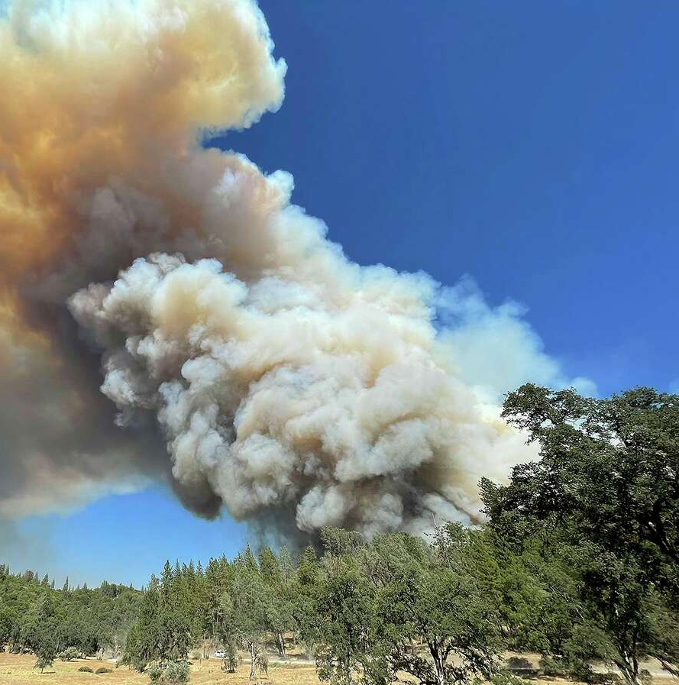

Utah’s Uintah Basin
Air Chemistry: Does wildfire smoke + local NO_{X}
lead to higher summertime ozone?
High organics
+
High NO_{X}
=
High
ozone

Slide 12
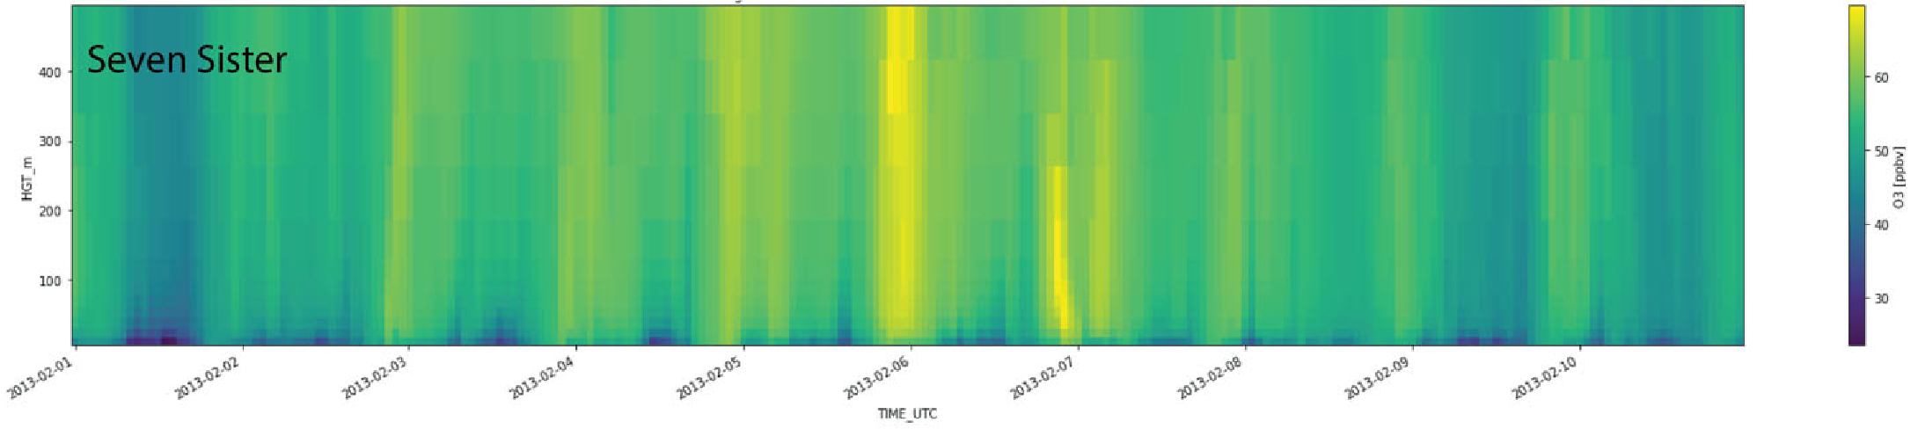
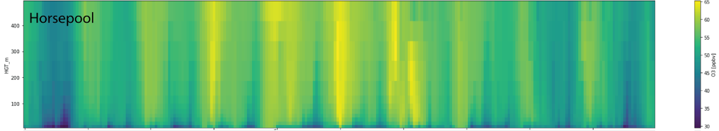
Utah’s Uintah Basin
Modeling: Applying model chemistry
to improved meteorological simulations
Previous winter inversion simulations were skewing boundary layer too high
New simulations correct this, may do better at winter chemistry

Slide 13
Utah’s Uintah Basin
Modeling: Quantitative forecasts
Plan is to use improved meteorological and chemical modeling to forecast winter ozone

Slide 14
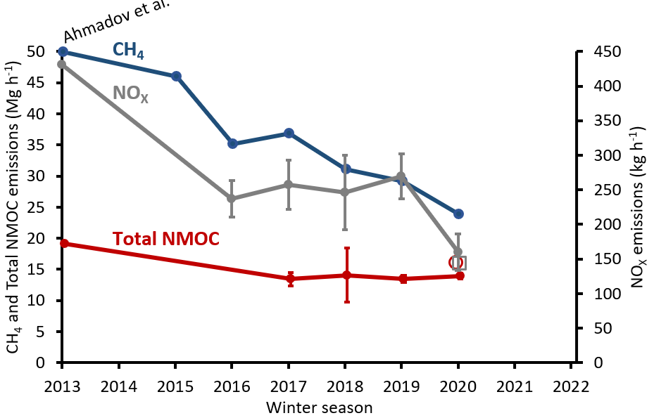
Utah’s Uintah Basin
Emissions: Top-down emissions inventory study

Slide 15
Utah’s Uintah Basin
Emissions: Prepare for a measurement study,
to begin in fall 2023
Learn about stakeholder needs and opinions
Literature search and analysis
Logistical and financial planning
Measurements

Slide 16
Utah’s Uintah Basin
Stakeholder Engagement
Real-time data website, ubair.usu.edu
Ozone alert program
  Email seth.lyman@usu.edu to sign up
UB Ozone Working Group
Stakeholder guidance
Annual report and spring newsletter

Slide 17
Utah’s Uintah Basin
How you can participate
Give your suggestions now
Email them to us (seth.lyman@usu.edu)
Stop by or call
Email me to officially join our stakeholder guidance committee (0-6 hour per year commitment)
Ideas about our current planned projects are welcome. Ideas for totally different projects are also welcome.

