Slide 1
Exploration of some interesting features of 2022-23 winter ozone
Seth Lyman
USU Bingham Research Center

Slide 2
Is recent high ozone at Dinosaur Monument anomalous?

Slide 3
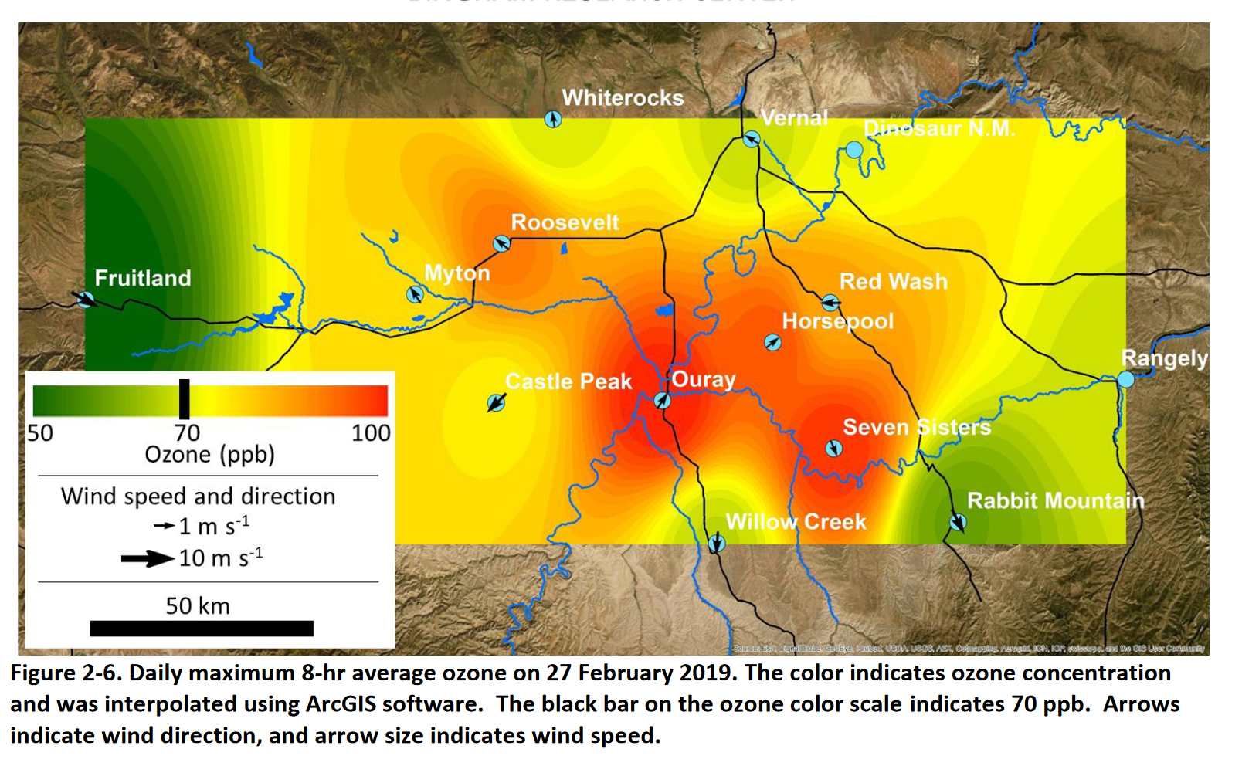
Yes, compared to the past few years, for example Feb 2019 (another year with lots of snow and high ozone)

Slide 4
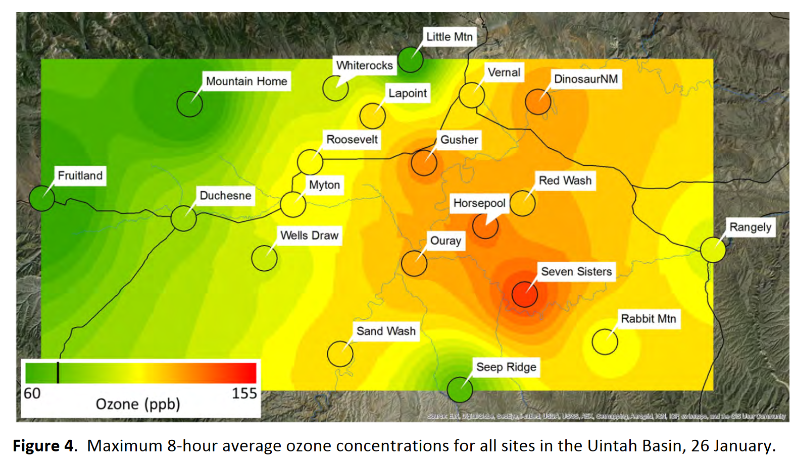
But not when compared to 2013 (another year with lots of snow and high ozone)

Slide 5
Another question: why has Ouray ozone been relatively low?
Winter ozone is driven (1) by elevation (a proxy for inversion strength and length) and (2) by proximity to emission sources
Changing source locations and nuances of inversion strength, intruding winds, etc., mean that every episode is different.

Slide 6
In general, 2023 looks more like 2013 than 2019. Why?
Renewed oil and gas activity in the eastern/northeastern basin?
Longer-lasting inversions with more complete snow cover that allow ozone and precursors to spread across the whole basin?
Something else?

Slide 7
Ozone maxima in the Basin have also looked more like 2013 than 2019:
Max 1-hr about 2 weeks ago was 132 ppb at Horsepool (Max regulatory 1-hr was about 120 ppb)
Max 1-hr in late Jan 2013 was >140 ppb at Seven Sisters (Max regulatory 1-hr was ~120 ppb at Ouray)
How much of the high ozone is due to meteorology, and how much is due to changes in emissions?

Slide 8
Meteorology this year is anomalous. How anomalous? We don’t know yet.
Nearly 100% snow cover through the whole basin this year
A little bit deeper than 2019, a lot deeper than 2013—but it came earlier in the year than 2019.
Snow albedo has not been decreasing, even though we haven’t had snow in ~2 weeks.
Snow depth and snow cover has been decreasing slightly

Slide 9
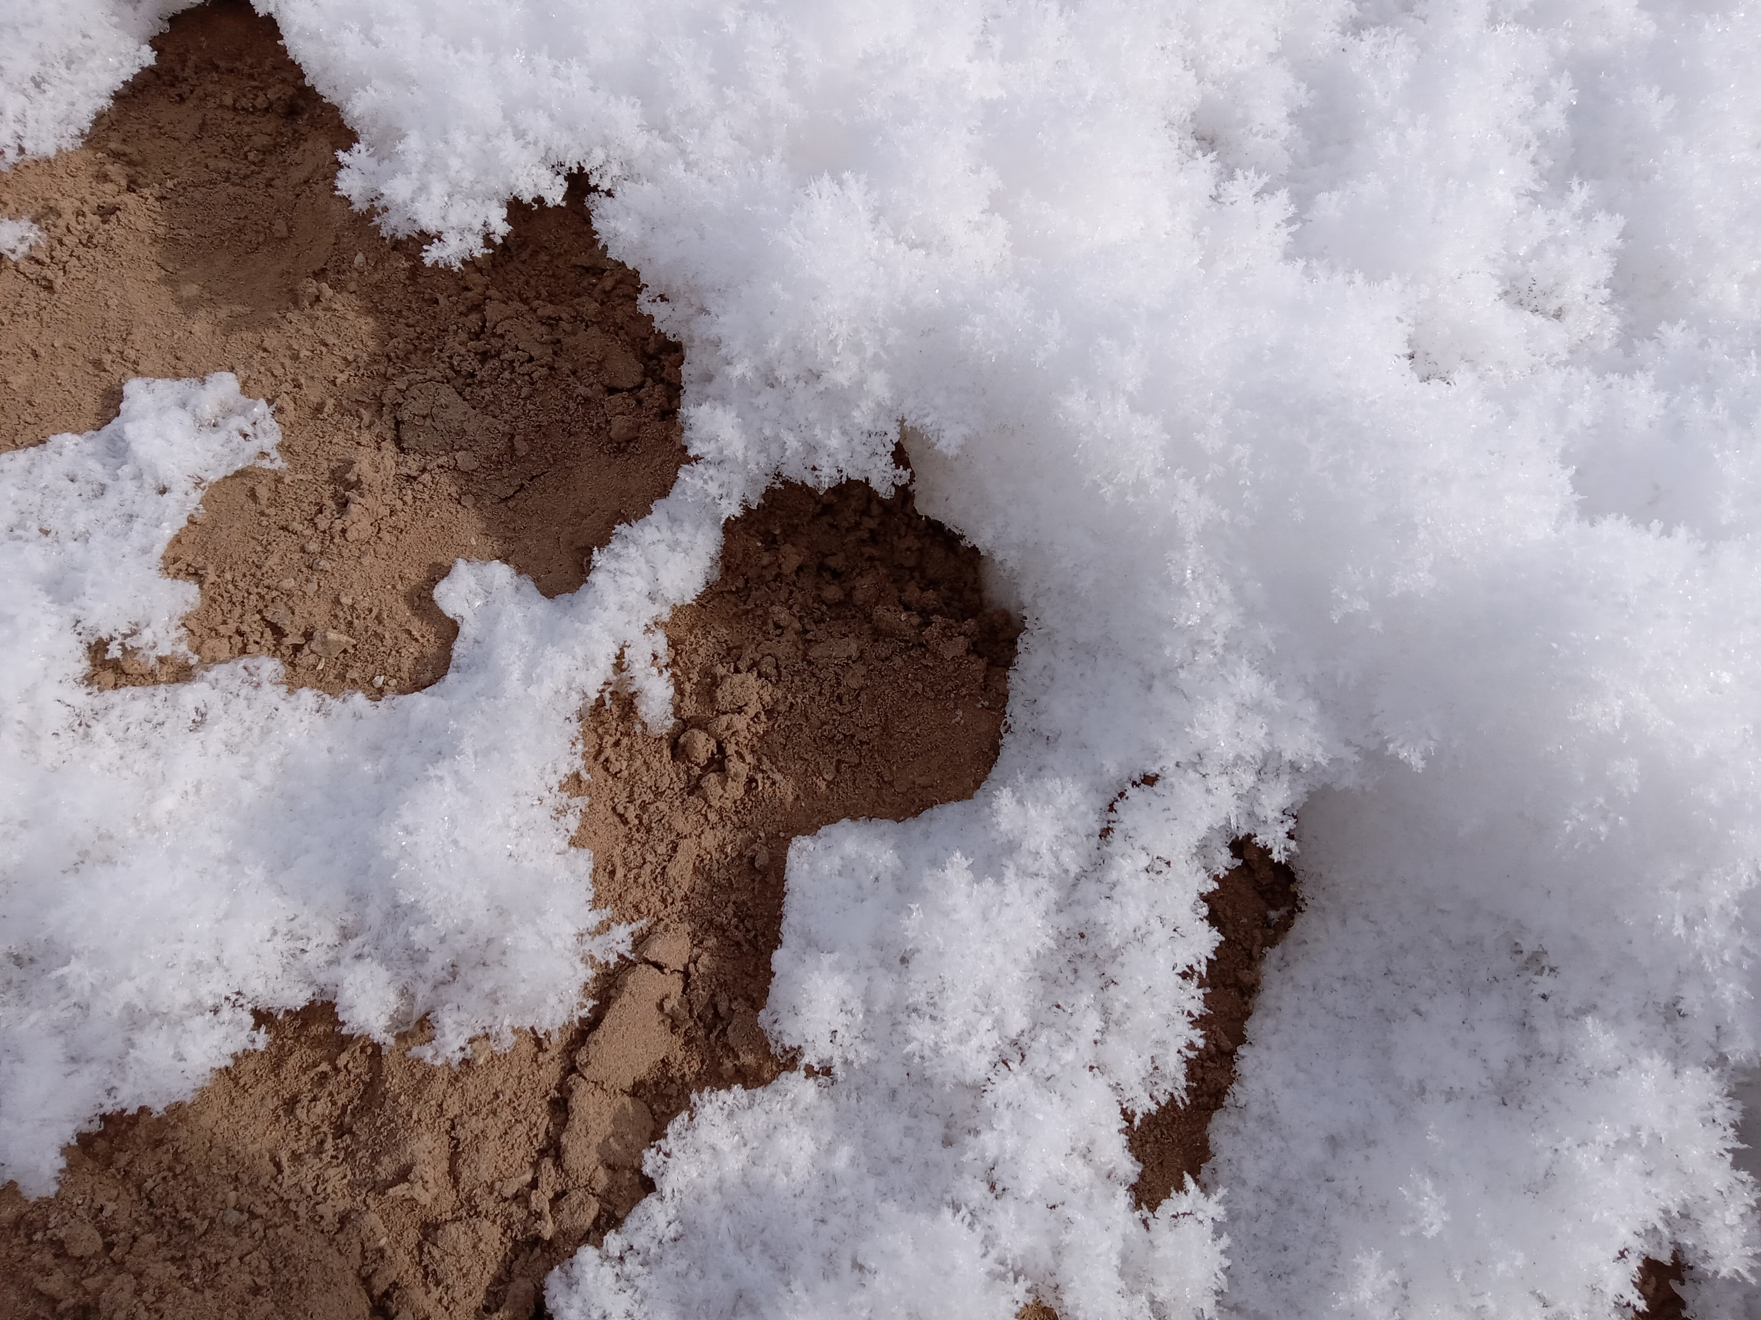

Slide 10
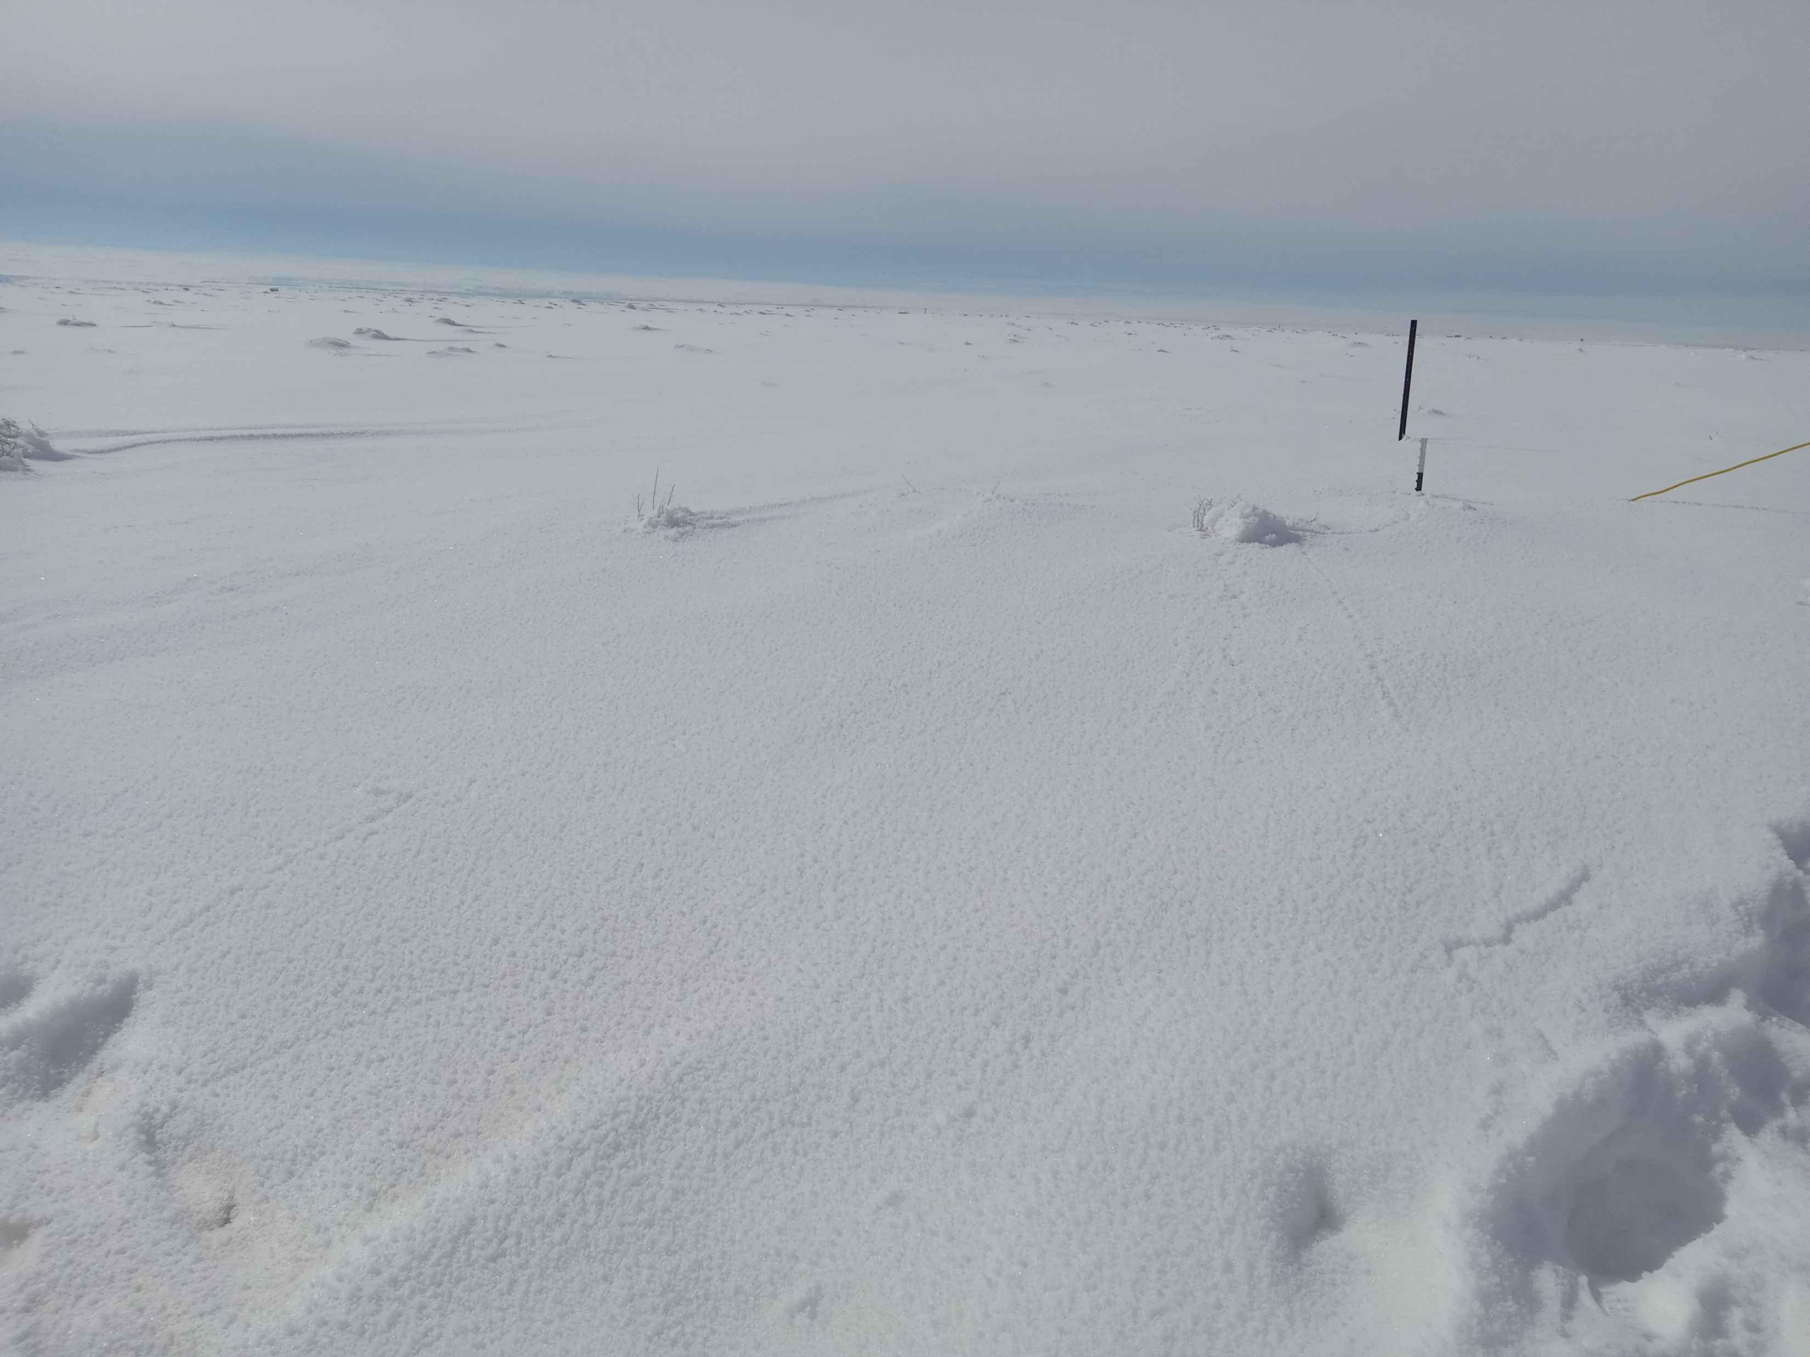

Slide 11
How much do small differences in snow depth, percent snow cover, albedo matter for ozone production?
I’m afraid we don’t know.
How much do chemical reactions in the snow matter for ozone production?
Perhaps significantly, and they might be more important when it is colder.
We will have more to say about that this fall.

Slide 12
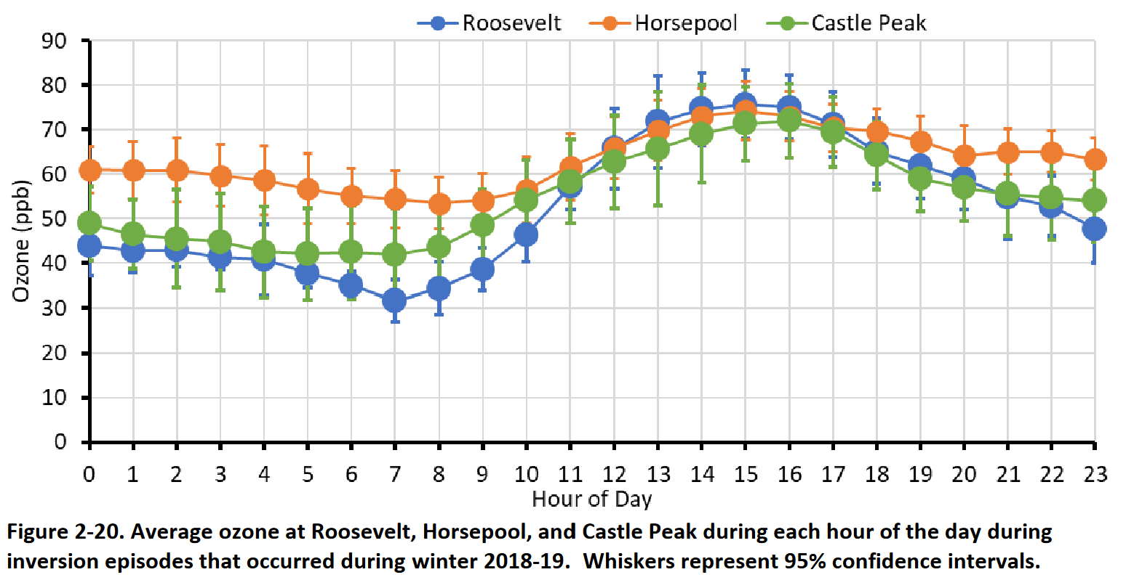
Why is ozone staying so high at night?
This is normal behavior
Nowhere for it to deposit to
Low NOx keeps ozone from reacting away at night
Sometimes it stays very high at night as a storm is moving in, often with cloud cover. We don’t know why.

Slide 13
How do ozone-forming emissions compare to previous years, like 2019 and 2013?

Slide 14
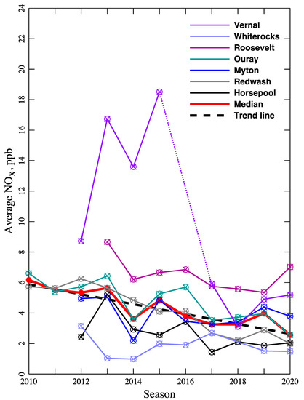
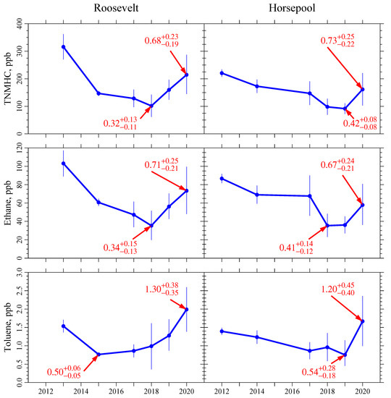
Marc’s paper showed declines in NOx, but not in organics. Subsequent work supports this.

Slide 15
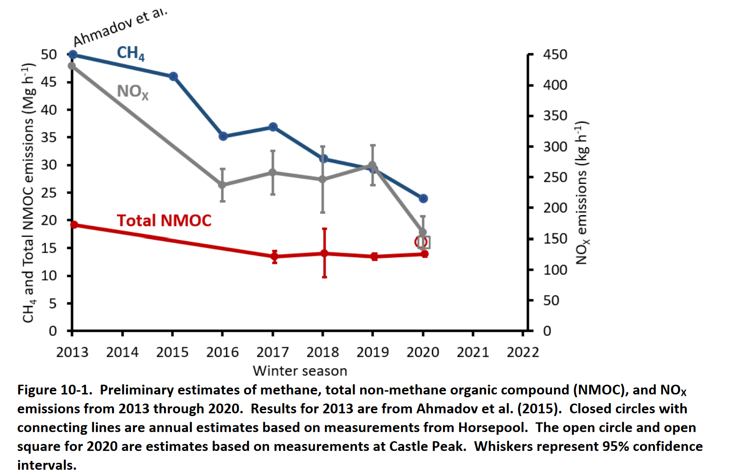
Another way of looking at it that shows the same trends
Note that this is total emissions, not emissions relative to total energy production

Slide 16
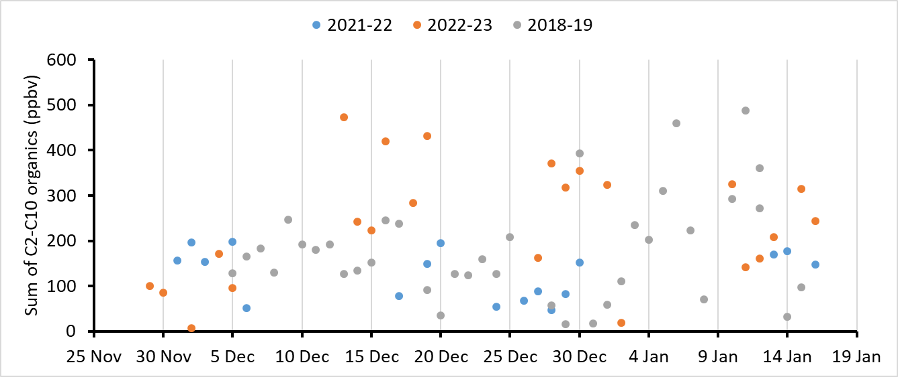
Horsepool non-methane organics don’t look dramatically different compared to previous years

Slide 17
Horsepool NOx doesn’t look different this year either

Slide 18
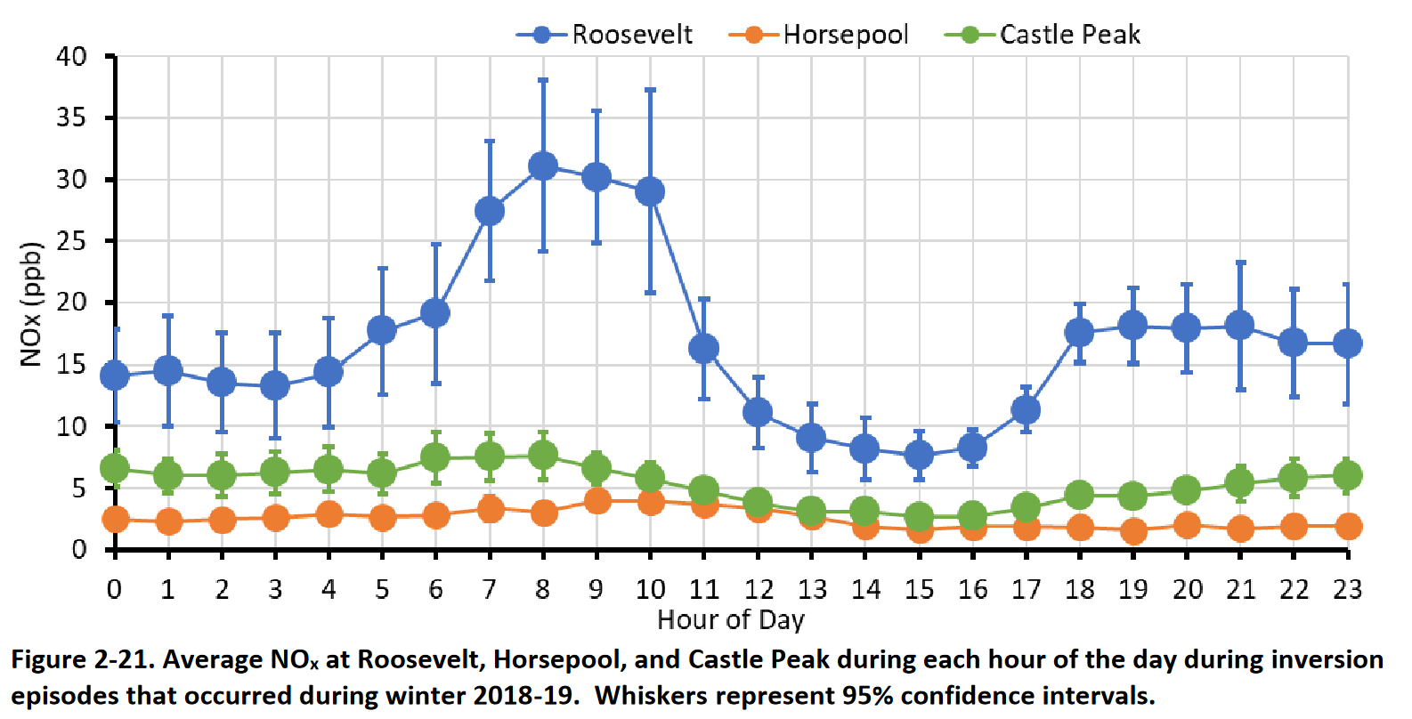
Horsepool NOx, winter 2018-19 (inversion periods only)

Slide 19
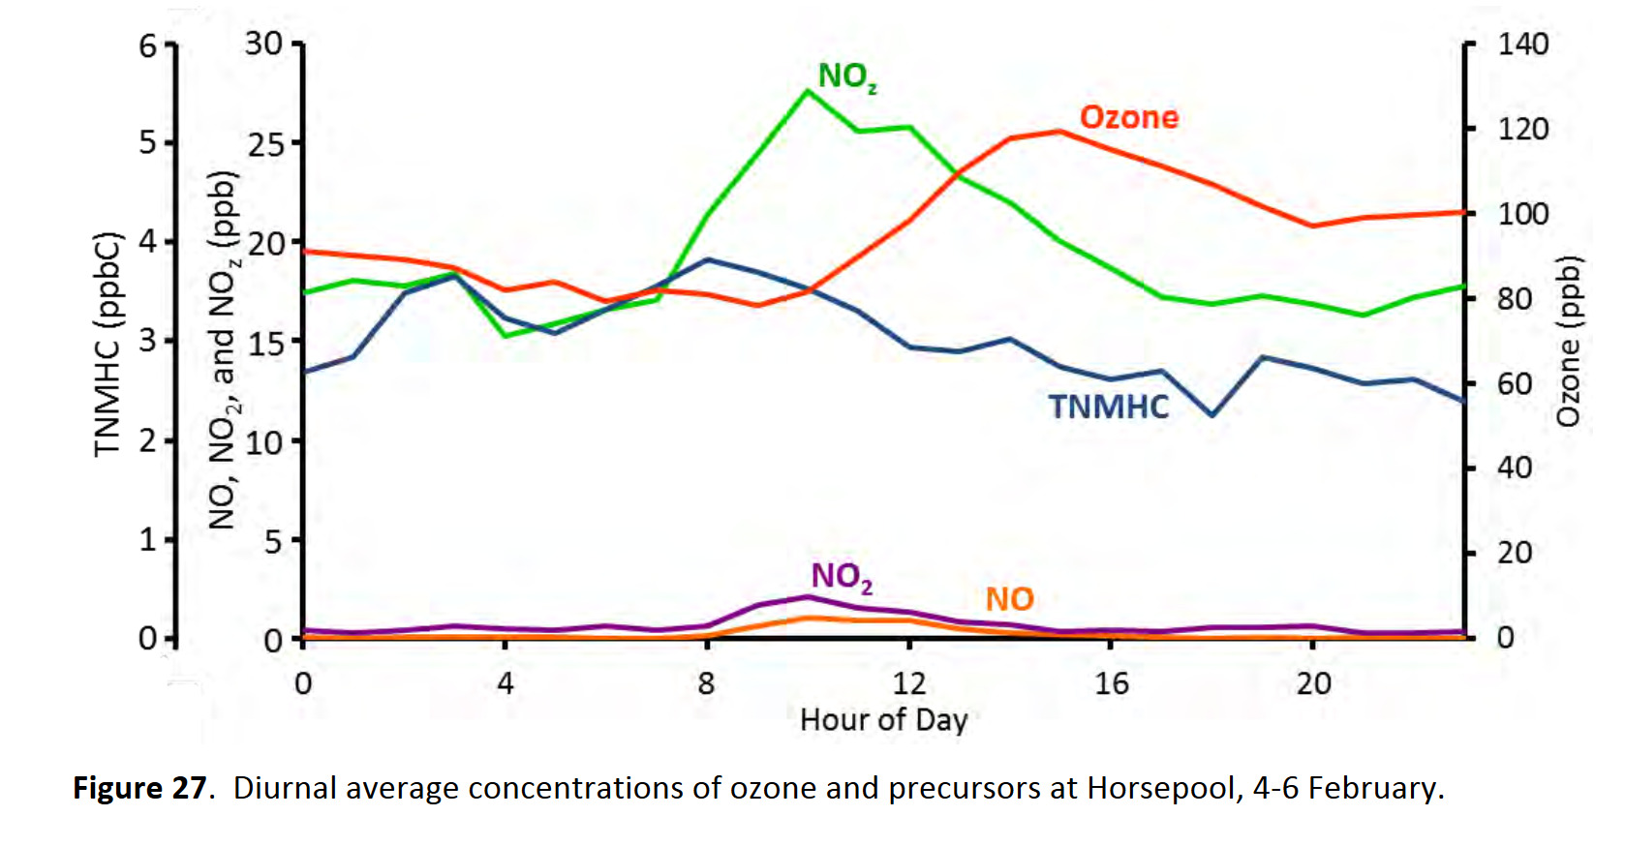
Horsepool NOx, February 2013 (inversion period)

Slide 20
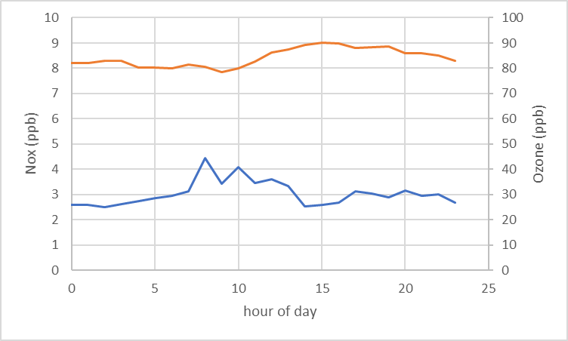
Horsepool NOx, 2022-23 (inversion periods, roughly defined)

Slide 21
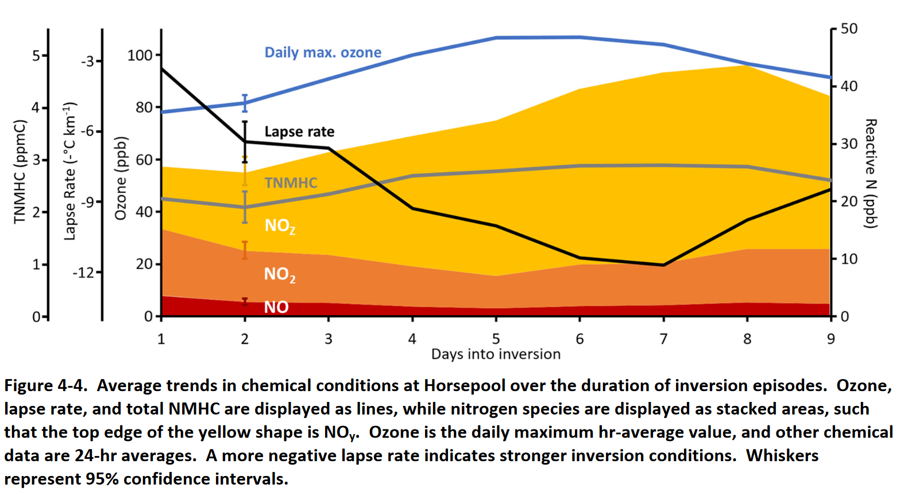
Average conditions over the course of an inversion episode, 2012-2018

Slide 22
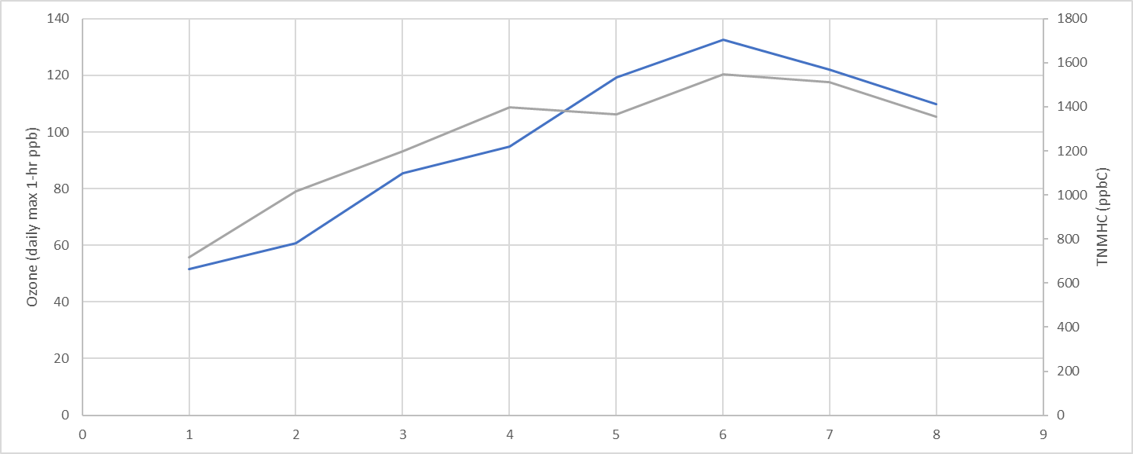
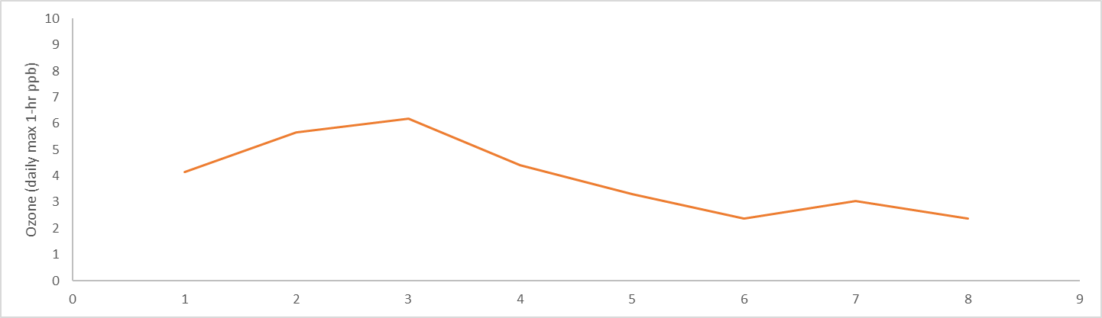
Inversion episode from first week of February 2023

Slide 23
So why are we having such high ozone?
It could be that emissions of NOx and/or organics are, in fact, up. This analysis is very rough-and-ready.
It could be that, with lower NOx, ozone is staying higher at night, and building up more during the day (this would be a bigger impact in early winter).
It could be that ozone this winter has been so high purely because of meteorology. We may have underestimated the importance of meteorology, especially incremental increases in snow cover.

Slide 24
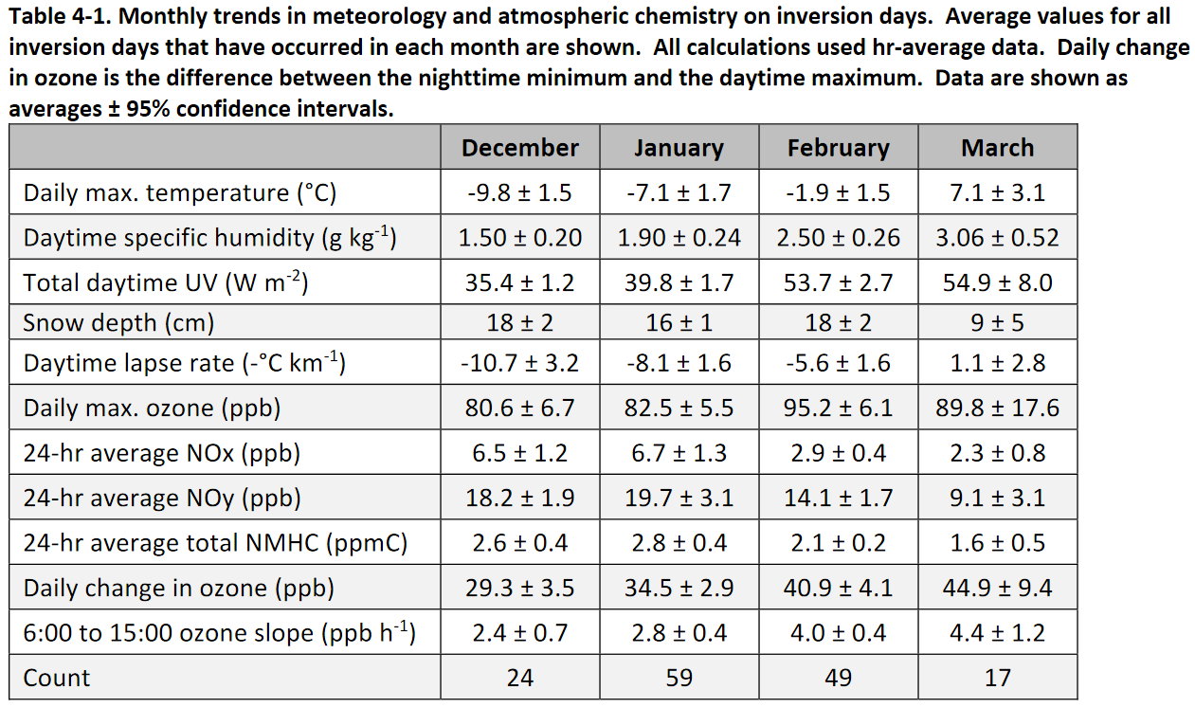
So what is in store for the next few weeks?
In short, probably more ozone.

