Slide 1
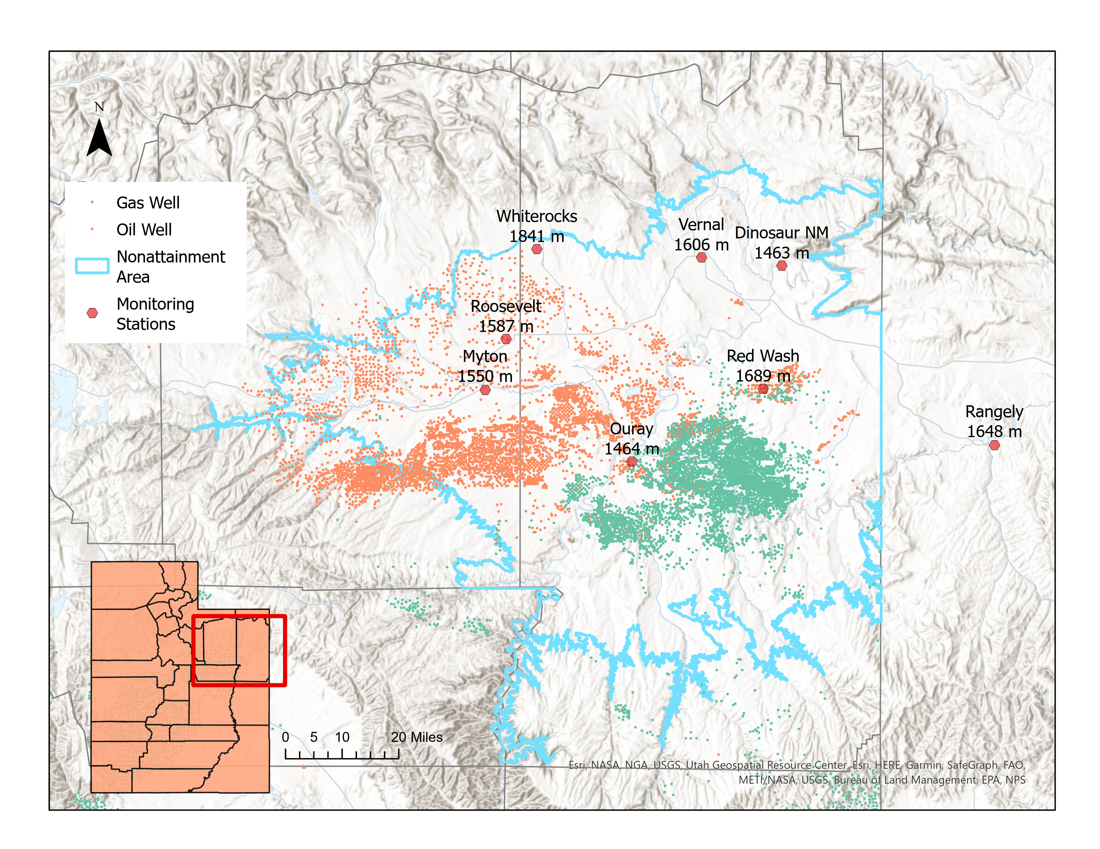
Uinta Basin Monitors
Ozone 2023
8-hr* | Dinosaur | Myton | Whiterocks | Ouray | Redwash | Rangely | Vernal | Roosevelt
1st Max | 119 | 101 | 105 | 102 | 105 | 92 | 101 | 112
2nd Max | 108 | 95 | 99 | 98 | 95 | 73 | 88 | 95
3rd Max | 106 | 94 | 92 | 93 | 86 | 72 | 82 | 95
4th Max | 98 | 94 | 88 | 91 | 81 | 71 | 78 | 93
5th Max | 96 | 91 | 87 | 90 | 80 | 71 | 78 | 90
6th Max | 96 | 89 | 85 | 90 | 76 | 65 | 75 | 89
Exceedences | 33 | 27 | 13 | 27 | 10 | 5 | 12 | 23
Design Value* | Dinosaur | Myton | Whiterocks | Ouray | Redwash | Rangely | Vernal | Roosevelt
2020-2022 | 64 | 66 | 65 | 67 | 66 |  | 64 | 67
2021-2023 | 76 | 76 | 72 | 75 | 71 |  | 69 | 77
*data not yet certified

