Slide 1
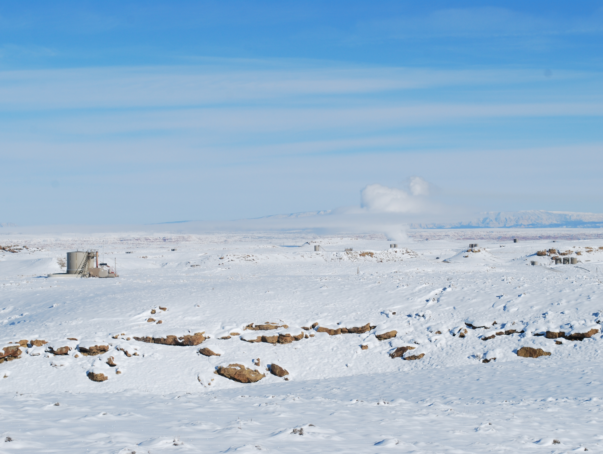


Basin-Wide Pollutant Emissions Estimates
Seth Lyman, Utah State University
John Lin, University of Utah
Huy Tran, Utah State University

Slide 2
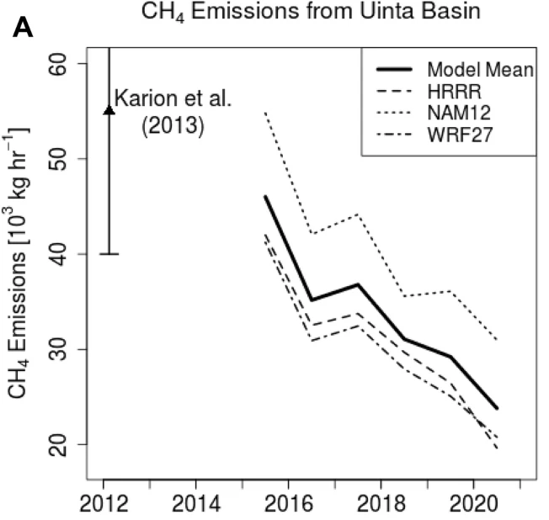
Methane emissions declined through 2020
Steady methane leak rate relative to gas production
Leak relative to energy production has declined by about 25% (because of transition to oil from gas)
Lin et al., 2021

Slide 3
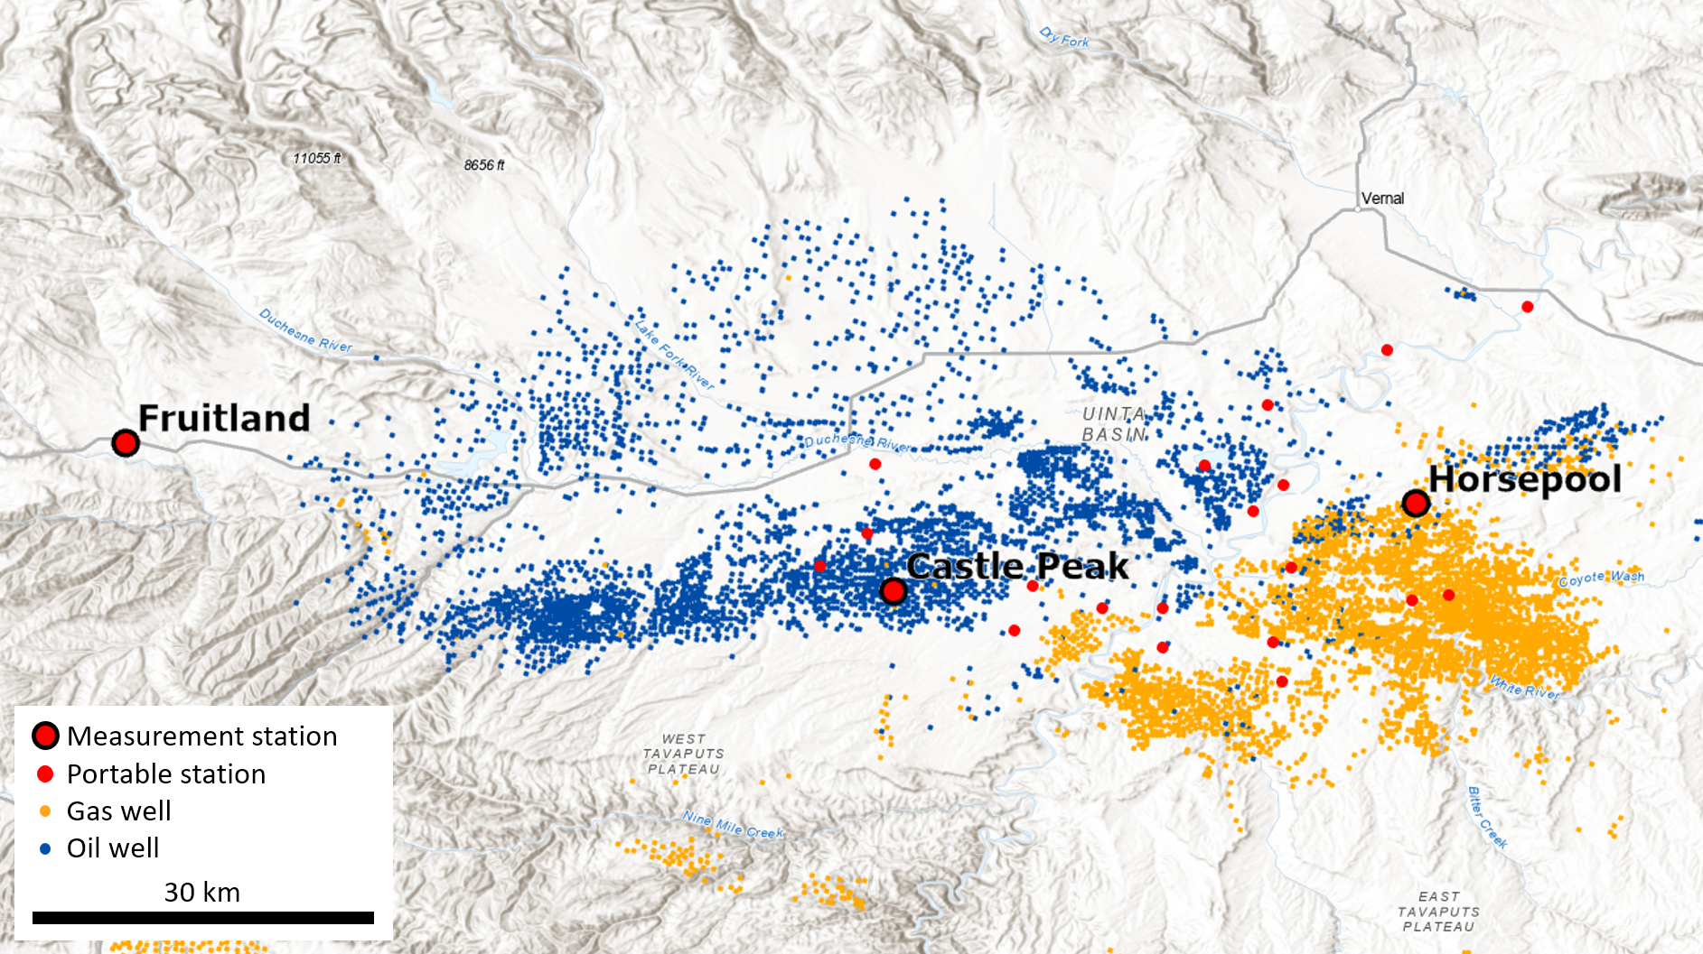
Measurement locations

Slide 4
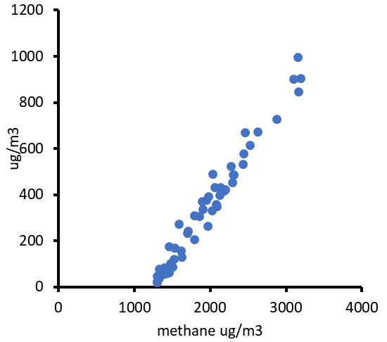
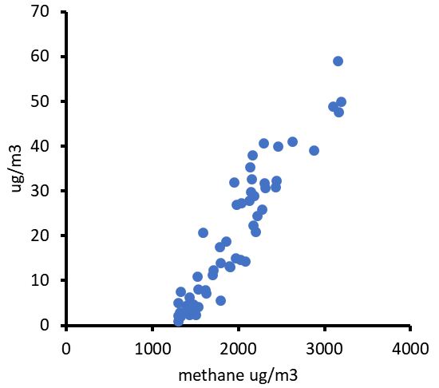
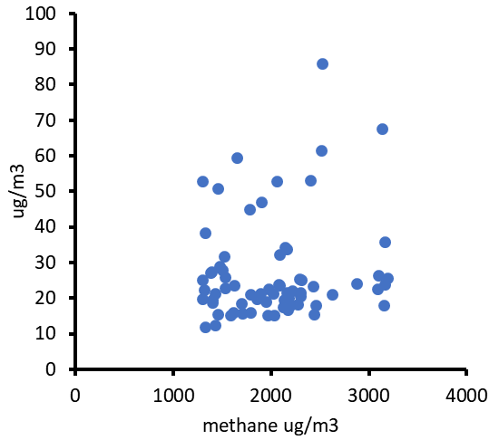
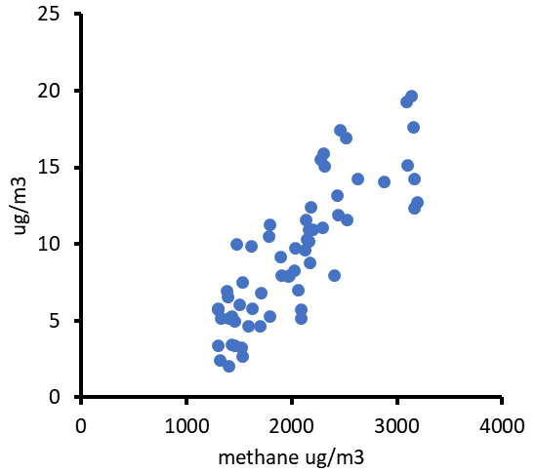
We used methane emission rates and correlations to determine NOx and organics emissions
Alkanes
Aromatics
Alcohols
NOy

Slide 5
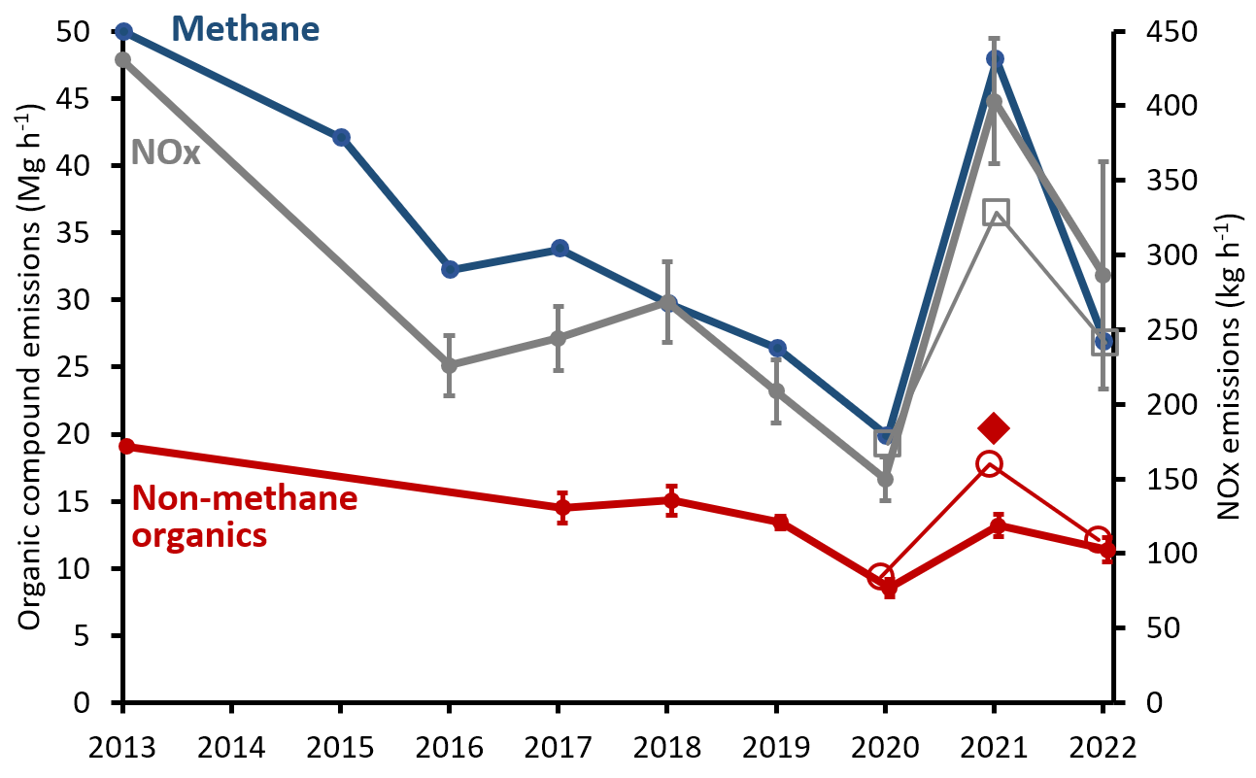
Emissions declined through 2020,
then took a big jump in 2021

Slide 6
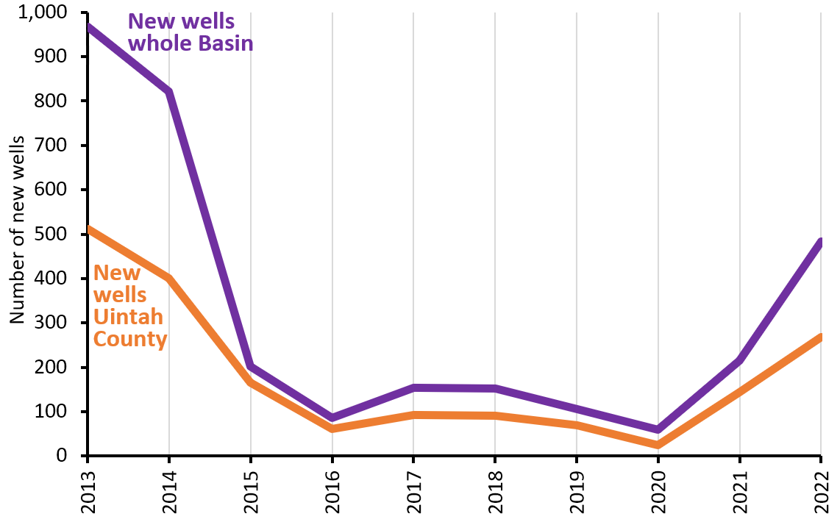
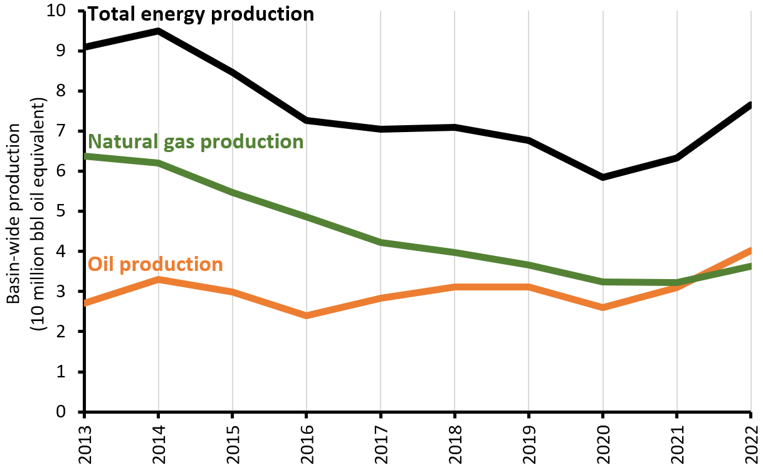
Increase in emissions may be related to
increase in energy production

Slide 7
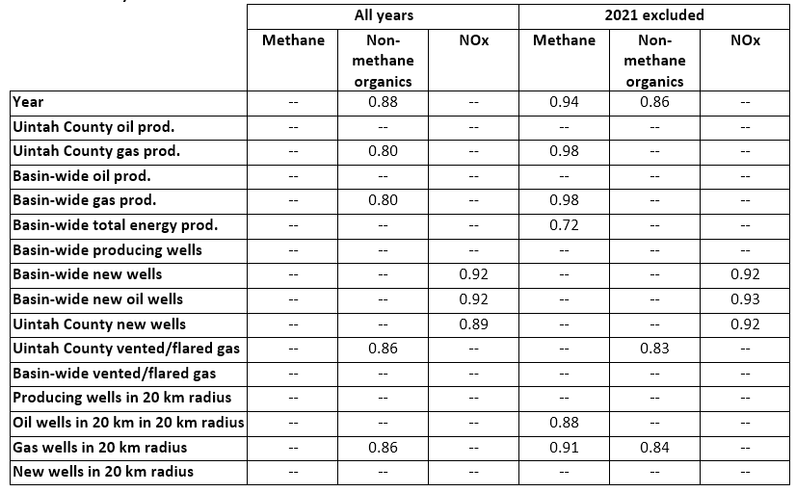
Correlations are unique
for different pollutant groups
(Spearman rank correlations)

Slide 8
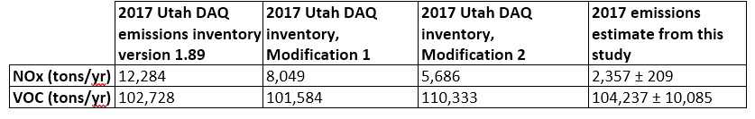
Regulatory inventory is much too high for NOx,
about right for VOC

Slide 9
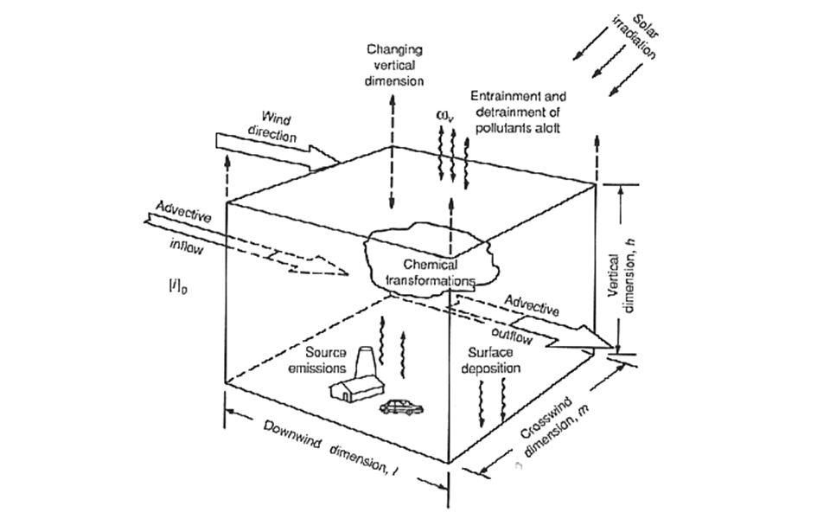
Air quality models
Box model

Slide 10
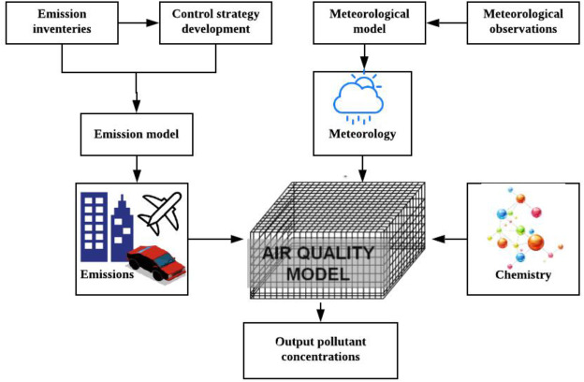
Air quality models
3D photochemical model

Slide 11
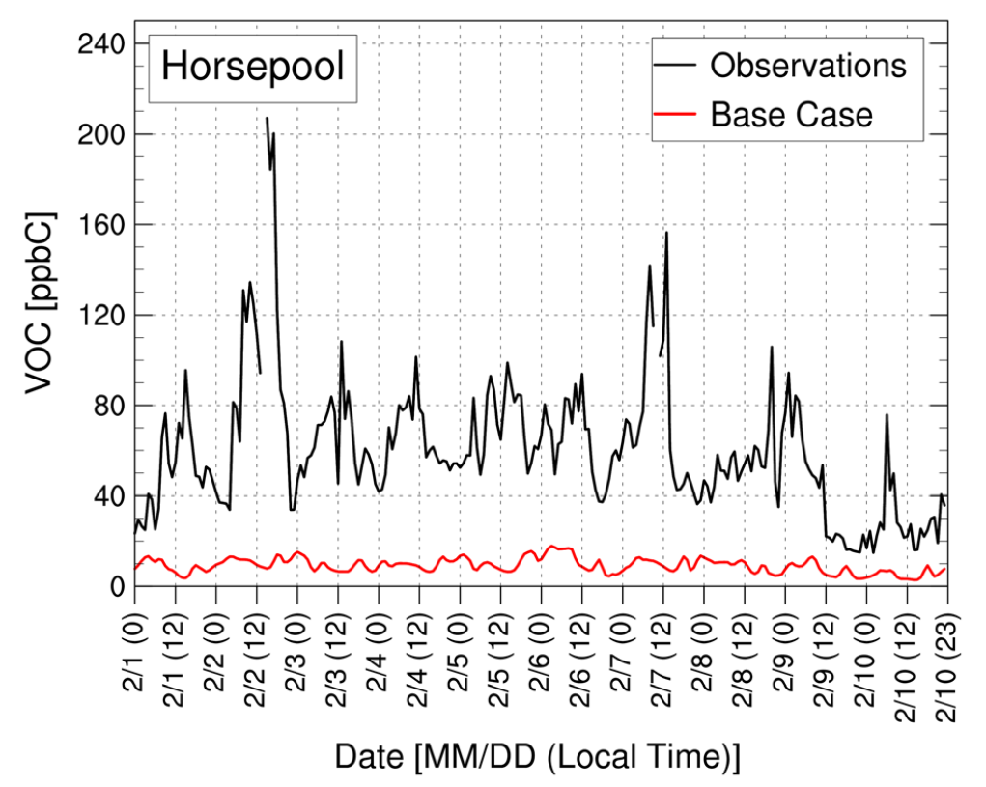
3D models mostly can’t produce winter ozone without juicing up the inventory
Matichuk et al., 2017

Slide 12
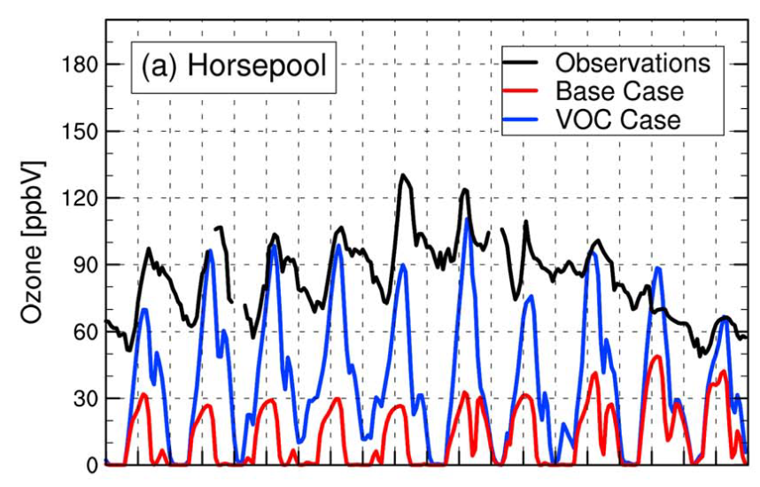
3D models mostly can’t produce winter ozone without juicing up the inventory
Matichuk et al., 2017

Slide 13
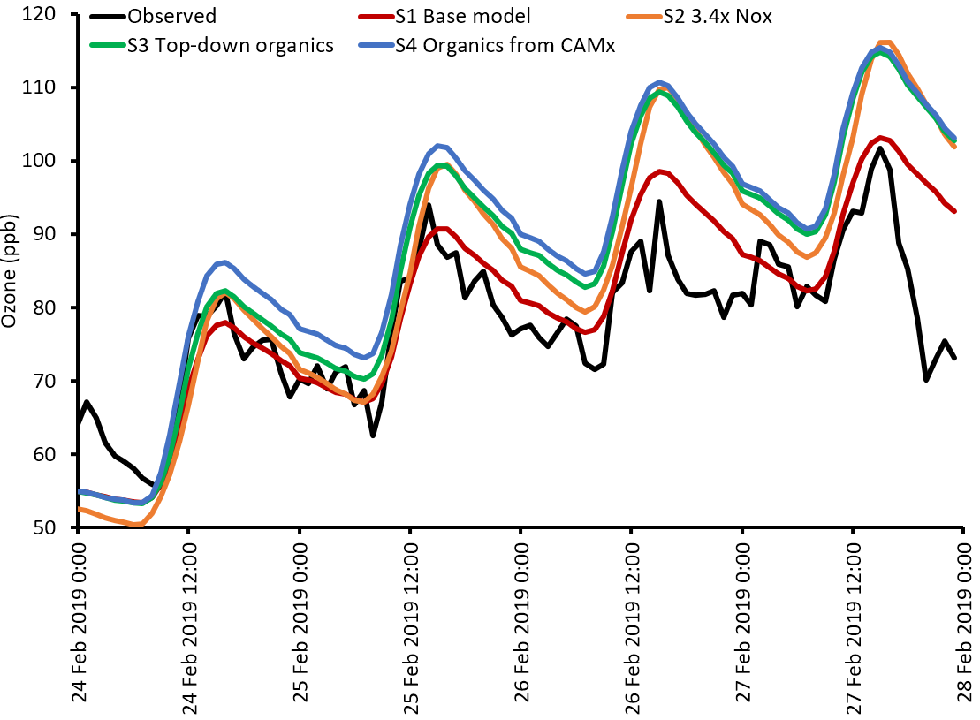
Box model shows 3D model output
produces plenty of ozone

Slide 14
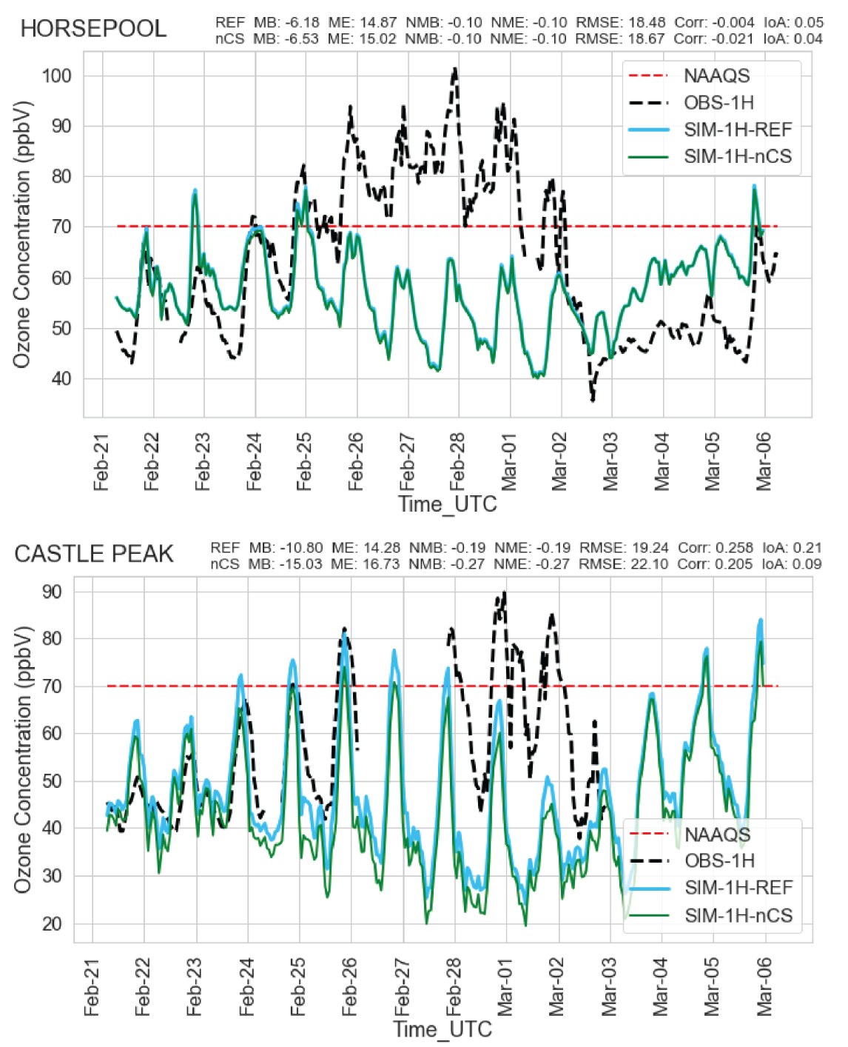
But that same output in the 3D model
doesn’t produce enough ozone!

Slide 15
What is going on?
The evidence shows that:
Inventoried total VOC emissions are high enough, but
VOC levels in modeled air are way too low, so
That VOC must be going somewhere! Thus,
We conclude that 3D models must be failing to capture the inversion adequately, so the model is allowing too much pollution to escape.
  Other evidence confirms this
  Model chemistry may also need improvement

Slide 16
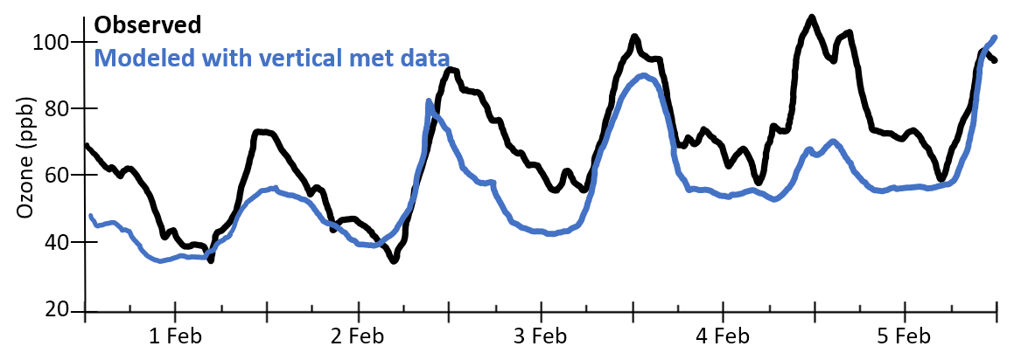
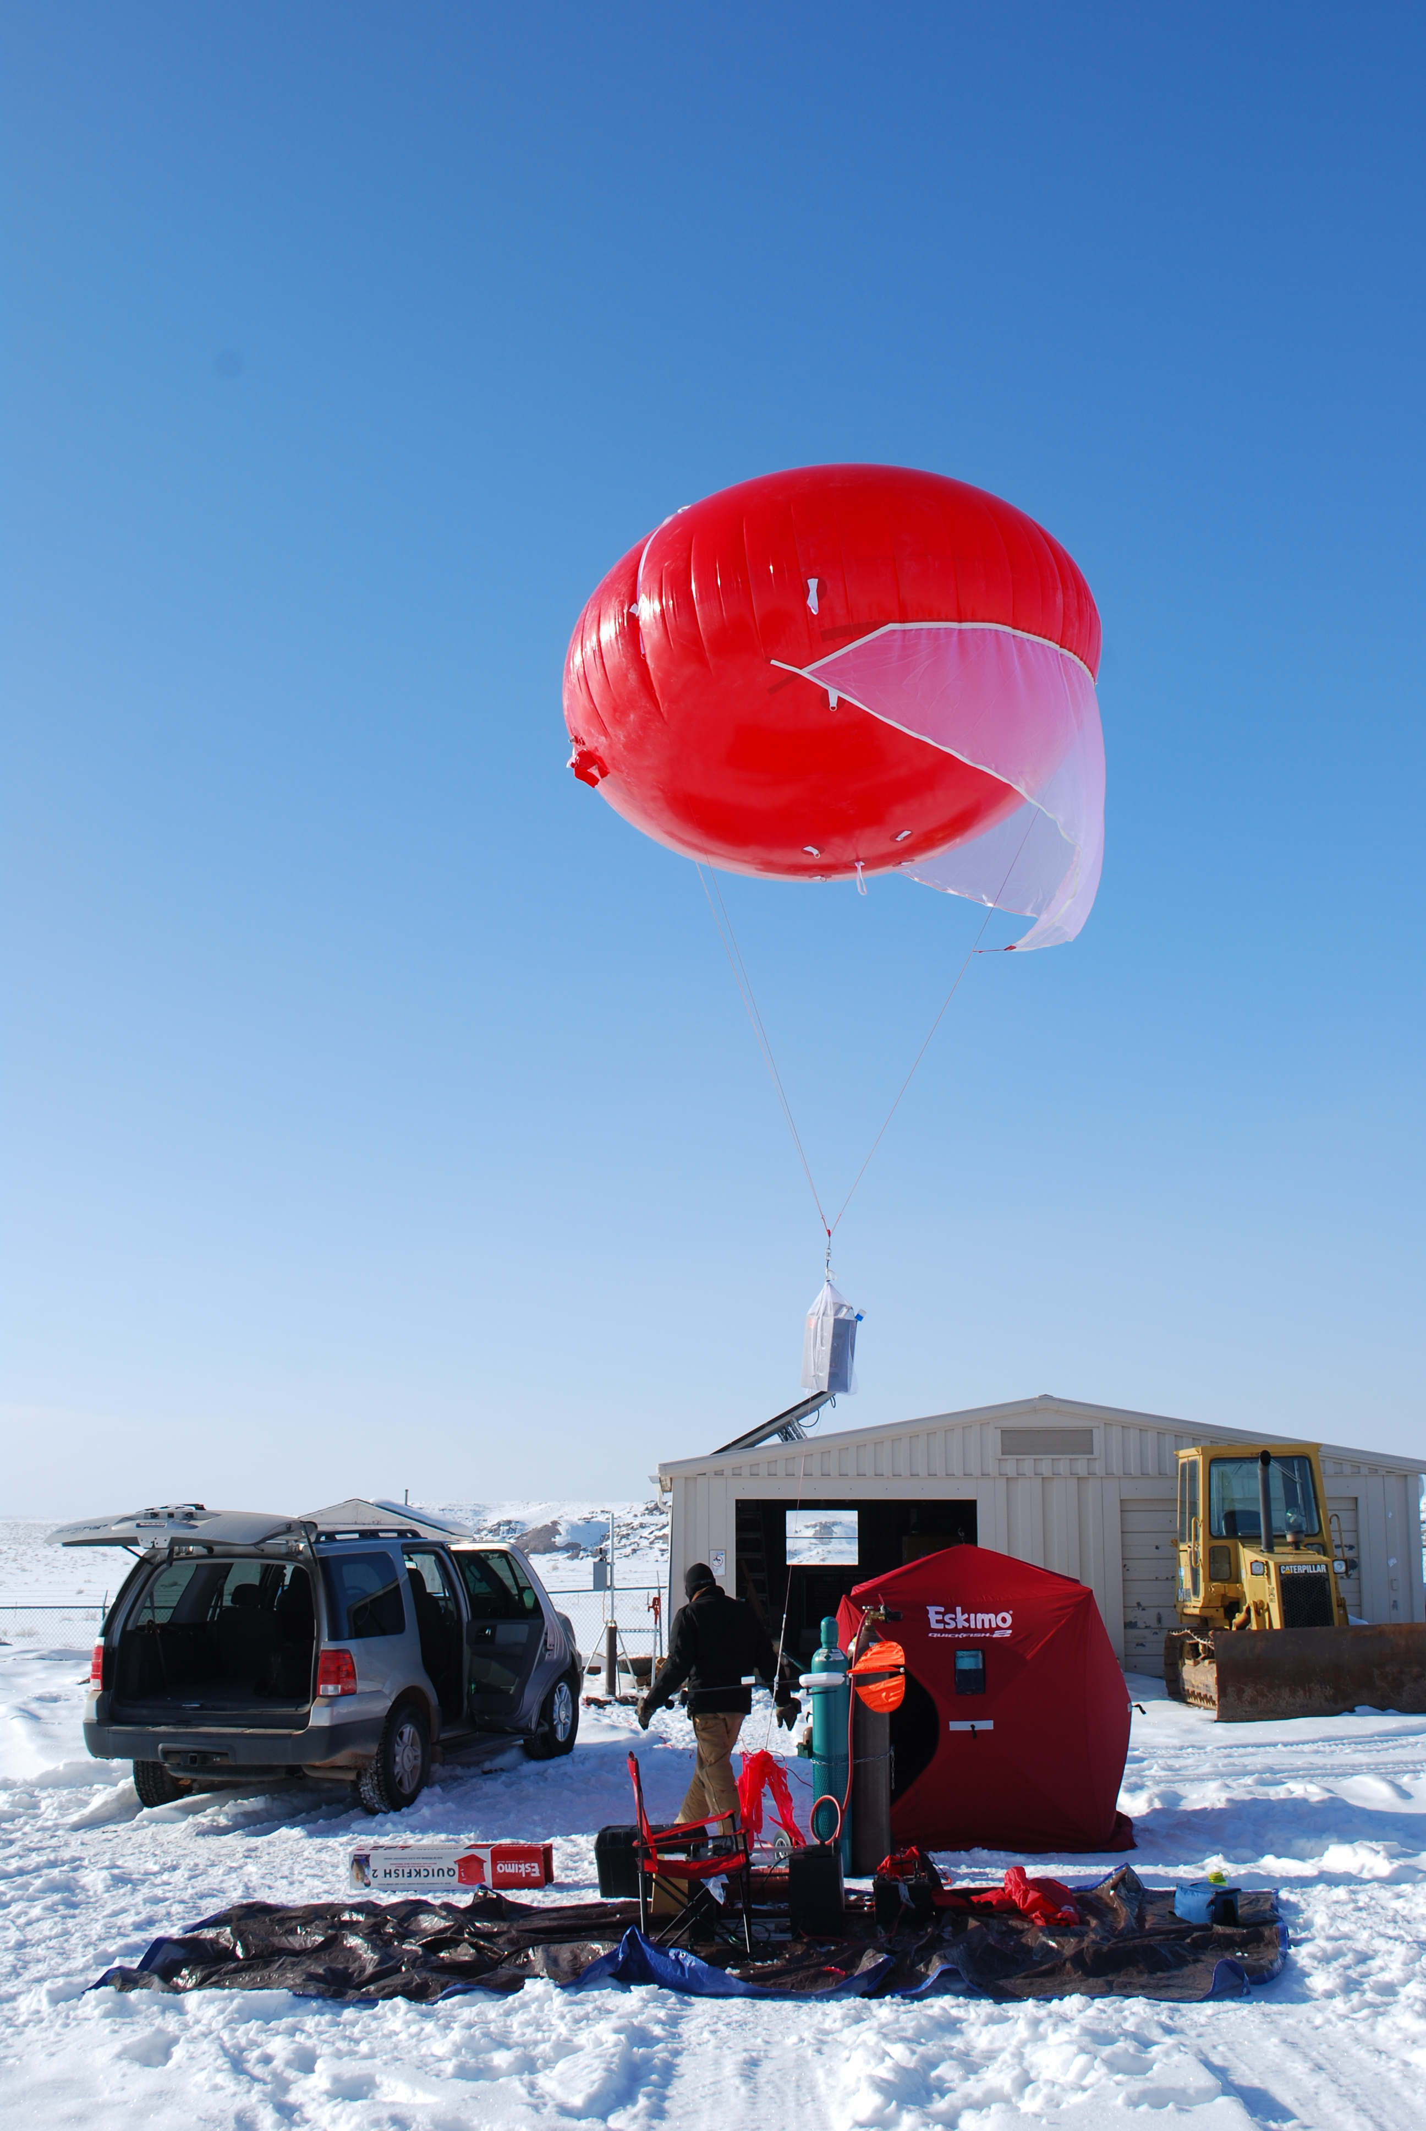
Forcing model to match met measurements helps, but is hard/expensive
Preliminary work by Trang Tran, USU

Slide 17
The End
Takeaways
More oil and gas means more emissions
What happened in 2021?
The DAQ inventory is pretty good for VOC, but needs source-specific tweaks, and is too high for NOx
Poor performance of 3D photochemical models is due to poor meteorology, and maybe poor chemical mechanism, not due to the inventory.
What to do next?
Hire a meteorologist and a new photochemical modeler
Continue and improve annual emissions estimates
This project was funded by:
Utah DAQ, Utah Legislature, and Uintah County SSD1

Slide 19
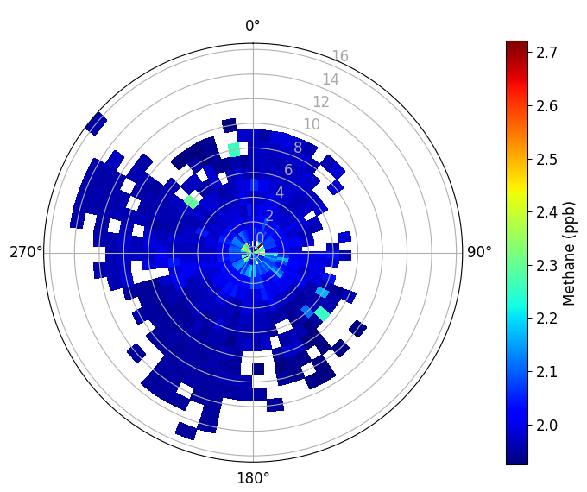
2021 spike wasn’t due to contamination from a single nearby source

Slide 20
Emissions declined through 2020,
then took a big jump in 2021

Slide 21
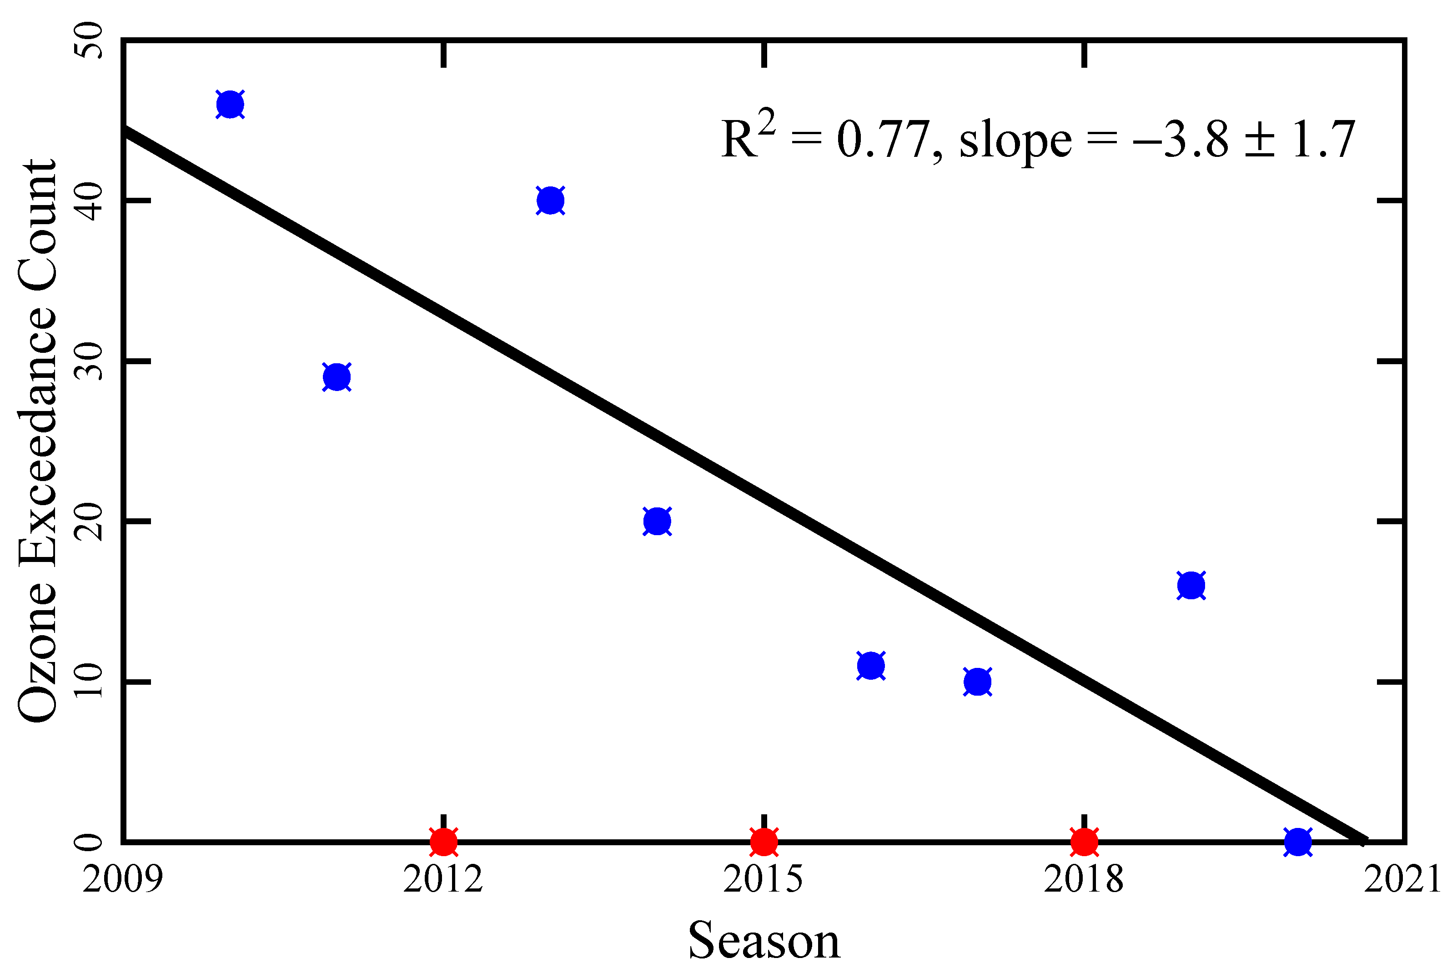
Ozone and NOx decreased through 2020 also
Mansfield and Lyman, 2021
Trend is robust, even when accounting for meteorology

Slide 22
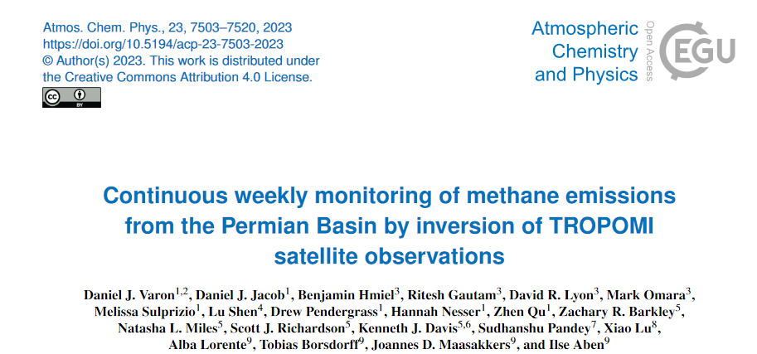
A better method for estimating emissions?

Slide 23
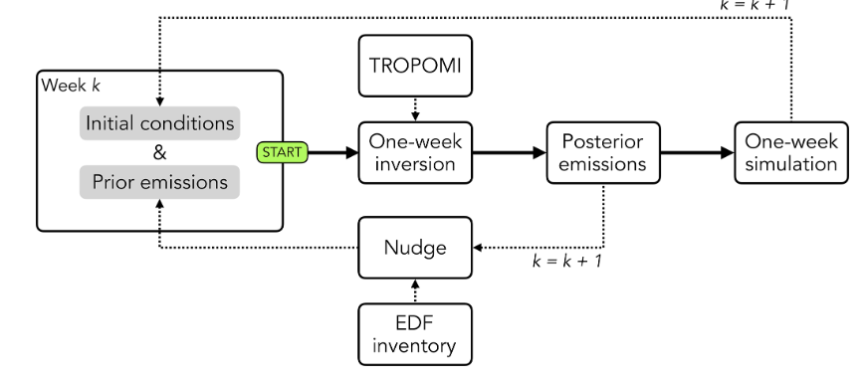
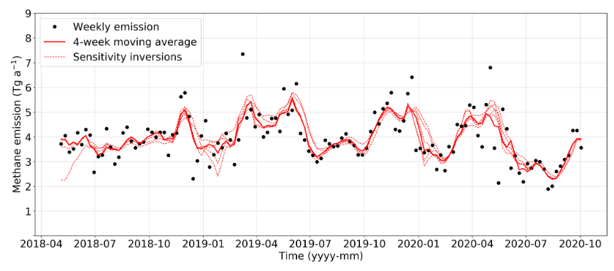
A better method for estimating emissions?

Slide 24
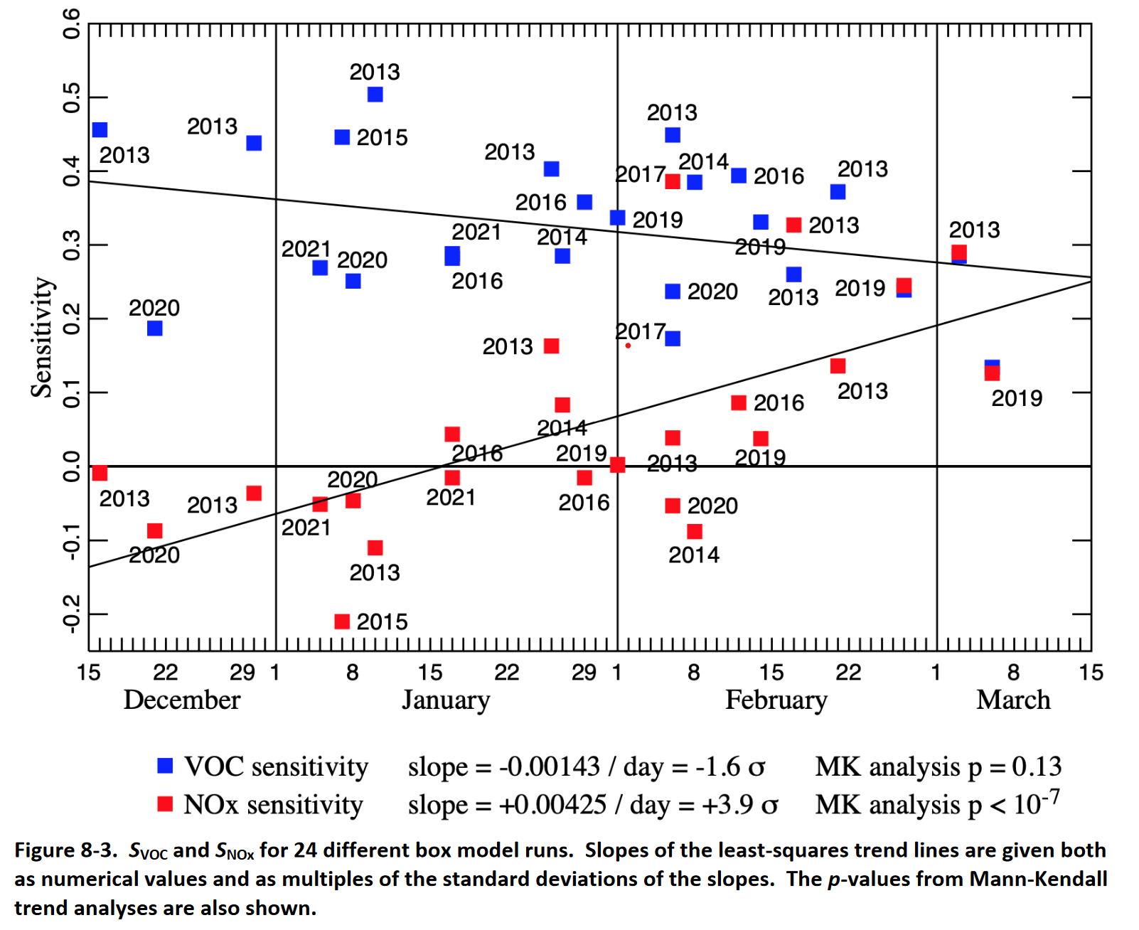
NOx is important in late winter,
organics are important all winter
Publication in prep; credit: Marc Mansfield

Slide 25
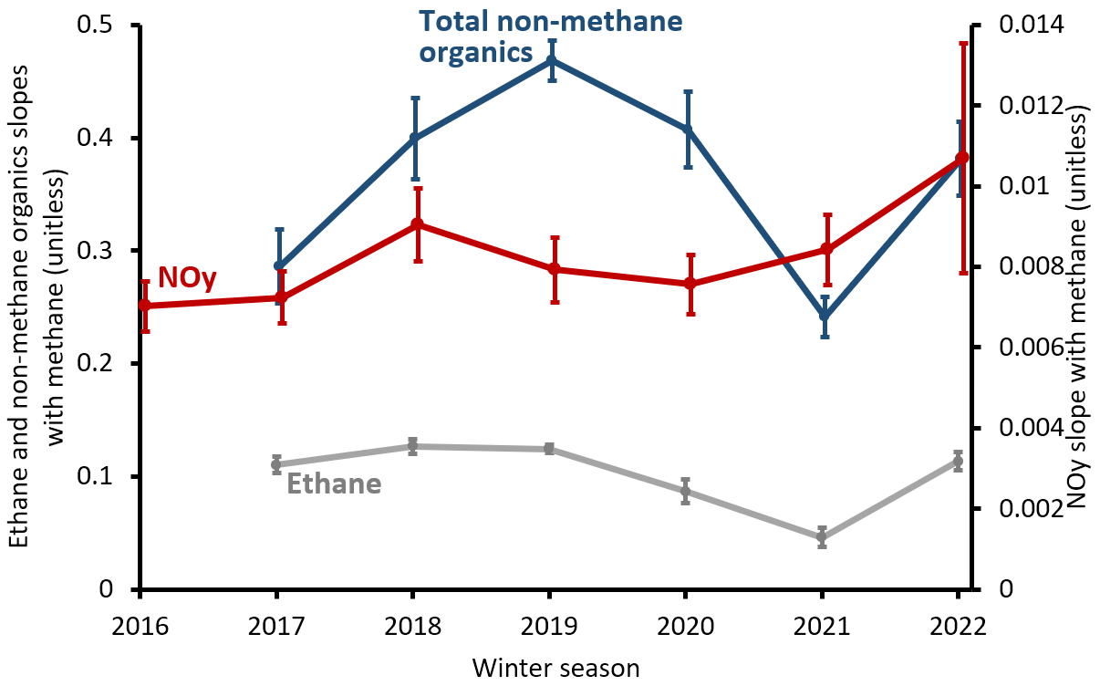
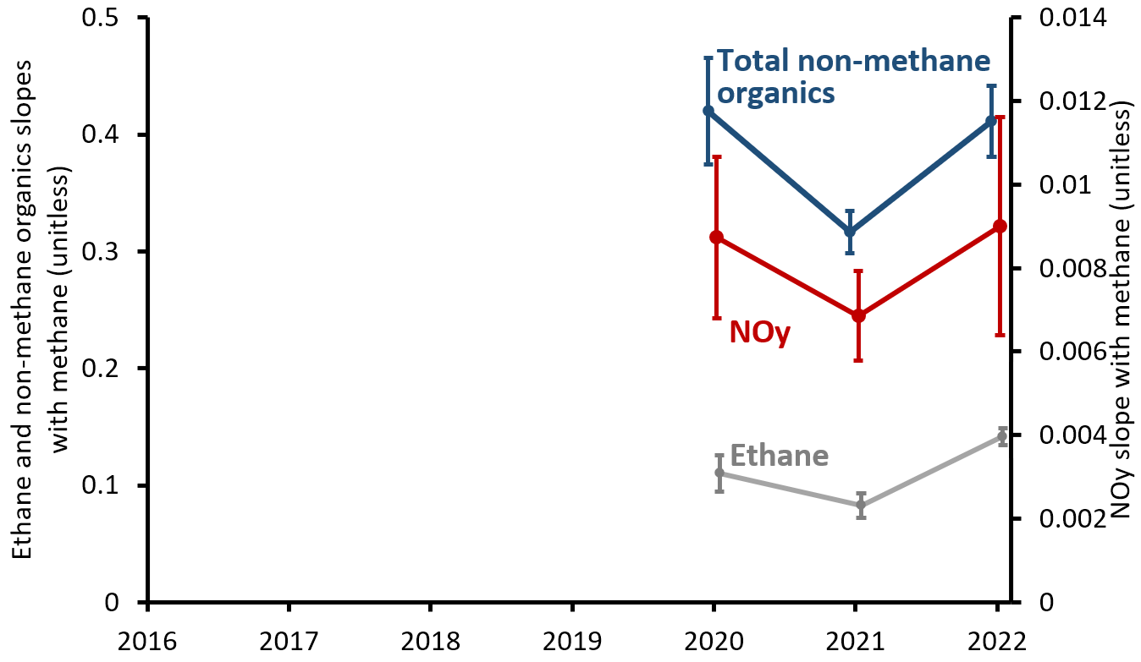
2021 spike appears to have impacted
the whole Basin
Horsepool
Castle Peak

Slide 26
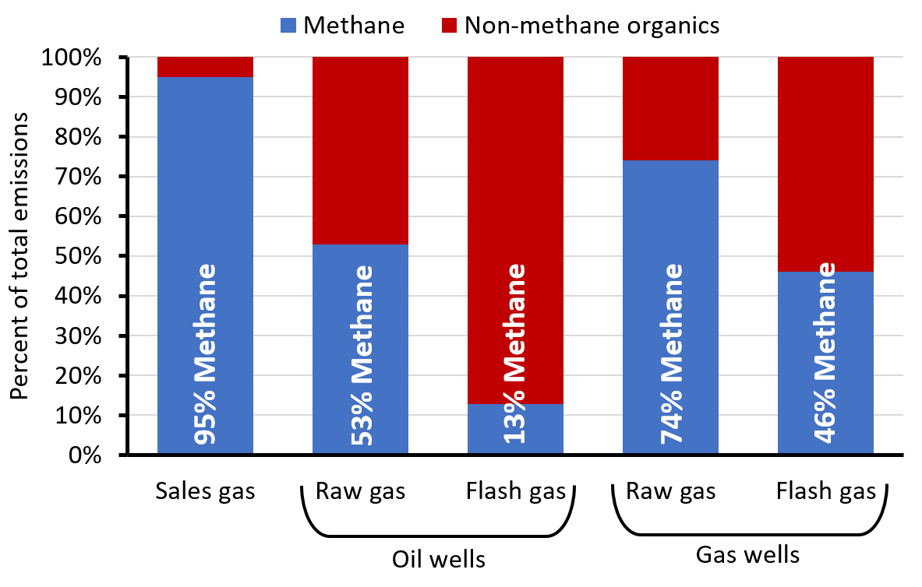
Sources of methane and non-methane organics
are not the same
Sources:
https://documents.deq.utah.gov/air-quality/planning/technical-analysis/DAQ-2020-004826.pdf
https://www.naesb.org/pdf2/wgq_bps100605w2.pdf

Slide 27
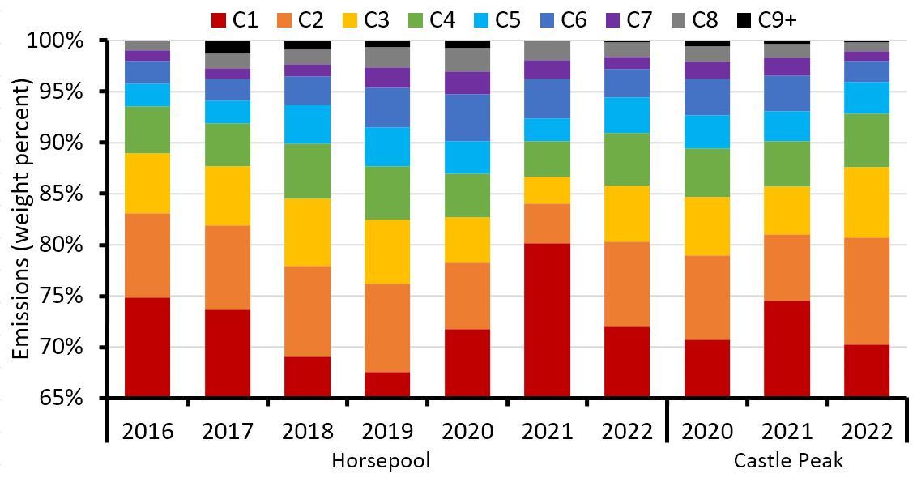
Composition trends through 2020 reversed in 2021

Slide 28
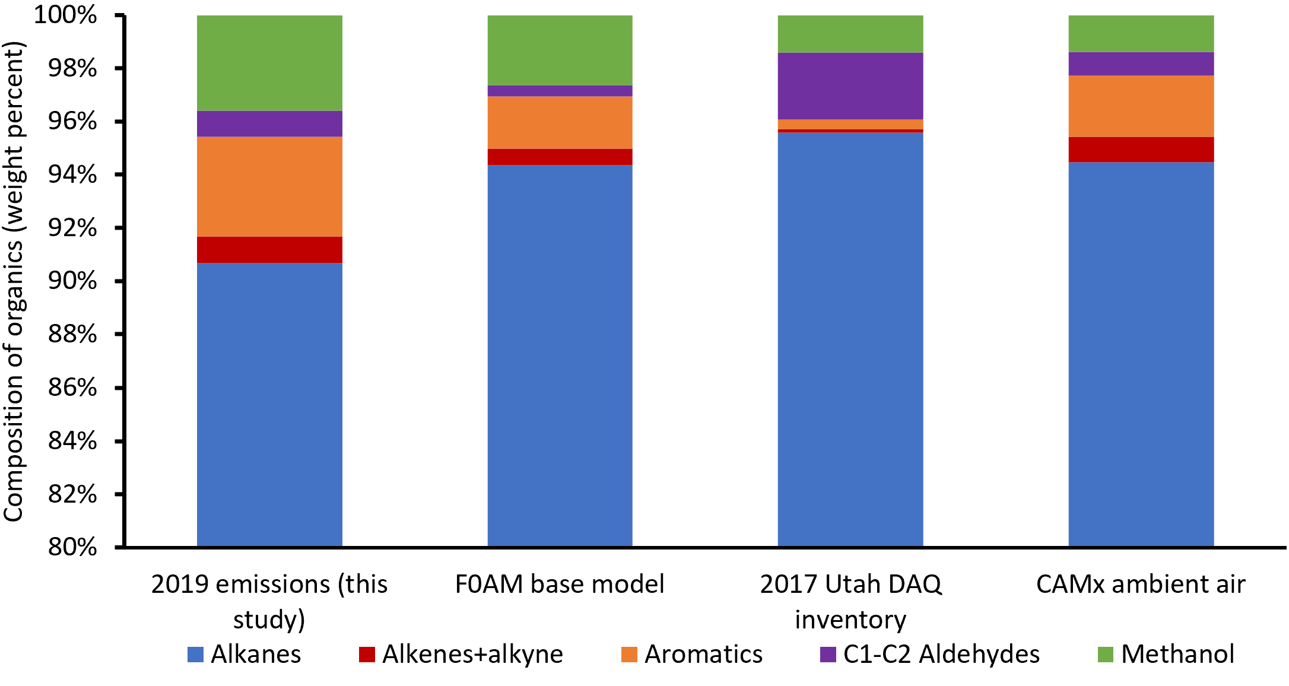
Regulatory inventory composition
seems about right, except for alcohols

Slide 29
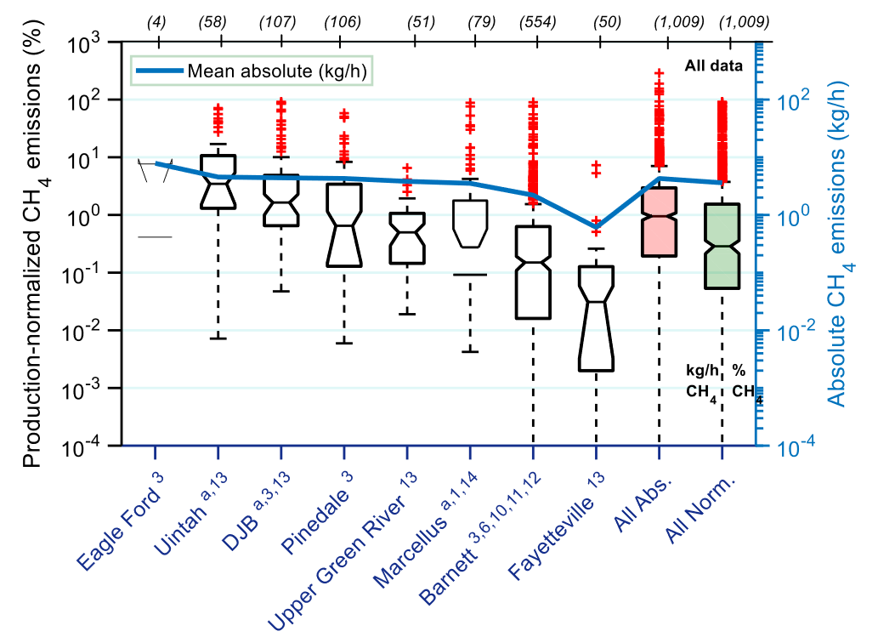
Natural gas emissions in the Uinta Basin
are relatively high
Several studies have shown production-normalized emissions of about 6-8%.
Nationwide average is about 2-3%
The Basin has:
Lots of older, low-producing wells
Lots of oil wells
Omara et al., 2018

Slide 30
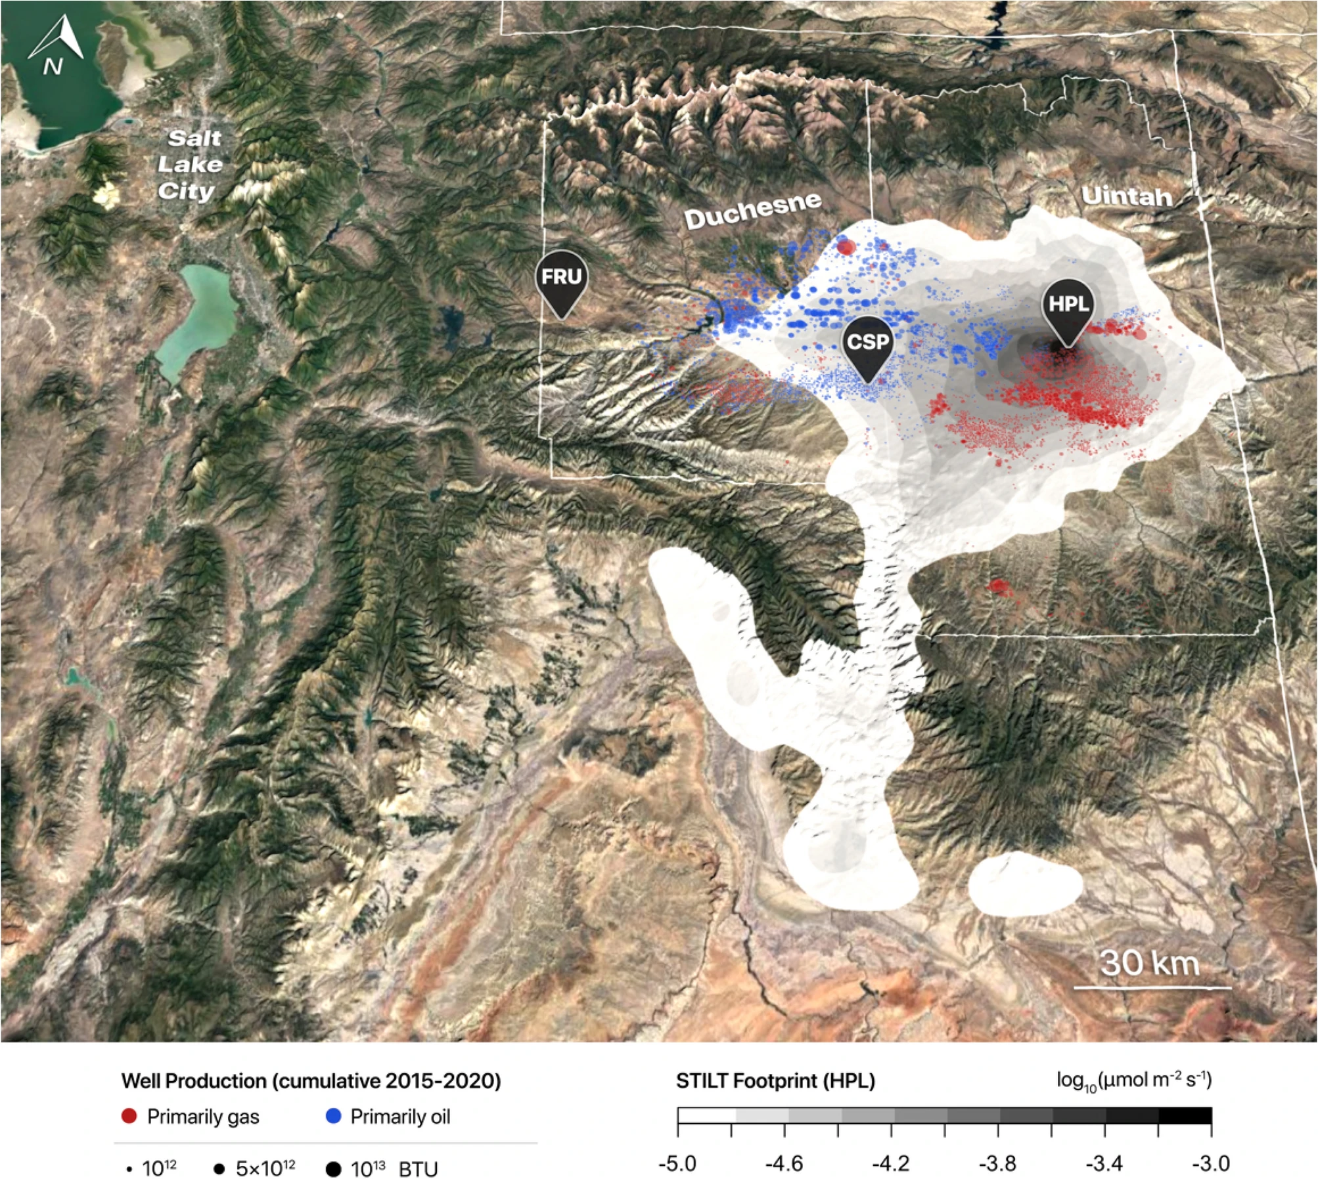
Estimation of annual methane emission rate,
Lin et al., 2021
Lin et al., 2021

