Slide 1
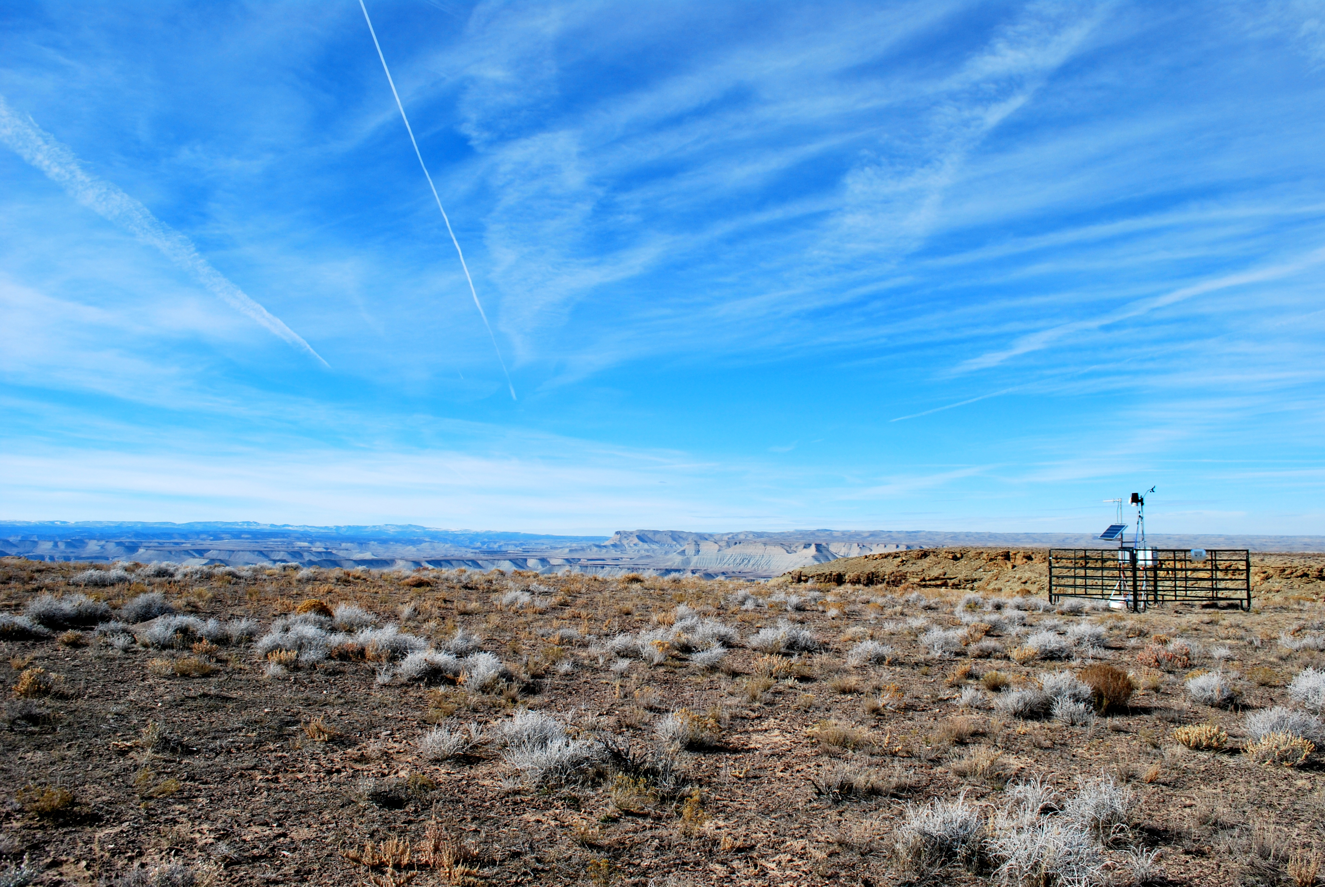


Trends in Uinta Basin-wide methane, VOC, and NOx emissions
Seth Lyman

Slide 2
This work was funded by the Utah Legislature, Uintah Special Service District 1, and the National Oceanic and Atmospheric Administration.
This workup is preliminary and subject to change.

Slide 3
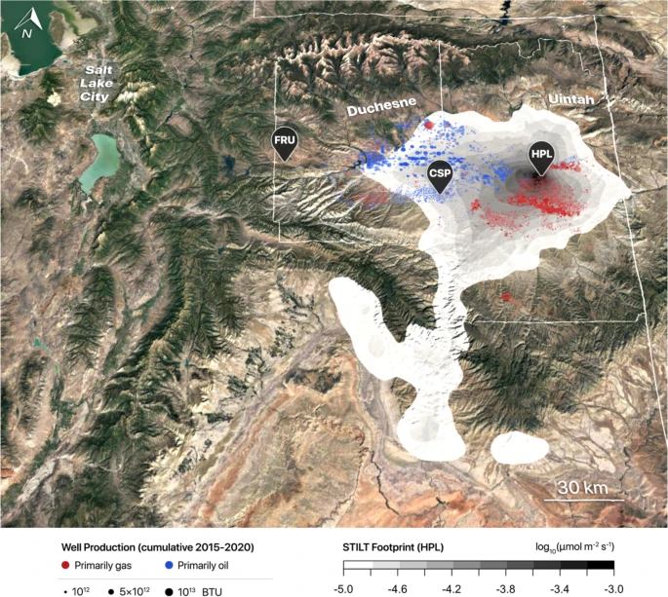
Methane emissions method 1
Lin et al., 2021

Slide 4


Methane emissions method 2 (2019-2024)
Prior Emissions
Posterior Emissions
Integrated Methane Inversion
Varon et al., 2022

Slide 5
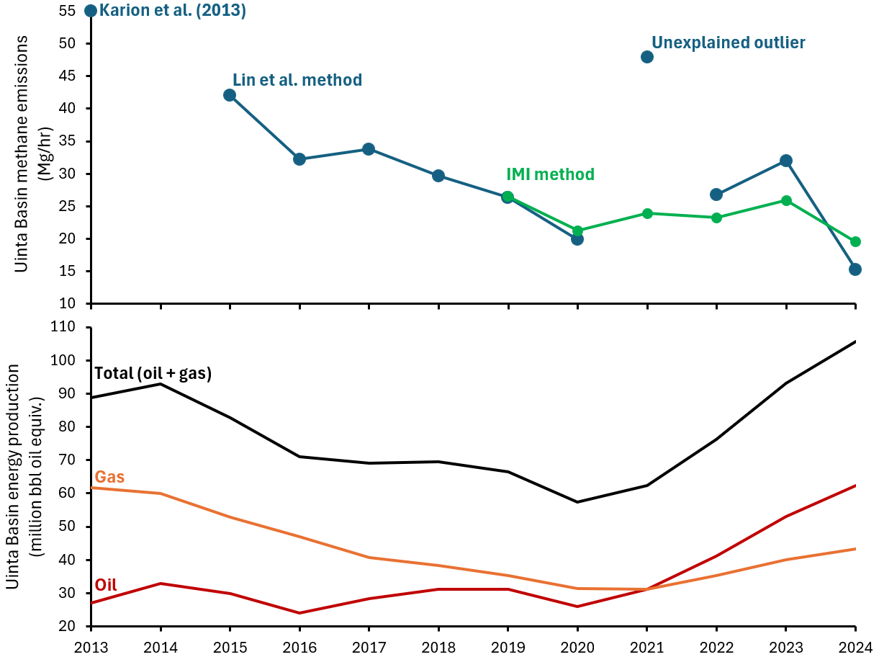
Basin-wide
methane
emissions
Basin-wide
energy
production

Slide 6
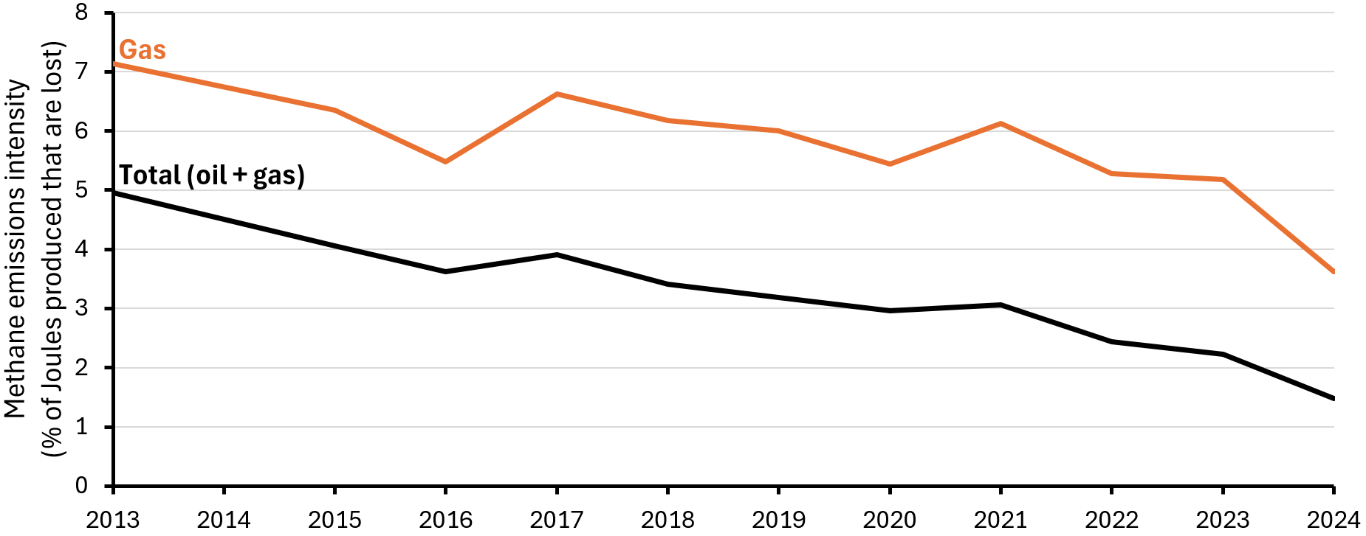
Emissions per energy production (emissions intensity)
*Using Lin et al. estimates through 2018, and IMI from 2019-2024

Slide 7
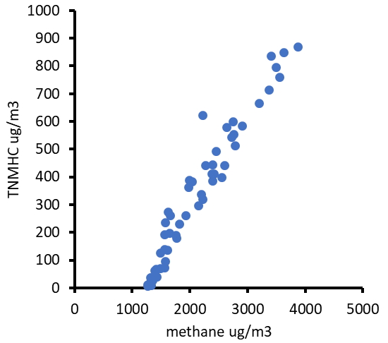
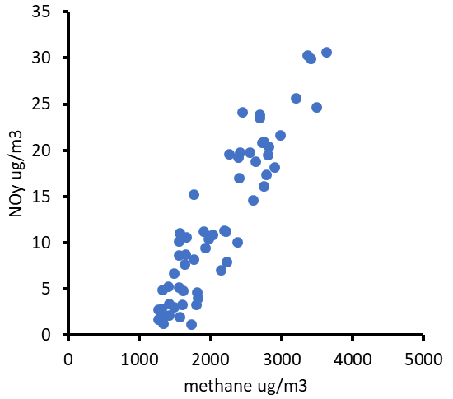
VOC and NOx emissions method
Currently only using Horsepool ratios. Will redo with other sites.

Slide 8
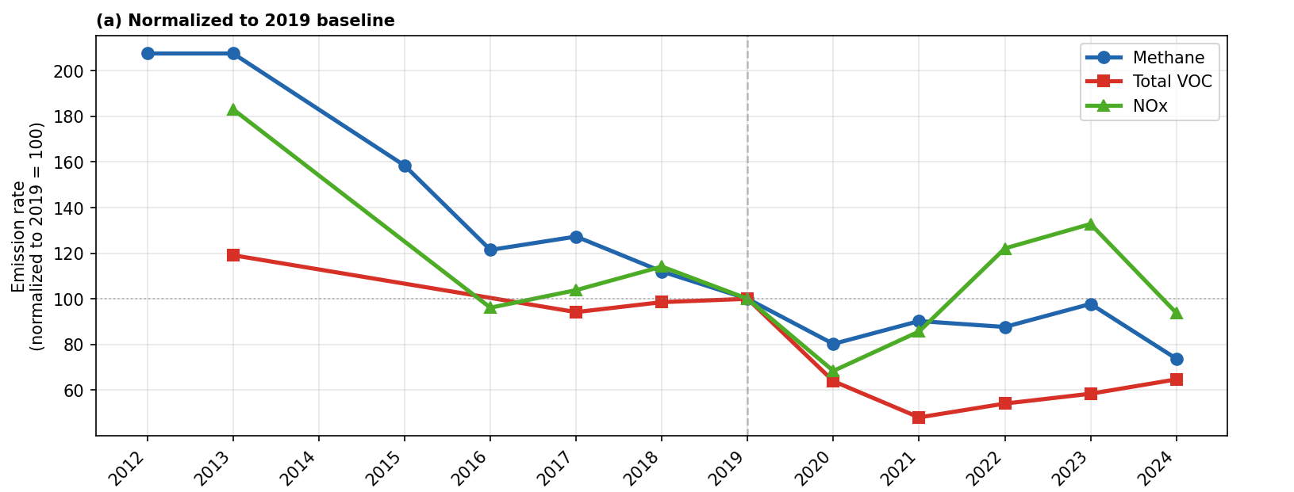
Methane, VOC, and NOx trends

Slide 9
Less steady declines for NOx and VOC
Nadir in 2020 / 2021 for all 3
NOx and methane decline again in 2024, VOC doesn’t

Slide 10
Less steady declines for NOx and VOC
Nadir in 2020 / 2021 for all 3
NOx and methane decline again in 2024, VOC doesn’t

Slide 11
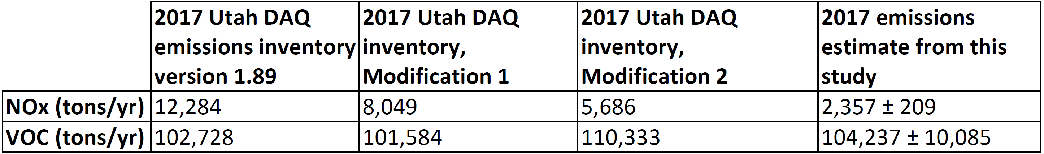
Our method produced VOC similar to, NOx lower than, 2017 inventory

Slide 12
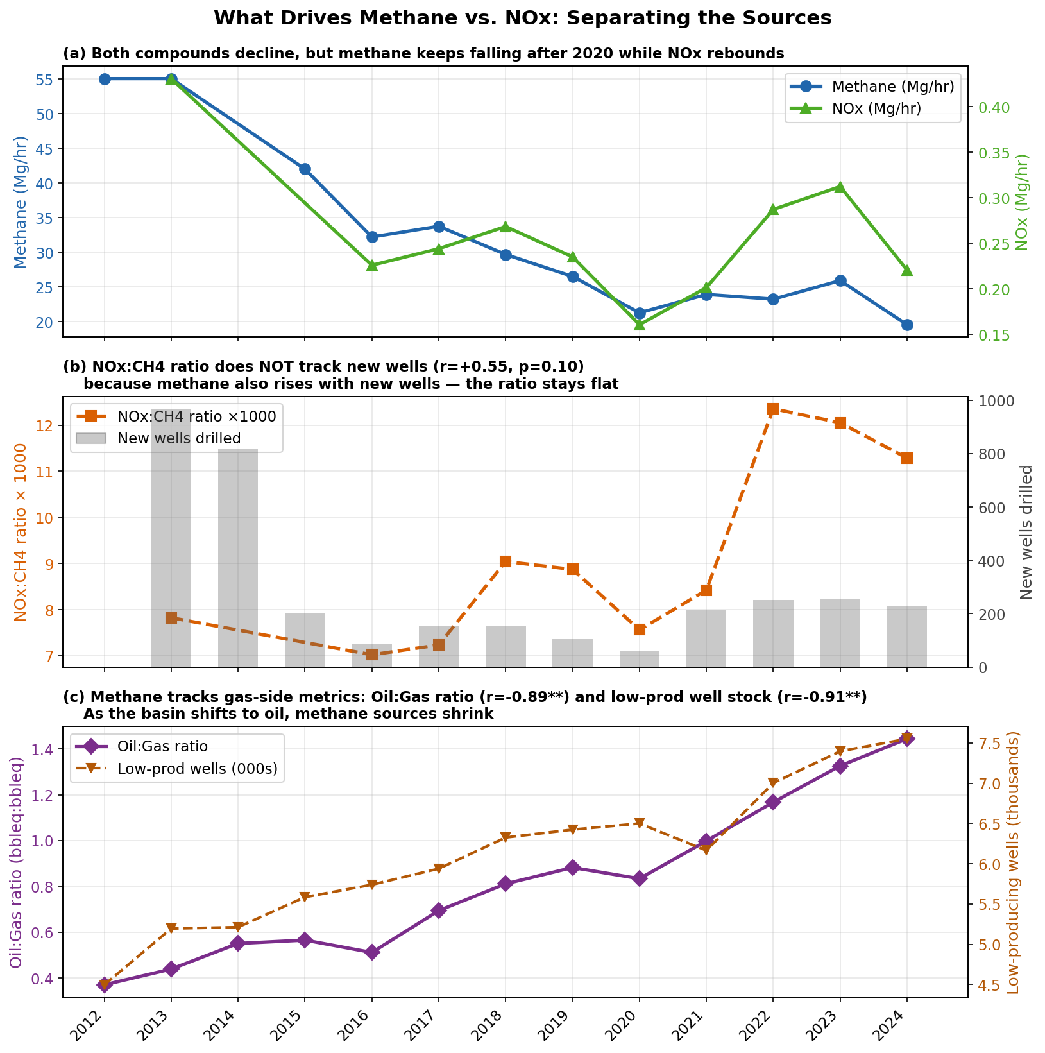
Methane declines more steadily than NOx
NOx rebounds strongly after 2020
Both decline again in 2024

Slide 13
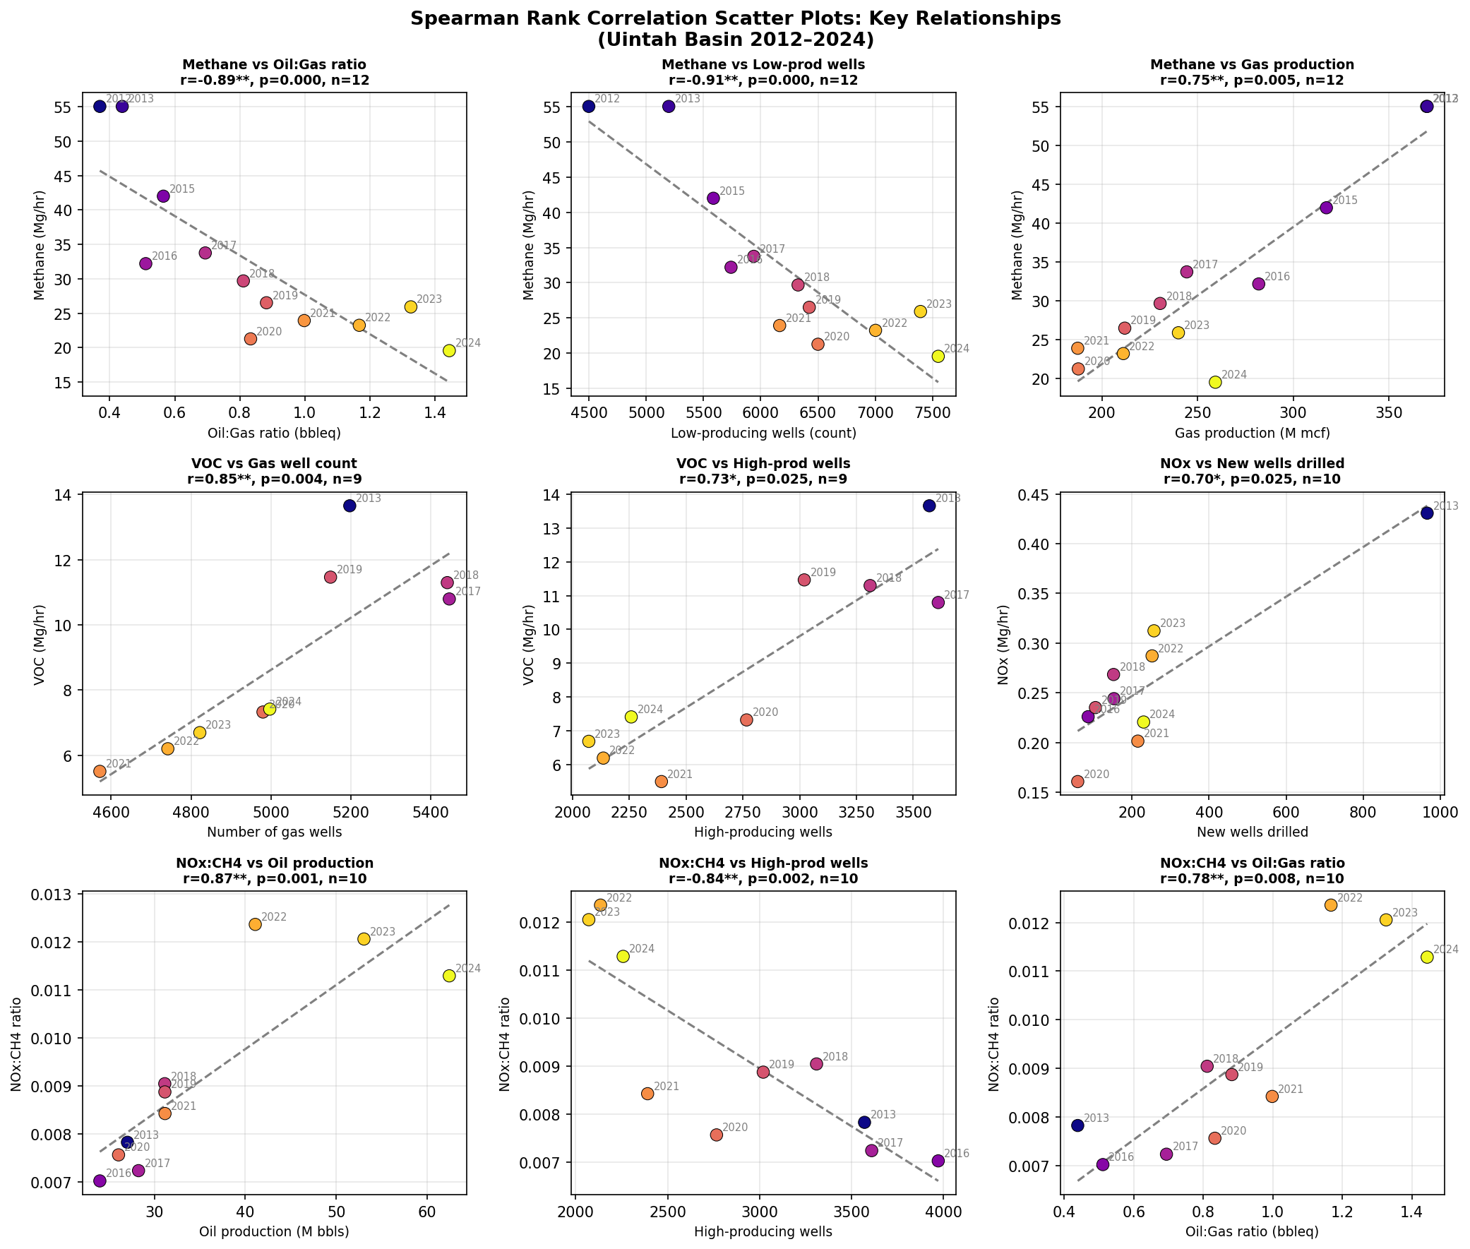
Methane emissions are driven mostly by gas production

Slide 14
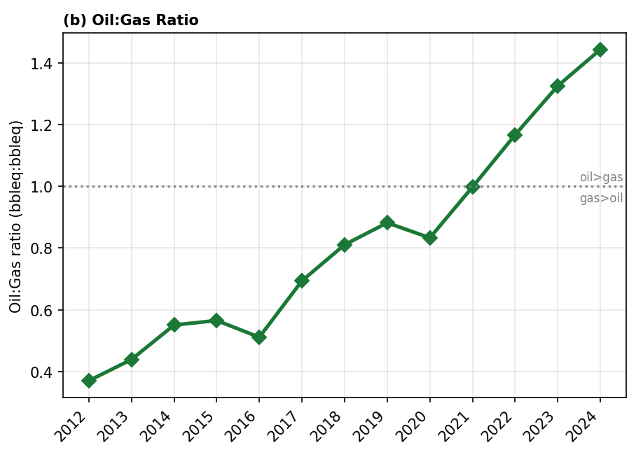
Methane emissions correlate negatively with oil:gas ratio

Slide 15
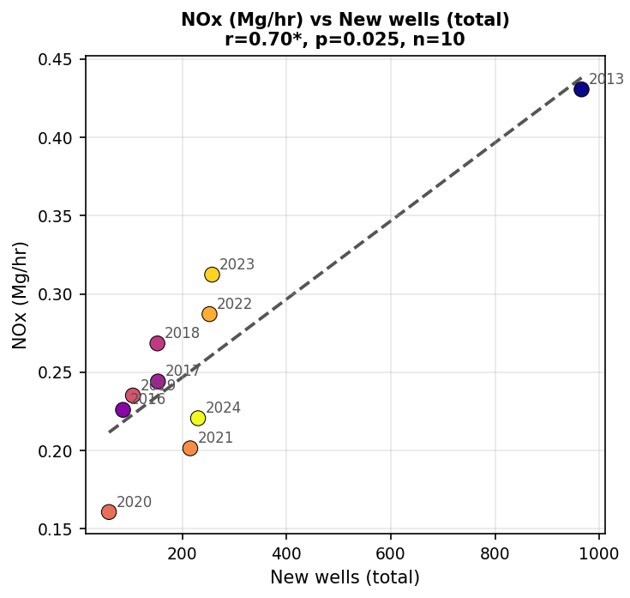
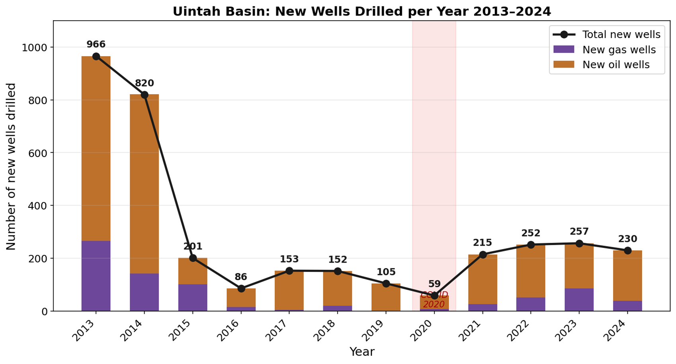
NOx emissions are correlated with drilling/completions

Slide 16
Higher NOx:methane ratio as oil:gas ratio increases
Oil activity emits more NOx?
Or just less methane overall?

Slide 17
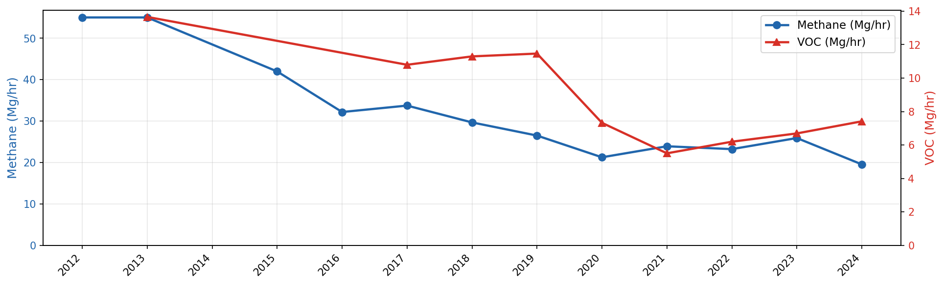
Little change in VOC until 2019, then rapid decline
VOC didn’t drop in 2024

Slide 18
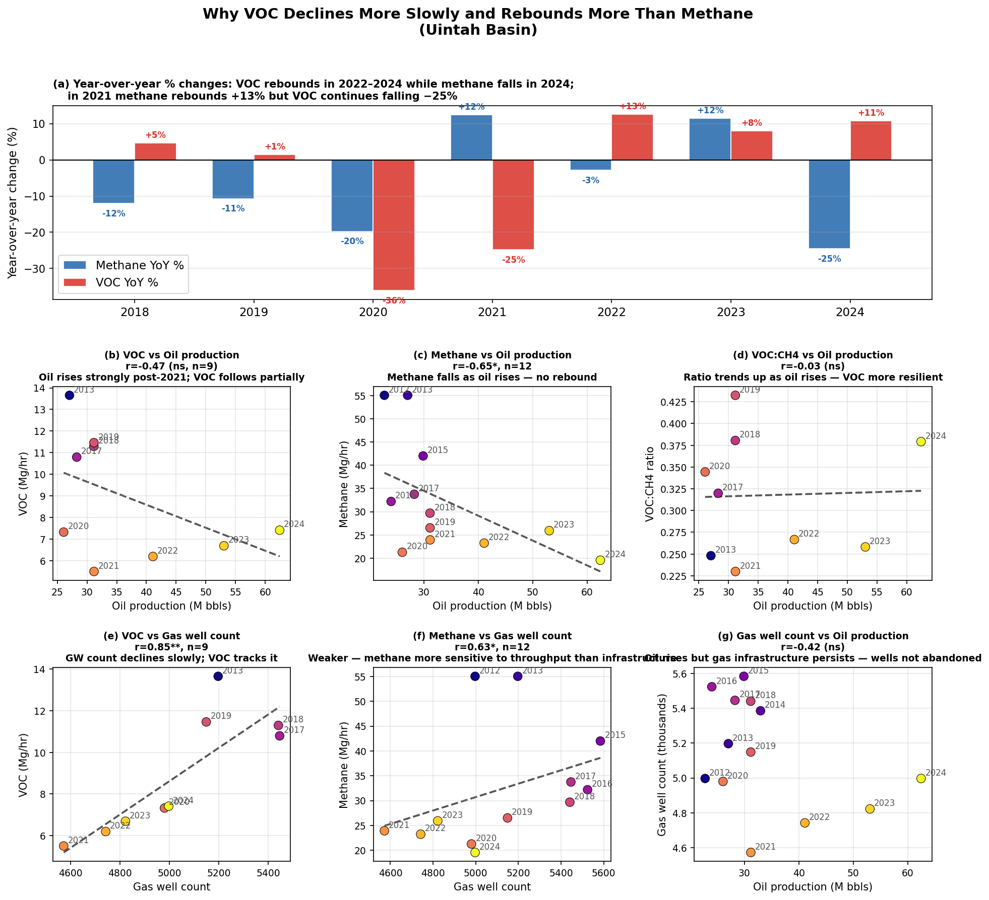
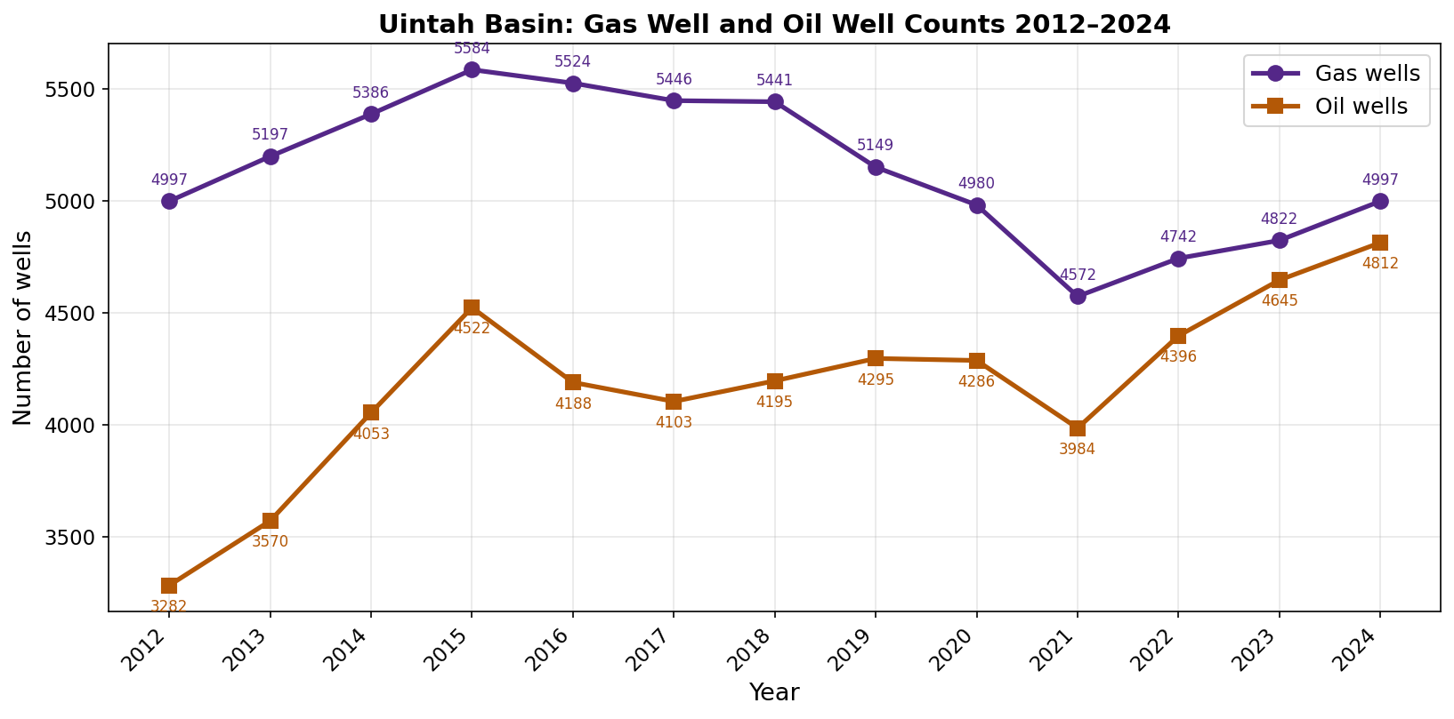
VOC correlates best with gas well COUNT

Slide 19
VOC correlates best with gas well COUNT

Slide 20
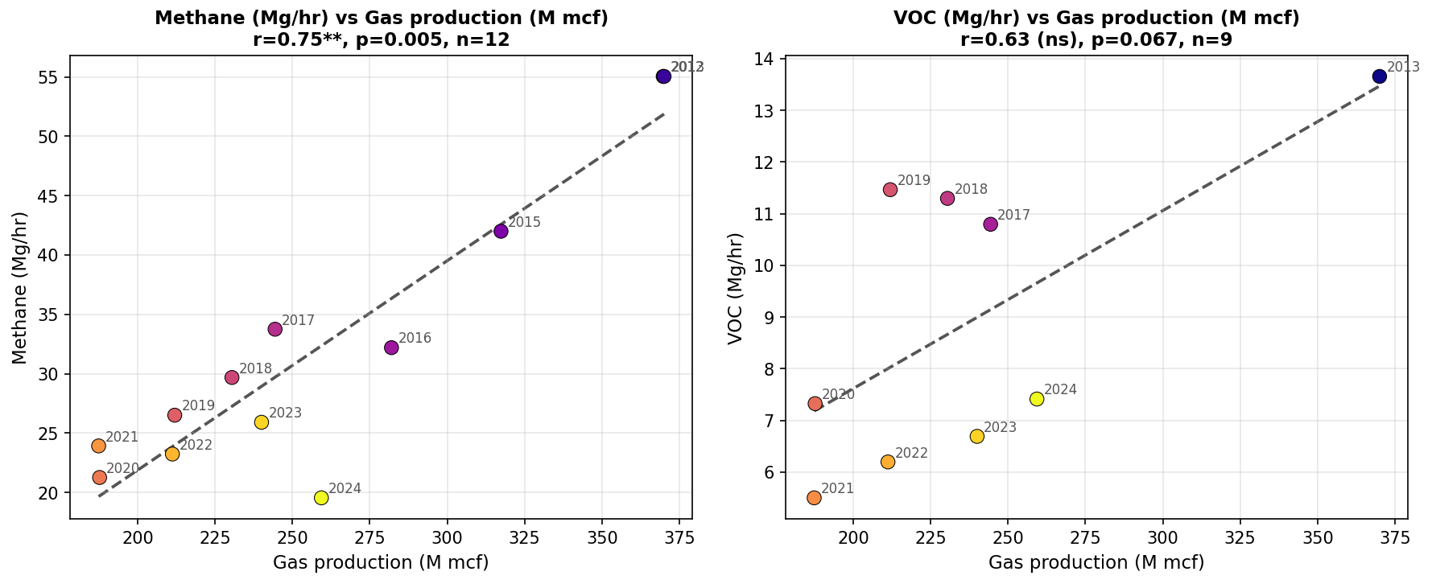
Methane correlates best with gas PRODUCTION

Slide 21
Why did VOC and methane diverge in 2024?
U&O FIP implemented in Feb 2024
Did FIP primarily lead to reductions in methane-rich sources?

Slide 22
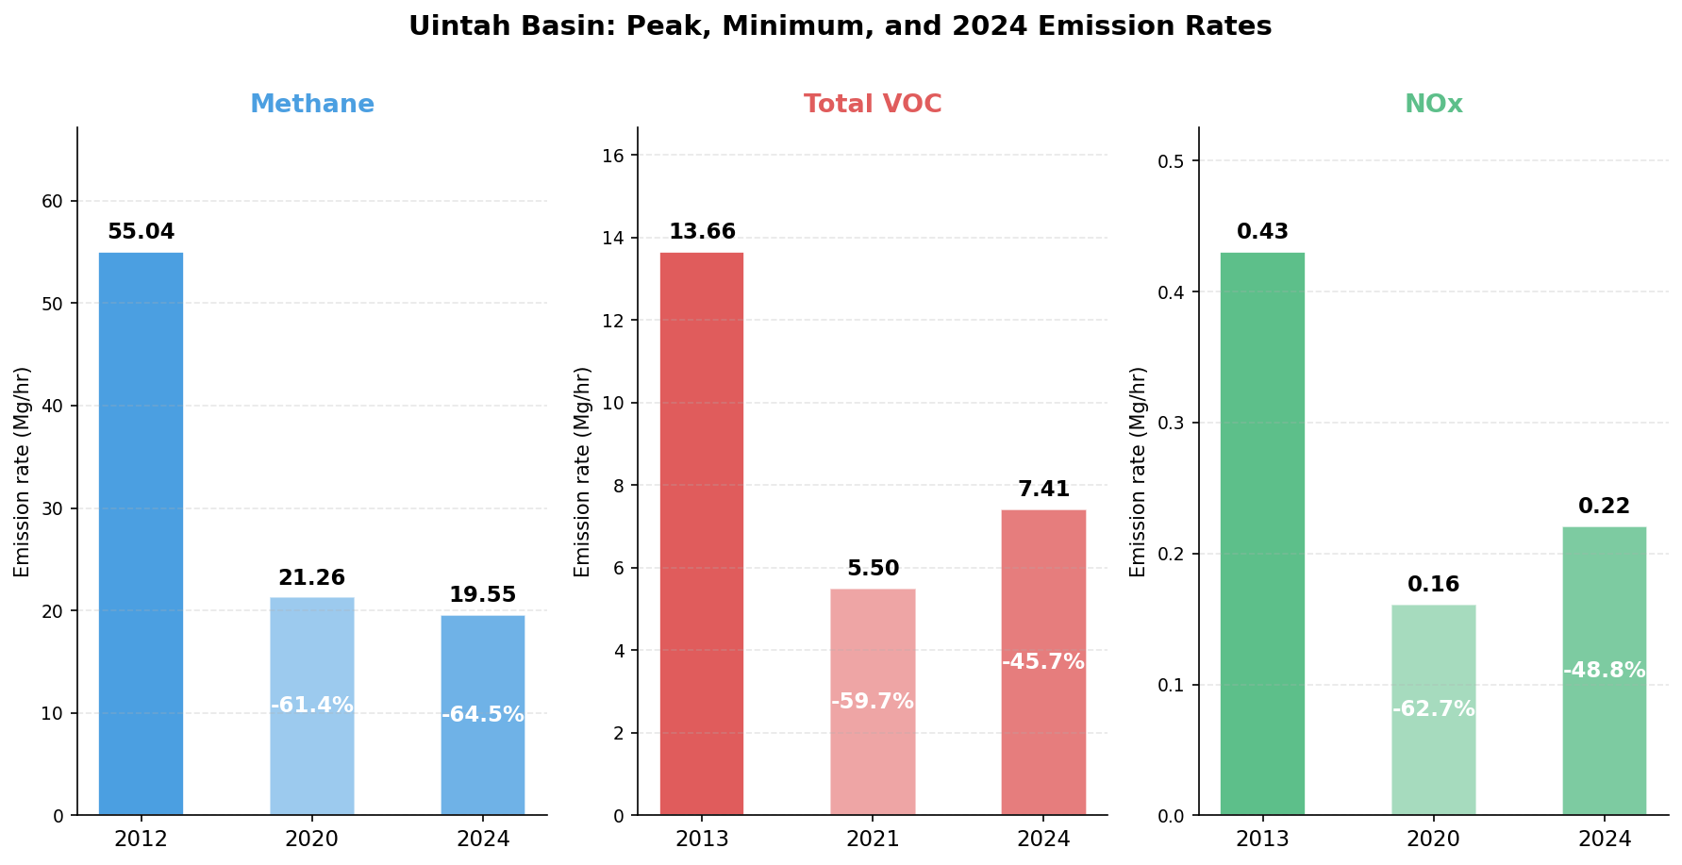
Methane, VOC, and NOx emissions trend summary
Mg/hr
Mg/hr
Mg/hr

Slide 23
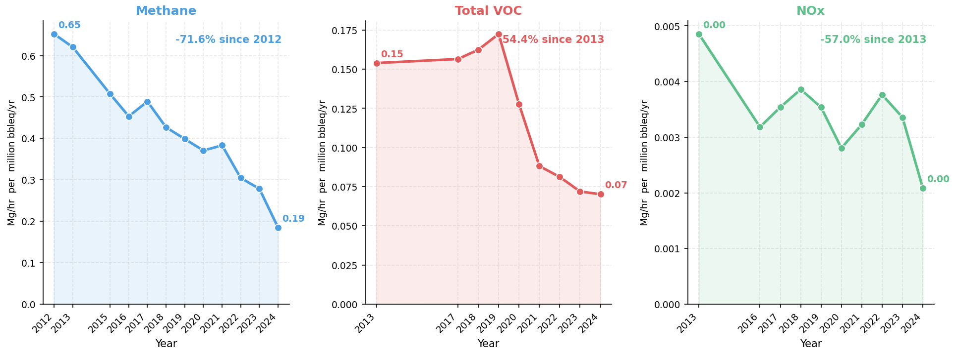
Methane, VOC, and NOx efficiency trends

Slide 24
Takeaways (preliminary):

Slide 25
Takeaways (preliminary):
Methane, VOC, and NOx emissions are a lot lower than a decade ago

Slide 26
Takeaways (preliminary):
Methane, VOC, and NOx emissions are a lot lower than a decade ago
Methane and VOC trends seem to track gas industry more than oil, but there are unexplored nuances

Slide 27
Takeaways (preliminary):
Methane, VOC, and NOx emissions are a lot lower than a decade ago
Methane and VOC trends seem to track gas industry more than oil, but there are unexplored nuances
NOx seems to track new well construction and maybe oil industry more than gas

Slide 28
Takeaways (preliminary):
Methane, VOC, and NOx emissions are a lot lower than a decade ago
Methane and VOC trends seem to track gas industry more than oil, but there are unexplored nuances
NOx seems to track new well construction and maybe oil industry more than gas
VOC is on the rise, including in 2024
VOC matters more than NOx for winter ozone

Slide 29
Takeaways (preliminary):
Methane, VOC, and NOx emissions are a lot lower than a decade ago
Methane and VOC trends seem to track gas industry more than oil, but there are unexplored nuances
NOx seems to track new well construction and maybe oil industry more than gas
VOC is on the rise, including in 2024
VOC matters more than NOx for winter ozone
Emissions are improving, but are not yet decoupled from oil and gas activity

