Slide 1
Uinta Basin Ozone Working Group Meeting
August 19th, 2020
Selection of chemistry mechanism strongly affects
photochemically-simulated winter ozone concentrations
in Uinta Basin
Trang Tran, Huy Tran, Marc Mansfield and Seth Lyman
Bingham Research Center – Utah State University
- Preliminary results -

Slide 2
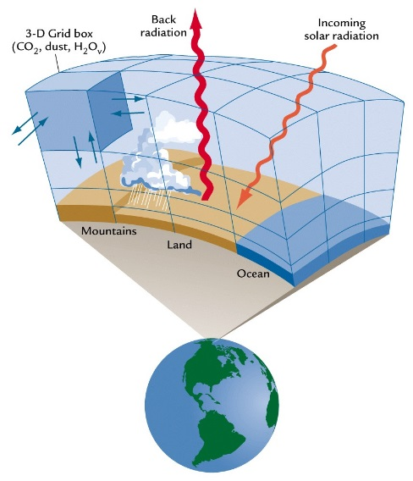
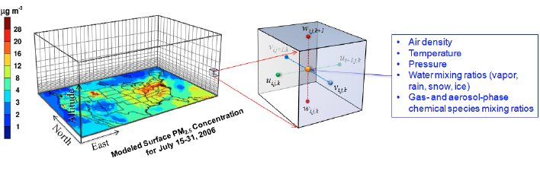
All three air-quality model components affect simulated ozone concentrations
Emissions
Meteorology
VOC/PM_{2.5} (tons/yr)
Component 3:
Air quality model
Chemistry mechanisms
Component 1:
Emission models
Component 2:
Meteorological model
Good air quality estimates

Slide 3
Important finding: the widely-used carbon-bond mechanism is deficient for simulations of winter ozone chemistry.
Low simulated ozone conc.
Bad Meteology
Bad Emissions
Bad Chemistry mech.

Slide 4
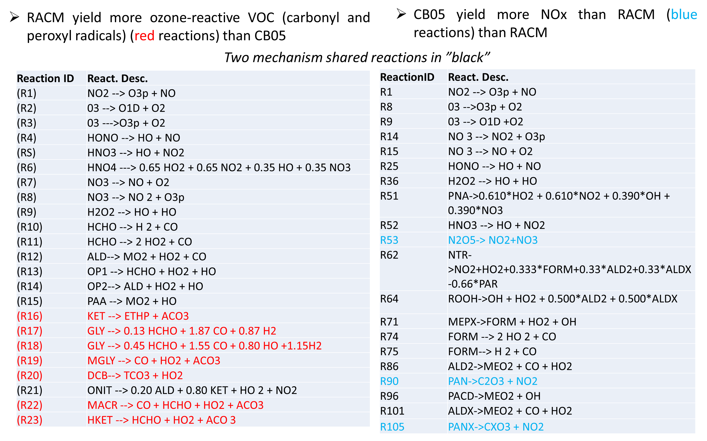
RACM
CB05

Slide 5
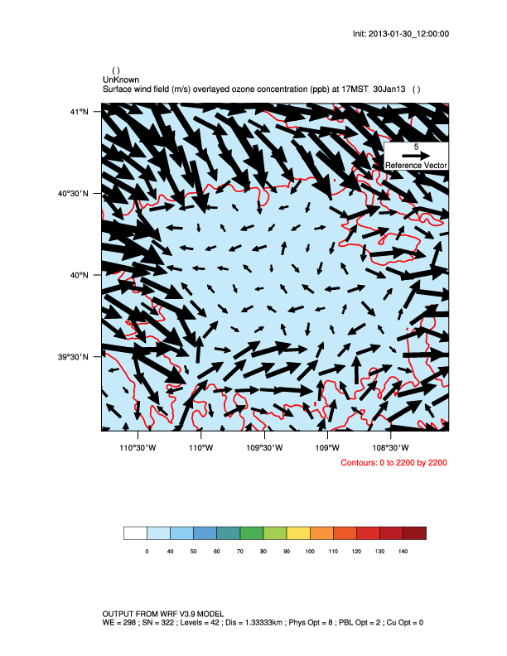
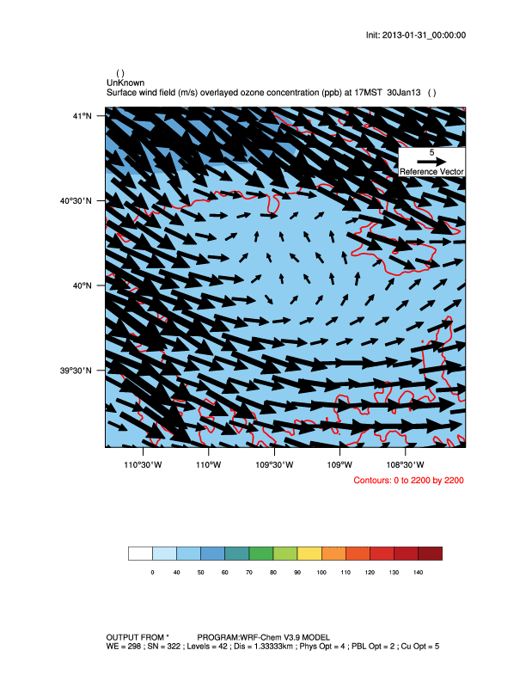
WRF-Chem simulations: test chemistry mechanisms CB05 vs RACM
WRF-CHEM CB5
WRF-CHEM RACM
VERNAL
VERNAL
OURAY
OURAY
NAAQS (70 ppb)
Notes:
5

Slide 6
Important finding: the widely-used carbon-bond mechanism is deficient for simulations of winter ozone chemistry.
Low simulated ozone conc.
Bad Met
Bad Emissions
Bad Chemistry mech.
CB05 was less ozone-reactive than RACM
CB05 resulted much lower ozone than RACM
NAQQS

Slide 7
UDAQ O&G 2014 bottom-up emission inventory simulated with RACM yielded higher ozone concentrations than simulated by CB6
NAQQS

Slide 8
Next steps:
Identify what reactions causing different behaviors yielded by CB05 and RACM mechanisms
Use box model (or run CAMx in box-mode) to test those reactions identified by the above step.
Expand sensitivity tests with other mechanisms (e.g., SAPRC, MOZART…) available for photochemical models for more throughout understanding of chemistry mechanism.
Incorporate “right-for-the-right-reason” mechanism into regulatory model (WRF-CAMx/CMAQ) to simulate winter ozone in Uinta Basin

