Slide 1

Automated, dynamic, SI-traceable field calibration of atmospheric elemental and oxidized mercury
Authors: Seth Lyman, Colleen Jones, KarLee Zager, Trevor O’Neil

Slide 2


Acknowledgements
Funding provided by the
U.S. National Science Foundation
Patents related to this work
10012622
10545123
Docket P23018.02 (pending)

Slide 3
The state of the science
Hg⁰ calibration:

Slide 4
The state of the science
Hg⁰ calibration:
NIST and others have primary standards, but no ambient-level field-ready standards

Slide 5
The state of the science
Hg⁰ calibration:
NIST and others have primary standards, but no ambient-level field-ready standards
Field instruments are calibrated with syringe injections from a saturated vapor source

Slide 6
The state of the science
Hg⁰ calibration:
NIST and others have primary standards, but no ambient-level field-ready standards
Field instruments are calibrated with syringe injections from a saturated vapor source
  Accuracy and stability challenges
  Not SI-traceable
  Few calibrations performed in practice

Slide 7
The state of the science
Hg^{II} calibration:

Slide 8
The state of the science
Hg^{II} calibration:
No commercial options for ambient levels

Slide 9
The state of the science
Hg^{II} calibration:
No commercial options for ambient levels
Lack of calibration led to ~20 years of resources wasted on biased KCl denuder-based Hg^{II} measurements

Slide 10
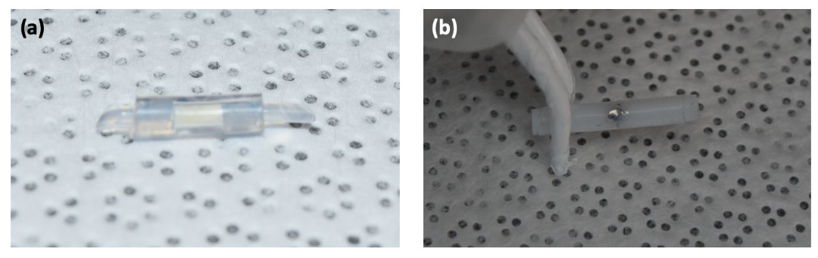
We are putting our effort
into permeation tube methods
First used by Landis et al., 2002?

Slide 11
We are putting our effort
into permeation tube methods
Capable of low, continuous emission rates
Shown to work in real field conditions
Simple (Tekran 2537 uses permeation tubes for internal calibrations, but it is neither independent nor SI-traceable)

Slide 12
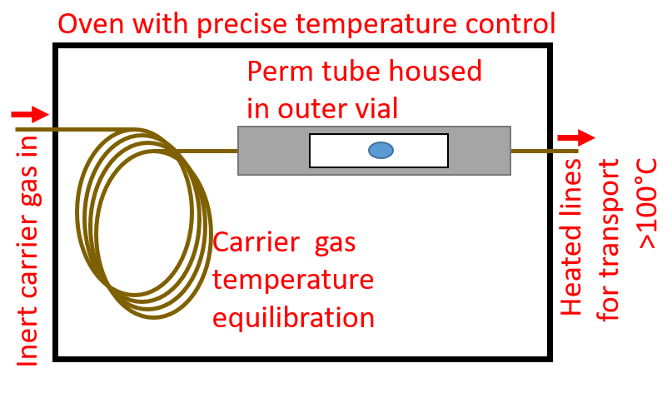
Basic principles of our method

Slide 13
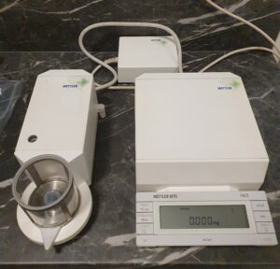
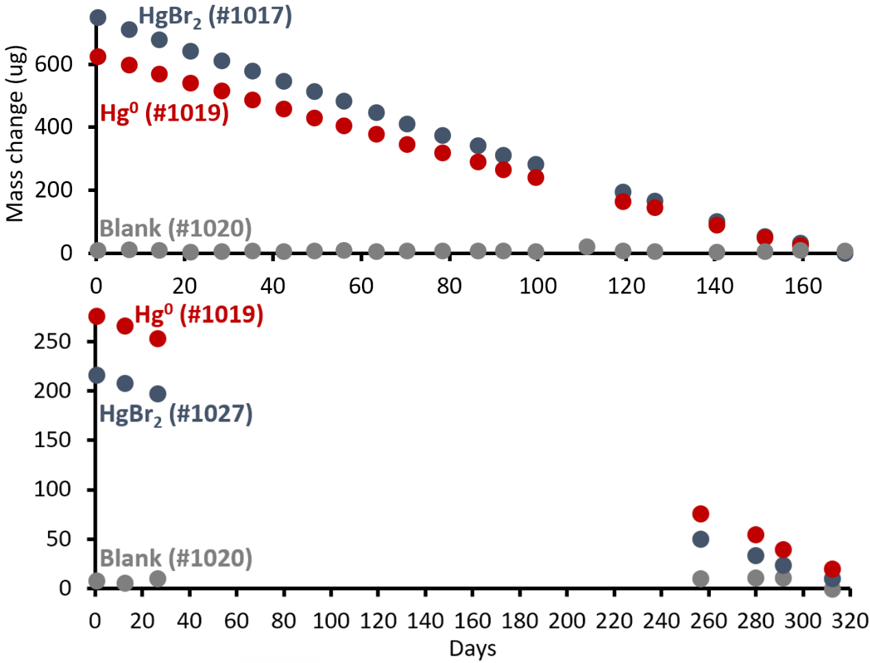
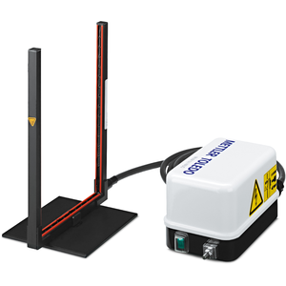
SI-traceable gravimetric verification of permeation rate
Elgiar et al., 2024

Slide 14
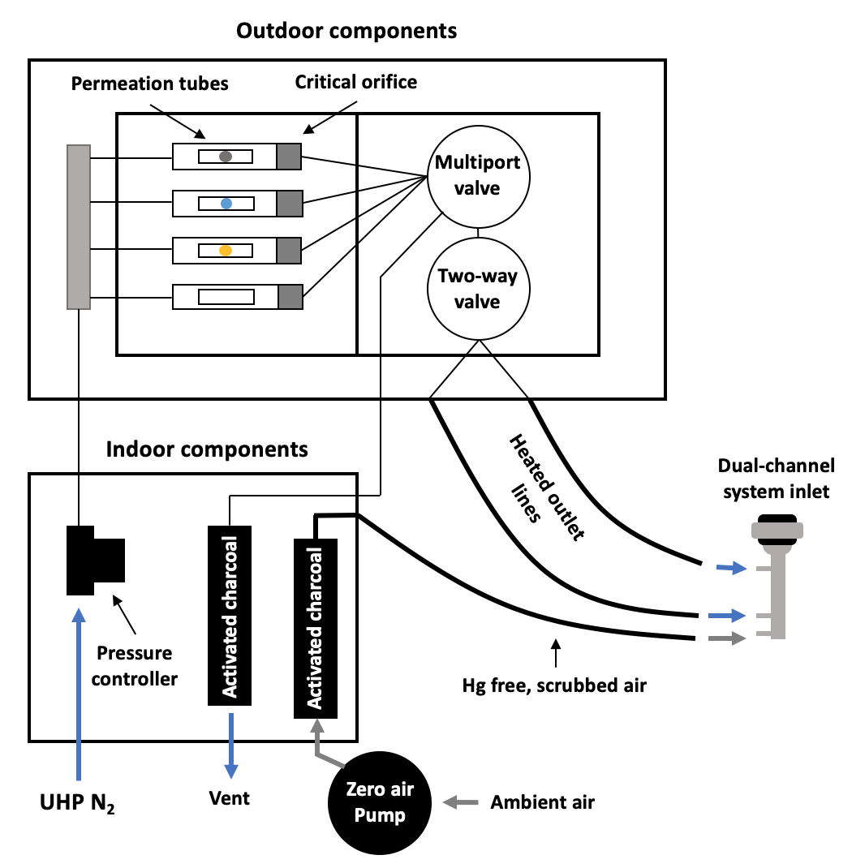
Independent determination of SI traceability
(Elgiar et al., 2024)

Slide 15
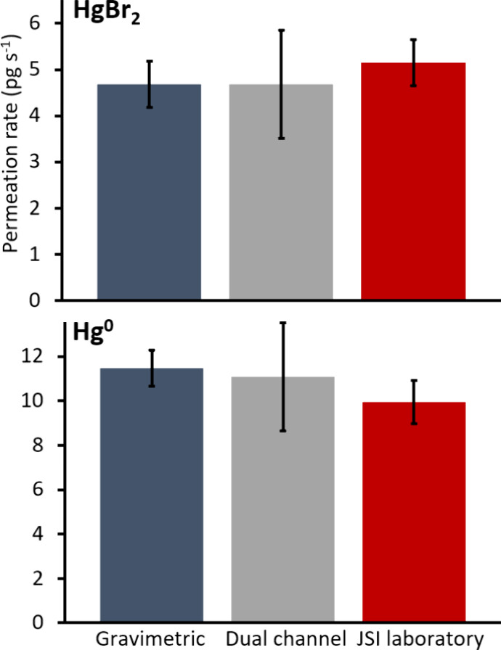

Independent determination of SI traceability
(Elgiar et al., 2024)

Slide 16
Two remaining problems

Slide 17
Two remaining problems
Hg^{II} permeation rates are too high
  Lowest we can do is ~100X ambient levels

Slide 18


Two remaining problems
Hg^{II} permeation rates are too high
  Lowest we can do is ~100X ambient levels

Slide 19
Two remaining problems
Hg^{II} moves slowly through all tubing materials
  1-2 hr tubing equilibration times needed

Slide 20
Two remaining problems
What our automated system tried
(and failed at):

Slide 21
Two remaining problems
What our automated system tried
(and failed at):
10-sec injection

Slide 22
Two remaining problems
What our automated system tried
(and failed at):
10-sec injection
140-sec pause

Slide 23
Two remaining problems
What our automated system tried
(and failed at):
10-sec injection
140-sec pause
10-sec injection

Slide 24
Two remaining problems
What our automated system tried
(and failed at):
10-sec injection
140-sec pause
10-sec injection
140-sec pause

Slide 25
Two remaining problems
What our automated system tried
(and failed at):
10-sec injection
140-sec pause
10-sec injection
140-sec pause
We overcame that problem by manually inserting into inlet

Slide 26
Two remaining problems
Step 1: Equilibrate for 2 hours by flowing Hg output to ambient air

Slide 27
Two remaining problems
Step 2: Manually insert calibrator outlet into analyzer for 10 sec

Slide 28
Two remaining problems
Step 3: Vent for 140 sec

Slide 29
Two remaining problems
Repeat steps 2 and 3 over and over

Slide 30
Two remaining problems
But this is neither routine nor automated, which was our goal

Slide 31
New system: dynamic draw-off

Slide 32
New system: dynamic draw-off

Slide 33
New system: dynamic draw-off
MFC to deliver inert gas

Slide 34
New system: dynamic draw-off
Another MFC to draw off a portion of the Hg+inert gas
MFC to deliver inert gas

Slide 35
New system: dynamic draw-off
Another MFC to draw off a portion of the Hg+inert gas
MFC to deliver inert gas
Custom, ultra-inert venturi flow measurement to measure remaining flow

Slide 36
New system: dynamic draw-off
Another MFC to draw off a portion of the Hg+inert gas
MFC to deliver inert gas
Remaining flow
Fractional
dilution rate
=
Total original
flow
Custom, ultra-inert venturi flow measurement to measure remaining flow

Slide 37
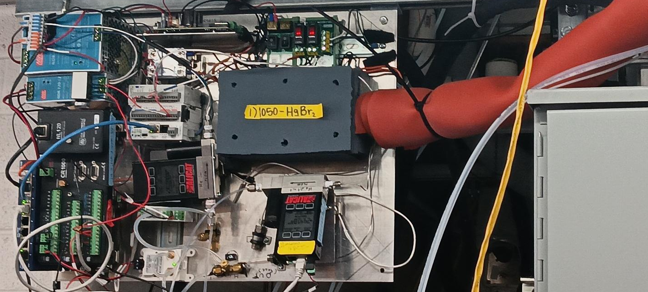
New system: dynamic draw-off

Slide 38
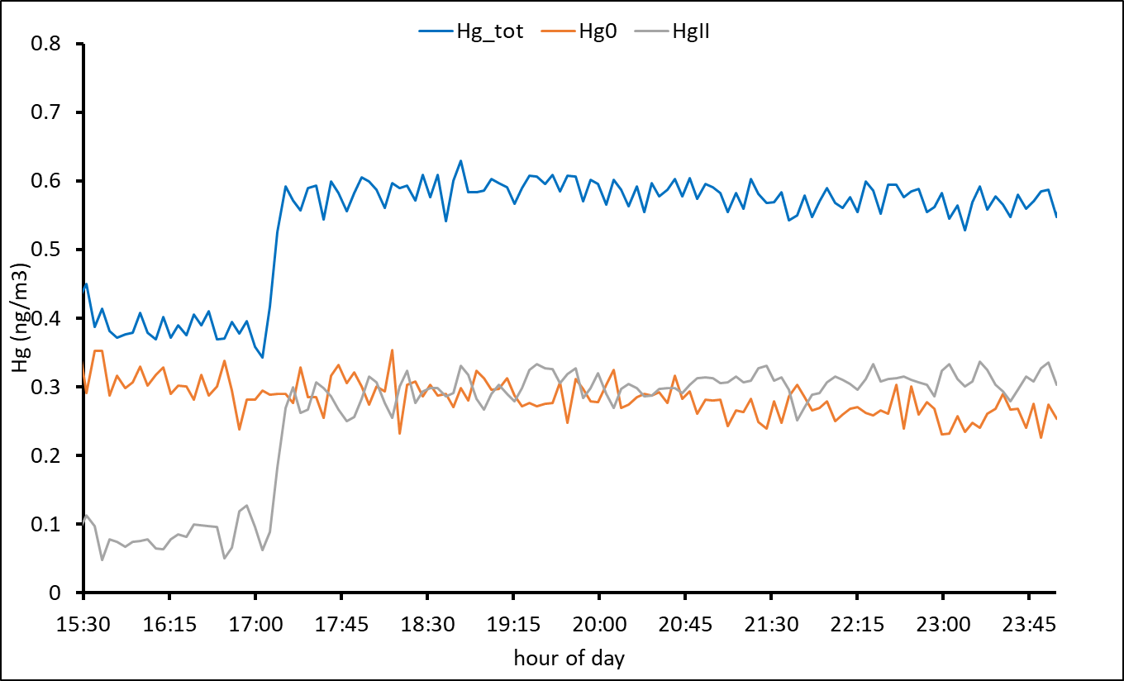
The system appears to be working

Slide 39
The system appears to be working
~10-min equilibration time

Slide 40
The system appears to be working
~10-min equilibration time
Mostly Hg^{II}

Slide 41
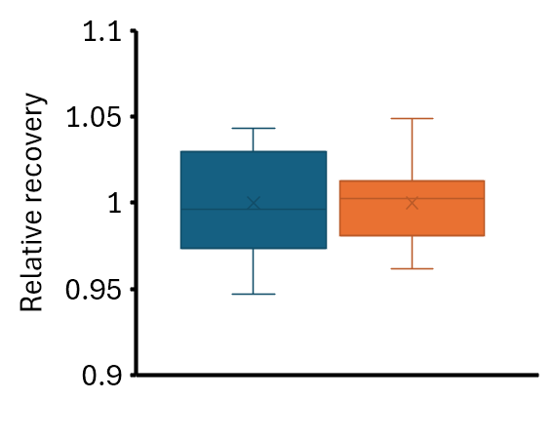
The system appears to be stable
at different permeation rates
1.9% of original flow remaining
0.25 pg/s effective calibration rate
3.0% of original flow remaining
0.40 pg/s effective calibration rate

Slide 42
Remaining challenge with the new system

Slide 43
Remaining challenge with the new system
Small drifts in flow measurements lead to unacceptable uncertainty in output.
Lots of flow measurements are underway to resolve this.

Slide 44
Where we are now
Hg⁰

Slide 45
Where we are now
Hg⁰
SI-traceable

Slide 46
Where we are now
Hg⁰
SI-traceable
Field ready

Slide 47
Where we are now
Hg⁰
SI-traceable
Field ready
Automated

Slide 48
Where we are now
Hg⁰
SI-traceable
Field ready
Automated
Dynamically adjusted calibration amount

Slide 49
Where we are now
Hg^{II}

Slide 50
Where we are now
Hg^{II}
SI-traceable

Slide 51
Where we are now
Hg^{II}
SI-traceable
Field ready

Slide 52
Where we are now
Hg^{II}
SI-traceable
Field ready
Automated

Slide 53
Where we are now
Hg^{II}
SI-traceable
Field ready
Automated
Dynamically adjusted calibration amount

Slide 54
Let’s talk
Seth Lyman, PhD
Utah State University
seth.lyman@usu.edu
(435) 630-1433

