Slide 1
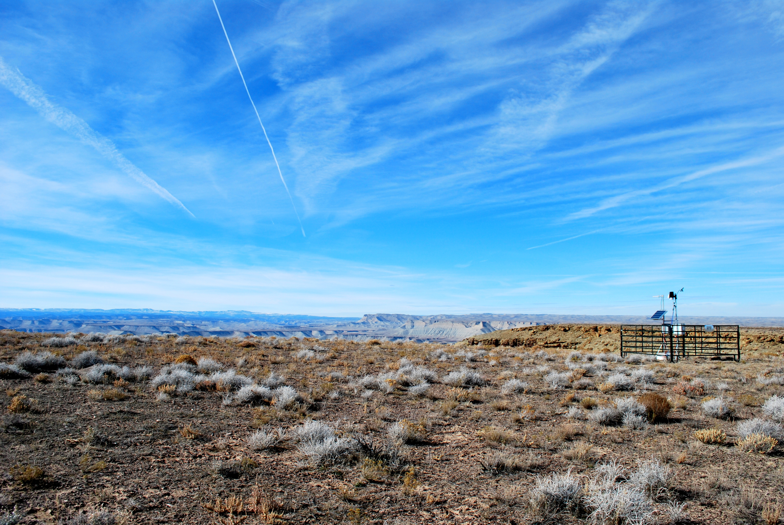


Trends in Uinta Basin-wide methane emissions
Seth Lyman
Tristan Coxson
John Lin, University of Utah

Slide 2
USU’s work was funded by the Utah Legislature and Uintah Special Service District 1, and the National Oceanic and Atmospheric Administration.

Slide 3
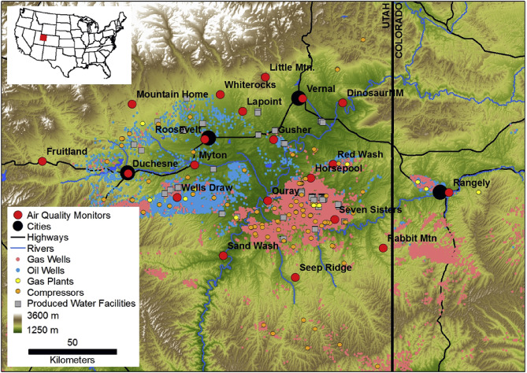
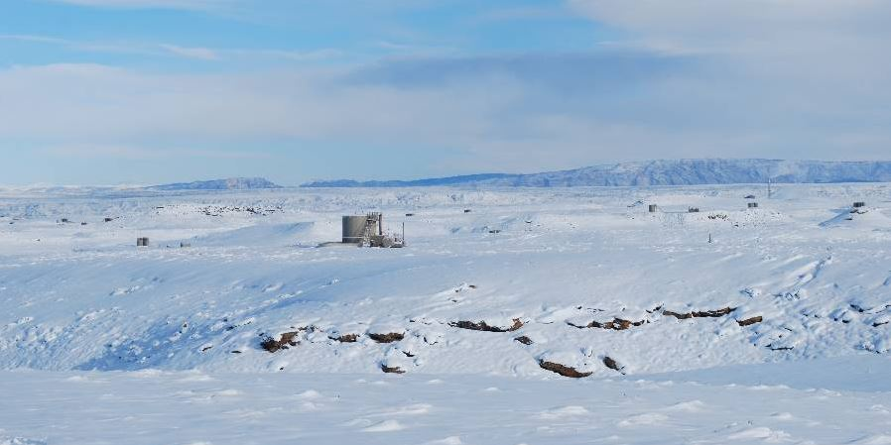
Utah’s Uinta Basin has high wintertime ozone due mostly to pollution from the oil and natural gas industry

Slide 4
How much pollution is emitted?
Is it changing?
If so, why?

Slide 5
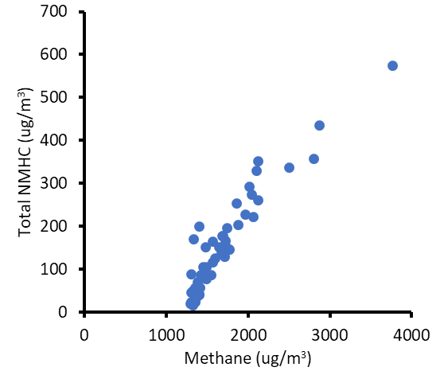
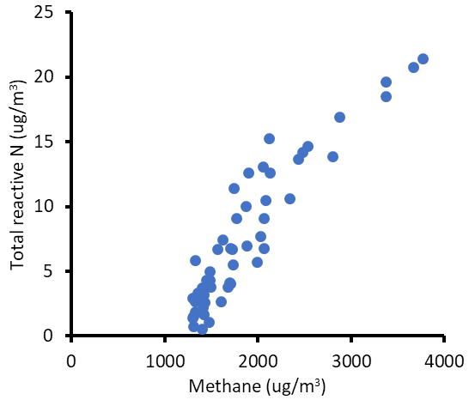
Here, we use methane as a proxy for all oil and gas-related pollution emissions

Slide 6
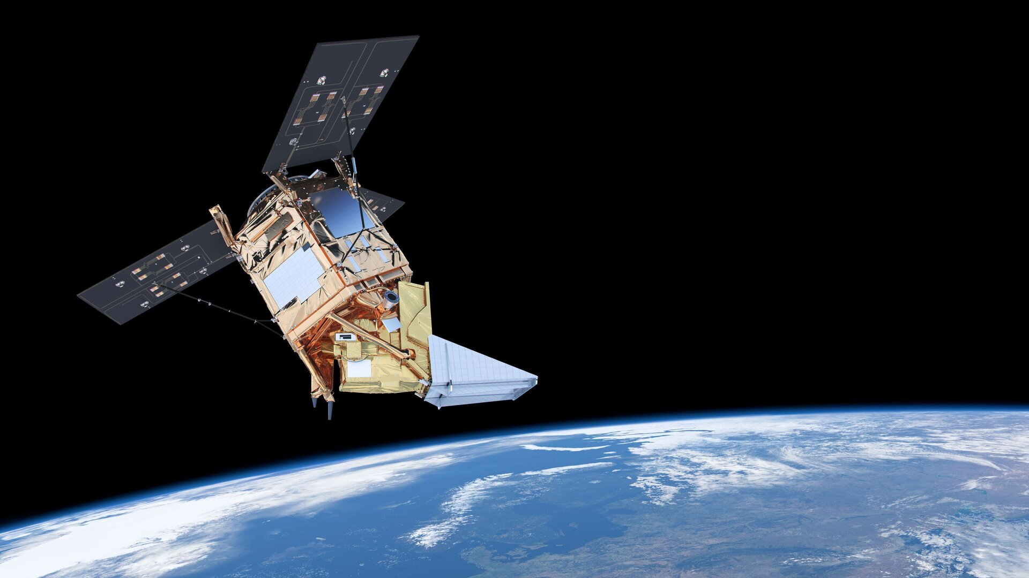
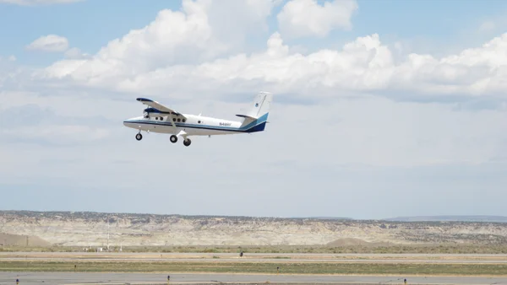
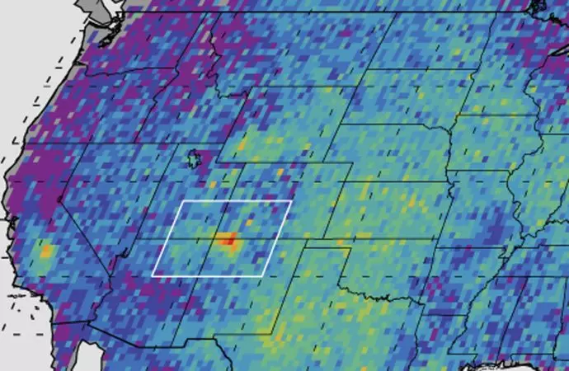
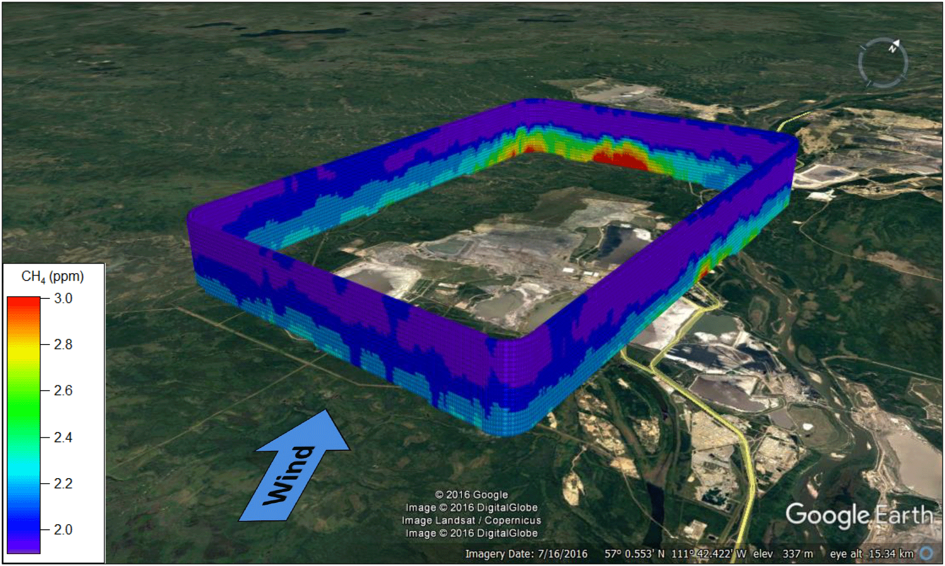
Emissions measurements can be made at different spatial scales
This presentation concerns basin-scale
measurements

Slide 7
Emissions measurements can be made at different spatial scales
Field and basin scales
  PROS: stability, lack of localized effects
  CONS: little information about specific sources

Slide 8
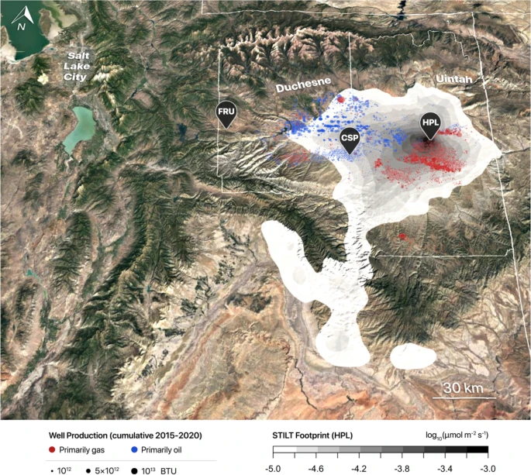
Basin scale estimate by Lin et al. (2021)
Lin, John C., et al. Scientific reports 11.1 (2021): 22291.

Slide 9
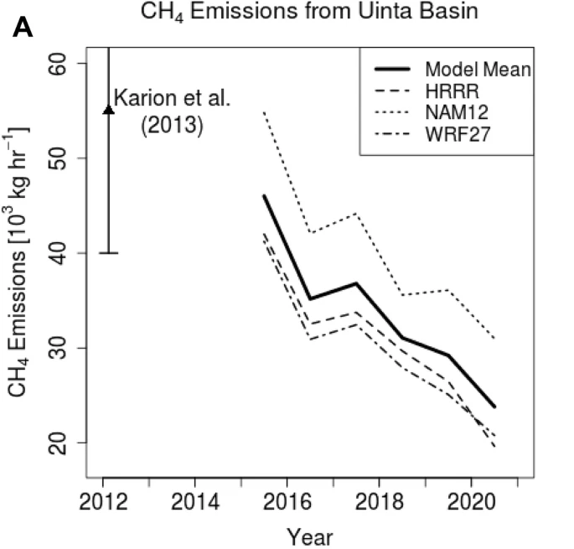
Basin scale estimate by Lin et al. (2021)
Lin, John C., et al. Scientific reports 11.1 (2021): 22291.

Slide 10
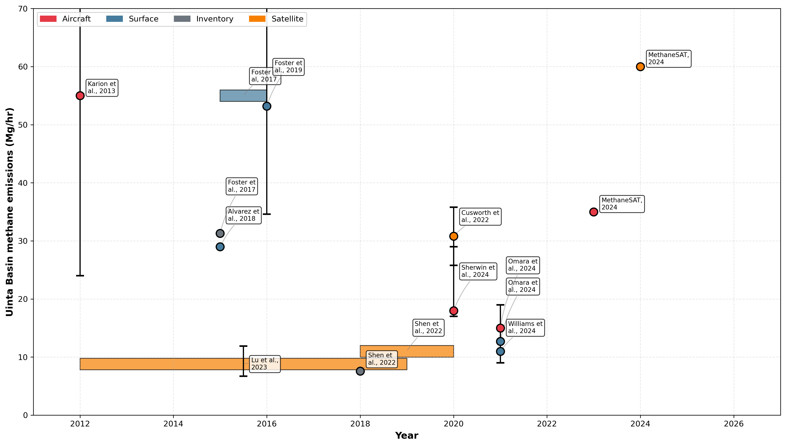
Other existing Basin-scale Estimates

Slide 11


New Basin-scale estimates using inverse modeling with TROPOMI and GEOS-Chem
Integrated
Methane
Inversion
Prior Emissions
Posterior Emissions
Varon, Daniel J., et al. Atmospheric Chemistry and Physics Discussions 2022 (2022): 1-26.

Slide 12
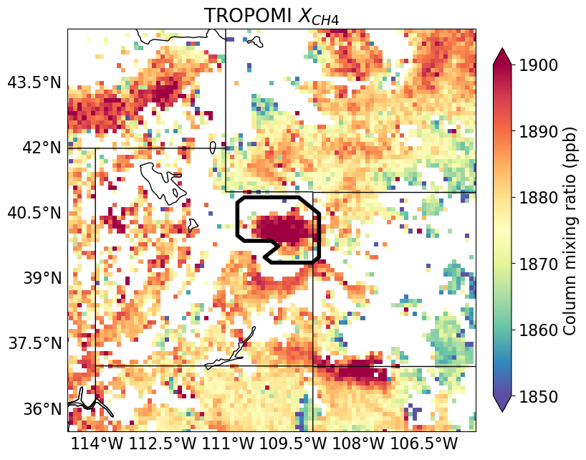
TROPOMI methane
Average for November-December 2021

Slide 13
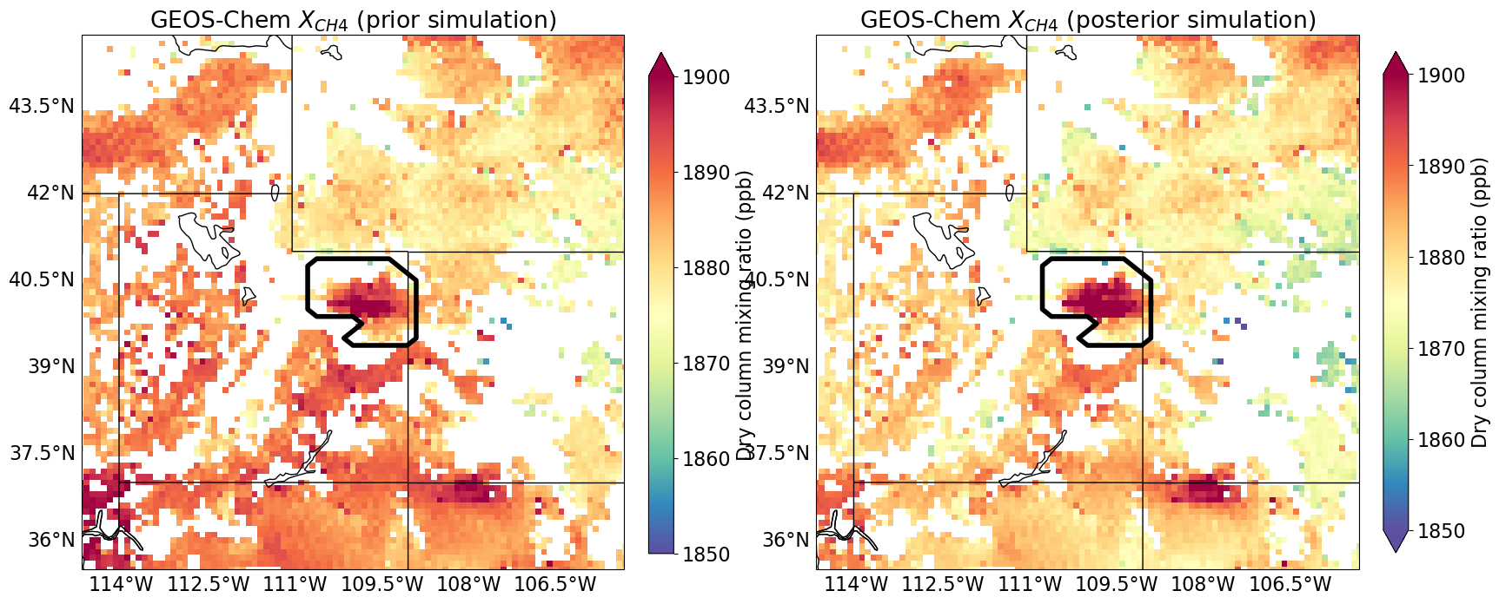
GEOS-Chem methane mixing ratio
PRIOR
POSTERIOR

Slide 14
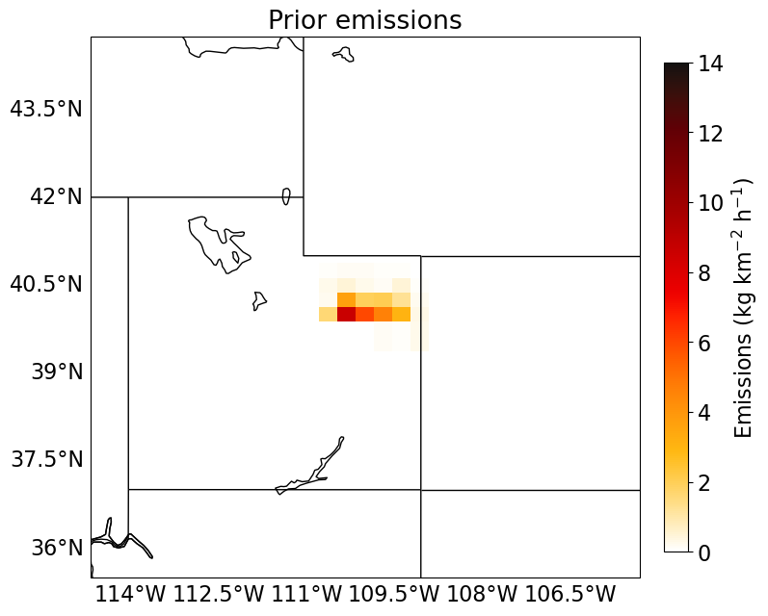
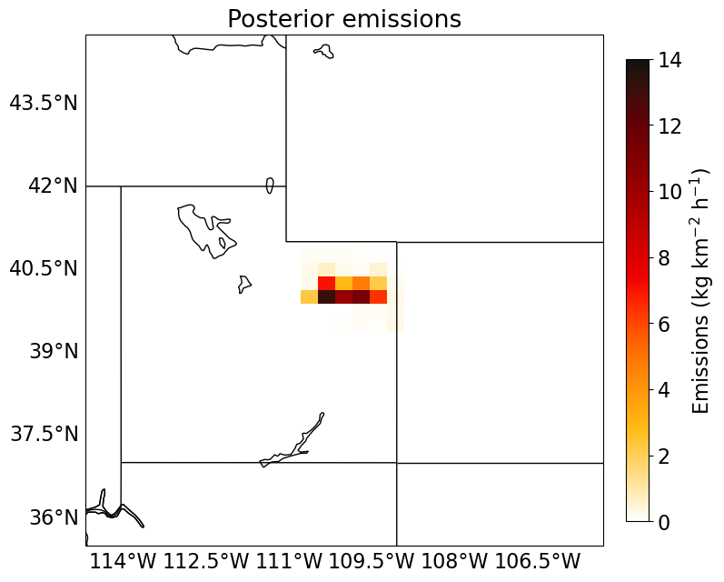
GEOS-Chem methane emissions
PRIOR
POSTERIOR

Slide 15
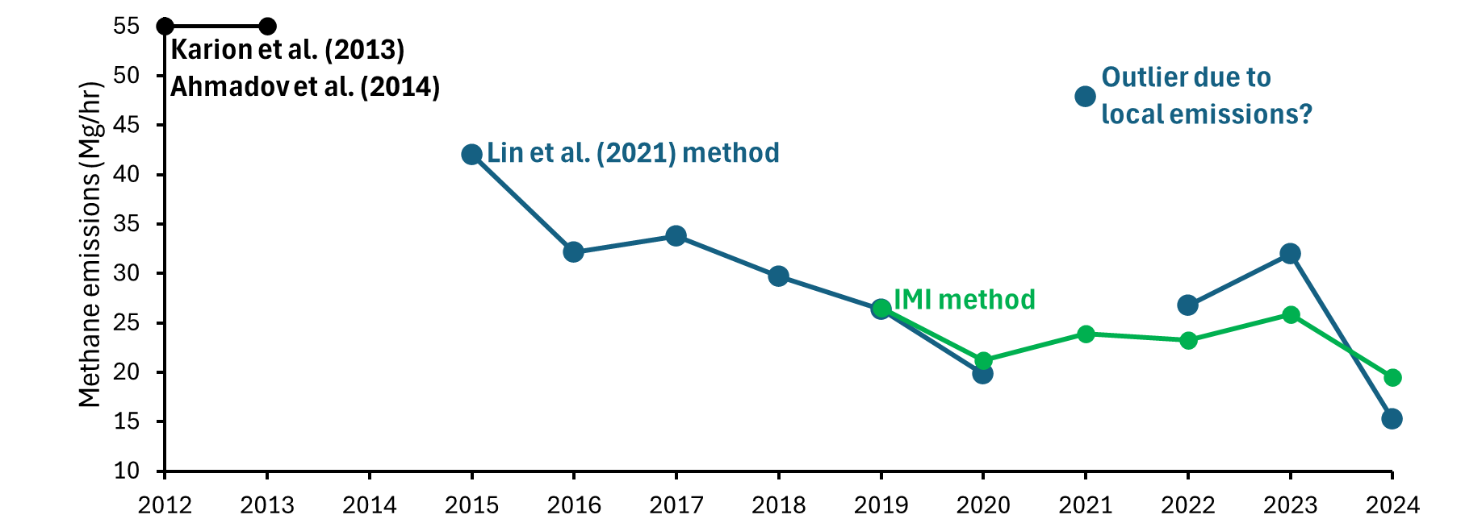
Methane emissions trend

Slide 16
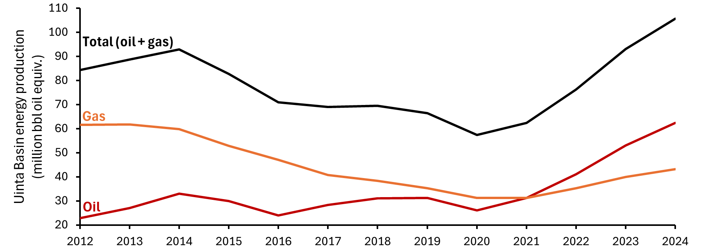
Energy production trend

Slide 17
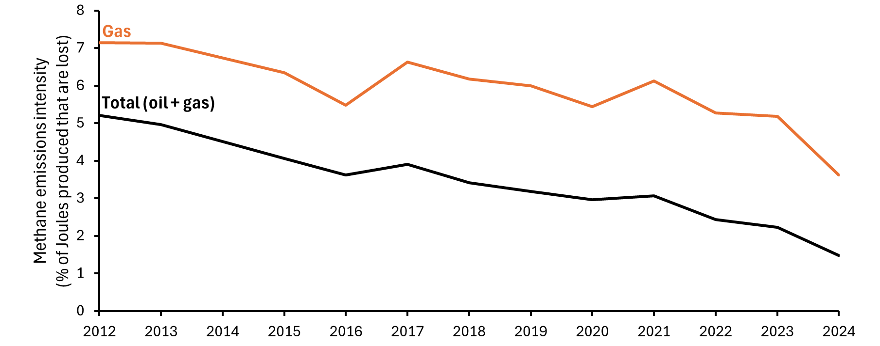

Slide 18
EPA CFR40, Part 60, Subpart OOOO
rules implemented

Slide 19
First round of Utah DAQ R307-500 series rules implemented

Slide 20
Full compliance with EPA CFR40, Part 60, Subpart OOOOa required

Slide 21
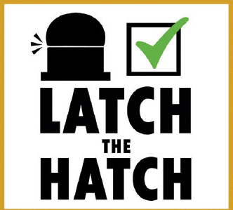
Utah Petroleum Association rolls out Latch the Hatch program

Slide 22
Original compliance date for EPA CFR40, Part 60, Subpart OOOOb (since postponed)

Slide 23
Full compliance with EPA FIP for Indian Country Lands required

Slide 24
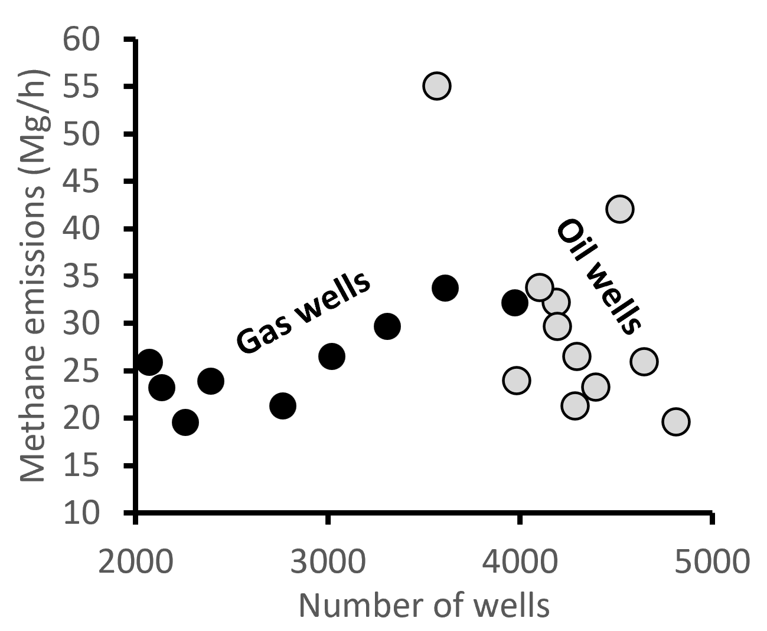
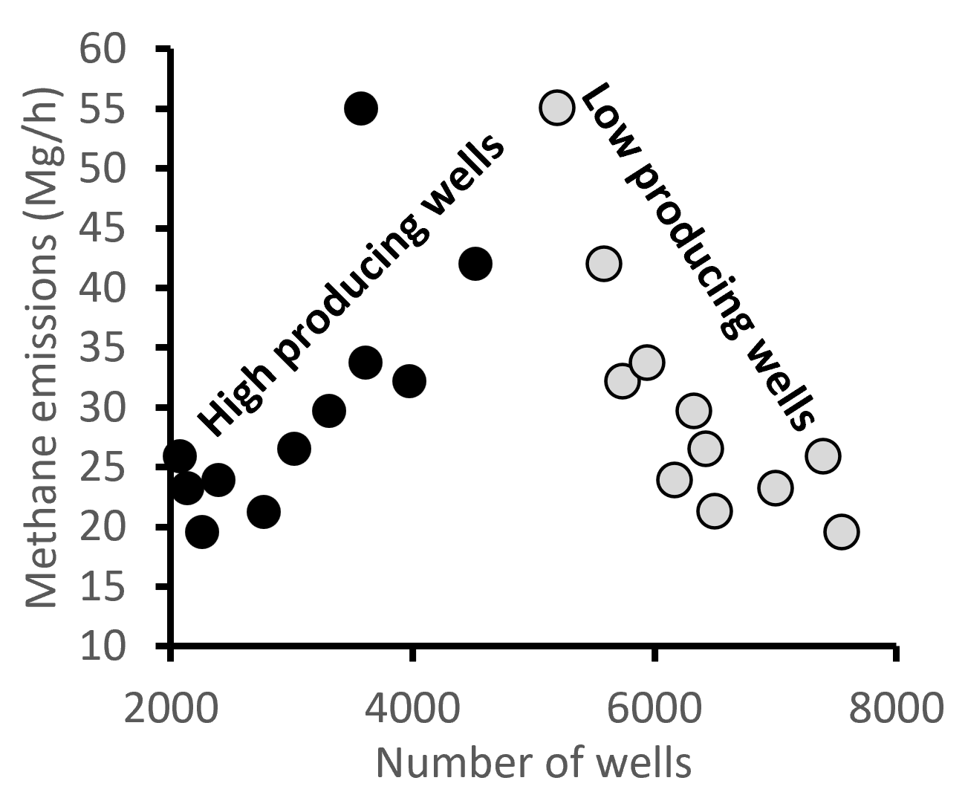
Annual emissions correlate with gas wells and high-producing wells

Slide 25
Annual emissions correlate with gas wells and high-producing wells
Why gas wells? Because they emit more methane than oil wells

Slide 26
Annual emissions correlate with gas wells and high-producing wells
Why high-producing wells? Because they emit more methane than low-producing wells

Slide 27
Is this helping winter ozone?

Slide 28
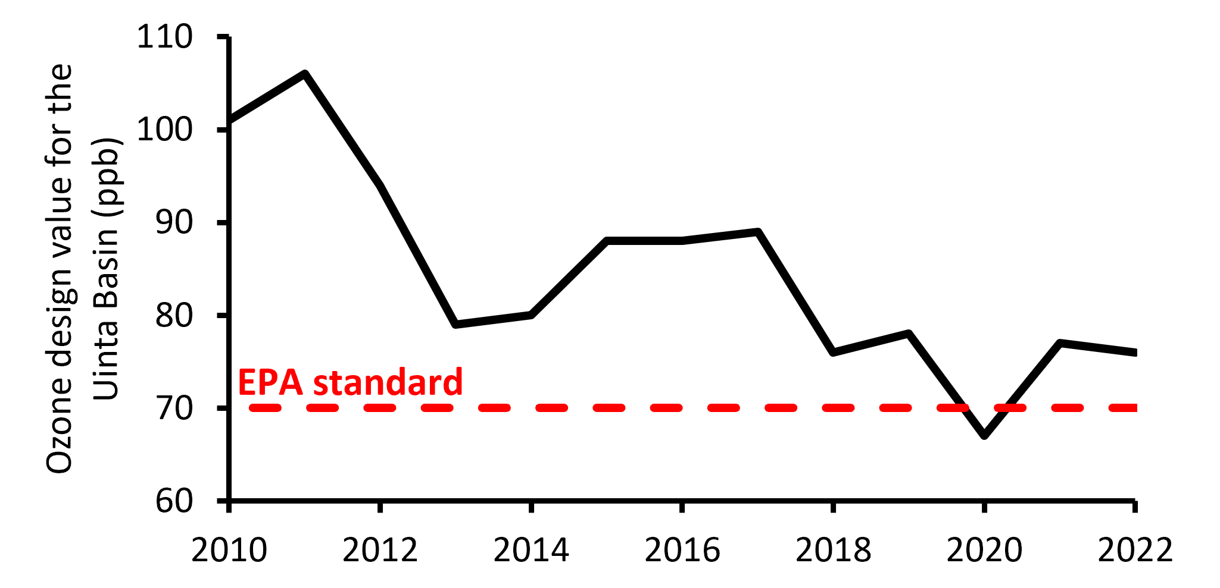
Is this helping winter ozone? YES

Slide 29
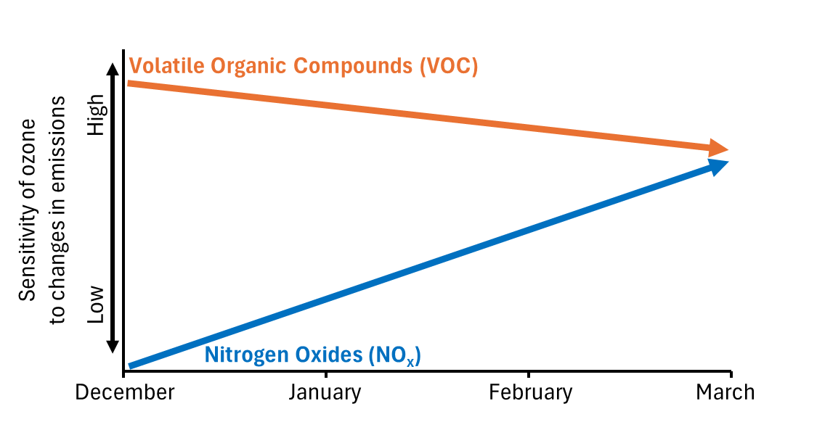
All emissions reduction actions have targeted VOC (or methane), which the right target.
Mansfield et al., 2025

Slide 30
If you want to play around with the data, visit
basinenergy.info

