Slide 1
Club Sports Fall Training
August 26, 2021

Slide 2
Introductions of personnel
Director of Campus Recreation- Daniel Lawrence
Associate Director of Campus Recreation- Katie Burns
Assistant Director of Healthy Lifestyle Programs and Community Engagement – Amanda Bray
Coordinator of Competitive Sports – Bailey Adams
Athletic Trainer – Kendra Gilmore

Slide 3
Introduction and organization
List of current clubs
Personnel/their roles
Officers
Notes:
Jaclyn has all of these slides

Slide 4
List of current clubs
Aggiethon
Baseball Club
Cycling Club
Esports Club
Figure Skating Club
Golf Club
Men's Hockey Club
Women's Hockey Club
Jump Rope Club
Men's Lacrosse Club
Women's Lacrosse Club
Pickleball Club
Powerlifting Club
Racquetball Club
Rodeo Club
Men's Rugby Club
Women's Rugby Club
Swim and Dive Club
Men's Soccer Club
Women's Soccer Club
Tennis Club
Men's Ultimate Club
Women's Ultimate Club
Men's Volleyball Club
Women's Volleyball Club
Notes:
The program is administered by the Campus Recreation Department, which offers professional guidance to the teams within the Club Sport Program. Each team is formed, developed, governed and administered by the student membership of that particular club working with the Campus Recreation Department. The key to the success of this program and each team is student leadership, interest, involvement, and participation.

Slide 5
Personnel/their role
Amanda:
Assist assigned teams with day-to-day operations, finances, student development
Bailey:
Assist assigned teams with day-to-day operations, finances, student development
Kendra:
Injury prevention and care, rehabilitation, emergency response and first aid
Executive Council:
Club Sport Community Service, Club Sports Funtivities, Team Disciplinary Actions, and Budget Presentations/Allocations
Other professional staff assist with the following:
Scheduling, Travel, Trademark/Licensing, etc.
Officers/Coaches:
Informing comp sports staff of team schedules, attending activities, etc.

Slide 6
Team officers
President
Vice President
Travel/Safety (must have CPR/AED/First Aid Certification)
Treasurer
Secretary
Other (social media, events manager, etc.)
*All roles are not required, but within your club you decide what you feel you need to run the program

Slide 7
Standards of conduct
General
Representation
Hazing
Disciplinary Procedures
Notes:
Jaclyn has all of these slides

Slide 8
General
Assume an obligation to conduct themselves and their organizations in a manner compatible with the University’s function as an educational institution.
All team members must maintain high standards of behavior and sportsmanship both on and off the field.
When visiting other campuses, team members are expected to respect local laws, regulations and authorities, and the same standards hold true for teams being hosted by Utah State University.

Slide 9
representation
As representatives of the University, team uniforms/gear easily identify team members and it is important that team members DO NOT wear team jerseys, sweatshirts, etc., while at a drinking/party situation.
There are NO drugs, alcohol, or other illegal substances allowed in vehicles, hotels/motels, or University facilities while on a team trip or at a team function. There is NO underage drinking allowed ever. As team members, you are responsible for the actions of your teammates, which affect the entire program.
If an incident does occur, please contact the Assistant Director of Healthy Lifestyle Programs and Community Engagement (Amanda) and inform them of the situation BEFORE they hear it from someone else.

Slide 10
Hazing
If a Club Sports team is found in violation of the Utah State University hazing policy, it will result in disciplinary action to be taken and may be grounds for suspension.
Just a few examples
Endangers the mental or physical health or safety of another
Involves consumption of any food, alcoholic beverage, drug, or other substance or any other physical activity that endangers the mental or physical health and safety of an individual
Involves any activity that would subject the individual to extreme mental stress, such as sleep deprivation, extended isolation from social contact
Involves defacing or destroying public or private property

Slide 11
Individual Disciplinary procedures
Failure of any team member to abide by the rules, policies, and procedures of the Club Sport Program while on Club Sports time or any conduct unbecoming to the team and detrimental to the University will result in one or more of the following penalties or disciplinary measures:
Warning or reprimand - written or verbal.
Probation in team participation - continued team participation will be based upon the team member satisfying certain requirements as specified by the Club Sports Executive Council or by the Assistant Director of Competitive Sports as situations require.
Suspension from team participation - temporary dismissal from team activities for a specified time, after which the team member will be eligible to return.
Withholding of transcripts for non-payment of team dues or refusal to return University property.
If necessary, University disciplinary offices may be involved.
Notes:
Club Sports time (travel, events, home games, etc.),
The Club Sports Executive Council may assist in this process alongside the Assistant Director of Competitive Sports

Slide 12
Team disciplinary procedures - Minor
Minor infractions include, but are not limited to:
Failure to submit required documents such as; Travel Authorization forms, injury reports, driver forms/tests, budgets, etc.
Second offense of improper social media or web content
Failure to maintain an accurate inventory of equipment/uniforms, etc.
Failure to have all participants have tryout waivers completed prior to registering on DoSportsEasy
Failure to clean up fields after events or to keep spectators off of fields during events.
Teams using fields they have not scheduled or occupying “Open Rec” scheduled space as a team.
Minor infractions will result in a warning given to the team and a $25 to $75 fine.
Notes:
Club Sports teams who do not follow proper policies and procedures as outlined in the Club Sport Manual and/or by the University while on Club Sports time (travel, events, home games, etc.) will be subject to being placed on probation or being suspended from the Club Sport Program. Punishments for infractions will be determined and imposed by the Assistant Director of Competitive Sports with assistance from the Club Sports Executive Council.

Slide 13
Team Disciplinary Procedures - Major
Major infractions include, but are not limited to:
Two or more minor infractions
Misuse of team funds and/or abusive use of team funds (including having a negative balance)
Not following proper purchasing procedures
Failure to submit University required paperwork, i.e. medical waivers, participant forms, team rosters, travel authorizations, eligibility forms etc.
Displaying conduct that is incompatible with the University’s function and purpose and the purpose of the Club Sport Program (i.e., unsportsmanlike behavior toward officials or opponents or inappropriate behavior on trips.)
Destruction of property or equipment
Not getting approval for logos and word marks, or misuse of them. All designs must be approved!
Allowing ineligible individuals to participate in team activities. Ineligibility can be caused by lack of waivers, low inaccuracy credits carried, NON USU student etc.

Slide 14
Team Disciplinary Procedures - Major
A $300 - $1,000 fine will be assessed for every major infraction. If more major infractions occur, or if the 1st infraction is serious enough, the following actions may also be taken:
Probation (will last one year to date of punishment unless otherwise noted)
Funds frozen
Loss of funding and/or facility usage
Suspension of Club Sport status on campus
The Assistant Director of Healthy Lifestyle Programs and Community Engagement will notify the team representatives in an email about major infractions. This email will state the reason for the infraction, the possible/probably consequences of the infraction. It is also likely a meeting will take place between the team officers, the Assistant Director, and Coordinator of Competitive Sports. The Club Sports Executive Council will also assist in deciding the consequences per situation.

Slide 15
Team Membership
National affiliation
Benefits of Being a Club Sport
Executive council
Notes:
Emma

Slide 16
National affiliation
All teams must belong to a national league or association and need to be aware of the rules and regulations of their governing body, as well as their individual leagues.
As all teams are members of associations, the Campus Recreation Department at Utah State University is a proud member of NIRSA, Leaders in Collegiate Recreation. The majority of professional staff and some student employees are member of NIRSA, and have access to wonderful development opportunities.

Slide 17
Benefits of being a club sport
Priority in scheduling Campus Recreation facilities, free on-campus storage
Access to specific university logos for marketing and apparel
Administrative/secretarial support through the Campus Recreation Office
Limited funding, credit card usage, mail services, fax service, copy machine access
Access to University Motor Pool vehicles for travel, and has a Travel Specialist who books all travel
Athletes can receive one course credit per semester after having the Assistant Director of Healthy Lifestyle Programs sign the Registration Form.
Donors and Sponsors can receive tax-write off through giving as approved by Advancement Services
Notes:
Emma

Slide 18
Executive council
Executive Council will work closely with the Assistant Director of Healthy Lifestyle Programs and Community Engagement and Coordinator of Competitive Sports on a number of items.
This council’s responsibilities include;
assist in deciding the distribution of allocations
disciplinary actions
reviewing new team applications
community involvement (service projects)
club sport activities
end of year banquet
how to better the experience and retention of participation in Club Sports
comprised of members from different teams to represent all Club Sports athletes
Applications are due Friday, September 10!!!
Notes:
Emma

Slide 19
Team responsibilities & requirements
Recruitment
Participant Eligibility
Online registration
Faculty/staff advisors
Coaches
Team member responsibilities
Notes:
Emma

Slide 20
recruitment
Aggie Nights Event in the ARC/ALF:
Required!
August 28th 7pm-11pm
Day on the Quad:
Required!
September 1st , 2019 10am-3pm
Updated website and social media outlets
Flyers posted on campus
Fill out marketing requests for items such as fliers, content for social media, team photoshoots for web pages, video requests located on Club Sport Resources page
Notes:
Emma

Slide 21
Participant eligibility
Non-discrimination on the basis of gender, sexual identity, race, color, national origin or handicap. Any USU student will be given the opportunity each year to try out for or join a Club Sport.
Faculty and/or staff are not eligible to participate in USU Club Sports
All USU students participating in Club Sports must be registered for a minimum of 12 academic credits and maintain a cumulative 2.0 GPA or higher.
Graduate students must be registered for at least 6 credits and a 3.0 GPA.
Ineligible players are not allowed to travel or participate in any practices, games, or competitions.
In some cases, students may be required to carry more credits and/or maintain higher GPA standards to be in compliance with national governing body guidelines
Notes:
Emma
If individuals do not meet the minimum requirement, and their league doesn’t have any specific requirements, it is at the ADCS discretion if they are allowed to compete. Each situation is unique, and Executive Council could be involved in the decision process.
All officers must complete the FERPA training (FERPA Training) and must notify the Assistant Director of Competitive Sports.

Slide 22
Online registration
Each member of a Club Sport team must complete the registration process via DoSportsEasy and pay dues through Fusion through their member portal. This includes electronically signing documents. You may also visit the Team Resource Page to find the links for both these websites
- Go to our https://usufusionweb.aggies.usu.edu/ to pay for your dues
- Go to https://www.usu.edu/campusrec/club_sports/dserec to complete your registration process to become a member on your select club
Notes:
Emma
New process!

Slide 23
coaches
Coaches have the responsibility for the following:
Signing the Coach Agreement, and become familiar with Club Sport Manual.
Assist with recruiting, developing, and improving skills of players.
Help enforce all Risk Management Policies, and develop/employ safety procedures.
Enforce rules and regulations and promote good sportsmanship and overall conduct on and off the field.
Notes:
Emma
Each team has the option to secure the services of one or more coaches. If a team chooses to have a coach it is the responsibility of the team to find and secure a qualified coach. The coach must fill out the appropriate paperwork and carry his/her own liability insurance. Under no circumstances are coaches allowed to be paid with team funds, by parents, students, etc. The coach may be a faculty or staff member or a member of the community not associated with the university.
NOTE: All team advisors and/or coaches are volunteers, and because of that volunteer status, are covered by the Worker’s Compensation Fund of Utah for any injury incurred during the performance of their responsibilities with their particular club.

Slide 24
Paying coaches
Individual clubs decide on coach’s set salary for the season Once decided, coach must apply to Club Coach position on Aggie Handshake and then meet with our HR Representative to complete paperwork.
Have them complete coach agreement on resource page and bring back to your direct report
Coach will need to log into Aggie Time for on field/court/ice time to make sure they are completing duties as coach (not how pay is determined, salary will be divided in biweekly pay for set season)
Must be salary based, can’t be paid with apparel or gifts
Club must email or meet with their direct report to discuss how the coach salary will be funded
Cannot use student allocations for this; fundraising only
Same sport clubs must talk with each other about set pay for coaches so that Title IX standards are met

Slide 25
Team member responsibilities
Be responsible for any equipment/uniform issued to you.
It is your responsibility to know the condition of your health , and it is strongly recommended that you have a physician’s exam before participation in your chosen sport.
It is your responsibility to know that violence, in any form, and directed against any opposing team member, officials, coaches, teammates, spectators or others on the scene is never permissible, no matter what the provocation.
It is your responsibility to know that you represent the University at any team event. An event begins when you leave campus and ends when you return.
It is your responsibility to cooperate with the Assistant Director of Healthy Lifestyle Programs and Coordinator of Competitive Sports in compliance with the regulations, policies and procedures as specified in the Club Sports Program Manual.
Notes:
Emma
This will be an online form each athlete must agree to

Slide 26
Finances
General
Revenue
Fundraising
Donations
Sponsorships
Dues
Allocation Money
Team Evaluation
Expenses
Equipment/Uniforms
Cash Reimbursements
Team Meals
Payment for Officials
Notes:
Jaclyn, Michael, and Colleen

Slide 27
general
In compliance with University policies, the use of off-campus accounts for student/university-funded programs is prohibited. Therefore, no Campus Recreation program may maintain a commercial checking or savings account.
All funds must be handled through the Campus Recreation Office. The most important reason for this requirement is to ensure that the Campus Recreation office has a full understanding of each of its programs financial activities. These guidelines also protect officers from being charged and possibly prosecuted for embezzlement under state statutes.

Slide 28
fundraising
All clubs must complete the Fundraising Application located on the Team Resources page before conducting fundraising event. List of fundraising options and policies for all student groups on campus can be found on the Team Resource Page.
AggieFunded – USU’s very own Crowdfunding platform. This is the only online option for teams to raise funds online. Please plan ahead and fill out an application online at www.aggiefunded.com
Teams may not go through GoFundMe or any type of other online funding, as teams will get 100% of the funds raised through AggieFunded.

Slide 29
donations
All donations for Club Sports teams can be done online through the Campus Recreation website on the Club Sport home page.
All donation checks must be mailed into the Campus Recreation office or delivered in person to the Aggie Recreation Center. The proper mailing address that should be used is:
USU Campus Recreation- c/o “your club sport”
Amanda Bray
7005 Old Main Hill
Logan, Utah 84322-7005

Slide 30
sponsorships
All solicitation to either individual people, business or companies must be approved prior to any communication done by a Club Sports coach, advisor, or athlete.
Similar to fundraising, clubs must complete the Sponsorship Application form located on the Team Resource Page prior to reaching out to any sponsors. Advancement will respond within 3 days with the approved list.

Slide 31
revenue
Every team has their own on campus bank account, that is monitored by Business Services. Your budget will be updated on DoSportsEasy
All athletes are required to pay dues. Dues should be paid using the online Fusion portal that can be accessed on the Club Sports website www.clubsports.usu.edu. Login is possible with the student’s USU A# and banner password. Team presidents must make arrangements with their direct report for any special exceptions to this rule such as a payment plan contract.
Notes:
Jaclyn will not approve contracts unless and email is sent to her containing the list of individuals who are approved to be on the payment plan

Slide 32
Allocation money
Club Sports is allowed a small amount of student fee money to be divided amongst all possible teams minus first year teams.
An evaluation will be decided upon and each team will be fully aware of what the expectations are for the entire school year. This evaluation will reflect how much money they will receive from the allocation amount available.
Your teams’ amount for this year is on your budget on DoSportsEasy

Slide 33
Team evaluation -Required points

Slide 34
Team evaluation- incentive pts

Slide 35
Equipment/uniforms
All equipment/uniforms must be approved before purchase. By your direct report to make sure you are sticking within your budget parameter.
A bid process for equipment/uniform/charter bus/flights over $5000 will take an additional two weeks processing time. When the requisition has been approved, the Purchasing Department will forward the purchase order to the vendor. The vendor will then ship the merchandise to the Campus Recreation Office.

Slide 36
Cash Reimbursements
Generally, all transactions involving acquisitions of commodities and services must be validated by the issuance of a purchase order by the Purchasing Department or use of the P- card.
The Campus Recreation Office must approve any expected reimbursement before purchase is finalized.
Do not make purchases with personal finances unless in an emergency. For all other purchases, they must be made using the P-card.

Slide 37
Team meals
Upon permission from your direct report, teams will be allowed to use their on-campus funds for team dinners. Permission will need to be given prior to travel or purchase if the team is eating within Cache Valley.
Student Affairs policy states that only 18% tip is allowed for any type of purchase.
It is University policy that a full roster of who attended that meal is documented and completed via the Meals and Entertainment Form. The Travel Officer will be required to turn that list into their direct report

Slide 38
Payment for officials
If your club pays officials through their governing body, then they will need to submit the invoice to their direct report to remit payment.
If your club pays officials directly, you will need to work with your direct report to complete the proper paperwork 2-3 weeks in advance of event they are working to see if they need to be hired on or paid by check.

Slide 39
Facilities & events
Scheduling/Facility policies
Hosting an event
Student employees
Camps and clinics

Slide 40
Scheduling/Facility Policies
Each team is responsible for scheduling all of its practices and games. All requests for on-campus facilities such as fields or gyms must be submitted through the DoSportsEasy events submission
If teams damage any part of Campus Recreation/University property/facility, they will be held financially accountable.
When using the facilities, all team affiliates must treat the Campus Recreation staff with absolute respect.

Slide 41
University holidays
There are certain days throughout the school year and summer that Campus Recreation facilities will be closed. This being said, it should be noted that at times teams will not be able to have access to their equipment located in the buildings. All closings/schedules can be found at https://www.usu.edu/campusrec/rec_facilites/closures
Labor Day
Fall Break
Thanksgiving Break
Christmas Break

Slide 42
Nelson Fieldhouse
The Fieldhouse is available during the winter months (January-March) to Club Sport teams for practices. Times are scheduled to allow for fair usage.
At times, it may become necessary to adjust schedules to accommodate special events or activities.

Slide 43
Hper gym/rooms
The HPER gyms/rooms may be available upon request.
The Intramural Sports Program has priority during their sessions, so work closely with your direct report to request practice space.
At times, it may become necessary to adjust schedules to accommodate special events or activities.

Slide 44
Northeast Recreation Field
This is a new natural grass field that can be used for games and special events that is located at the corner of 1200 E 1100 N.
This space will be reserved just like all other fields, through event requests on DSE
This field can host lacrosse, rugby, soccer, and ultimate games. There is a restroom, storage space, and gravel lot.

Slide 45
Aggie legacy fields
It is highly recommended that all teams competing during the spring semester, schedule home events during the latter part of spring.
Snow accumulated on the turf field will not be removed. The removal damages the turf and we must rely on the sun to melt the snow.
Remember, Cache Valley has unpredictable heavy snowstorms in the spring that will not be cleaned off. If you do choose to schedule early spring events be prepared to a) have a back-up indoor facility scheduled or b) play with the snow on the turf.

Slide 46
Stan laub center
This facility is only available at the permission and request of the professional staff within the Athletics Department. Your direct report will assist in this process and will be the only ones to contact Athletics.
Campus Rec, Athletics, and Event Services have a space trade agreement to allow up to 125hrs of free rental of the LAUB
The trade is that we have to provide at least 15 club members to volunteer at all home football games. Can be from any club, but highly encourage clubs that are going to utilize this space to step up on this.
This will also be included as an option for required volunteer service opportunities
Teams may split the space to help preserve hours being used

Slide 47
Field marking
Campus Recreation has a paint machine, which is available to those teams needing field markings. It is the responsibility of the team to communicate any dimension or line changes per the teams’ national governing body to your direct report to schedule a time to paint the fields.
This cost is planned to come out of the overall Campus Recreation budget, therefore teams should not need to budget for these costs.
Notes:
Emma

Slide 48
Hosting an event/clean up
When hosting an event such as a tryout, game, tournament, please reserve by posting event on DSE.
Registration fee for hosting events should be handled through the Campus Recreation Office.
Any mailings may be sent through the office as well. All registration fees collected will be deposited directly into each teams’ account.
Coaches and/or officers must be present at all times.
Teams are responsible for fields/gyms set-up and clean-up after any practice, game or tournament.
Teams that leave fields/gyms or other facilities in disarray will be charged with a minor infraction.
Notes:
Emma

Slide 49
Student employees
During all home games/tournaments, a Competitive Sports Supervisor will be assigned. All teams are to treat them with absolute respect, and communicate with them before, during, and after the games as needed.
Their role is to be available to assist during injuries, manage crowd control, set up field, turn on the lights, tear down field, and provide assistance to officials, coaches, or the Athletic Trainer when necessary.
Club Sports athletes who attend other team’s games should check in with the Competitive Sports Supervisor to sign in for the Incentive Program.
Notes:
Emma

Slide 50
Youth camps and clinics
In order to run a youth camp or clinic, your direct report must be notified a minimum of one month prior to the event.
All participants under the age of 18 must have a parent or legal guardian sign an informed consent and participation waiver.
Each participating adult acting as a volunteer coach or an adult assisting in any capacity with the camp/clinic, must complete the Protection of Minors training.
Notes:
Emma

Slide 51
Dosportseasy
registration
Event management
budget

Slide 52
registration
Go to the below link to register: https://www.usu.edu/campusrec/club_sports/dserec
Log-in at top right corner where it says Hi, Guest (use A# and banner password)
Select registration on chosen club sport to start membership process

Slide 53
Registration- Personal and Officer information
Personal Info: contact information, address, and emergency contact
Additional Information: you position with the club, age, and if you are a safety officer
Medical Info: need to know medical info, ATS profile, and if you need to complete baseline testing
Driver Info: if you are going to be a designated driver. If so, you will need to complete driver training and upload a screen shot of completion
Risk & Conduct: This is our Club Sport Waiver and Code of Conduct for you to agree to (must follow link to resource page to view manual to allow you to check the box)
Documents- where you upload driver test, American Red Cross Cert, and the Protection of Minors training completion (located on Team Resource Page)

Slide 54
Registration- summary
Before anyone becomes an approved member on the club, all items must be approved and the summary should look like below image
After tryout period, only approved members are able to participate with the club (this includes practice, games, and travel)

Slide 55
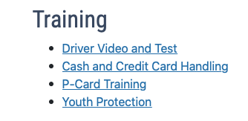
REGISTRATION- SUMMARY Continued
You can find the Cash and Credit Card Training, Driver Video and Test, Pcard Training (if club receives one), and Youth Protection trainings on Club Resource Page here: https://www.usu.edu/campusrec/competitive-sports/club-sports/team-resource
All Club Members/Coaches Required to completed Youth Protection Training
You can upload a screen shot of completions on DoSportsEasy
If you need the complete American Red Cross CPR/AED/First Aid, please work with direct report to get registered through Campus Recreation Courses at $40

Slide 56
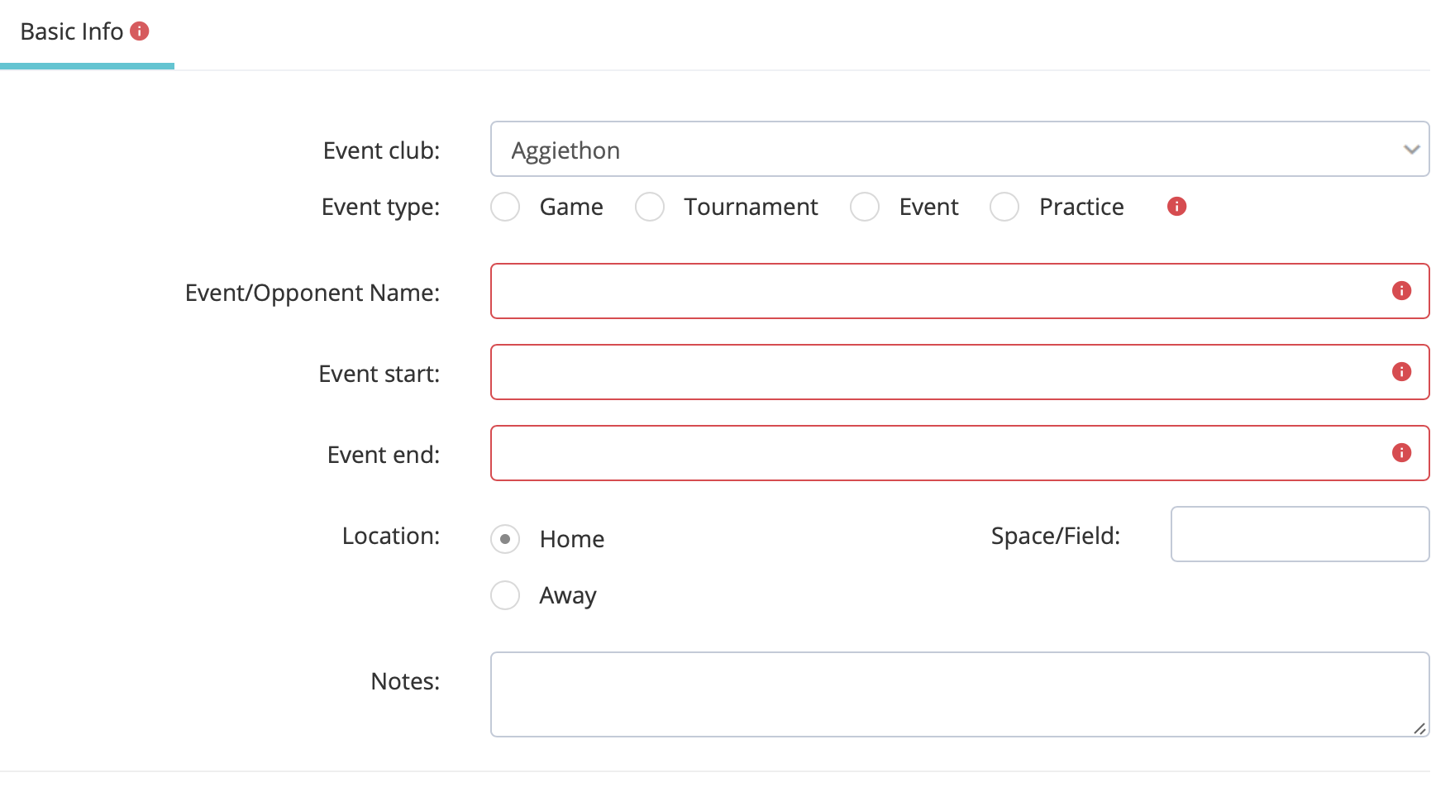
Event submission
You must submit all events including: tryouts, first official practice, home events, away events, fundraising, and volunteer
Put fundraising and volunteer events under the event tab selection in Basic Information
Put cash advance request in Notes and specify what amount of the advance is used for select items (gas, food, etc)
Information can be edited until a week out from event if travel
For home games: put what supplies needed for set-up in notes box on Basic Info page

Slide 57
Event- travel
Event Site- general info about the event and its location/dates for travel. This is where you put any notes needed to know when making reservations/cash advances.
Method of Travel- personal vehicles, rentals, charter, plane, etc
Lodging- Unless you know the hotel you want to stay at, just post number of nights and rooms until you work it out with Travel Specialist
Arrangement- must select the groups of who is driving and who will be in that car as well as who is staying in which hotel rooms if it is an over night.
**All of this information must be completed before we can submit a travel request**
Reservation: 15 business days; Non-Reservations: 10 business days

Slide 58
Event- report/Summary
-Must complete event report 72hrs after event ends as we are going to be submitting successful stories to be posted in USU Newsletters
-Place any injuries, awards, or updates in notes box

Slide 59
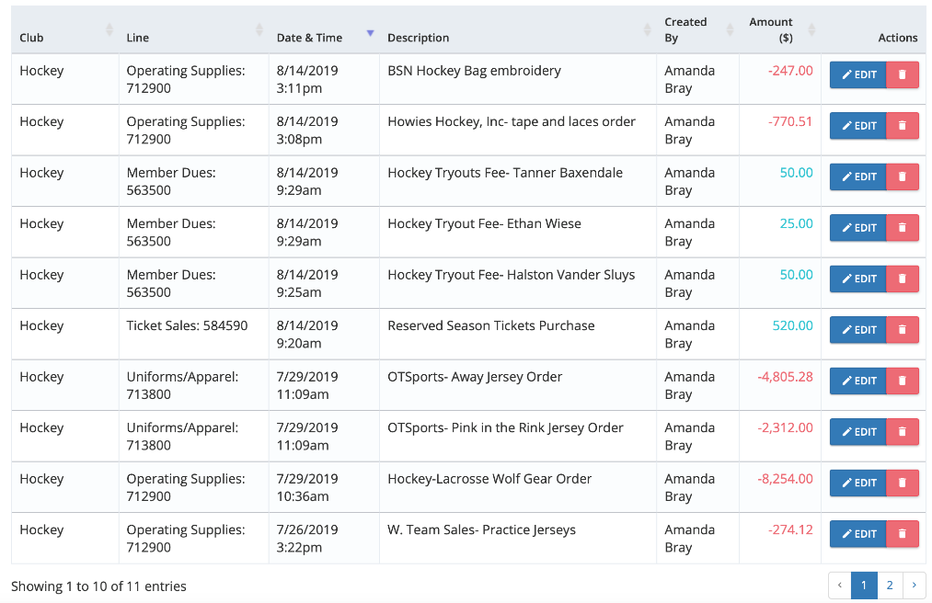
Budget view
All officers will have access to club budget page and balances broken down into specific account codes
You will also be able to see the list of items being purchased and income with notes that describe each transaction

Slide 60
Risk Management
General
Athletic training services
Schedule
Athletic Training System (ATS)
Injury related policies
Natural weather Hazards
COVID Policies

Slide 61
general
To provide a safe and positive recreational experience for all participants, it is necessary to prevent accidents and injuries before they happen
•Club Sport officers, members, coaches and advisors should emphasize safety and proper technique during all team related activities.
Have at least two members certified in CPR/First Aid/AED

Slide 62
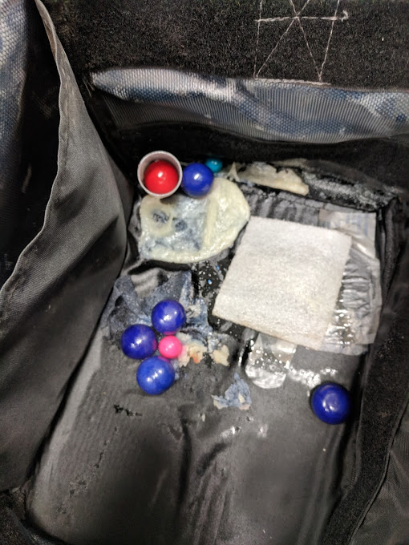
General
Travel med bag
If it needs to be restocked bring it in.
If you lose it you pay to replace it.
If it is not taken care of you lose the privilege.
Travel Injury report forms
FILL THEM OUT
HIPAA

Slide 63
Athletic training services
Injury Prevention and Care Center
Injury prevention, examination, rehabilitation, management and referrals.
Alpine Orthopedics
AT Aides-available for day to day taping and minor first aid. They are not certified.
Ice Bath!

Slide 64
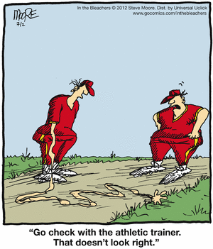
Athletic training schedule
AT Aide Schedule
Monday-Thursday 2pm-9pm
Schedule is subject to change

Slide 65
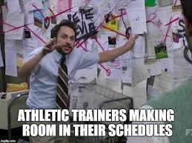
Athletic training schedule
There is only one AT for all clubs, intramurals and open recreation.
High risk sports have priority- NATA Policy
Communication is key

Slide 66
Athletic Training System
Athlete Login-usucs2.atsusers.com
Medical history form
COVID Forms
Schedule an appointment
View injuries and treatments
Treatment Sign in
QR code:
Athletes MUST sign in for all treatments

Slide 67
Injury related policies
Bleeding Policy
If a player is bleeding, has an open wound, or has an excessive amount of blood on their uniform or clothing, they shall be removed from the game to receive medical attention.
In order for the participant to return to the game, they must have the bleeding stopped, the wound covered, and/or clothing changed. This is for the safety of the participant as well as for the safety of others.
In the event of an on-campus injury that results in an extreme amount of blood loss, call 911!

Slide 68
Concussions
A concussion is a brain injury that may be caused by a blow to the head, face, neck or elsewhere on the body with an “impulsive” force transmitted to the head.
No two brain injuries are alike.
Baseline Testing: Hockey, LAX, Rugby.

Slide 69
concussions
Concussions can occur without loss of consciousness or other obvious signs.
A player who exhibits signs, symptoms, or behaviors consistent with a concussion, WILL be removed immediately and WILL NOT return to play until cleared.
Second Impact Syndrome
Concussion Protocol: Optimize recovery

Slide 70
Natural weather hazards
Campus Recreation staff members are available to provide brooms and any other equipment which may be needed for the upkeep of gymnasiums and other play areas. Coaches and officers have the responsibility to make every effort to provide a safe environment. This can be accomplished in part by observing the condition of all courts, gyms and fields.
Bad Weather Conditions
Weather can affect the safety of all Club Sports participants and spectators, and more specifically weather conditions vary greatly in Cache Valley. Club Sport coaches and Competitive Sports Supervisors should know what conditions to look for wherever they are participating in an event. The referee and/or Campus Recreation personnel (AT or Supervisor) have the authority to call games if the safety of everyone watching/playing is at risk.

Slide 71
Lightening/heavy rain/hail
Once participants become aware of a storm or other bad weather, they should be on alert for thunder and lightning.
NATA Position Statement: Lightning within 6 miles: Teams/spectators should already be inside. Play can resume 30 min after the LAST strike within 6 miles.
Keep everyone away from structures in open areas, such as picnic shelters, tall, isolated trees or objects that project above the landscape, water and grounded objects, such as metal fences, tanks, rails, and pipes.
All activity should be stopped and participants directed to shelter in the event of heavy rain or hail. Proper judgement should be used when playing or practicing on extremely wet fields. Playing on natural grass fields in that condition may cause significant damage.

Slide 72
COVID-19 POLICIES
New COVID Case Containment Manager
Cindy Gill – cindy.gill@usu.edu 435-994-5791
USU COVID-19 Policies for all who are experiencing COVID-19 symptoms and/or have been exposed to someone with COVID-19:
Self-isolate,
Complete the USU COVID-19 Questionnaire
Get tested
Follow up with your case containment investigator
Symptom check: All Club Sport athletes will fill out the COVID-19 symptom screening form in ATS on game/competition days only
Vaccinations: Fully vaccinated athletes should upload their vaccine record to their aggie health portal. This can be done here: http://aggiehealth.usu.edu/. Doing so could assist in a quick release from quarantine if an exposure occurs.

Slide 73
Covid-19 Policies
Team exposure protocol: In the event of a team exposure (Defined as the direct contacts can't be identified), the entire team will quarantine until cleared by the COVID Case Containment team. When notified of exposure, team members will immediately fill out the COVID-19 questionnaire.
Those not in attendance at time of exposure will be released from quarantine.
Athletes who are fully vaccinated are eligible for a waived quarantine as long as they are not experiencing symptoms. Their case containment investigator will confirm eligibility and advise them.
Athletes who have tested positive for COVID-19 within 90 days are eligible for a waived quarantine as long as they are not experiencing symptoms.
All other athletes will be released individually by the case containment team through the investigation process in determining if there was direct contact with the positive case.
Tracking practice attendance: Team safety officers (or coaches) will fill out a daily practice attendance log to keep track of those that were at practice. This will ensure that in the event of an exposure contact tracing can quickly be completed.
The link for the form is https://forms.gle/gSUQB7ZJuBfbaQGs5
Travel Requirements: When traveling on behalf of the university, you are required to wear face coverings when carpooling in a personal vehicle, rental, motor pool, charter bus, or plane.

Slide 74
COVID-19 personal Responsibility
Get vaccinated if you are able
Stay home if experiencing any COVID-19 symptoms and get tested.
Submit USU COVID-19 Questionnaire if experiencing symptoms or you have been exposed to a positive case.
Respond to Case Containment when they contact you.
Wear a mask indoors and in large gatherings.

Slide 75
Marketing &trademark licensing policies
Trademark and Licensing
Social Media and website policies
Marketing services

Slide 76
Trademark Licensing
Aimee Brunson
Trademark Coordinator
Aimee.brunson@usu.edu
Heidi Adams
Director, Trademark and Licensing
Heidi.adams@usu.ed

Slide 77
website and Social media policies
Through effective social media communication, Campus Recreation will be able to achieve its mission to enhance students’ college experience through play, wellness and adventure.
Fundraising on social media can help you achieve your yearly funding needs. USU PR (official USU page) will not post your fundraising campaign efforts and should be posted and shared from your club social media platforms.
Please note: if you have an Instagram, Facebook, or a Twitter, send the login info to campusrecmarketing@usu.edu
If you don’t share this information, we will be forced to shut down your page

Slide 78
Social media
Club Sports social media accounts must be in compliance with university and Campus Recreation policies
Social media accounts must use the approved logo as the main profile photo provided by campus recreation marketing
Should have “USU” at beginning of username (i.e. @usubaseball, @usu_hockey, etc.)
Do not post anything that will violate the USU Visual Identity Program i.e. altering logos
New accounts/platforms must be approved through Campus Recreation Marketing before creation
Campus Recreation Marketing needs records and admin access of all social media accounts created under USU Club Sport names
All fundraising efforts should be posted on your club social media platforms.

Slide 79
website
The Campus Recreation website is the main page for all Club Sports news and information. Each team has its own website to use for news, ticket sales, paying dues, schedules, rosters, and social media streams.
Team schedules, pictures, or ticket sales can be posted on their individual pages. Please work with your direct report with any edits you would like to make.

Slide 80
Marketing Services
What can be done for free:
Create flyers and put them on TV screens in the ARC
Print flyers using campus rec’s printers
Team photos, game photos, photoshoots
Videos
What can be done at a cost:
Send any marketing material out to print (for an additional cost)
Create merchandise for sale to fans or for your team to wear
Please submit any requests 4 weeks in advance to assure that it will be completed in time. Marketing staff is completing requests for all Campus Rec Areas and can not promise a request can be met when it is after that time frame.
To submit a request email: anaelle.sure@usu.edu

Slide 81
Travel procedures
Policies
Travel rosters
Driver’s requirements/policies
Rental vehicles
Hotel reservations
University travel

Slide 82
Competitive Sports Travel Specialist
Travel Specialist: Kayleen Streator
kayleen.streator@usu.edu
Phone: (801)231-8947
Office Hours

Slide 83
General Procedures
Official representatives of Utah State University
All travel must be processed through the Travel Specialist (Kayleen)
TA is needed anytime you leave Cache Valley
Only due paying members and coaches/managers are authorized to travel
Travel binders can be picked up from Amanda the week of travel
The Athletic Trainer may travel when schedule permits; travel costs for Trainer are covered by the club

Slide 84
Safety is the First priority
No co-ed room sharing
No hitchhikers
Travel is restricted between the hours of 11:00 pm and 5:00 am
Driving time cannot exceed ten hours per 24 hour period
Change drivers every 4 hours
STOP in a safe place to change drivers
Wear your seat belt anytime the vehicle is in motion
For weather factors, an accident, or if your vehicle breaks, down contact Amanda immediately

Slide 85
Travel request
Travel not needing reservations must be turned in at Least 11 business days prior to departure (can be turned in anytime prior)
Travel requiring reservations must be turned in 16 business days prior to departure The sooner the better
Late requests cannot be guaranteed to be fulfilled or processed
LATE TRAVEL request will be fined $75.00

Slide 86
Team roster
Each team will submit a full roster with emergency contacts at the start of the year/season
Included in the travel request will be a list of all who are traveling
Changes will be given 5 days prior to departure

Slide 87
Transportation
Ground Travel
Flying
University Motor Pool
Rental vehicles
Personal vehicles
Group flights are done through Southwest
Minimum 2 weeks prior to departure
Passenger name changes may be done up to 72 hours prior to departure
12 and 15 Passenger vans are NOT permitted by State Law
Do NOT use University vehicles for personal errands
Do NOT transport family members in University Motor Pool vehicles
All drivers must have completed the driver safety video and test prior to departure

Slide 88
Driver Requirements
Every driver of a vehicle used for University-related purposes must meet the following criteria:
Possess a valid license to operate the type of vehicle involved
NO citations received within the past 12 months for any of the following: An automobile accident, driving under the influence of alcohol or drugs, or reckless driving
Ensure vehicle is duly licensed and registered, and driver is authorized to operate vehicle
Complete Driver Training Procedure
Must be done every school year (link found on the team resource page)
Email the “Certificate of Completion” to the Amanda

Slide 89
Hotel/Lodging
Rooms will be shared
Standard four-person occupancy
No co-ed rooming
Team funds cover room rate and taxes; room charges will be divided among those assigned to the room
Incidentals
Hotels will NOT be booked on the Las Vegas Strip
Hotels must be refundable
AirBnB/ VRBO can be used but require additional time to book
Many aspects should be taken into consideration when booking a hotel
Location
Cost (room charge and additional fees)
Amenities

Slide 90
Booking hotels
Booking will be done through Lucid Travel usu.lucidhotels.us
Guest Link https://www.lucidtravel.us/university/utah-state-university/9045

Slide 92
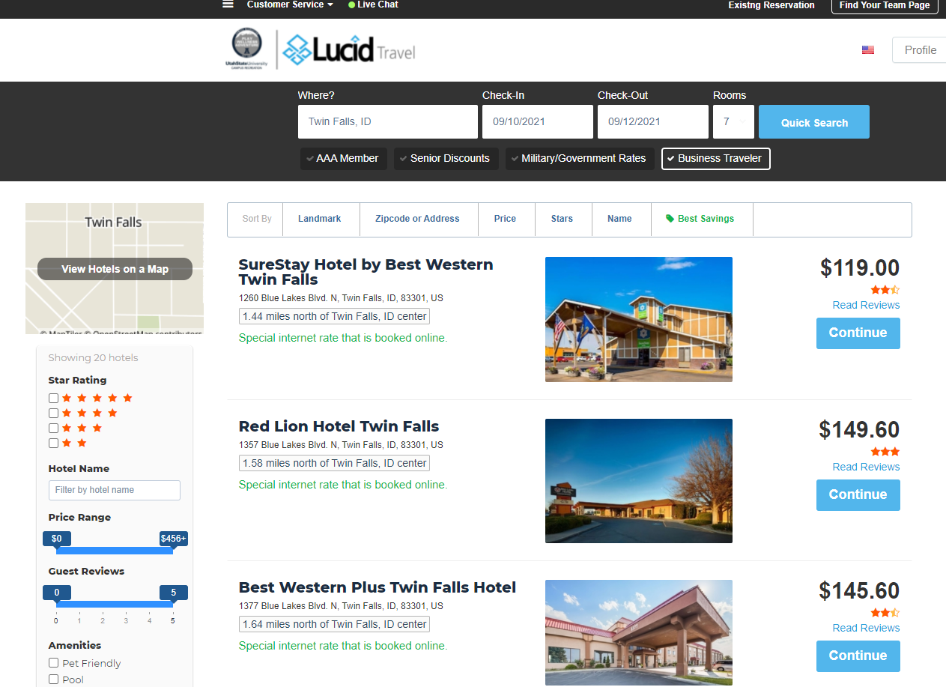

Slide 93
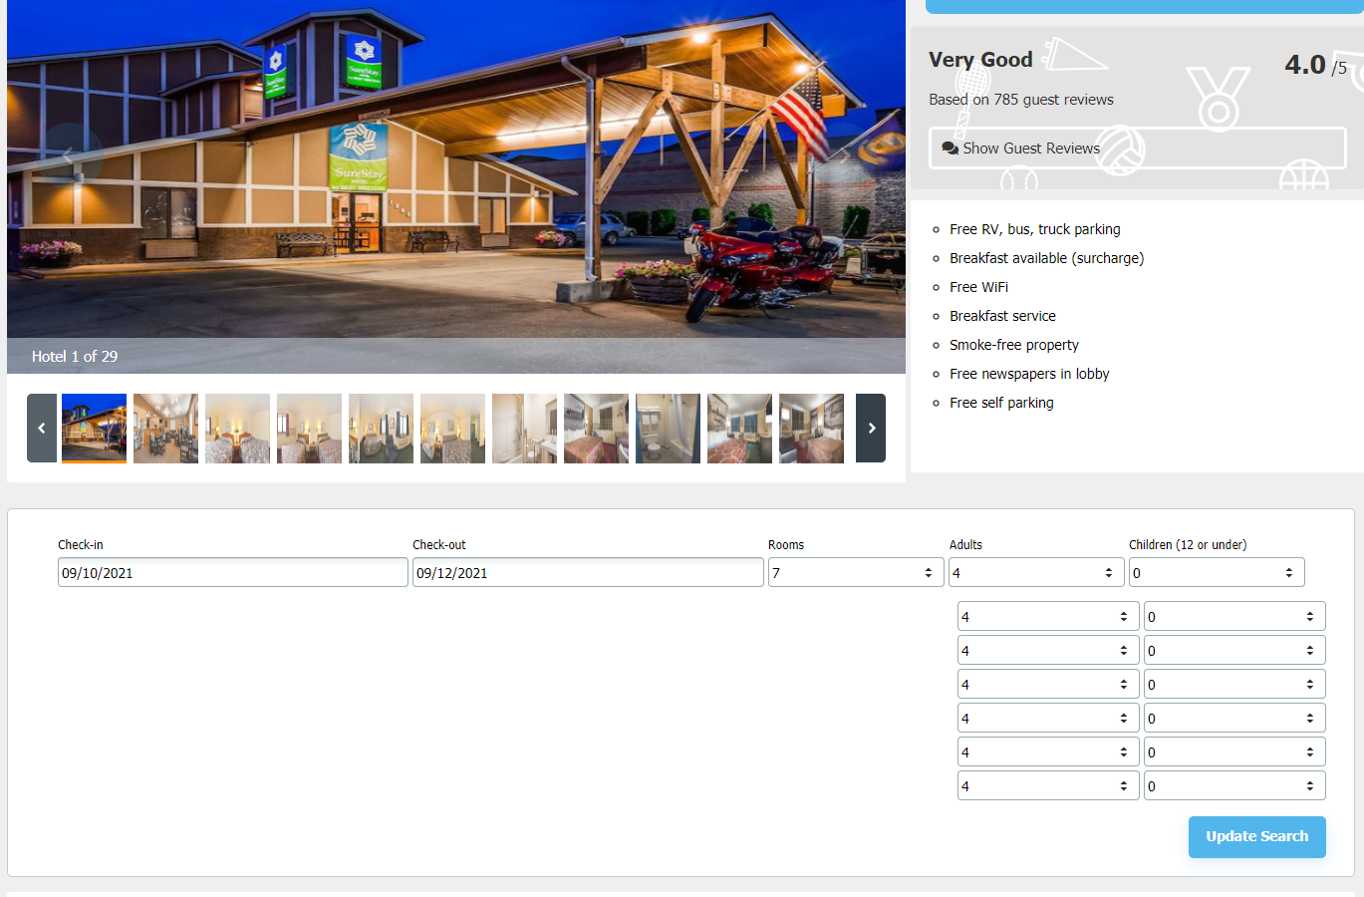

Slide 94
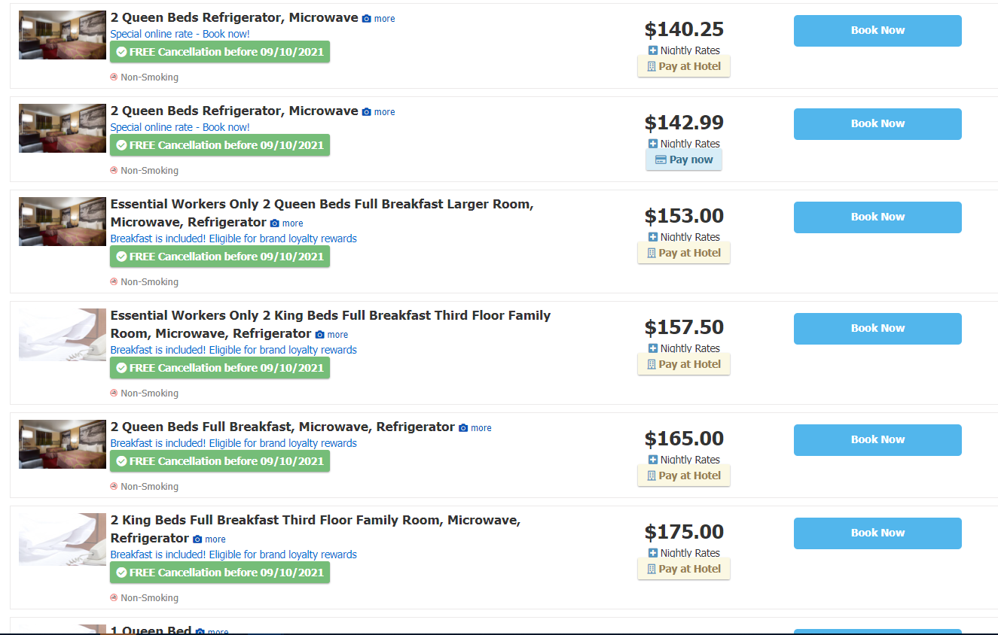

Slide 95
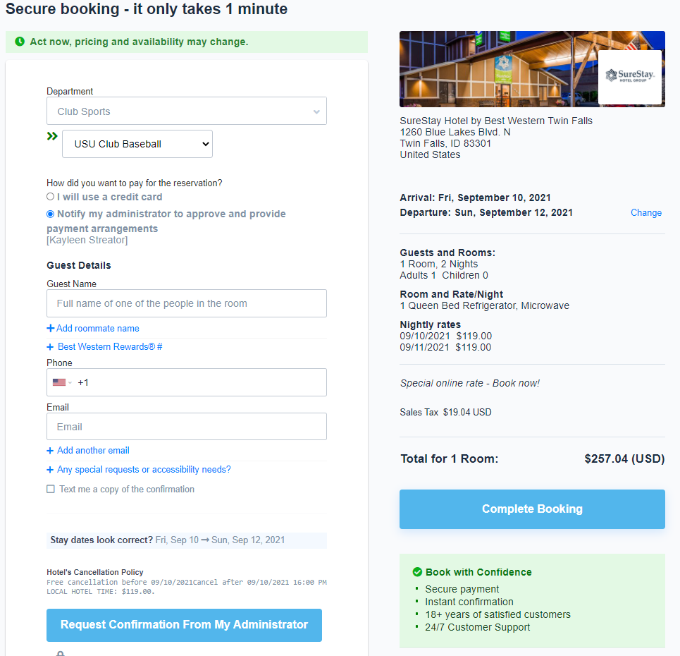

Slide 96
Flight Reservations
Group flights must be booked a minimum of 14 business days prior to departure
Flight roster must have: name as it appears on Driver License, date of birth, and gender
Once a deposit is paid on a group flight it cannot be changed (flight date, times, or # of passengers)
Individual flights are nonrefundable 24 hours after booking
Group flights are done through Southwest

Slide 97
All Cards
University credit card
Assigned to coach or president
Itemized receipts
Receipts turned in 48 hours after return
Late receipts may be fined $75
Receipts must be signed by card holder

Slide 98
Cash advances
Cash advances MUST be requested a minimum of 5 business days prior to departure
Advances will be in the Travel Officer’s name
Funds will be direct deposit
Accounts receivable set up on SSB
Please DO NOT email your account info
Club Travel Officer is responsible for the full amount of the advance

Slide 99
Cash distribution
Venmo
Must have itemized receipts

Slide 100
Closing out cash advances
Receipts and unused advance must be returned to Travel Specialist within 5 days of return
Receipts and cash must equal total amount of the advance
Itemized receipts are required
Late and/or incomplete advances will receive a fine $25.00 and lose of advance privileges
After 60 days, an outstanding advance will become taxable income to the traveler that received the advance

Slide 101
After Return
All receipts and documents must be turned in within 5 days of return
Clubs returning documents late may be fined a minimum of $25.00
Binder and all card receipts will then be returned to Assistant Director of Competitive Sports
Cash advance receipts are turned in to the Travel Specialist

Slide 102
Questions?

Slide 103
Reminders and Updates
Unified Sports
Aggiethon
Fitness and Wellness opportunities
Upcoming events
Direct reports

Slide 104
Unified sports events
Opportunity to be a volunteer for an event or be a partner for a sport and obtain easy incentive points
Event this year:
Fall Social: Futsal Event at ALF Sat, Sept 4th 10am-11:30am
Fall Offerings: Flag Football, Bocce Ball
Spring Offerings: Basketball, Soccer, Volleyball, Bocce Ball
Visit the below link to see more information on dates, volunteer forms, and contacts
https://www.usu.edu/campusrec/unified_sports/index

Slide 105
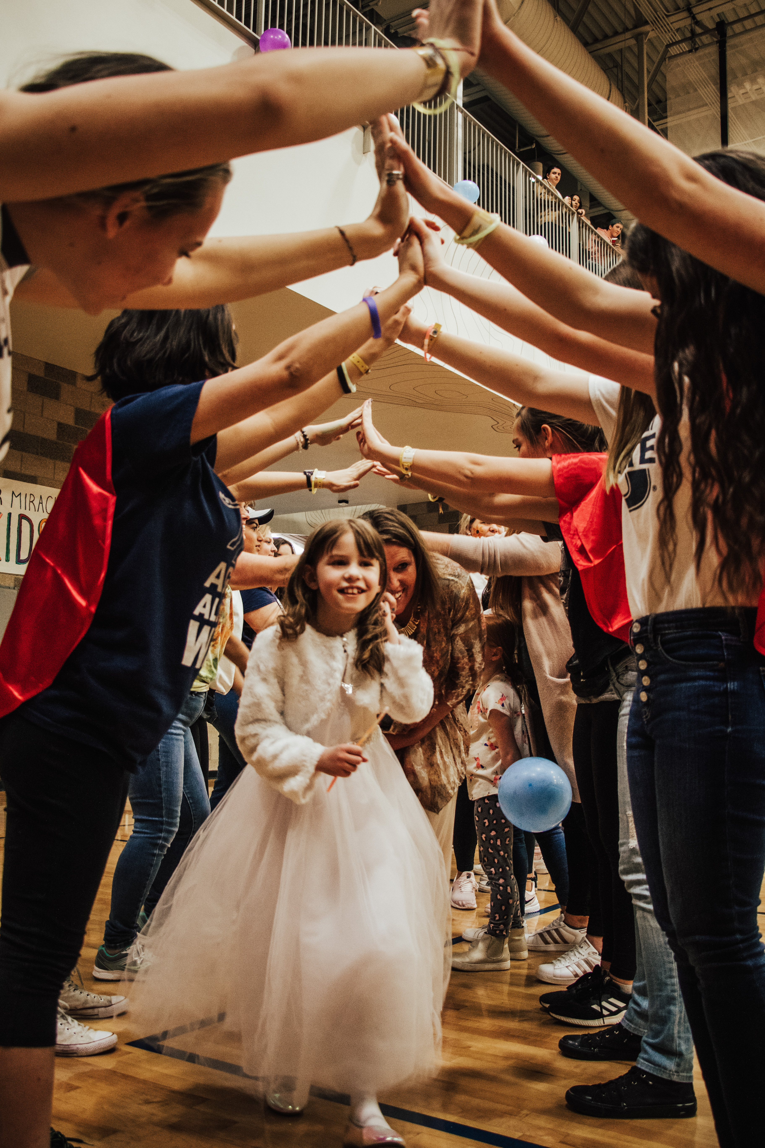
AggiEthon
What is it? USU’s outreach program for Primary Children’s Hospital
How? We party and raise awareness and money through our parties
Main Event: November 13th at the Fieldhouse
Your help? Register at aggiethon.usu.edu and talk to any of us about how your club can sponsor the movement
Contact: dancemarathon@usu.edu 801-540-7626 (Kyson’s Cell)

Slide 106
Fitness and Wellness opportunities
Our campus recreation Fitness and Wellness Program has various opportunities for your club to grow and get involved to improve your overall wellness as a club.
Strength and Conditioning, Wellness Coaching, and soon a Registered Dietitian
For more details, contact Kenzie Sorrells at mckenzie.sorrells@usu.edu

Slide 107
Upcoming events
Rec Fest- Saturday, August 28th
Be there at 6:30pm for set-up at ARC South Court
Day on the Quad- Wednesday, September 1st 10am-3pm
Make sure to be there for set-up at 9:30am
Aggie Wellness Fair- Thursday, September 23rd 11am-1pm at Aggie Legacy Fields and ARC North Court

Slide 108
Direct reports
Must post tryout dates and first set practice date after tryouts on DSE (no other practices needed)
Grab tryout waivers from direct reports
Roster checks will be conducted after tryout period starting Sept 20th
Below is the breakdown for who your direct report will be this year
Makes sure to sign up for the 1:1 Fall meeting with direct report – meeting papers are at the sign-in table
Amanda | Bailey
Aggiethon M/W Hockey M/W Lacrosse Rodeo M/W Rugby Racquetball Pickleball Powerlifting Esports | Baseball Cycling Jump Rope M/W Soccer Swim and Dive M/W Ultimate M/W Volleyball Golf Figure Skating

