Slide 1
USU Campus Recreation Club Sports Training
8-28-2026

Slide 2
University Resources
.
Header: Who supports your club?
Campus Rec Staff
  Spencer Bitner — Director
  Reed Phinisey — Associate Director
  Trey Gross — Assistant Director of Competitive Sports
  Ashley Brown — Outdoor Programs
  Baily Kruzan — Marketing
  Macy Gustavas — Aquatics & Safety
  Jaron Lerhol & Nate Wright — Club Sports Managers
  Anna Francis — Operations Assistant
Key University Partners
  Business Services — Jennifer Seamons
  Travel — Barbara Madsen
  Parking — Tein Hawke
  Event Services — Erich Olschewski
  Your Direct Report is your first stop - they streamline everything.
  Campus Recreation office must have a full understanding of each of its programs’ financial activities.

Slide 3
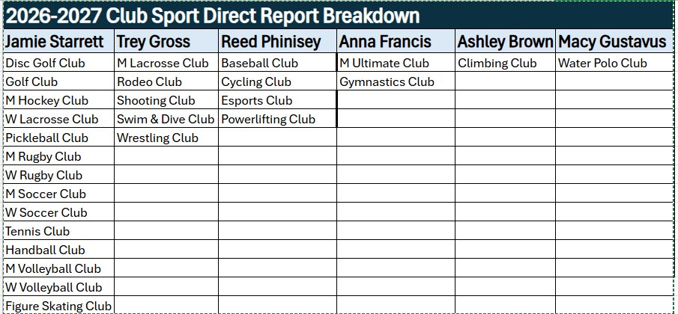
Direct Reports

Slide 4
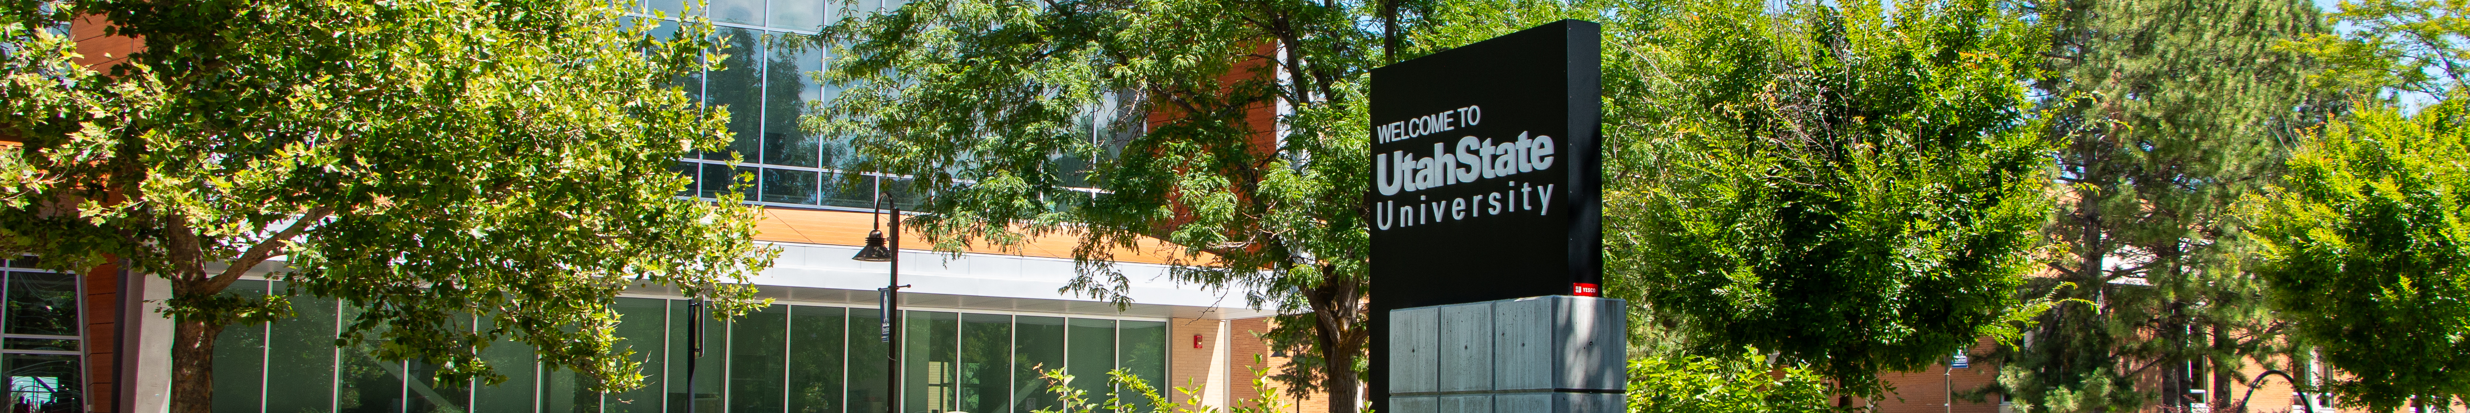
TL;DR
Spring of 2015 was the last time the Campus Recreation Fee was increased
We asked for a $10.46 fee increase in 2026
$4.48 to cover salaries and create a new staff position creating new revenue-generating opportunities
$5.98 to improve student access, increase student wages for retention, remove barriers to fitness, and establish eSports hardware replacement

Slide 5
Fiscal Year 26
University Fee Comparisons
Utah State University $52.16
Boise State University ~$55-72.00
Colorado State University ~$143.56-$161.13
University of Nevada, Reno ~$55-$75.00
Fresno State University ~$66.66
Utah Valley University $63.80
Washington State University $191.00
Notes:
USU - https://www.usu.edu/student-affairs/student-fees
Boise State - https://www.boisestate.edu/vpfa-budget-and-planning/wp-content/uploads/sites/351/2023/11/Campus-Recreation.pdf
CSU - https://thehub.colostate.edu/wp-content/uploads/sites/2/2025/07/General_Fee_Schedule-1.pdf
University Nevada - https://www.unr.edu/fitness/memberships
WSU - https://urec.wsu.edu/about-urec/urec-funding/src-and-stephenson-funding
UVU - https://ushe.edu/wp-content/uploads/pdf/agendas/2025/03272825/UVU_2025-26_Tuition_Fee_Adjustments.pdf
Fresno State - https://auxiliary.fresnostate.edu/association/src/faq.html

Slide 6
Summary
FY27 Fee Proposal Increase for Salaries
 | Fee Equivalent | Dollar Amount
Staff Wages Aquatics Coordinator | $1.52 | $50,768.00
Campus Recreation Salaries | $2.96 | $98,864.00
Sub Total | $4.48 | $149,632.00
First Priority
Second Priority
Direct to Student Employees
Increase Student Access
Guarantee Future Student Access
FY27 Fee for Proposal Increase for Improved Student Experience
 | Fee Equivalent | Dollar Amount
Expansion of Bouldering Wall/Ongoing O&M | $0.32 | $10,688.00
Student Fitness Programs | $0.80 | $26,720.00
Wage Hourly for Group Exercise | $1.41 | $47,094.00
Student Wages | $2.40 | $80,160.00
Esports R&R | $1.05 | $35,070.00
Sub Total | $5.98 | $199,732.00
Total | $10.46 | $349,364.00

Slide 7
Allocation Tier System​
To be eligible for funding, the funding proposal and organization must meet the following criteria: ​
The student-led organization must be registered with Student Success under Campus Recreation as a formal competitive club, remaining in good standing and meeting the minimum requirements outlined in the Club Sports Manual.​
Each Spring, during designated allocation presentation times, a funding/allocation proposal must be submitted. ​
Clubs will be notified of these meetings' sign-up periods. ​
Allocation presentations will not be accepted outside of these designated times, except during a club's inaugural application period. ​
The allocation requested must align with the purpose of the registered student organization, as defined in its application. ​
All funding decisions are made by the Coordinator of Club Sports and designated Campus Recreation staff. ​
Allocation funding is not guaranteed and depends on various factors, including club status, available funds, and unforeseen variables. ​
Clubs placed on probation may face partial or complete forfeiture of allocated funds by the University.​
Following the allocation presentations, clubs will be categorized into one of five tiers, determining the status and allocation funding for each club. ​
Note: The tier system is used to assist Campus Recreation and the Coordinator of Club Sports in determining funds and is no way a guarantee for funding from Campus Recreation Department.​
If your club falls into tier 5 your club will be placed on probation and be required to submit an action plan to avoid suspension. ​
nformation

Slide 8
Allocation Presentations
Your club’s funding pitch
Professional business presentation
Present the who, what, why
Details matter
Show:
  How funds will be used
  Why assistance is needed
  What activities justify support
Not for grievances
Funds support: uniforms, equipment, operating costs
Not allowed: coach pay, bonding activities
Near end of spring semester
All DSE events will be totaled (games, tournaments, community service events)

Slide 9
Allocation Presentations - Spring Semester
Club Sports as a whole is allocated a specific amount of student fee money to be divided amongst all possible teams minus first year teams.
We use your allocation presentation data to make requests for more funding from student fees.
To be eligible for this money, you club must present to Campus Recreation why they need assistance, how they will use this money, and why their club deserves the money based on activities.
Come to impress you are asking for financial support and this is to be handled like a professional business presentation.
  Presentations are a professional setting and is not a place to air your grievances.
The Who, What, and Why’s are crucial to showcasing the need your club has for funding. *DETAILS MATTER*
Allocations are designed to assist with club needs such as uniforms, equipment, and operating costs. It is not to be used for paying coaches, or club bonding activities.

Slide 10
Club Allocation Tier 2​
Tier 2: (Maximum of 5 Clubs. Potential Funds in the entire Tier $15,000.00) Criteria- Club significantly exceeded minimum requirements: ​
Allocation presentation was scheduled and presented on-time and in a professional manner. ​
Competed in more than two intercollegiate events and was in top 30 percentile of clubs in terms of event/game participation.​
Met and maintained minimum member requirements. ​
Exceeded required number of service projects (minimum of 5 members for 2 or more hours each).​
All officers attended required trainings and meetings.​
Raised more than the amount they were allocated from Campus Recreation.​
Club ensured their website was maintained and up-to-date with relevant club information including officer contact information, current social media links, sponsors or donor list, and schedules.​
Club constitution was updated and posted on-time.​
Followed all member registration policies, with no more than 1 reminder or warning .​
Travel Rosters were submitted on-time with no errors for all events.​

Slide 11
Club Allocation Tier 3​
Tier 3: (No Slot Limit. Potential Funds Based on Participation) Criteria- Club exceeded minimum requirements: • Allocation presentation was scheduled and presented on-time and in a professional manner. ​
Competed in more than two intercollegiate events and was in the top fifty percentile of clubs in terms of event/game participation. ​
Met and maintained minimum member requirements. ​
Met or slightly exceeded required number of service projects (minimum of 5 members for 2 or more hours each).​
Majority of officers attended required trainings and meetings.​
Raised slightly more than they were allocated from Campus Recreation.​
Club website was mostly up-to-date with relevant club information including officer contact information, current social media links, sponsors or donor list, and schedules.​
Club constitution was updated and posted on time.​
Followed all member registration policies, with no more than 2 warnings.​
Travel Rosters were submitted on-time with no errors or warnings for the majority of events.​

Slide 12
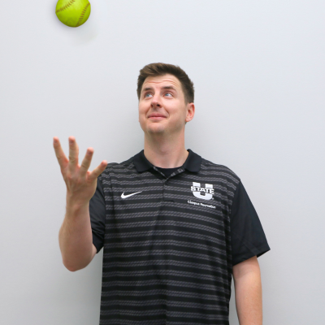
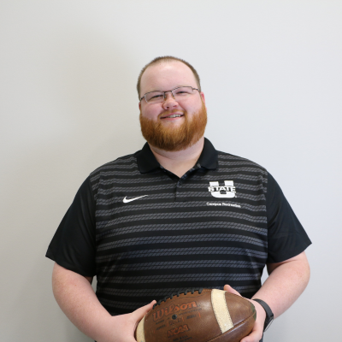
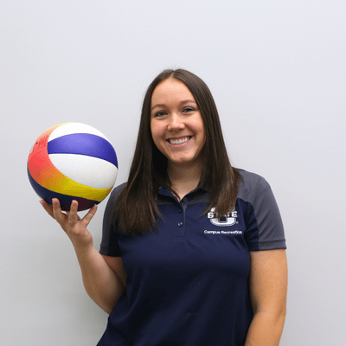
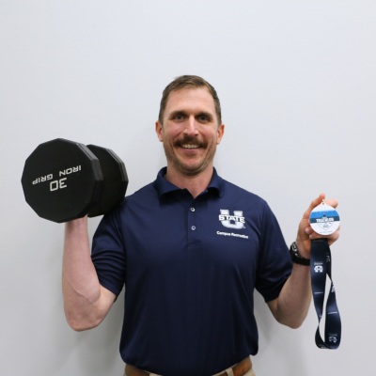
Club Benefits & Campus Recreation

Slide 13
Club Benefits & Campus Recreation
$50,000 in direct funding through allocations
Access to Athletic Trainer
Donations to clubs are consider charitable
Ecommerce and transaction hardware at events
Facilitation of events and programs
Hours for the ARC, ALF, Laub Indoor facility, Estes Center, etc.
  Custodial, maintenance, priority scheduling, etc.

Slide 14
New Roster Membership fee
$25 for each team member on the roster in December
Goal to cover the cost for
  Do sports easy software licensing
  Operations Assistant
  Increase allocations
700 Club Sport Athletes x $25 = $17,500
Goal is to get you all an additional $10,000 in allocations

Slide 15
Do Sports Easy - DSE
Where members register
  Campus rec club sports resource page
    https://www.usu.edu/campusrec/competitive-sports/club-sports/
  Log-in at top right corner with A#
  Select registration on chosen sport to start membership process
  All members must sign the waiver and member agreement
    Waiver signed before tryouts. We can print some off for you to have at tryouts if needed
Submit events/games/travel - must submit a request to host a home event, match, or tournament, as well as away games or tournaments
See budget

Slide 16
Trainings
Registration Servicenow Requests: Learn Blue Trainings
  https://usu.service-now.com/aggies?id=sc_cat_item&sys_id=a80a85d61b73ce50e242fccbde4bcb7a
  Reason for request is club sports and submit
You only have two weeks to complete your trainings
Upload proof of completion on DSE
Trainings have to be completed before adding events into DSE
Driver info: even if the member doesn’t plan on driving, the defensive driver training must be completed

Slide 17
Home Events
Need to be submitted at least two weeks prior
Space is not guaranteed (first come first serve)
Registration fee for hosting events should be handled through your direct report
If minors are present all participating club members must have a completed and turned in Protection of minors training before the event! NO EXCEPTIONS!
You need to fill out all the sections! Including the summary after the event.

Slide 18
Travel Requests
Reservation requests (overnight stay) need to be submitted 15 business days or three weeks in advance. Or more!
Non-reservation requests (no overnight stay) need to be submitted 10 business days or two weeks in advance.
The roster for all travel needs to be accurate and finalized 72 hours prior to event
Submit all details on DSE!
  The notes section on all travel needs to be a detailed narrative of the event plan
Make sure you only buy stuff for the travel on the travel dates provided. If your travel is 9/19 - 9/20, don’t buy gas 9/21!
Rental cars/hotels - double check these are good to go before leaving
Fuel can only be purchased for travel - there has to be a TA# with fuel receipts

Slide 19
Club Finance
Financial rules every club must follow
No off-campus bank accounts
All funds handled through campus rec
Each club has a university index
Dues paid through fusion
Payment plans require approval
Tema dinners allowed (18% pre-tax tip)
Officials paid through governing body or campus rec
Avoid personal purchases
No purchases outside travel dates
Per university policy, the use of off-campus accounts is prohibited

Slide 20
Dues & Member Payments
Campus Rec no longer tracks dues
Officers responsible for tracking
50% dues paid before participation
Non-payment -> Student conduct
Practice-only membership option
Try out fees
Negative balances = all members liable
At least 50% of dues must be paid BEFORE members are authorized to participate

Slide 21
All Card Rules
How to use your club’s all card
Two all card holders required
Fuel purchase only during travel
TA# required on fuel receipts
Amazon purchases via direct report
Walmart requires tax-exempt card
Costco cannot apply tax-exempt
Receipt signed & turned in on time
Ask before purchasing gifts

Slide 22
Finances and Receipts
Your budget will be updated on Do Sports Easy
Dues paid online
Each club has two officers with a card
  Any lost or damaged keys will be the club’s responsibility
All cards have a single purchase limit of $4999
Monthly limit of $9999
All purchases are Tax Exempt!
Check DSE before making purchases
Do not go into the negatives! Pay attention to your budget before making purchases.
Let us know before you buy a gift or reward - there’s a form we need to fill out

Slide 23
Finances and Receipts
Be Specific - gas price, how many miles, how many jackets, who for, why do you need it, etc
Each card is associated with a box account
QR codes for each card
Get receipt -> sign name by total -> scan QR code -> fill out form/submit photo of receipt -> DONE
  Keep receipts for semester but using the QR code you don’t have to bring in your receipt or email it
This should limit lost receipts without turning them in in person
Receipts need to be turned in on time! After 30 days your card will be shut off.
Address: 7005 Old Main Hill Logan Ut, 84322
Phone #: 435-797-0557

Slide 24
Officer Training
Service Project Requirements
Each Club Sport is required to support Campus Recreation and the broader community through volunteer service during both the fall and spring semesters.
  At minimum, each club must:
    Volunteer at one Campus Recreation special event each semester. At least 25% of the club’s active roster must participate for the club to receive credit.
    Complete at least one additional volunteer or community service activity each semester elsewhere on the Utah State University campus or within the Logan community.
Club officers are responsible for coordinating volunteer participation and submitting any required documentation, attendance records, or verification of service to their direct report via DSE. Submission must include event/date, members attended and total hours.
Failure to complete the required volunteer service may result in an allocation reduction, fine, loss of incentive-tier standing, probation, or other disciplinary action as determined by the Coordinator of Club Sports.
Staff Expectations

Slide 25
Officer Training
Fall Events
Color Run. 9/12 – 7:30am-12pm – 40 Volunteers
Big Blue Boo 5K. 10/23, 3-7pm – 25 Volunteers
Turkey Trot. 11/20, 3-7pm – 25 Volunteers
Staff Expectations

Slide 26
Officer Training
Club S&C
We are looking for 2-3 teams to sign up for Strength & Conditioning this semester!
Available Days/Times: T/Th, 8-10pm
Dedicated facility and equipment access (Fieldhouse)
Tailored programming and instruction
Pre & Post Assessment
Staff Expectations

Slide 27
Club Responsibilities
Baseline expectations for every club​
Represent USU professionally​
Maintain high standards of behavior & sportsmanship​
Follow all university policies​
Keep storage areas clean & organized​
Report detrimental conduct​
Respect student employees​
All travel outside cache valley requires a TA​
Maintain minimum membership​
Register all members & complete waivers before participation​
All members must maintain High Standards of Behavior and Sportsmanship, on and off the field.​

Slide 28
Club Responsibilities (Operations)
Daily operations your club must manage
Closet and Shed use
Store items in designated areas
No food or trash
Do not block electrical panels
Return key watcher keys – fines apply
Equipment
Clubs purchase and maintain their own gear
Field painting requests: 1 week prior (TBD)
Home Events
Submit DSE request 2+ weeks prior
Officers must be present
Clubs handle setup and cleanup
Infractions issued for poor facility care
Communicate 6 weeks in advance for events with Youth
If a venue is left in disarray clubs with incur a major or minor infraction

Slide 29
Health and Safety
Protecting your members
Members are responsible for their own health
Concussion baseline recommended
Campus rec does not provide insurance
AT required for certain sports
AT Concussion decisions are final
AT Office hours available
Injury reporting
  Report all injuries (practice & games)
  EMS calls reported immediately
  Travel/safety officer submits forms within 24 hours
  Athletic Trainers

Slide 30
Hazing
The Clery Center’s hazing resources emphasize that hazing is more than just dangerous initiation activities or “traditions.” Hazing is any group-related activity that humiliates, degrades, abuses, or endangers someone—regardless of whether they willingly participate.

Slide 31
Hazing
The key takeaway for campus organizations, teams, and leaders is that “they agreed to do it” does not automatically mean it isn't hazing. Peer pressure, power dynamics, and the desire to belong can undermine meaningful consent.

Slide 32
Hazing -
https://www.clerycenter.org/hazing
\The Clery Center recommends moving beyond simply responding to incidents and instead building
  Healthy group cultures
  Positive traditions
  Meaningful alternatives to hazing.
It provides tools including the We Don’t Haze documentary, policy-planning resources, and a comprehensive hazing-prevention toolkit.

Slide 33
Hazing
If it is criminal contact the police
Report any form of Hazing to Student Conduct and Community Standards
Campus Recreation Staff are reporting employees

