Slide 1
P-CARD TRAINING

Slide 2
A proper receipt must include the following:
An itemized description of the items purchased
Date of purchase
Name of the merchant/vendor/supplier
Amount of purchase
NO TAX! (tax exempt number is printed on the card)
The cardholder signature
Index number (if you don’t know it, talk to your Director)
Event name or justification for purchase
If you are not able to obtain a proper receipt from the merchant, or if the receipt is lost you must first go back to the store and try to obtain one. If you are unable to do so, you will need to fill out a Substitute Receipt Form. Substitute Receipt Forms are automatically audited, therefore, we don’t want to use them often.
Please check your receipt before leaving the purchase location to ensure they gave you the tax exempt benefit. If you were charged tax, have the vendor fix it at that time, otherwise you will be asked to go back later and have them issue a credit.

Slide 3
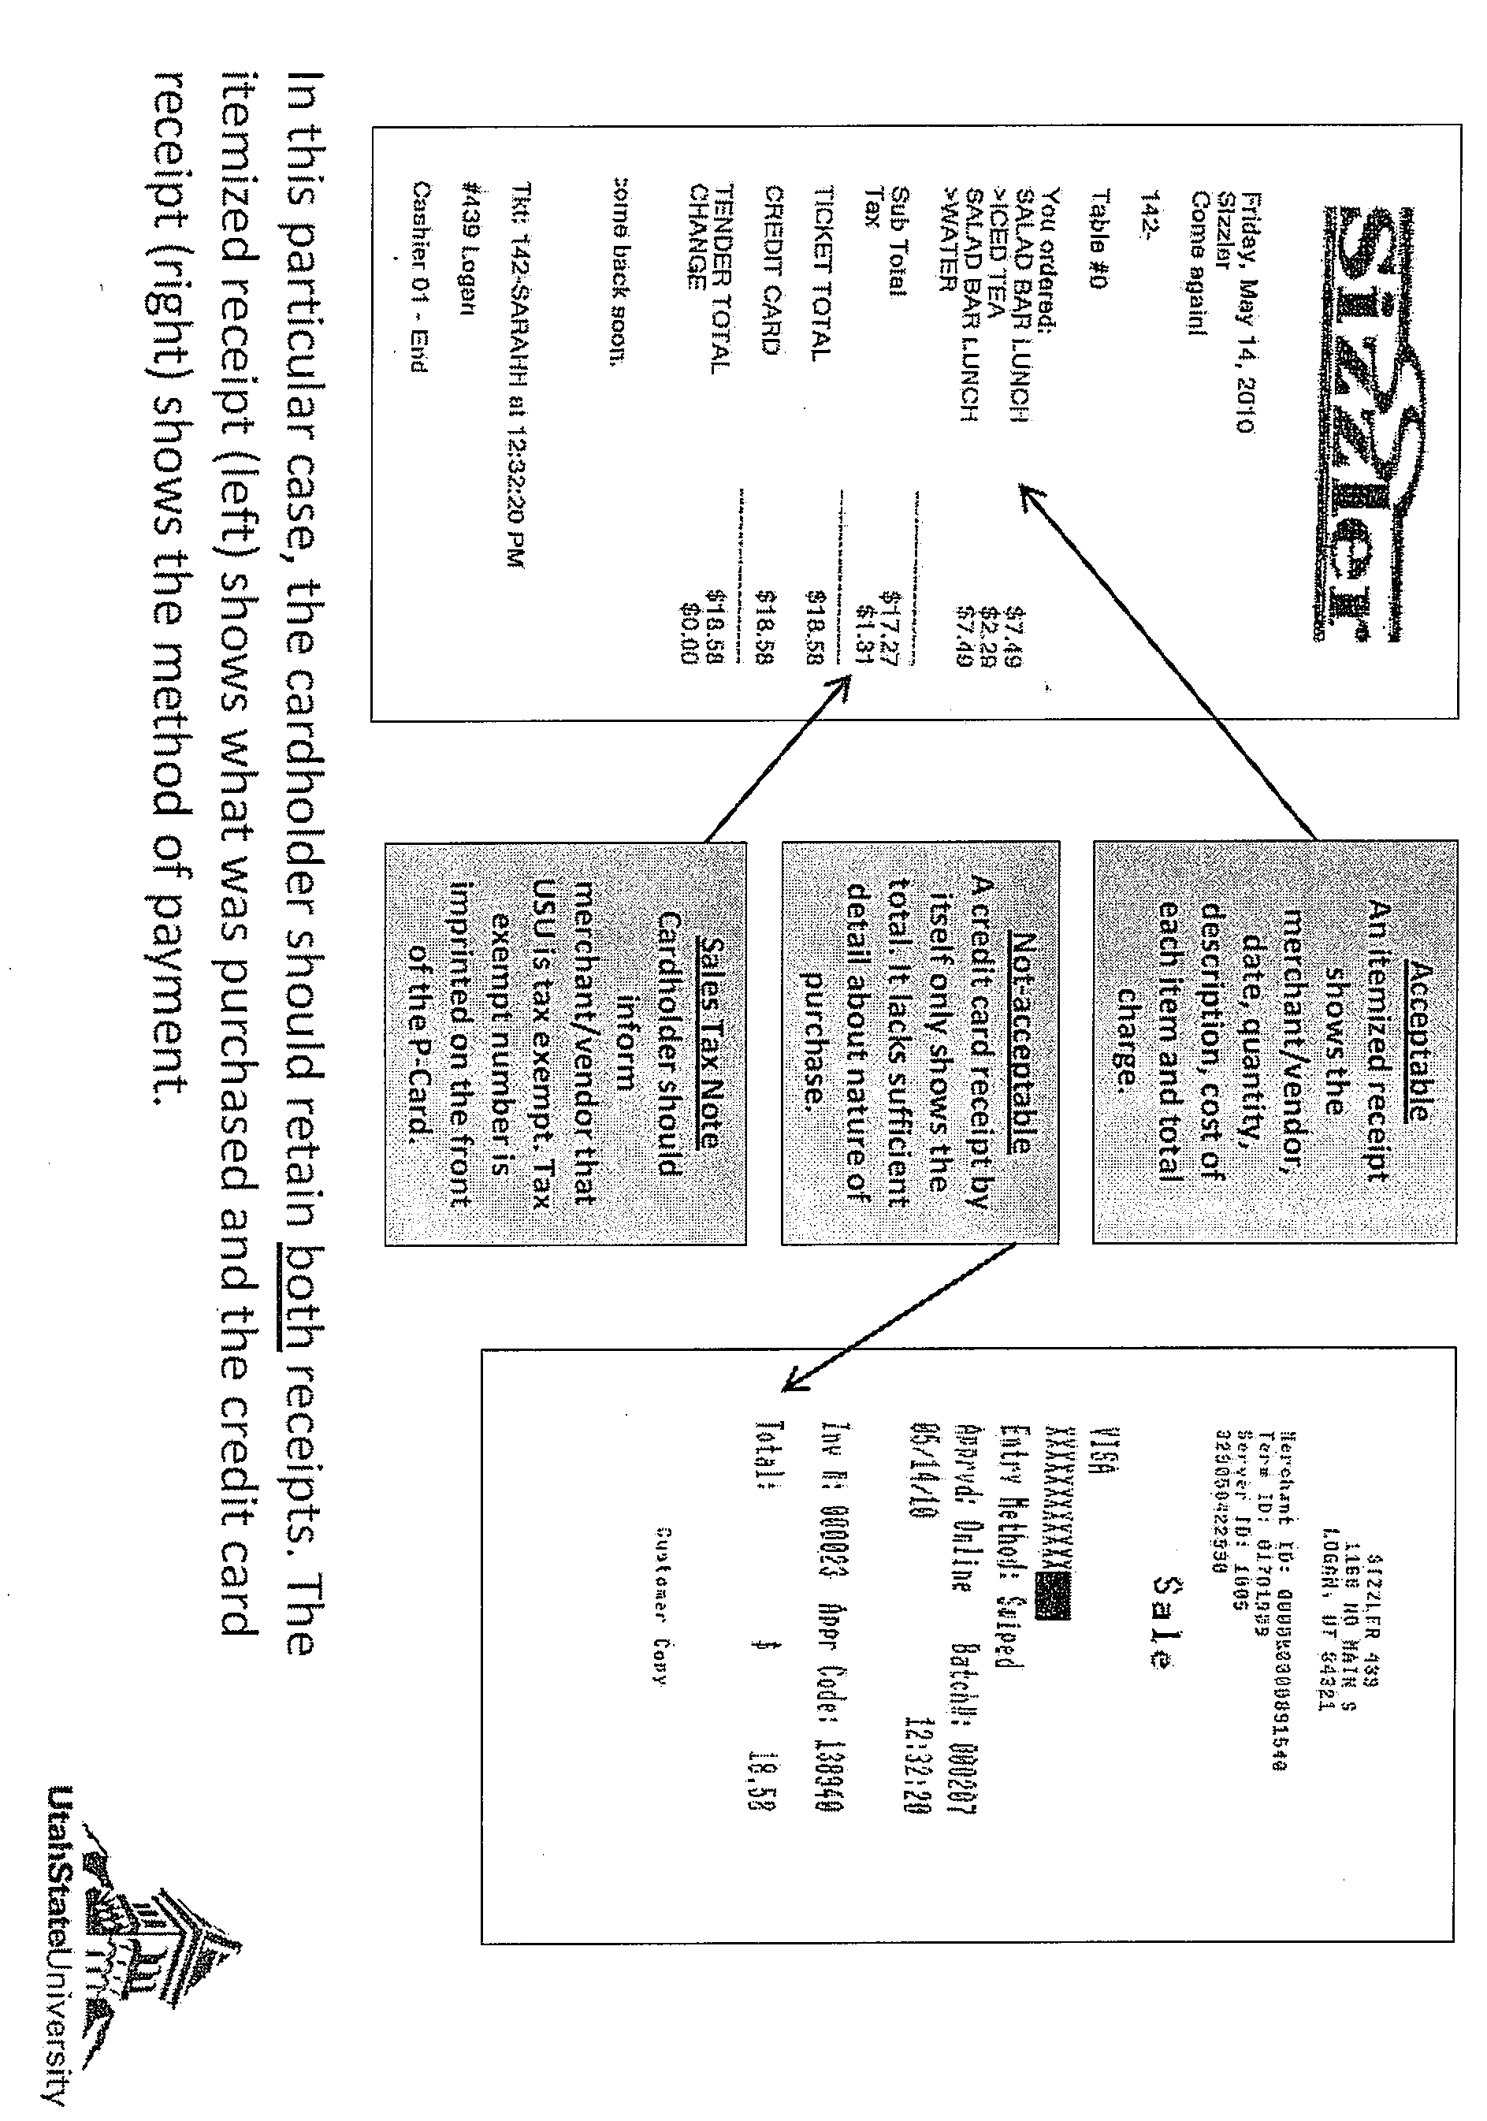
ITEMIZED RECEIPT

Slide 4
When purchasing online:
Verify the merchant’s website is secure. There should be a “lock” icon in the browser window. There should be “Https” in the browser address when entering the P-Card number.
Do not send the p-card number through email.
When purchasing on-campus:
* Always take your P-Card with you – merchants are required to see the card.
* Use the OCC number (printed on the card), not the 16-digit card number.
* Keep the OCC number as secure as you do the 16-digit Visa number.
ONLINE and ON CAMPUS PURCHASING

Slide 5
PROHIBITED PURCHASES
No personal purchases (even if you intend to reimburse the University)
Travel expenses on Travel or All card only—not a pcard.
No alcohol purchases.
No paying for services
No construction.
No research animals.
No radio active chemicals or isotopes.
No splitting purchases.

Slide 6
SPLIT PURCHASES
Purchases cannot exceed card limit.
Cannot pay some now and some later to keep things under the limit.
Cannot run the card twice in a row for the same thing.
EZ Buy is the best option for large purchases. Contact your Finance Specialist before the items are ready for pick up so a PO can be generated to give to the vendor. Then a check can be generated within 24 hours of product completion.

Slide 7
Service Now Electronic Forms
The Meals &Entertainment form and the Memberships and Dues form is now electronic through Service Now. These forms will now be filled out by the card holder. Receipts requiring M&E or Memberships and Dues forms will be processed as follows.
Receipt and M&E are scanned into Box as one file by department.
Level 10 processor will upload to Service Now where they will select M&E or Memberships and Dues.
The Level 10 processor will fill out the electronic form based on the info submitted with the receipt.
The receipt will route to Finance Specialist (level 200) for verification.
The receipt will route to department director (level 300) for approval.

Slide 8
RECEIPTS
When a purchase is made, the purchaser is responsible to turn the receipt into the department liaison with 24 hours of purchase for scanning into your Box. Each cardholder has a QR code that is connected to your Box, after you get your receipt and sign your signature by the total scan the QR to attach your receipt.
Anna Francis is the Business Services Receipt Attacher (Level 10). Her job is to search your Box for the receipts that match Service Now transactions. If the receipt is not available to attach, the transaction will be placed on the Missing Receipt report.
The Missing Receipt report is sent to each department every week. The department liaison then works with the cardholder to track down missing receipts.
If the receipt is still not available on Box after 28 days, the card is eligible for suspension. All cards in the card holders name will be suspended until pending receipts are turned in. During that time, work-related purchases made by the cardholder will not be reimbursed.

Slide 9
REMINDERS!
A P-card is a card that can be used for basic purchases on or off Campus except when connected to travel. A P-card can be used by the P-card holder AND anyone delegated as a user.
An ALL Card can be used for any type of purchase, travel related or not, but can ONLY be used by the cardholder. An ALL Card cannot have any delegated users.
Anyone being brought to Campus to speak to a group, (student or employee) regardless of whether or not they are receiving payment, needs to have a contract in place. This can be a lengthy process, so please speak to your supervisor or Finance Specialist if you have questions on how to proceed. Allow 4-6 weeks!
Anything being rented requires a contract that cannot be signed by anyone except a designated USU representative.
If you have a purchase that will exceed $5,000, USU Purchasing Policy states a bid must be obtained before the purchase can be made. Please contact your supervisor or Finance Specialist on how to proceed.
Personnel of Student Affairs are allowed to tip 18% on meal purchases unless the restaurant has a policy stating otherwise.

Slide 10
Out of respect for your Department Liaison and Finance Specialist who reconciles the p-cards, PLEASE get a proper receipt and make sure it is handed in within 24 hours of purchase. We can’t give you or your Director up-to-date figures if we can’t process Service Now transactions.
THANK YOU!!!

