Slide 1
Travel
2026-2027

Slide 2




Travel Specialists:
Barbara Madsen
Barbara.Madsen@usu.edu, 435-797-9825
How to start your travel
Rules and Procedures
Reservations
Helpful hints

Slide 3
A TA (travel authorization) is needed ANY TIME you leave Cache Valley! No exceptions.
A TA number is required to purchase everything associated with your travel.
A TA will be initiated by your direct report and approved through business services after your Do Sports Easy is completed. Direct deposit will need to be set up for the traveling representative.

Slide 4


Rules and Procedures
Remember, earlier is BETTER.
Not submitting the travel requests prior to travel is against University Policy, and is a minor infraction that will result in at least a $75+ fine. Not completing a travel request prior to travel more than once will result in a $300+ fine and your team may lose travel privileges after the first time.
Travel needing reservations must be turned in at least 3 weeks (15 business days) prior to departure.
Appointments for reservations must also be 3 weeks prior to departure.
Travel not needing travel reservations must be turned in at least 2 weeks (10 business days) prior to departure.

Slide 5
STEP ONE: Make a travel plan:​
​
Check your account balance and meet with your direct report to discuss travel options and budget.
Look up some hotels and flights to have an idea of prices and options to book. Have at least 2-3 options before appointment.

Slide 6
STEP TWO:
Complete Do Sports Easy
Include all travel information!

Slide 7
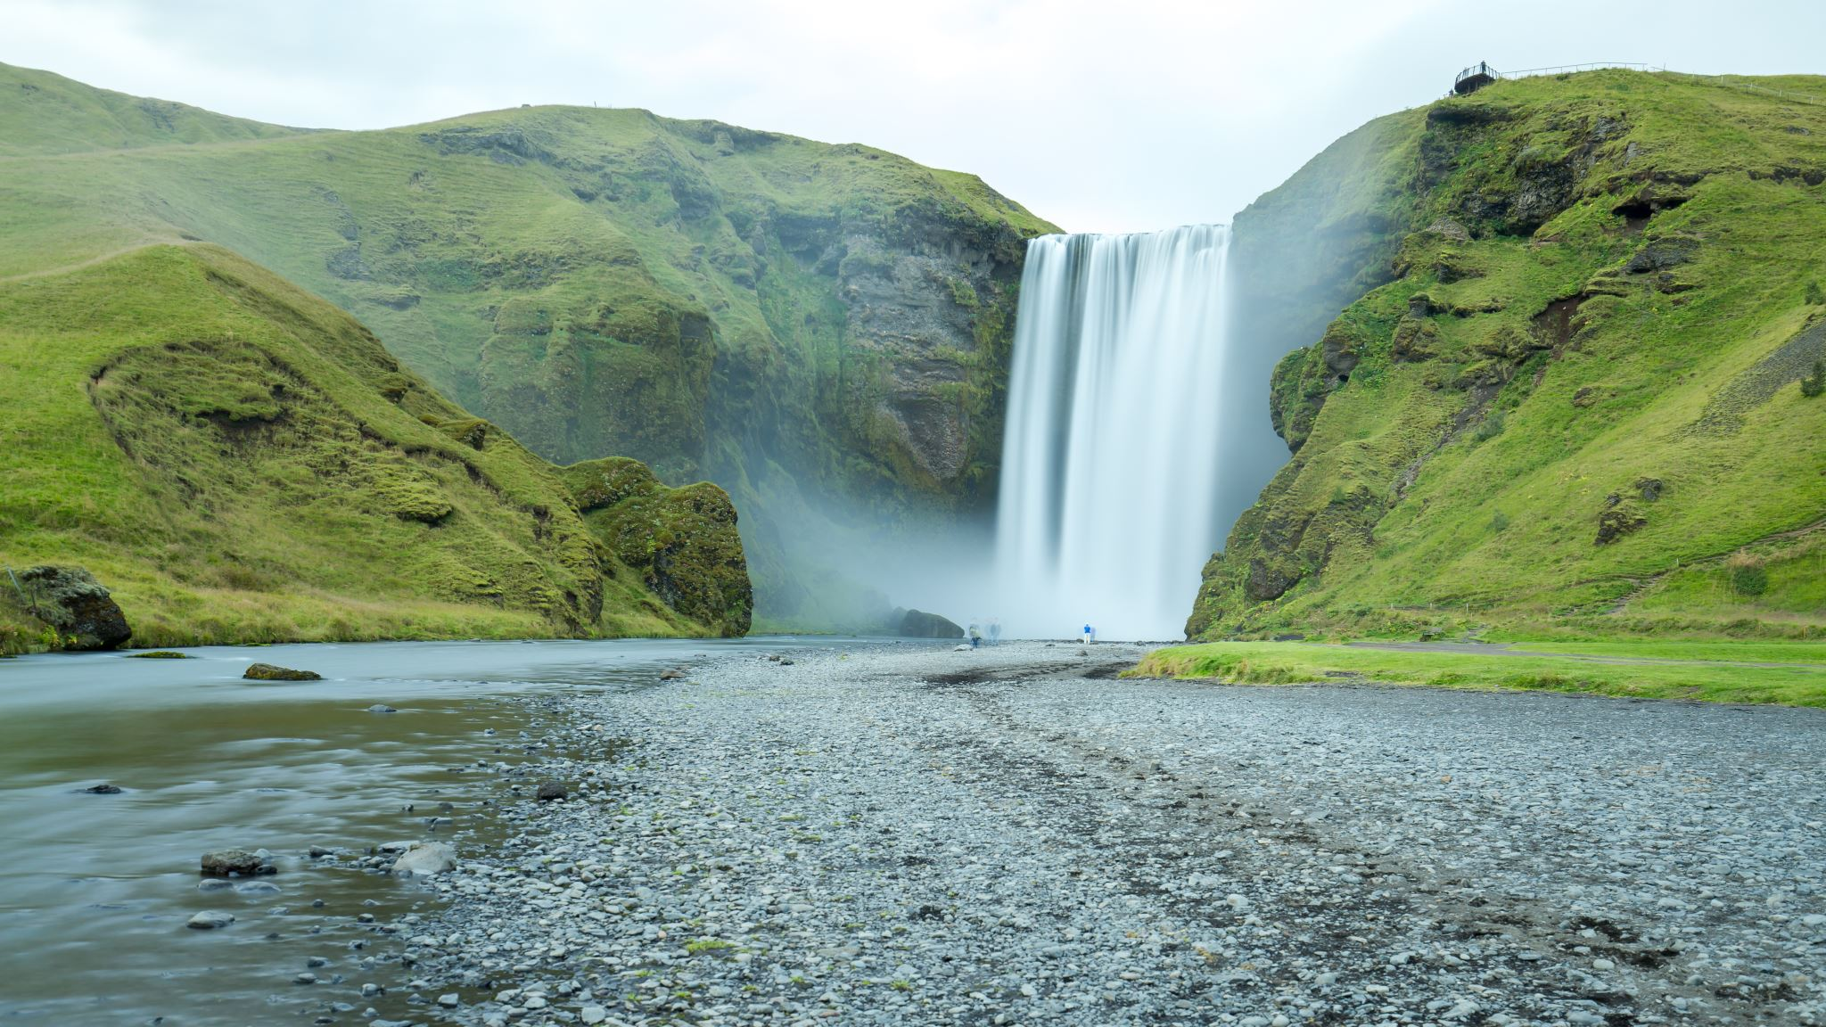
STEP THREE: Make travel arrangements:
OPTIONS:
You can either-
Complete your hotel, flight, rental car reservations on your own with your All card (you will turn in your signed receipt to be completed with Campus Rec)
OR
Complete your hotel, flight, rental car reservations with your direct report (receipts will be signed at time of booking)

Slide 8
All Cards
University credit card- ALL CARD
Request a card from Jennifer.Seamons@usu.edu.
Cardholders are required to complete USU's cardholder training regardless of type of card when applying for their first P-Card and every two years after through the Annual Compliance Training Calendar. Cardholder training is available online at USU Cardholder Training for Cardholders and Delegated Users.
Purchases cannot exceed $4999.
(Your department can set a lower amount.)
Your card amount can be increased by emailing your direct report then they will initiate a request with Jennifer or Barbara three days before you make your purchase. The limit will then return to normal.
You will need to explain what reservations you are purchasing and approximately the amount, the increased amount you need, what club team, and the purpose of your purchase/travel at time of request.

Slide 9
All Cards
Splitting a transaction to avoid card decline due
to the single transaction limit is prohibited, no matter what the single transaction limit is. Some hotel reservations will only sell a certain amount of rooms in one transaction (like Lucid).
UPON RETURN:
Keep all receipts! Take a picture of them in case you lose one.
Receipts need to be turned in 72 hours after return to Campus Rec and
you will fill out a form for reconciliation of expenses. If they were pre-paid the receipts will be signed at time of purchase.
(late receipts may be fined $75)
Itemized Receipt
An itemized receipt is produced by the vendor and contains all of the following information:
The name of the company
The date (the dates MUST match the dates on your TA) example: Gas RECEIPTS; please explain if they don't match!
Description of purchase
Price of item and quantity per item purchased
The total amount charged
Signature

Slide 10
Helpful travel tips for Transportation
Flights
Flying:
You can book individual flights through the airline of your choice. Prices will vary and increase the closer they are to your departure date. Please look early for the best rates; booking 6-8 weeks in advance is when most airlines have prime rates.
Each airline has varied cancelations depending on the cost of the ticket. Please read the policy so you know if you can cancel, transfer, or change your ticket. If you purchase non-refundable tickets, there are no refunds.
You can book group flights (10 or more passengers) with Southwest, Delta, etc. Group flights may incur booking fees for each person. Southwest has been used the most with two free bag and doesn't charge extra fees.
No extra fees for booking, ticketing, or name changes.
Unlimited name changes up to three business days before date of travel.
For every 29 Group tickets purchased, one Tour Conductor ticket will be provided free of
carrier charges (does not include taxes and fees from $5.60 one-way).

Slide 11
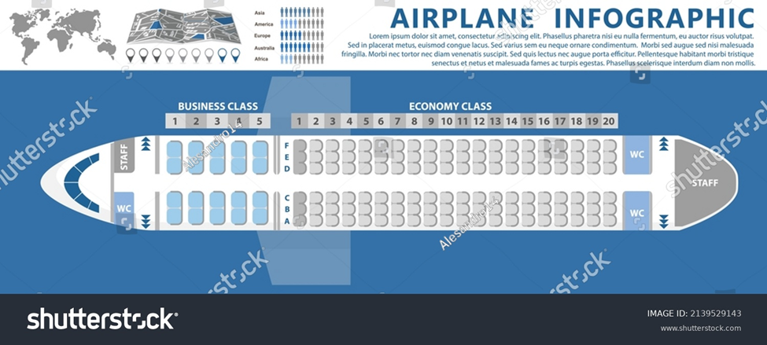
Helpful travel tips for Transportation
Flights
Flying: Group sales:
Flights with more than 10 passengers will most likely need an increase on card.

Slide 12
Driving:
Options include: Personal vehicles, Motor Pool, Rentals
Personal Vehicles
Always start with a full tank and fill tank on day of return
Keep all receipts to turn into campus rec for fuel purchased with card.
You must have a valid license to operate the type of vehicle involved
NO citations received within the past 12 months for any of the following: an automobile accident, driving under the influence of alcohol or drugs, or reckless driving
1. Vehicle needs to be licensed and registered, and driver is authorized to operate vehicle
2. Complete Driver Training Procedure (link on team resource page)
3. Must be done every school year
4. Upload the “Certificate or Completion” to DSE when registering.

Slide 13

Safety is the First Priority
No hitchhikers
No traveling between the hours of 11 pm and 5 am
Driving time cannot exceed 10 hours per 24 hour period
Change drivers every 4 hours when driving for 10 hours
(STOP in a SAFE place to change drivers like rest area, gas station, off an exit)
Wear your seat belt any time the vehicle is in motion
For weather factors, an accident, or if your vehicle breaks down, call direct report/campus rec immediately
For accidents, please refer to http://www.usu.edu/risk/vehicles/vehicle-use-policy and find additional information for Enterprise and accidents in team Tracker in BOX

Slide 14

Safe travels!

