Slide 1
What’s old & what’s new in p-card
Tuesday, August 13, 2019

Slide 2
Why do we do what we do???

Slide 3


Slide 4
Because that’s the way we have always done it!
?
?
?
?
?
?
?
?
?

Slide 5
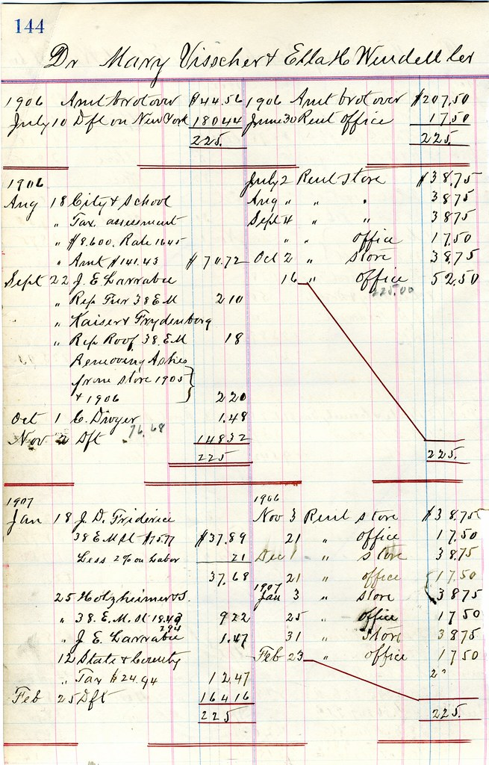

Oh! How things have changed!
OLD WAY
NEW WAY

Slide 6

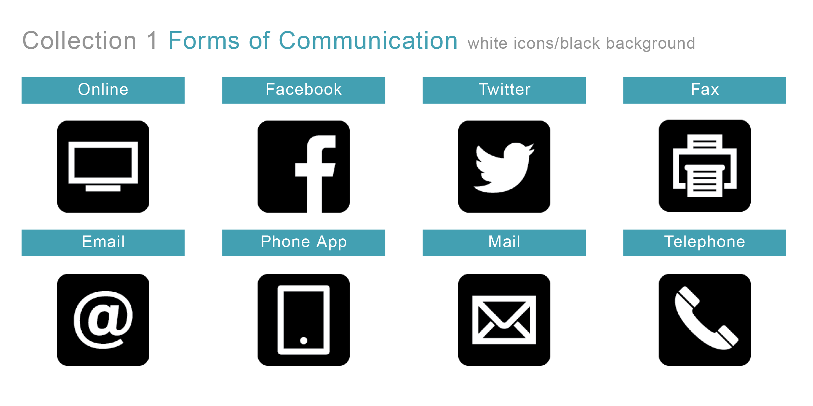
Oh! How things have changed!
OLD WAY
NEW WAY

Slide 7

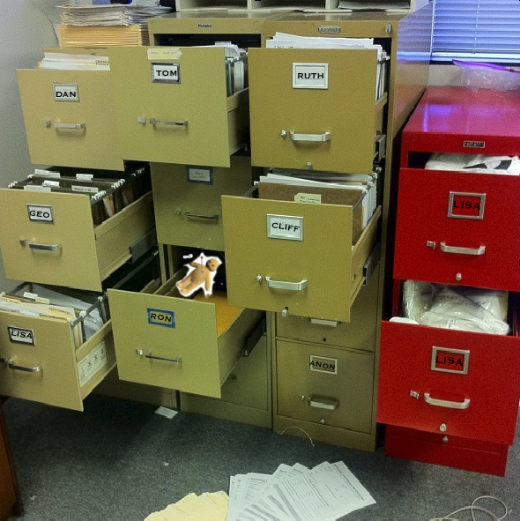

Record retention
PAPER – STACKS & STACKS OF PAPER
ELECTRONIC STORAGE SYSTEM

Slide 8

P-card RECORD RETENTION
ONCE A TRANSACTION IS COMPLETED (S# IN BANNER)
AND THE MONTHLY REPORTS HAVE BEEN RECONCILED
  THERE IS NO NEED TO RETAIN PAPER COPIES OF RECEIPTS OR SUPPORTING DOCUMENTATION

Slide 9

RECORD RETENTION
PROCESSING TRANSACTIONS IN A TIMELY MANNER

Slide 10
P-card RECORD RETENTION
TRANSACTION RECORDS ARE STORED IN SERVICE-NOW
TRANSACTION RECORDS PRIOR TO JUNE 1, 2018 ARE STORED IN XTENDER
WORKFLOW TRANSACTIONS ARE IN XTENDER
FGIDOCR
ENTER S#
GO
RETRIEVE
Items that are not electronically stored should be kept for 5 years.
Special Projects

Slide 11
Utah state sales tax state tax license no. 11895815-002-stc
Online
In Person
Attempt to indicate that Utah State University is a tax exempt entity whenever possible.
Not every website has a tax free option.
lodging is an example of a purchase that currently is not exempt unless the amount is for a $1,000 or more or the vendor has a negotiated contract.
The tax exempt number is printer on the front of every p-card.
Let the Merchant know prior to starting your transaction.
Although penalties are not assessed for Utah Sales Tax charged to your purchase, if the amount is material, your department may want to pursue a sales tax credit from the vendor.
Not every vendor will honor the exemption. If this is the case, make a comment on the receipt and the P-card transaction in Service-Now.

Slide 12
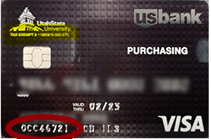

Slide 13
Fraudulent p-card transactions
CARDHOLDER
Notify the P-Card Program Administrator by phone (435) 797-1011or email pcardadmin@usu.edu
Sign-up for text or e-mail Fraud Alerts
  U.S. Bank offers text and email fraud alerts, which cardholders can enable via Access Online. If a cardholder is enrolled for this service, they will receive an email or text if a fraud alert has been placed on the account. The cardholder can respond via text to confirm if the transaction is fraudulent or legitimate. Once contact is made and validity of the transaction is confirmed, the block is removed. If the cardholder has not contacted U.S. Bank before the end of the business day, the account will appear on a report that Client Services receives the following day. Client Services will send an email to the Program Administrator to advise that the account needs to have activity confirmed by the cardholder.
Immediately contact US Bank at 1-800-344-5696. This number is printed on the back of every P-card
The cardholder must call the issuing bank immediately upon discovering a fraudulent transaction. Help is available 24 hours a day.
Authorized and unauthorized charges must be verified by the cardholder.
US Bank will block additional use of a lost/stolen cards upon telephone notification. Prompt action in these circumstances can reduce the University’s liability for fraudulent charges.

Slide 14
Cardholder Access Online Log-in
Cardholders should sign up for an ID to access their statement and transaction information using U.S. Bank Access Online.
Access Online: access.usbank.com
Org Short Name = USUEDU
Go directly to Self- Registration
Through Access Online, cardholders can:
View General Account Information/ Balances/ Payment Address
View Current and Historical Statements Online
Maintain their address/phone number on account (if your organization allows them to maintain their address)
View & Dispute Transactions
Run Transactional Reports
View Foreign Transactions/US dollar amount on posted Items
Set up text and email fraud alerts
Through the Access Online Mobile App, cardholders can:
View account status, balance, available credit balance and credit limit, search, filter and store the 99 most recent transactions
Please note that cardholders will still require their Organization Short Name, User ID and password to log into the mobile app. For assistance related to the mobile app, please contact our Access Online Help Desk at 877.887.9260.
By Calling U.S. Bank Customer Service at 800.344.5696 cardholders can:
Change their PIN
Report Lost/ Stolen /Non-Received/ Damaged/ Expired Cards
Initiate Transaction Disputes
Request Name/ Address Changes

Slide 15
Fraudulent p-card transactions
SERVICE-NOW
Mark the transaction receipt classification as FRAUD
  This will send the transaction to the P-card Office and create a replacement card request in Service-Now.
  We will monitor the fraud case until the credit transaction comes through.
  We will match the transactions and post them to BANNER
  Send a copy of all Fraud related correspondence to pcardadmin@usu.edu
Mark the CREDIT transaction receipt classification as FRUAD.
Why??
  We have constant communication with U.S. Bank.
  We will monitor and make sure the credit is received within the allotted time.
  Makes all Fraud information available for reporting purposes.

Slide 16
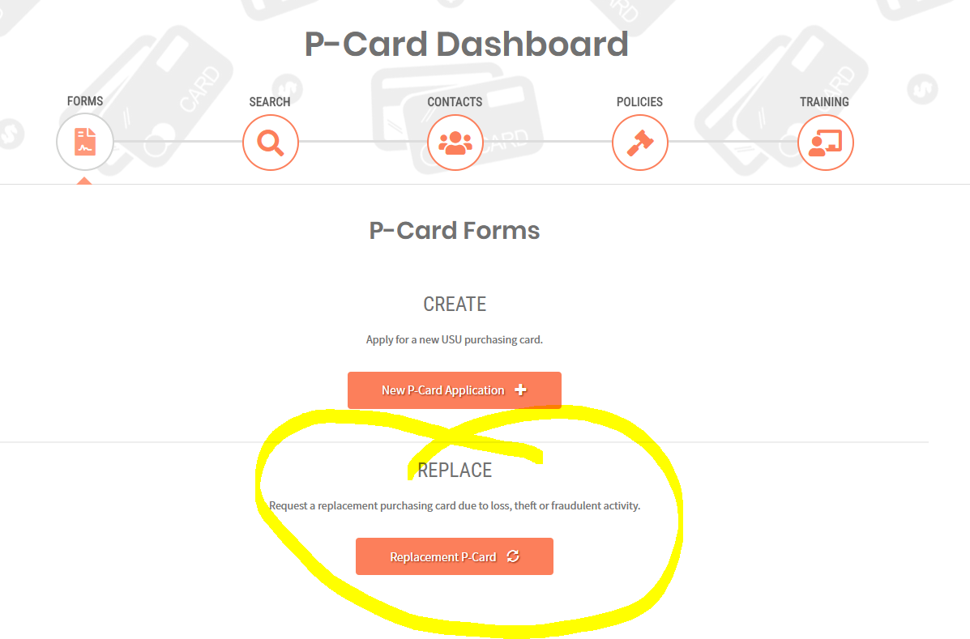
LOST OR STOLEN p-CARD
CARDHOLDER
BUSINESS SERVICES-SERVICE NOW
Immediately contact US Bank at 1-800-344-5696. This number is printed on the back of every P-card.
The cardholder must call the issuing bank immediately upon discovering that the card has been lost or stolen. Help is available 24 hours a day.
Notify the P-Card Program Administrator by phone (435) 797-1011or email, pcardadmin@usu.edu

Slide 17
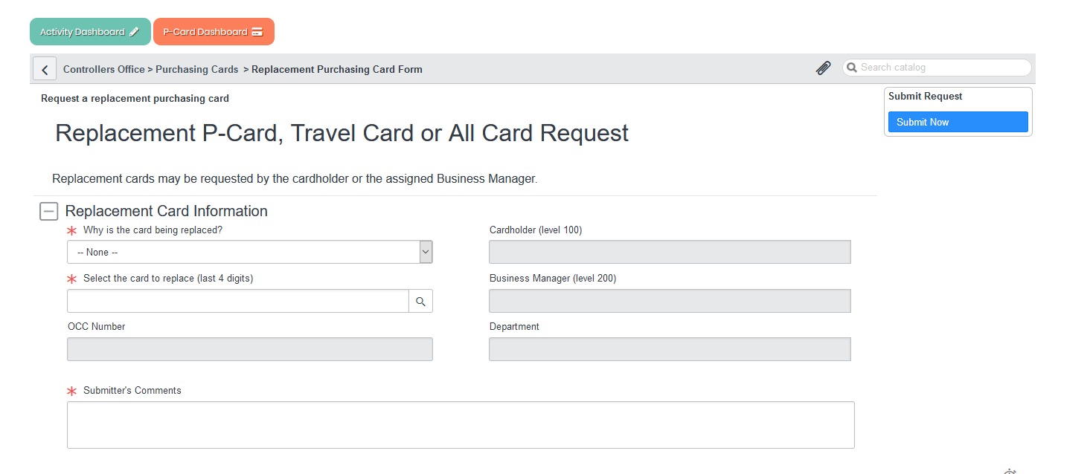

Slide 18
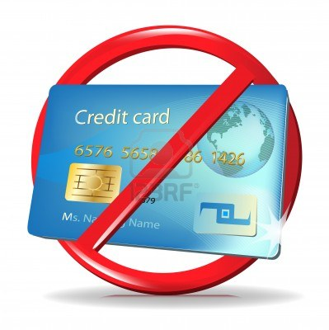
Canceling a p-card
When an employee is terminated or unavailable to approve transactions, their p-cards should no longer be used.
E-mail pcardadmin@usu.edu to cancel cards.
Credit transactions will always be allowed on cancelled cards.
Any transaction that has already been authorized will post to a cancelled card.

Slide 19
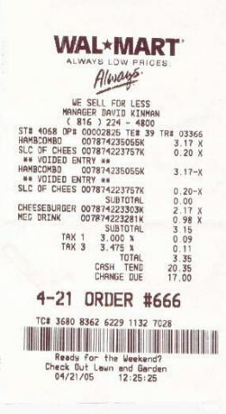
Itemized receipts
REQUIRED
Name of vendor
Date
Description of purchase
Price and quantity per item purchased
Total amount charged

Slide 20
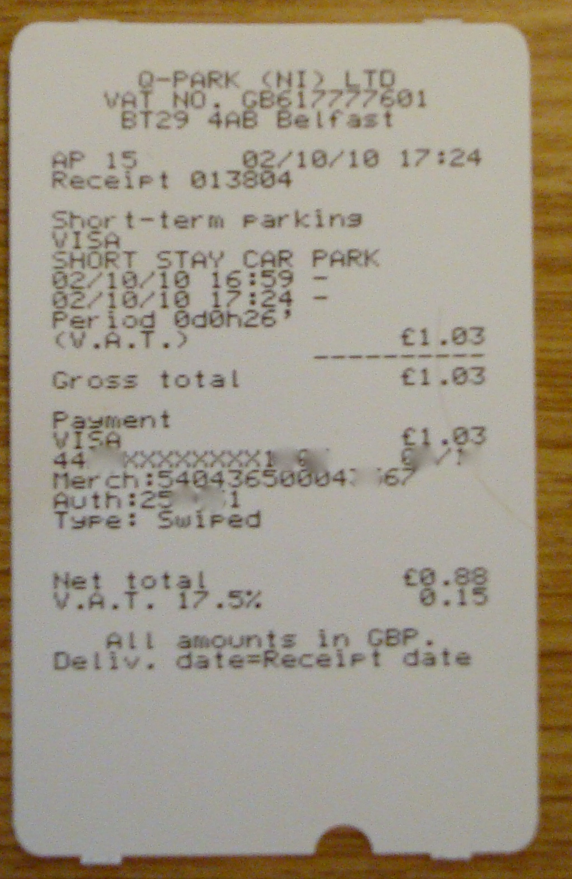
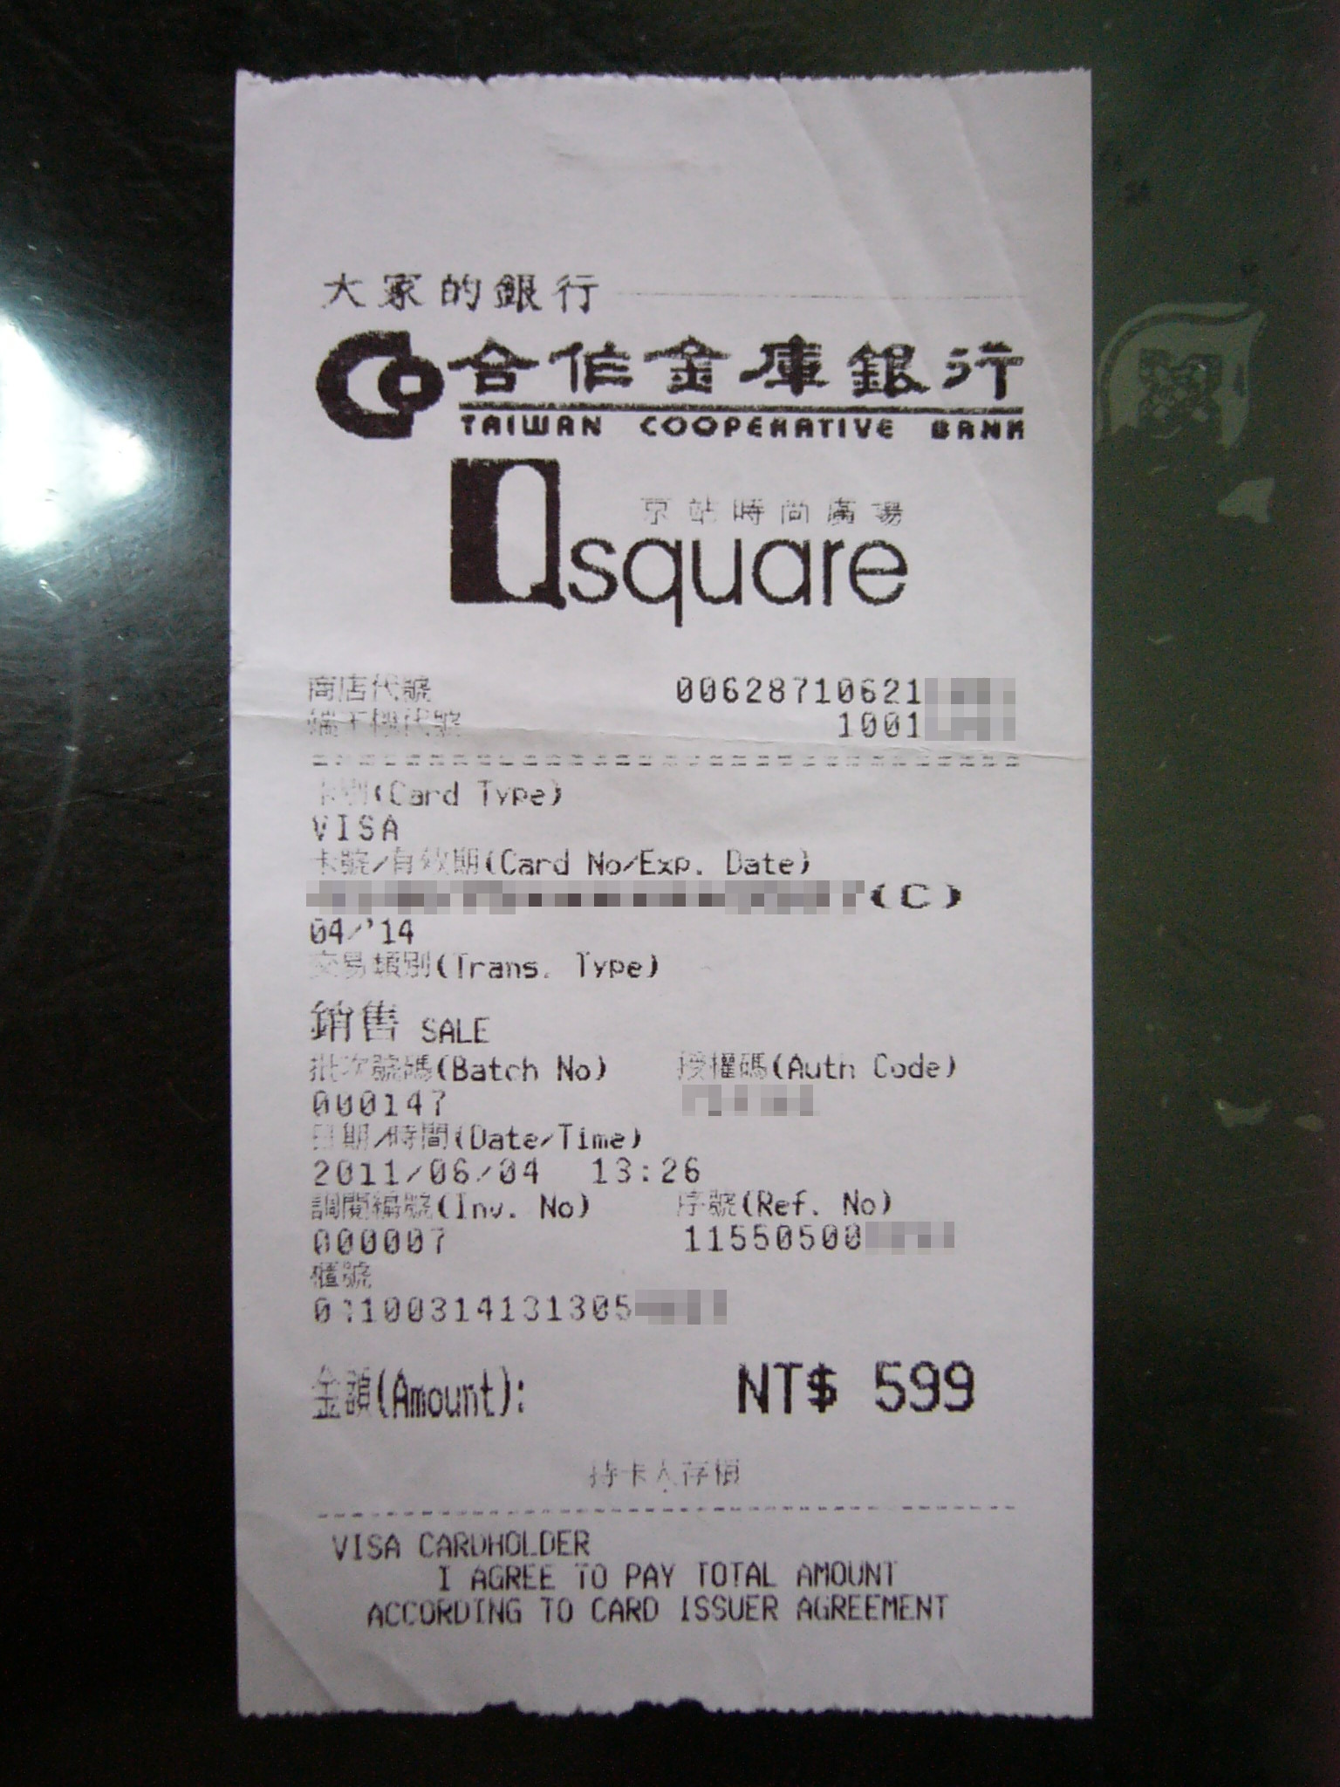
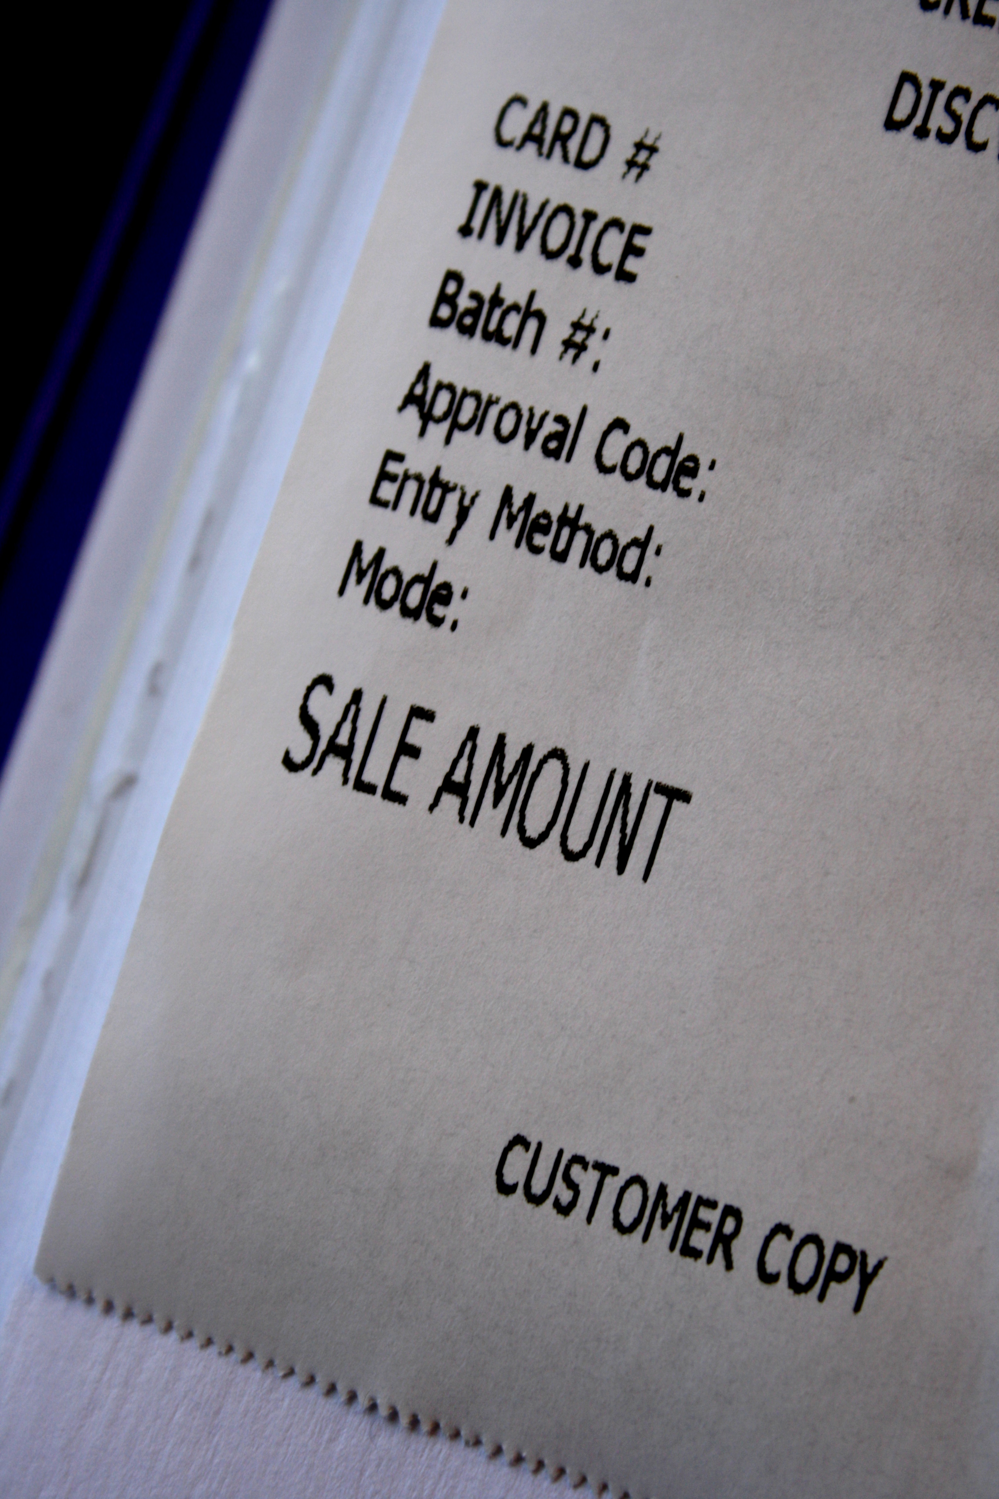
Itemized receipts

Slide 21
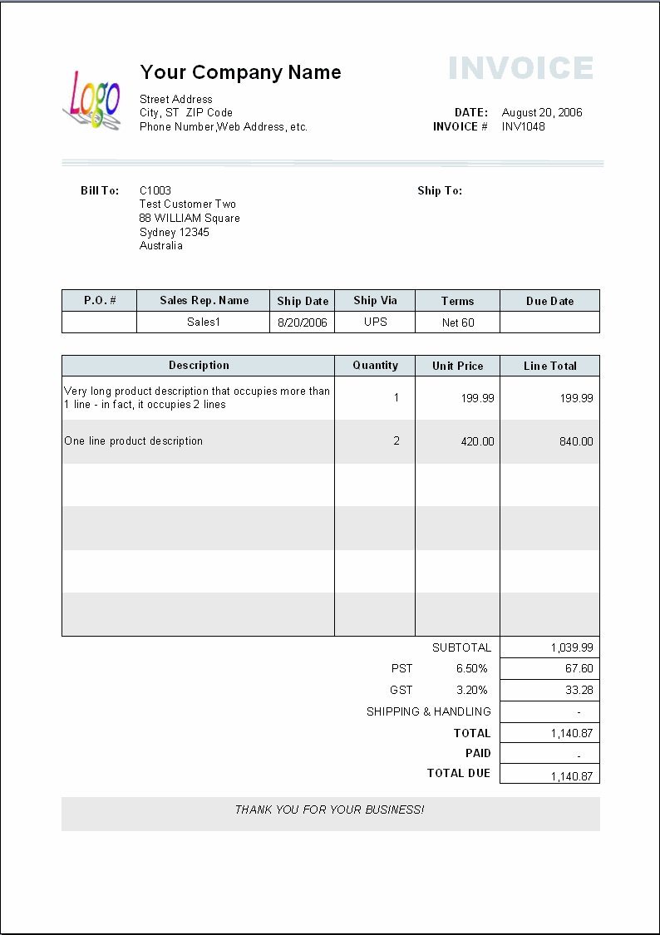
ITEMIZED RECEIPT VS. INVOICE

Slide 22
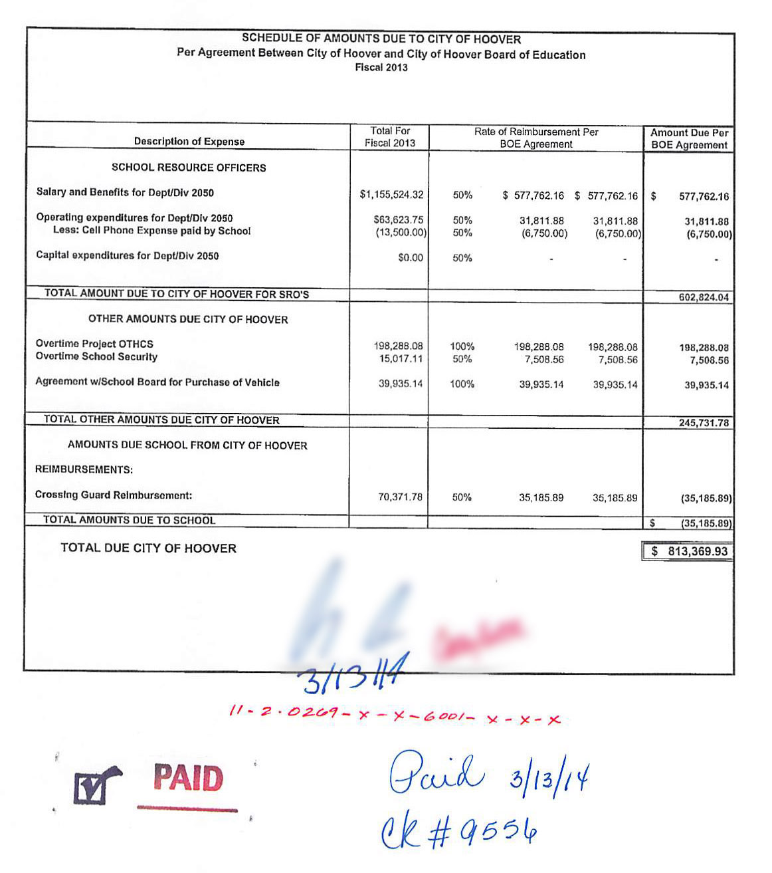
ITEMIZED RECEIPT VS. INVOICE

Slide 23
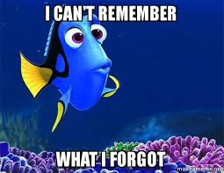

Comments in service now

Slide 24

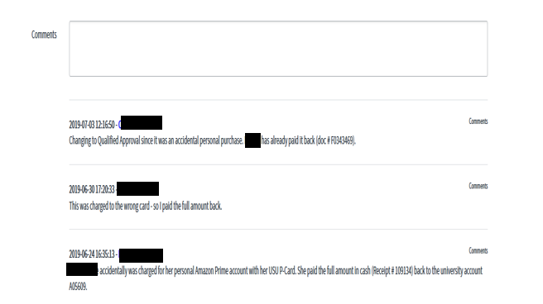
COMMENTS IN SERVICE NOW make them & read them

Slide 25

Quick thoughts & ideas
Departmental e-mail for all receipts
  Cardholders can e-mail receipts directly to the receipt attacher.
  Cardholders can immediately take a picture of their receipts and e-mail it to the receipt attacher.
Paying Invoices by Credit Card
  Every invoice over $500 goes into pay with credit card folder in EZ-Buy
  Cost Effective
  Vendors get paid faster
    Payment Plus – Single Use Credit Card
  We need the live link
Alcohol MCC Code
  Request the addition pcardadmin@usu.edu
  Rural areas – this may be their only option
  Bar & Grill establishments

Slide 26
Live presentations in service-now
Cardholder set-up and export
Transaction search and export
Where is the transaction held up at?
Where is that p-card application?
Delegates in Service-Now
  Department Person for Department Person
  Business Services for Business Services
  Set the appropriate time length for the proxy
Travel w/ M&E or M&E w/Alcohol

