Slide 1

Housing Needs Assessments 101
What, Why and How
Wendy Sullivan
Wendy@wswconsult.com
303-579-6702

Slide 2
Session Goals
What information a housing needs assessment can, and should, provide
Why the information is important
How to use it

Slide 3
What is a Housing Needs Assessment (HNA)?
A Housing Needs Assessment (HNA) provides a wholistic view of the community and housing market to determine local resident and employee housing needs across the entire income spectrum: from extremely low income through market rate.
Notes:
It looks at what the market is providing for housing, what residents and locals needs, and where the “gaps” are – this is where local programs and policy come into play to provide more housing options.

Slide 4
Example Spectrum of Housing Needs
*Incomes represent 2018 HUD calculated income limits for 2-person households
Notes:
It looks at what the market is providing for housing, what residents and locals needs, and where the “gaps” are – this is where local programs and policy come into play to provide more housing options.

Slide 5
Definitions
Affordable Housing – housing is affordable if the monthly housing payment (rent or mortgage plus utilities) is <= 30% of gross (before tax) household income.
AMI (Area Median Income) – Dept. of Housing and Urban Development standard used to define income limits for community housing units produced at various levels of affordability.
Housing Program or Strategy – an identified mechanism to address a specified community housing need, such as a type of regulation, incentive, program, fund, etc.
Housing Action Plan – an implementation plan for identified housing strategies, including actions to take, when, and by whom.
Housing Spectrum – an illustration which depicts what may be ideal for most communities – the availability of housing that is affordable to households at all income levels and provides options for changing life circumstances.

Slide 6
Building Blocks of a Balanced Housing Plan
Housing Needs Assessment
The data: how much and what type of housing is needed for whom at what prices
Housing Action Plan
Establish goals
Management and monitoring
Administration
Roles, responsibilities
Timeline
Coordination
Tracking/monitoring
Work Plans
Identify and prioritize housing strategies
Need: capacity and $$ (and partners)
Updates
Listen + Frame
Program support, education, information
Help attract/acquire funding, resources, development
THE STORY
Understand Community values
Link homes to local values
FRAME

Slide 7
HNA Contents
Housing Needs
How much?
Demographics
Economy
What price?
For whom?
Development environment
Housing inventory
Housing market
Resources, opportunities

Slide 8


Resident and Employee Housing Needs
Catch-Up – Current Deficit
Keep Up – Future Need
Unfilled jobs
Rental/for-sale shortage
Overcrowding
Job growth
Retiring employees
+105
+340-410
Total Through 2026: 445-515
HOUSING UNITS
HOUSING UNITS

Slide 9
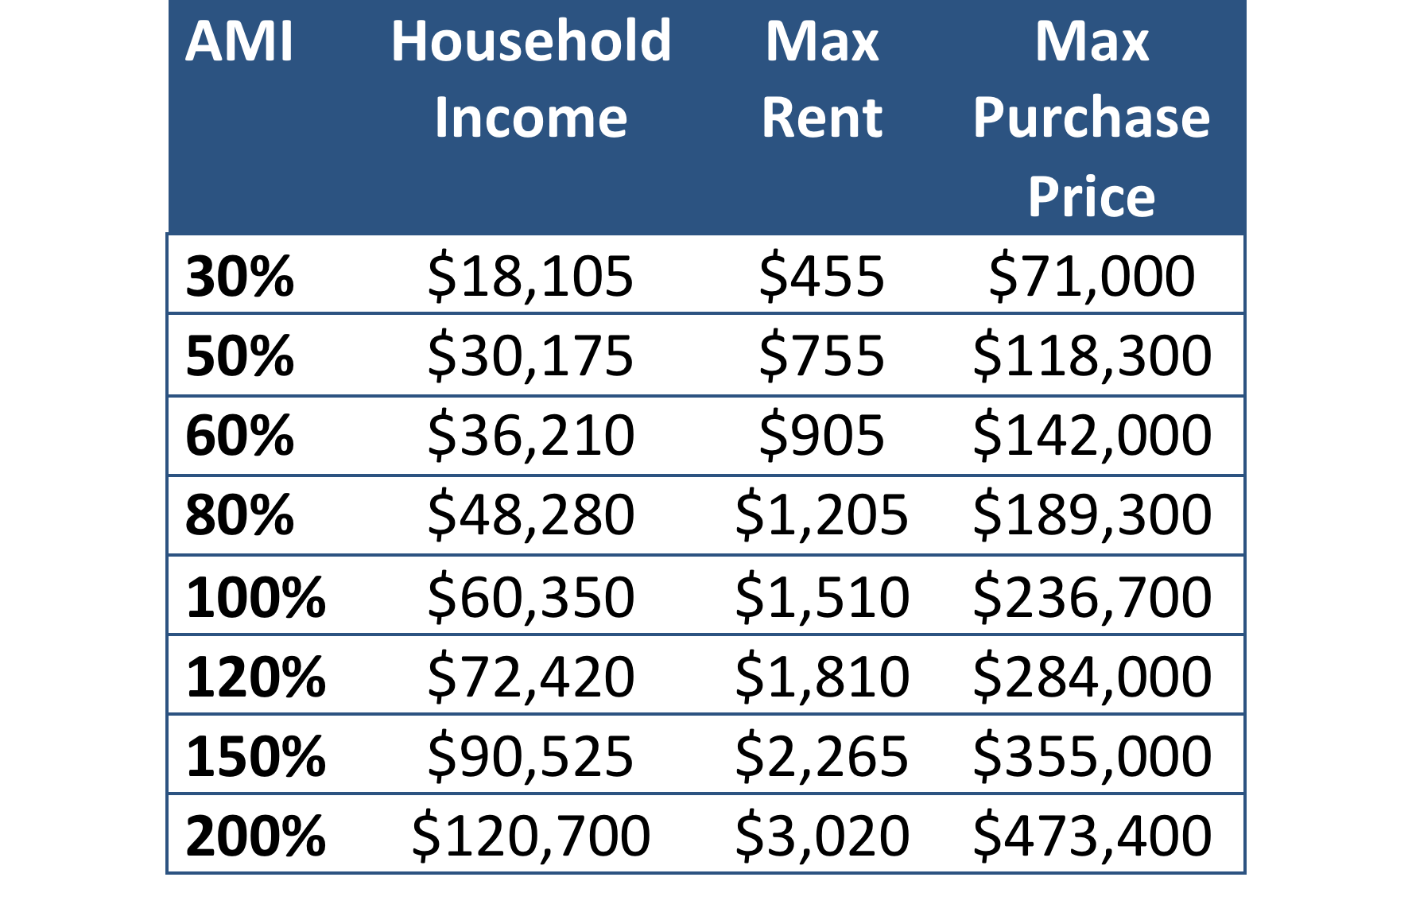
What Prices Can Residents Afford?
(2.5-persons)
“Community Housing”
30% of income for rent/mortgage
Notes:
Definition: housing is affordable when no more than 30% of a household’s gross income is used for rent/mortgage.
Table shows income for average 2.5+-person household in Big Sky.
Purchase prices assumes 30-year mortgage at 5% with 5% down and 20% of the payment covering taxes, insurance and HOA fees … 1% rise in rates will decrease affordable purchase price by about 10%.
Terminology: affordable, workforce housing, community housing
Price points of housing that relate to the categories discussed on the prior slide include:
Affordable subsidized <60%... (federal programs/funding available)
Primary renter market (80% and below) - $1,000; $166K
First time HO: 80-100% (150K-200K)
Move up ownership – above 200K (up to 300/350K primarily in your local market)
Homes above 350-400K – some locally employed HH can purchase these; but second HO heavy esp >700K

Slide 10
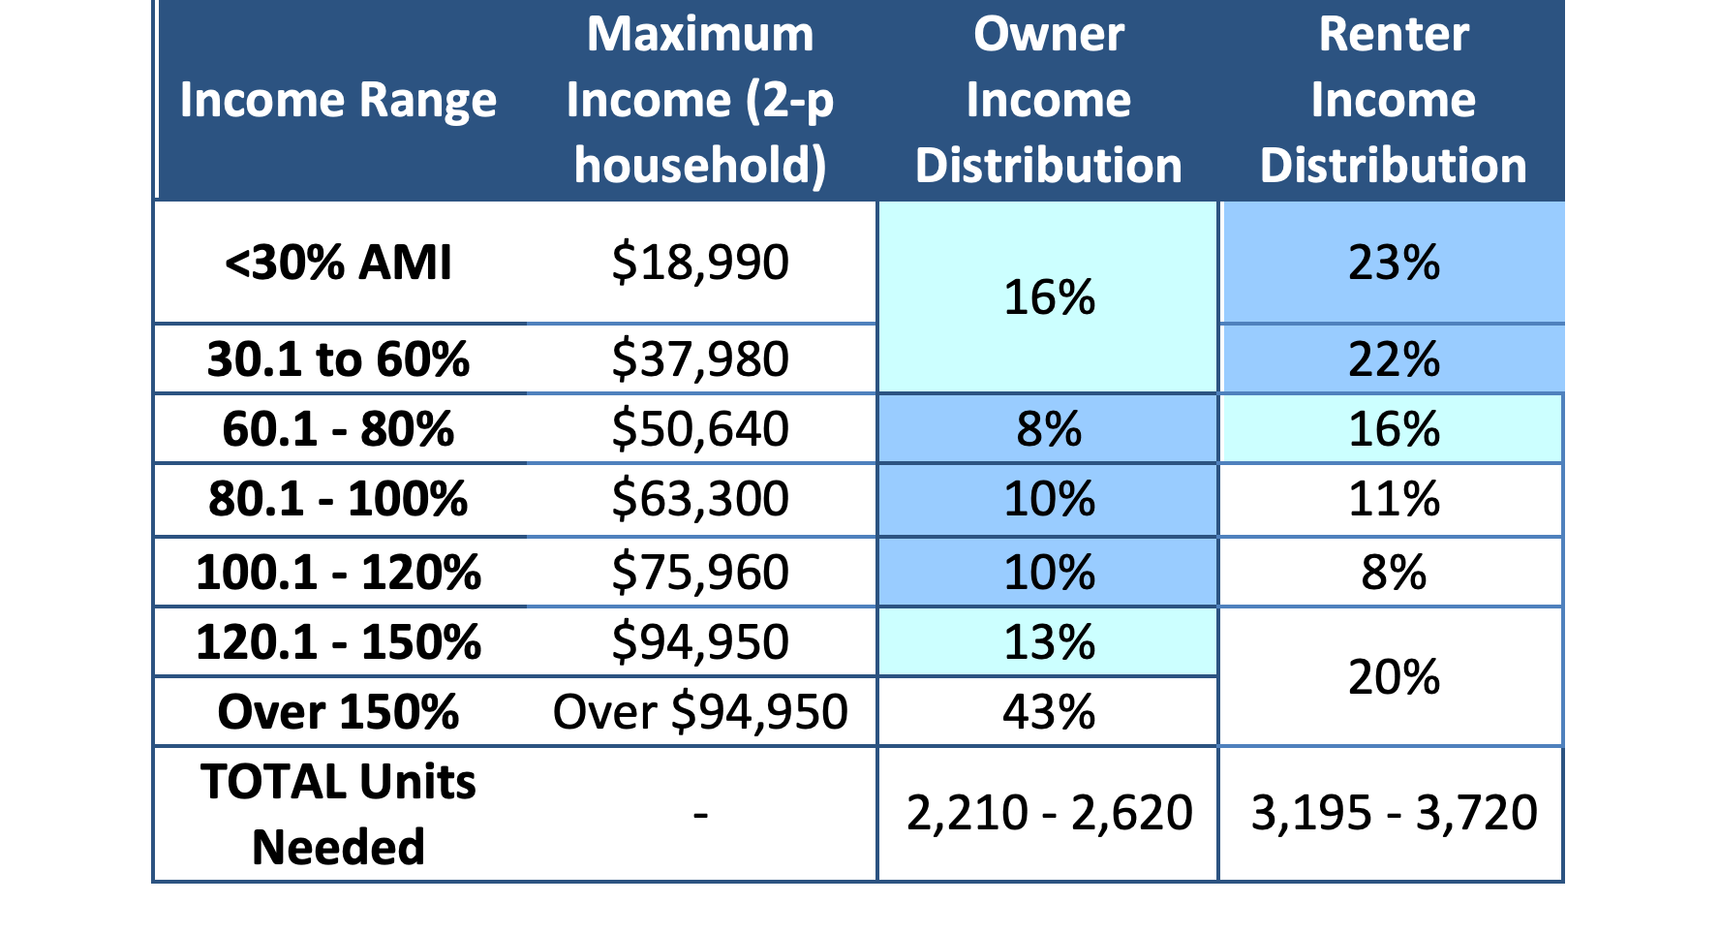
Resident and Employee Housing Needs
Notes:
Primary ownership: $160K to $350K – up to $400K for SF homes;
Primary rental: $500 to $1,000/mo; up to $1,200 for entry/young professionals.

Slide 11
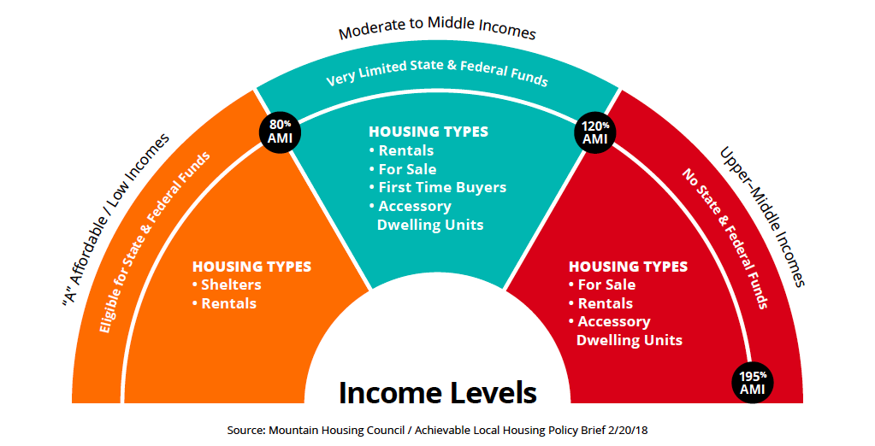
How to Use?
Establishes a “common
Vision” by which to set
goals, coordinate efforts,
and monitor progress:
Tells the “story” | Target capacity and resources
Build support/education | Ground programs in reality of needs

Slide 12
Set Yourself Up For Success
The Needs Assessment Process and Its Content Matters
Avoid Common Pitfalls

Slide 13

Pitfall #1: Terminology matters!
Community
Housing
Achievable
Local Housing
Workforce
Housing
Affordable
Housing

Slide 14
Pitfall #2: Data matters!
LOCAL DATA:
Assessor, MLS
Planning depts, etc.
YOUR STORY
PRIMARY RESEARCH
Interviews
Surveys
NATIONAL/STATE DATA:
Census/ACS
QCEW (jobs), etc

Slide 15
Pitfall #3: Know your community!
Political will
Funding
Expertise & Capacity
Management
and Oversight
Community ownership, support, education
Notes:
Will dictate the depth/breadth of study needed; and type of info to include/story to tell

Slide 16
Pitfall #4: Involvement matters!
Data
Engagement
Education
Implementation
Jurisdictions
Organizations
Non-profits
Employers/
Institutions
Community
Other stakeholders
Notes:
At the city, this would include, for example, incorporating the Plan into any Memorandums of Understanding (MOU) or contracts for implementation with supporting partners, as well as prioritizing strategies for which the City has a role and identifying capacity and next steps for implementation.

Slide 17
What NOT to Expect from a HNA
Common RFP Over-Asks or Expectations (Myths)

Slide 18
Myth #1 – HNA will build housing!
Not on its own – but it should provide information to:
Build public support (“story” and information)
Attract developer investment/interest
Compete for public monies/grants/programs
Understand your opportunities, capacity and limitations
Prioritize what to do first

Slide 19
Myth #2 –
HNA will tells us EXACTLY what to build
(# bedrooms, size of units, etc.)
Too much detail – moving target
Unnecessary – spare the expense
There is a time for this – Market Study (specific project on a known site)
Notes:
Time for this: when you are ready to create a project on a known site – Market Study (right product in the right location for the right audience at the right time)

Slide 20
Housing Needs Assessment Focus:
The Entire Bridge
Housing Market Study focus:
A specific project within
one piece of the bridge

Slide 21
Myth #3 –
HNA will tell us what we need over the next 20 years!
Consultants do not have a crystal ball (COVID?)
Housing markets change – MUST track regularly
Housing is hard – monitor progress and change programs as needed!
Do not pay for what you don’t need/will not use

Slide 22
Myth #4 –
We will learn the ONE THING to SOLVE our problem!
There is NO SILVER BULLET – multiple programs
One entity cannot do it all – it takes a community to build and retain a community
The problem is never “solved” – forever evolving

Slide 23
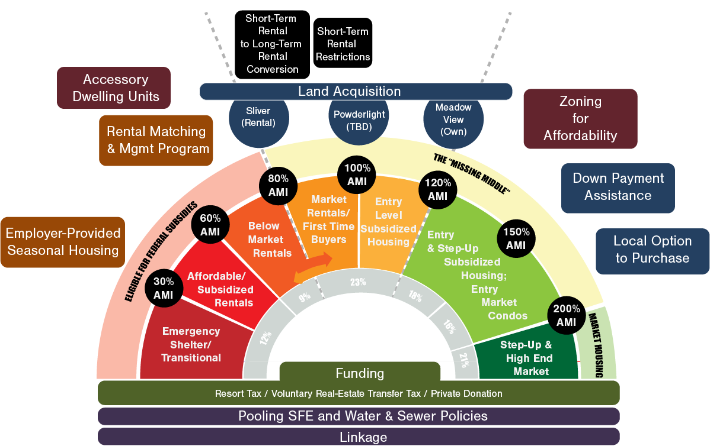
Housing Action Plan Summary
Notes:
General summary: scary graphic; summarizes the entire action plan: about 14 strategies to be implemented over the next 5 years to address the range of housing needs in Big Sky by residents and the workforce: “community housing”. This is what a 20+-member housing work group, comprised of various big sky stakeholders, employers, inst/orgs, board members, the two counties, etc spent the last several months working on, with the goal of providing more housing available to the community. You will understand this graphic by the end of our presentation, but in general, the left side represents lower incomes – seasonal workers, entry wages, etc; middle incomes at the peak and higher in incomes on the right side. The placement of the various strategies – each one of the boxes outside the bridge – generally corresponds to the income/price point of housing each strategy will target. The goal: a mix of ownership and rental housing at various price points that the community can afford to allow people to come to big sky, grow families, downsize and retire…. Life cycle housing.
As Brian mentioned (?), this process began in Nov 2017 with the first stage gathering community input through a wide-spread survey and compiling information to understand the current housing, economic market and associated needs. This information was presented at the end of Feb 2018 and kicked-off the formation of the Housing Action Plan to address community issues and identified needs.
During this presentation, Christine and I will share the stage: Christine will spend a little more time getting you familiar with this figure and show where the existing housing market hits on this bridge vs. where the primary needs of residents and the workforce are. To prvide some context for the range of housing strategies developed, I will provide some background on “how you got here” – the factors that contributed to the current shortage of community housing. We will then discuss “why this matters” – why is having housing for the community important? Finally, we will discuss how much housing Big Sky needs over the next five years to address needs and keep up with growth. This all sets the stage for further discussion of the Housing Action Plan itself: why it is important, why it has several strategies (not just one) and what they are, and what Big Sky intends to achieve in the near-term and longer term through this Plan.
One important note, however. This is called the big sky community housing action plan for a reason – it took the community coming together to form it and it will take the community coming together to make it successful: it takes a community to build a community. And with that: Christine?

Slide 24
Myth #5 – We need to know the kitchen sink!
- OR (converse) -
We know we have a housing problem – no data needed!
Don’t overpay for stuff you don’t need (see “know your community” above)
Converse: “If you don’t know where you need to go, how can you get there?”

Slide 25
Questions?
- Thank You -
Wendy Sullivan
Wendy@wswconsult.com
303-579-6702

