Slide 1
Affordable Care Act Made Easy…..ish

Slide 2

Affordable Care Act (ACA or “Obamacare”)
Was signed into law in 2010
Requires employers of a certain size (USU is that size), who offers health insurance to their employees, to offer medical coverage to any employee who works over a 30 hour a week average
Requires the employer offer medical coverage only to the eligible employees
An employer has to be able to prove that they offered health insurance to no less than 95% of their eligible employee population or they may be subject to a penalty ($2500 per full-time employee minus the first 30 will be incurred)

Slide 3
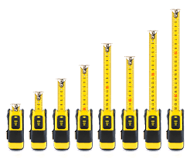
Measurement Periods
Initial Measurement Period
Initial Stability Period
Standard Measurement Period (SMP)
Administrative Period
Stability Period
Crying Period
Acceptance Period

Slide 4
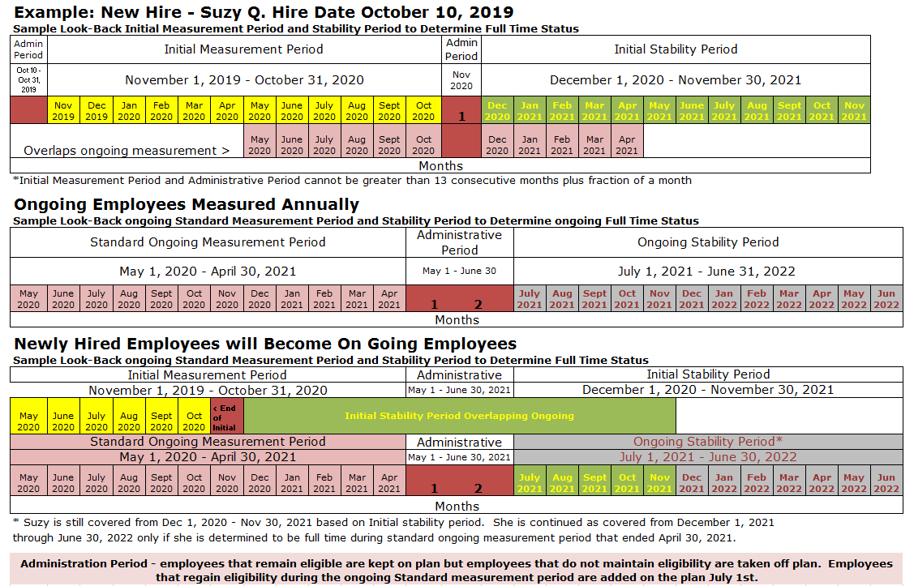
HOW DO THE MEASUREMENT PERIODS WORK?

Slide 5
Example: New Hire - Suzy Q. Hire Date October 10, 2019
Sample Look-Back Initial Measurement Period and Stability Period to Determine Full Time Status
Admin Period | Initial Measurement Period |  |  |  |  |  |  |  |  |  |  |  | Admin Period | Initial Stability Period
Oct 10 - Oct 31, 2019 | November 1, 2019 - October 31, 2020 |  |  |  |  |  |  |  |  |  |  |  | Nov 2020 | December 1, 2020 - November 30, 2021
 | Nov 2019 | Dec 2019 | Jan 2020 | Feb 2020 | Mar 2020 | Apr 2020 | May 2020 | June 2020 | July 2020 | Aug 2020 | Sept 2020 | Oct 2020 | 1 | Dec 2020 | Jan 2021 | Feb 2021 | Mar 2021 | Apr 2021 | May 2021 | June 2021 | July 2021 | Aug 2021 | Sept 2021 | Oct 2021 | Nov 2021
Overlaps ongoing measurement > |  |  |  |  |  |  | May 2020 | June 2020 | July 2020 | Aug 2020 | Sept 2020 | Oct 2020 |  | Dec 2020 | Jan 2021 | Feb 2021 | Mar 2021 | Apr 2021
Months
*Initial Measurement Period and Administrative Period cannot be greater than 13 consecutive months plus fraction of a month

Slide 6
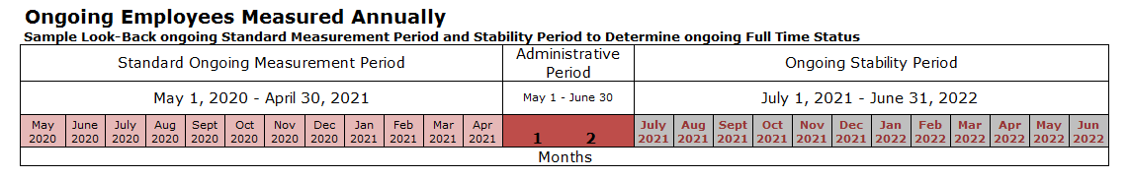

Slide 7
Newly Hired Employees will Become On Going Employees
Sample Look-Back ongoing Standard Measurement Period and Stability Period to Determine Full Time Status
Standard Ongoing Measurement Period |  |  |  |  |  |  |  |  |  |  |  | Administrative Period |  |  | Stability Period*
May 1, 2020 - April 30, 2021 |  |  |  |  |  |  |  |  |  |  |  | May 1 - June 30, 2021 |  |  | July 1, 2021 - June 30, 2022
May 2020 | June 2020 | July 2020 | Aug 2020 | Sept 2020 | Oct 2020 | Nov 2020 | Dec 2020 | Jan 2021 | Feb 2021 | Mar 2021 | Apr 2021 | 1 | 2 |  | July 2021 | Aug 2021 | Sept 2021 | Oct 2021 | Nov 2021 | Dec 2021 | Jan 2022 | Feb 2022 | Mar 2022 | Apr 2022 | May 2022 | Jun 2022
 |  |  |  |  |  |  | Still in the Standard Ongoing Measurement Period |  |  |  |  |  |  |  | Ongoing Stability Period
May 2020 | June 2020 | July 2020 | Aug 2020 | Sept 2020 | Oct 2020 | < End of Initial | Initial Stability Period Overlapping Ongoing
Months
* Suzy is still covered from December 1, 2020 - November 30, 2021 based on Initial stability period. She is continued as covered from June 1, 2020
through December 31, 2020 only if she is determined to be full time during standard ongoing measurement period that ended October 1, 2019.
Administration Period - employees that remain eligible are kept on plan but employees that do not maintain eligibility are taken off plan. Employees that regain eligibility during the ongoing Standard measurement period are added on the plan July 1st.

Slide 8

Who is exempt from ACA eligibility?
Work Study
Vista/Americorps
Who is eligible for ACA coverage?
P10’s – Exempt working a 30 hour a week average (1560 hours per measurement period)
P03’s - Grad Students reporting an average of 30 hours a week worked or more – 20 hours credited per week (1560 hours per measurement period)
P05’s - Wage Hourly employees working a 30 hour a week average – 30+ hours a week (1560 hours per measurement period)
P07’s – Teaching No Benefits, working a 30 hour a week average – 2.25 per credit + office hours (1560 hours per measurement period)

Slide 9
Rules of enrollment
Coverage starts upon start date of the full-time hourly position
Or
Coverage starts after administrative period once an employee has been deemed eligible
Rules of termination
If upon the SMP the employee has not worked 1560 hours during that period
If upon an employee experiencing a “downshift” in position and do not choose to continue coverage
Coverage ends on the 15th or the last day of the month
If moving from benefitted to non-benefitted and are qualified, if they do not average 130 hours per months for 3 months they lose coverage

Slide 10
Process for the departments
Make sure the employees complete an ACA form upon hire, transfer to their department, change in employment status.
Turn paperwork into HR timely
Then Hayden enrolls the employee
Hayden also sets up in PEAREVW for 1095 process (1095's are sent out to every employee in March)
Departments should notify Hayden if they know the employee is terminated or no longer working full-time hours

Slide 11
OTHER ITEMS TO REVIEW:
26 WEEK QUALIFICATION
-Break in employment must be over 26 weeks or it is not considered a break in employment and the employee get’s credited for hours during the break.
DOWNSHIFT RULE
- If they worked enough hours to qualify with hours from their benefited position and currently have insurance, we would offer them ACA. If they do not average 130+ hours a month for three months they would lose coverage.
OPEN ENROLLMENT PROCESS
- Every year in May, if they are on ACA and qualify for insurance, they will be offered a chance to make changes.
FUTURE OF ACA
-No changes on the horizon

Slide 12
BREATHE
​

