Slide 1

Transitioning
To Non-exempt:
What is Changing?

Slide 2

Your Rights and Responsibilities Under the Fair Labor Standards Act (FLSA)
Now eligible for overtime as comptime.
Vacation leave accrual might change based on years of service at USU. Employees now eligible to earn comp time as a third type of leave.
Required to accurately track hours worked.
Communication with supervisor about work schedule becomes even more critical.
Continued to be paid on a salary basis but time worked is tracked on an hourly basis in 15 min. increments.
Be aware of policies on breaks and meal periods.
Be aware of rules around travel.
No longer eligible for ESC lump sum payments. Additional work at USU is paid at time and one-half rates if working more than 40 hours per week.

Slide 3

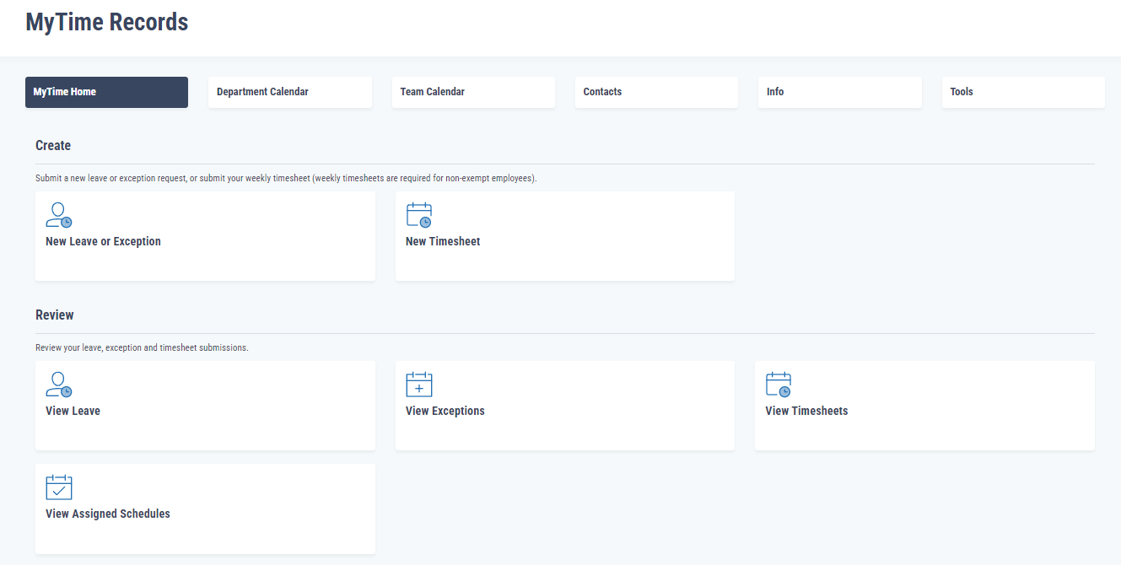
Time Keeping
Employees record hours only when leave hours are used OR additional hours worked beyond the scheduled number of hours worked. This is known as “exception hours”. The rest of the hours will default in a weekly timecard from the schedule setup by a business services representative. Leave is reported in 15 min. increments.

Slide 4
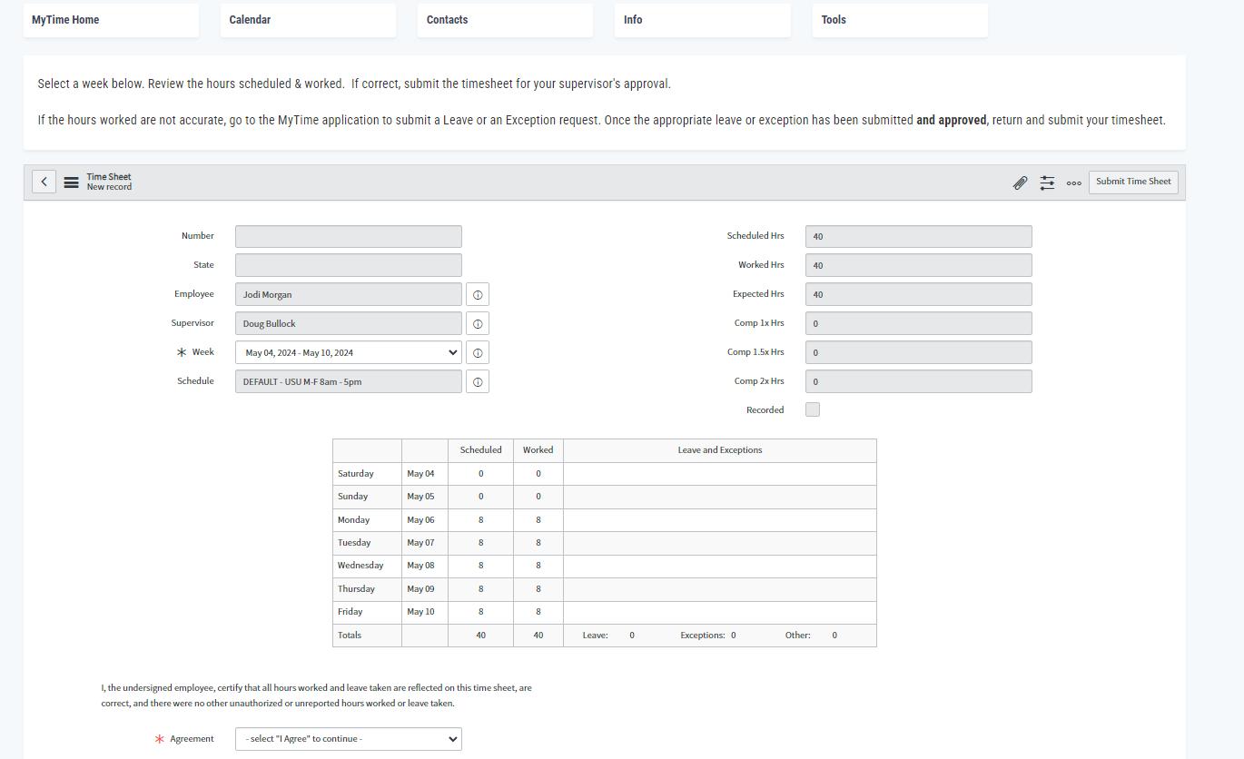
Work week = 12:01 a.m. Saturday to midnight following Friday.

Slide 5


Rest Period – 15 minutes every 4 hours worked
Compensated time. Is not cumulative and not to be used at the beginning or end of the day. Employees are encouraged to leave area to take a break.
Meal Period – 30 to 60 minutes provided for those working 5 consecutive hours or more
Time is not compensated. Employees are encouraged to leave area. If an employee does any work during their lunch (take a call, read emails, etc.) the lunch must be compensated.
Question: My office is having a Potluck during lunch. Is it compensated or not?
HR answer – It depends:
If your supervisor is requiring you to be at the potluck, then it is compensated.
If you chose to be at the potluck, then it is not compensated.

Slide 6
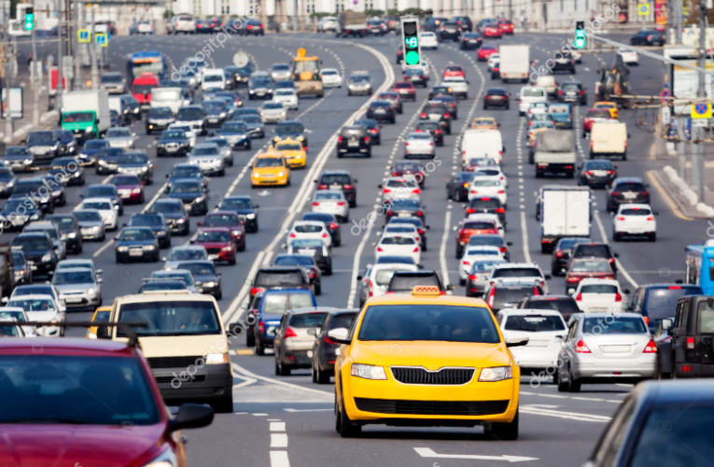
Travel – Normal Workday
General Rule – All travel time during the normal work hours are compensated.
Except
Normal to and from home commute time.
30-to-60-minute meal break.
Any pre-approved personal errand time.

Slide 7
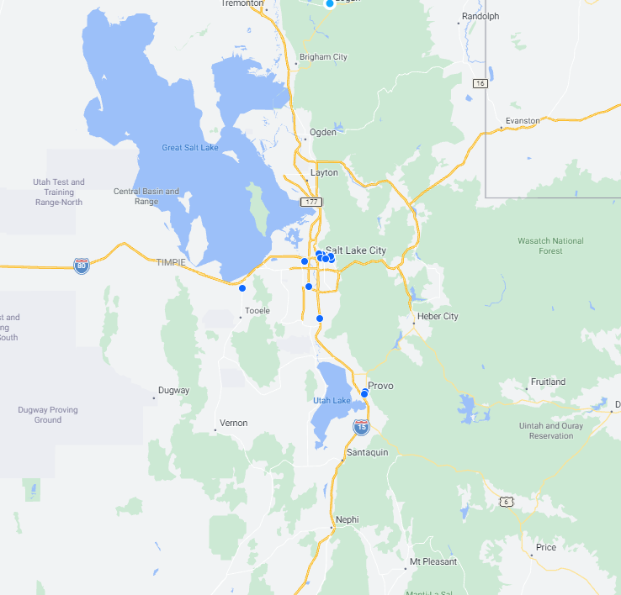

Travel: Out of Town- One Day Travel
All time spent traveling is compensated.
  May deduct employee’s normal commute to and from home time.
  May deduct normal meal period.

Slide 8

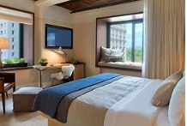
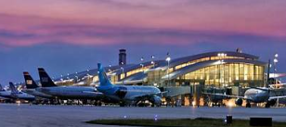
Travel: Overnight
Standard Work Hours Must be Established and Communicated
Normal Work Hours
Travel time during normal work hours will be compensated no matter what day of the week it is.
Time at destination or hotel, when free from work related duties is not compensated even during normal work hours.
May deduct normal to and from home commute time the day leaving and the day returning.
May deduct normal meal periods (if relieved from duties) if not required to attend.
Outside Normal Work Hours
If a passenger and no work is being performed (phone calls, emails, computers, etc.) the travel time is not compensated.
If the driver or pilot, then travel time is compensated.
If supervisor requires employee to attend any trainings, dinner receptions, etc. the time is compensated.
If employee choses to attend additional trainings, dinner receptions, etc. the time in NOT compensated.

Slide 9
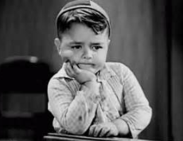

Waiting Time: On Duty
Usually, short periods of time and unpredictable in nature. Employee is not allowed to leave the workplace. The time is compensated.
Waiting Time: Off Duty
Employee is completely relieved of work duties and allowed to leave workplace. The employee can effectively use the time for their own personal purposes. Time to return to work is defined ahead. Time is not compensated. Example: meeting ends at noon. Next meeting does not begin until 2:30. Employee is free to leave and does not need to return until 2:30. Noon to 2:30 is not compensated.
On Call: On Premises
Employee is not allowed to leave the workplace. The time is compensated.
On Call: At Home
The employee can use the time for their own personal purposes. Is given a defined amount of time to come into the workplace or respond to the call. Time is not compensated until called. All time spent responding to the call is compensated.

Slide 10
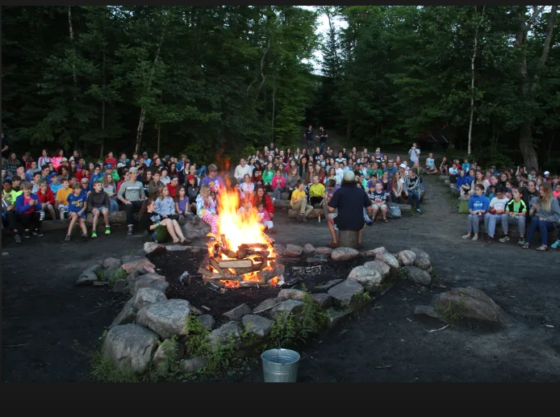
Sleeping Time: Fewer Than 24 Hours
All hours are compensated minus regular meal periods. The university is not required to provide sleeping facilities.
Example: 4-H Camp Chaperone hired 6 p.m. to 8 a.m. to help kids get into tents by 9 and be available if anyone needs something during the night. All hours minus a meal period (if relieved of duties) will be compensated.
Sleeping Time: 24 Hours or More
The university is required to provide adequate sleeping facilities.
The following can be excluded from compensated hours of pay:
Meal periods when relieved from duties.
Sleeping periods of not more than 8 hours provided the employee had 5 hours of uninterrupted sleep. If less than 5, then all hours are compensated.

Slide 11

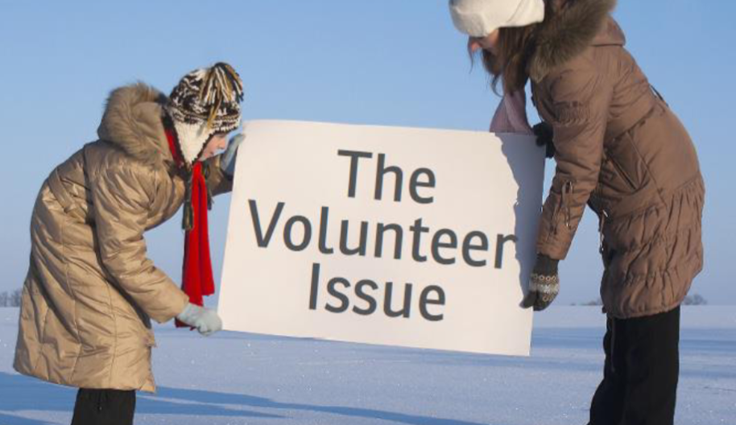
A Volunteer is an individual who performs hours of service for civic, charitable, or humanitarian reasons, without promise, expectation or receipt of compensation for services rendered.
  Is the activity less than a full-time occupation?
  Are the services offered freely and without pressure or coercion?
  Are the services of the kind typically associated with volunteer work?
  Have regular employees been displaced to accommodate the volunteer?
  Are the services being offered substantially the same as those provided by a university employee in a paid position?
  Does the worker receive (or expect) any benefit for providing the service?
To safely be considered a volunteer, the first three answers need to be “yes”, and the last three answers need to be “no”.

Slide 12

Responsibilities
Accurately record number of hours worked on the correct day.
Accurately record number of leave hours taken on the correct day.
Get pre-approval before working overtime.
Accurately record overtime hours on the correct day.
Certify timecard on a weekly basis.
Communicate travel schedule with supervisor before traveling.
Work with supervisor if flex schedule is necessary to prevent overtime.
Work with Business Services if you would like an exception schedule built in MyTime.
Do not perform work duties during break and lunch periods.
Do not “donate” or “volunteer” your time doing the same work that you are paid for.

Slide 13

Policies
3203: Overtime
3205: Time and Attendance
3017: Volunteer Services
3205: Call-Back Pay

