Slide 1


Going on a Treasure Hunt
March 9, 2022

Slide 2
The Map MyUSU

Slide 3
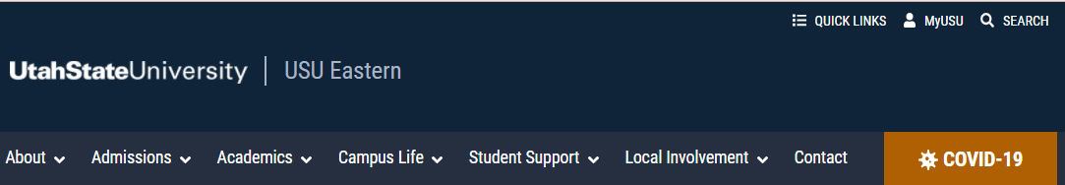
Starting Points MyUSU
USU Eastern Website (or any USU campus page)
URL
https://my.usu.edu

Slide 4
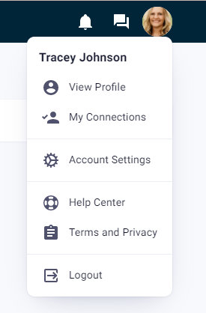
Making the Map Yours Customizing Your MyUSU Account
View Profile
Edit Profile
Change Cover Image / Update Image
About me info
Account Settings
General
Integrations link Microsoft Account
Privacy
Notifications

Slide 5
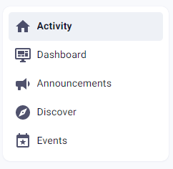
Exploring Getting the Lay of the Land
Activity
Shows all posts to your groups
Dashboard
Notifications from your services
Announcements
Announcements for MyUSU Admin
Discover
View Groups/Events/People from across all of USU
Events
View events from your Groups

Slide 6
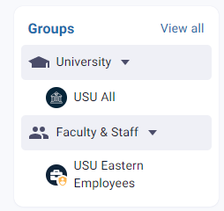
Default Groups
USU All
USU Eastern Employees
If you are not in the USU Eastern Employee group contact Tracey Johnson, tracey.johnson@usu.edu.

Slide 7
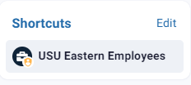
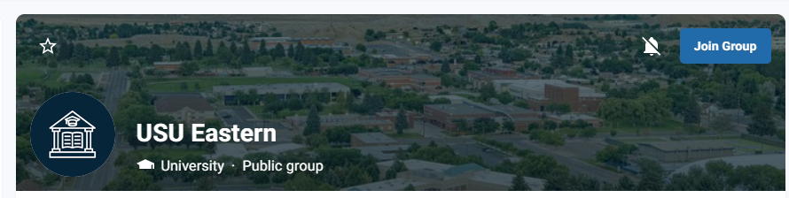
Joining Additional Groups
Browse / Search Groups
Click Group Name to see content
Join Group
Add to Shortcuts
Unmute Group Notifications

Slide 8
USU Eastern Employees Group

Slide 9
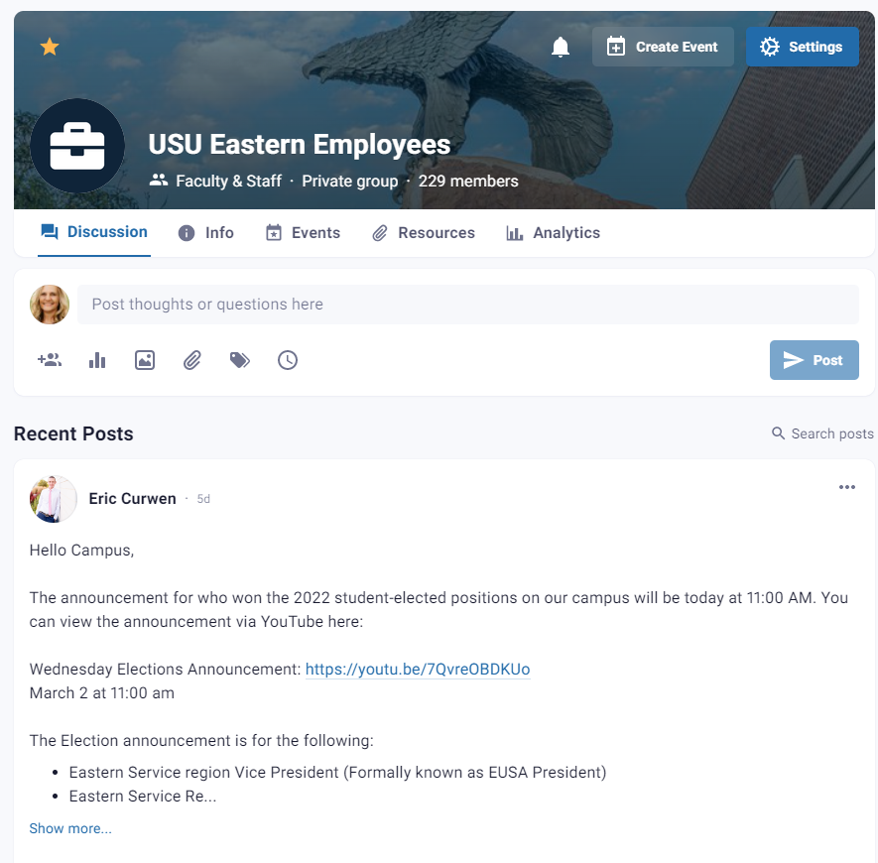
Discussion
Similar to any social media feed
Members of the group can post to the feed
Members of the group can add events
Use to communicate with USU Eastern employees

Slide 10
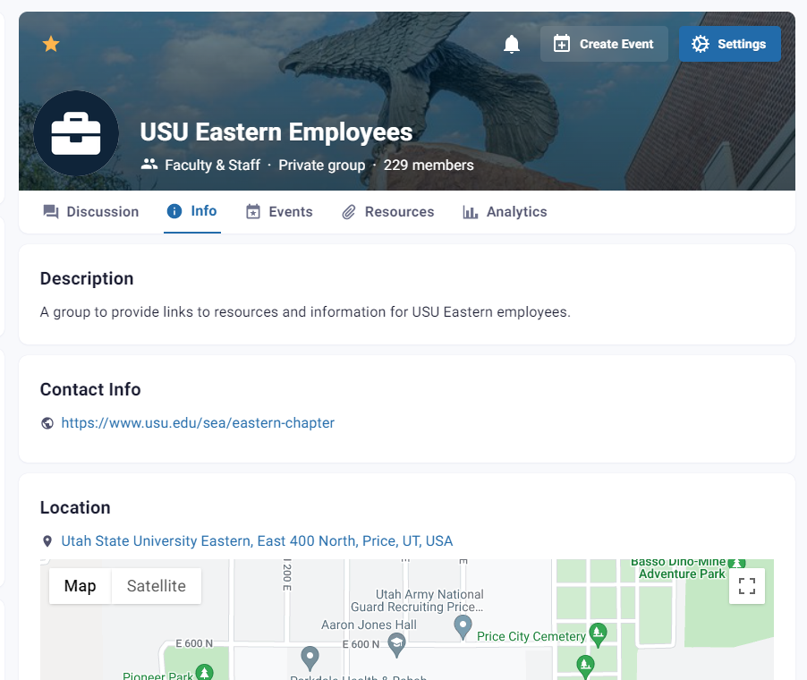
Info
Information about the group

Slide 11
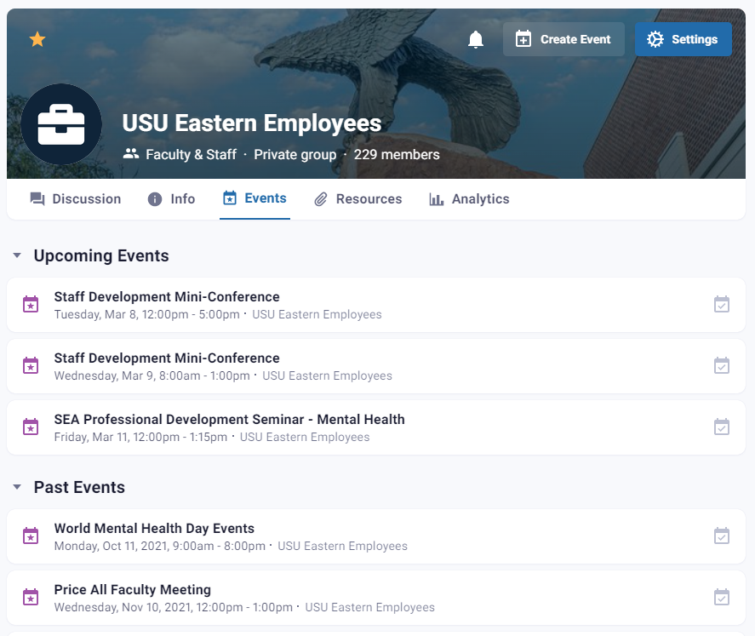
Events
Events for this group

Slide 12
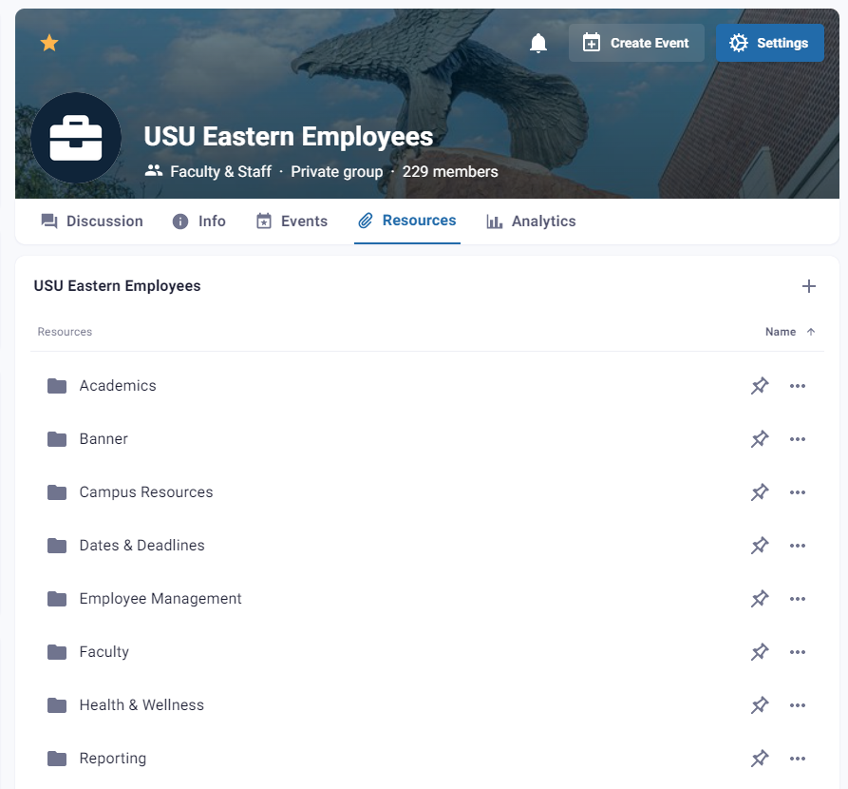
Resources
Categorized links to employee resources
If you have a resource you would like added contact Tracey Johnson, tracey.johnson@usu.edu.

Slide 13
Spotlighted Resources

Slide 14
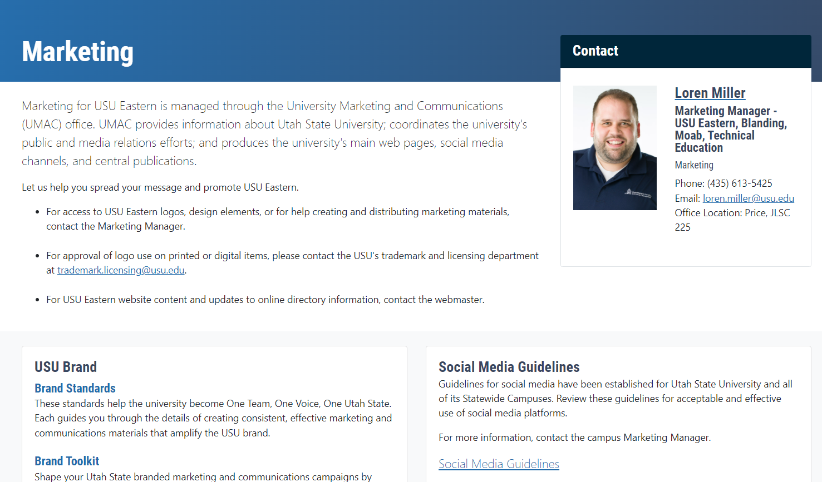
Campus Resources Campus Marketing
Contact Information
USU Brand
Link to brand.usu.edu
Access to branding information such as policies, resources, logos, templates, colors, etc.

Slide 15
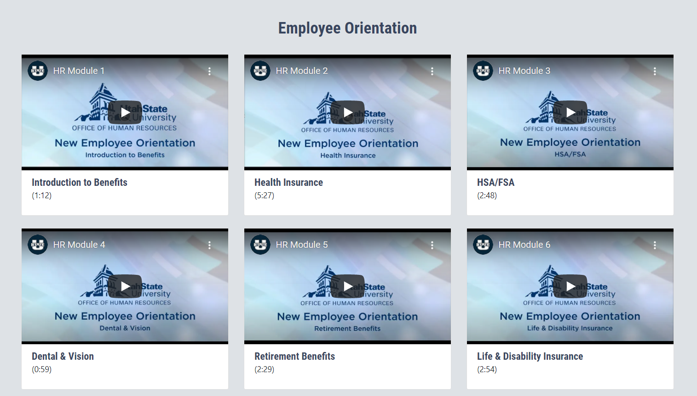
Campus Resources Employee Orientation
Links to USU Eastern HR Orientation videos
Great resource for new and existing employees to review benefits for USU Eastern employees

Slide 16
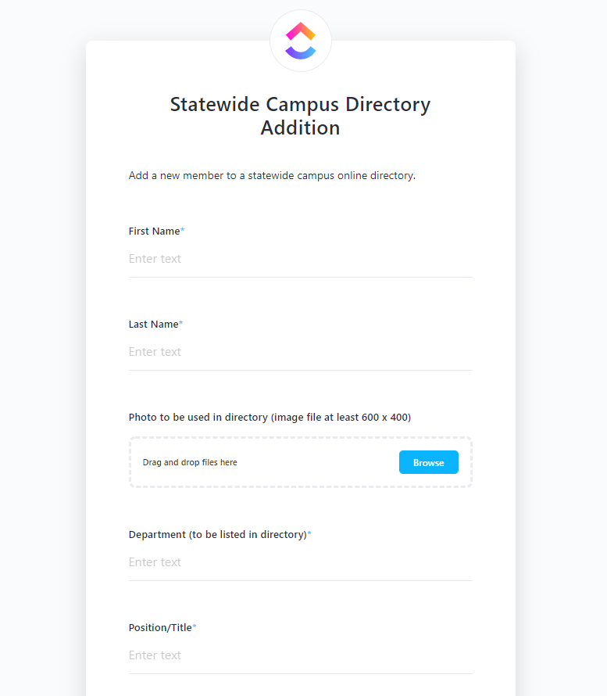
Employee Management Add/Edit Directory Listing
Links to form to add/edit/remove directory member
When the form is completed the employee information will be modified in the USU Eastern website directory, MyUSU, and appropriate list serves

Slide 17
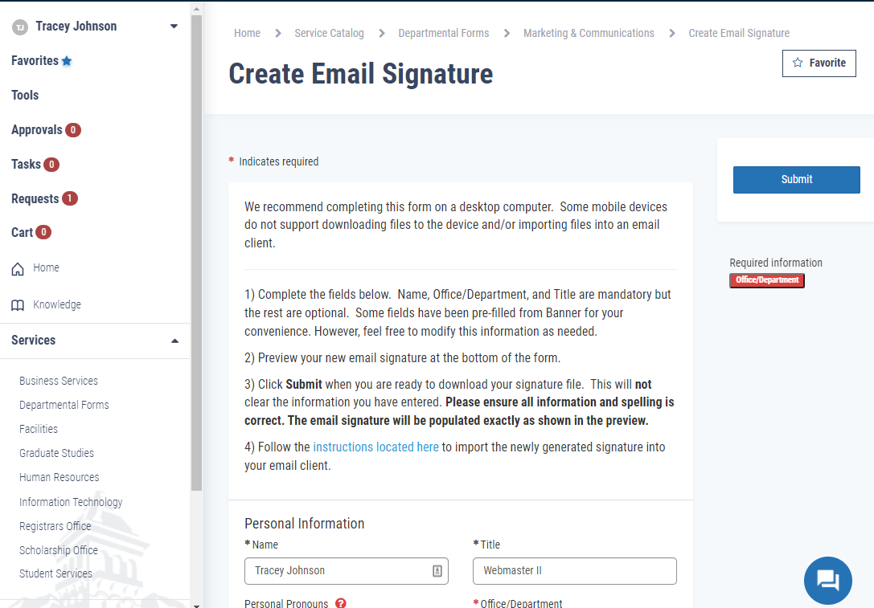
Employee Management Create Email Signature
Links to ServiceNow template
Fill in the form to create a downloadable email signature
Use the directions provided to add the signature to your email program.

Slide 18

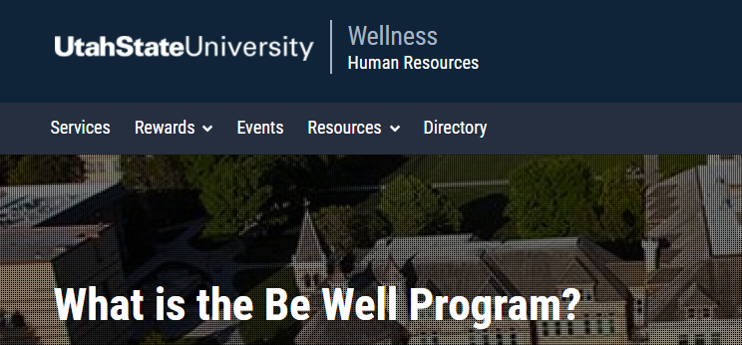
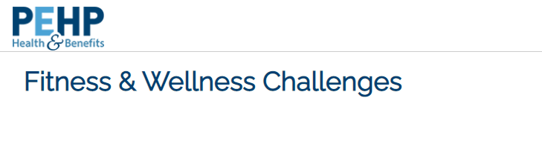
Health & Wellness
Aggies Thrive
https://www.usu.edu/hr/aggies-thrive/
Mental Health Resources
Employee Assistance Program
Be Well
https://www.usu.edu/wellness/
Healthy Lifestyle Resources
PEHP Fitness & Wellness Challenges
https://www.pehp.org/fitnesschallenges
Challenges for health goals some include rewards

Slide 19
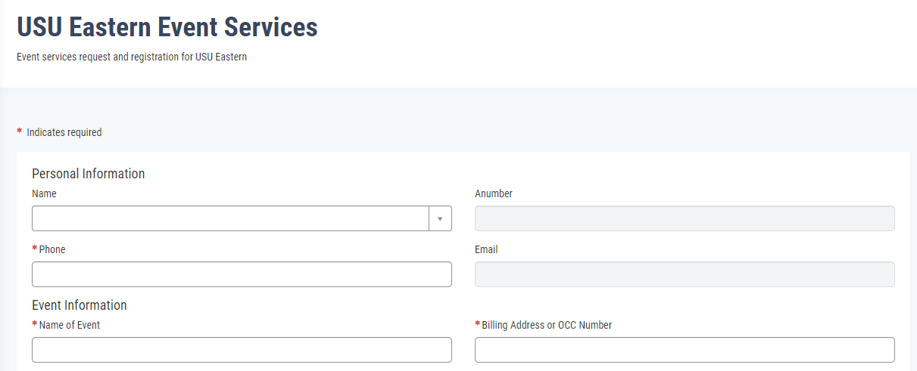
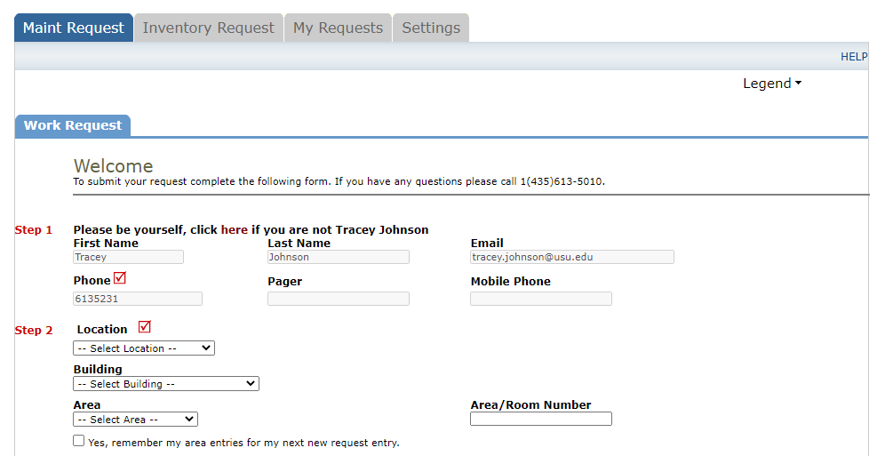
Service Requests
Broadcast Meetings
Event Services
Facilities/Maintenance
IT Support

Slide 20
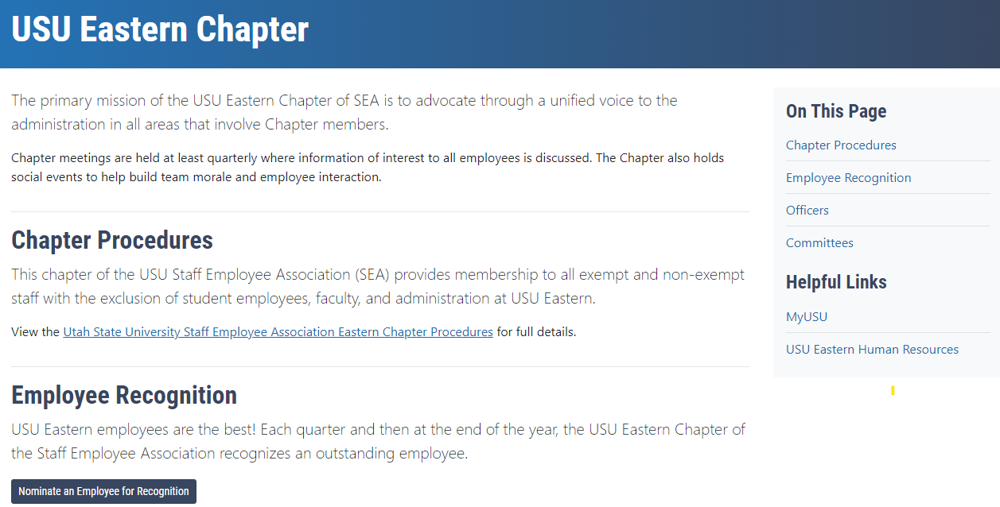
Staff
Staff Employee Association (SEA) – USU Eastern Chapter
Information about the SEA – USU Eastern Chapter

Slide 21

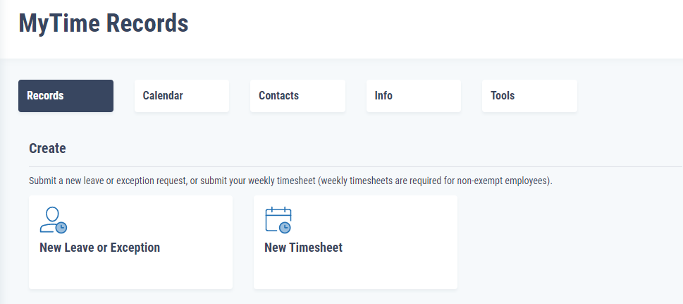
Time & Leave
Time/Leave Records
Aggie Time
https://aggietime.usu.edu/login/auth
MyTime
https://usu.service-now.com/aggies?id=mytime_records

Slide 22
Thank You
Questions?
Suggestions?

