Slide 1
Knowledge is Power
START!
How to Increase Your Impact Through Education

Slide 2
What We Will Be Learning
1. Benefits of Completing College
3. Learning to Set Goals
2. Dear Future Self…
4. Act On It!
Knowledge is power but completing your degree is the key.
Becoming a #GoalGetter by setting S.M.A.R.T. goals
Write it down, and make it happen.
Actions speak louder than words…especially in this activity!

Slide 3
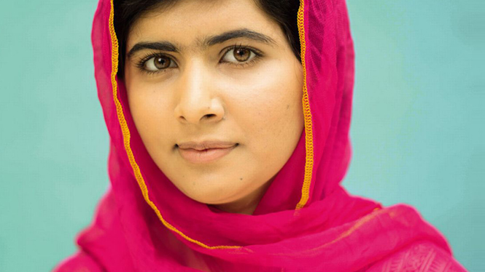
—Malala Yousafzai
“The content of a book holds the power of education and it is with this power that we can shape our future and change lives. ”

Slide 4
What We Are Learning About
01.
1. Benefits
2. Future
3.. Goals
4. Act
Benefits of A Degree
Knowledge is power but completion is the key.

Slide 5
Completing college offers life-long benefits for women

Slide 6
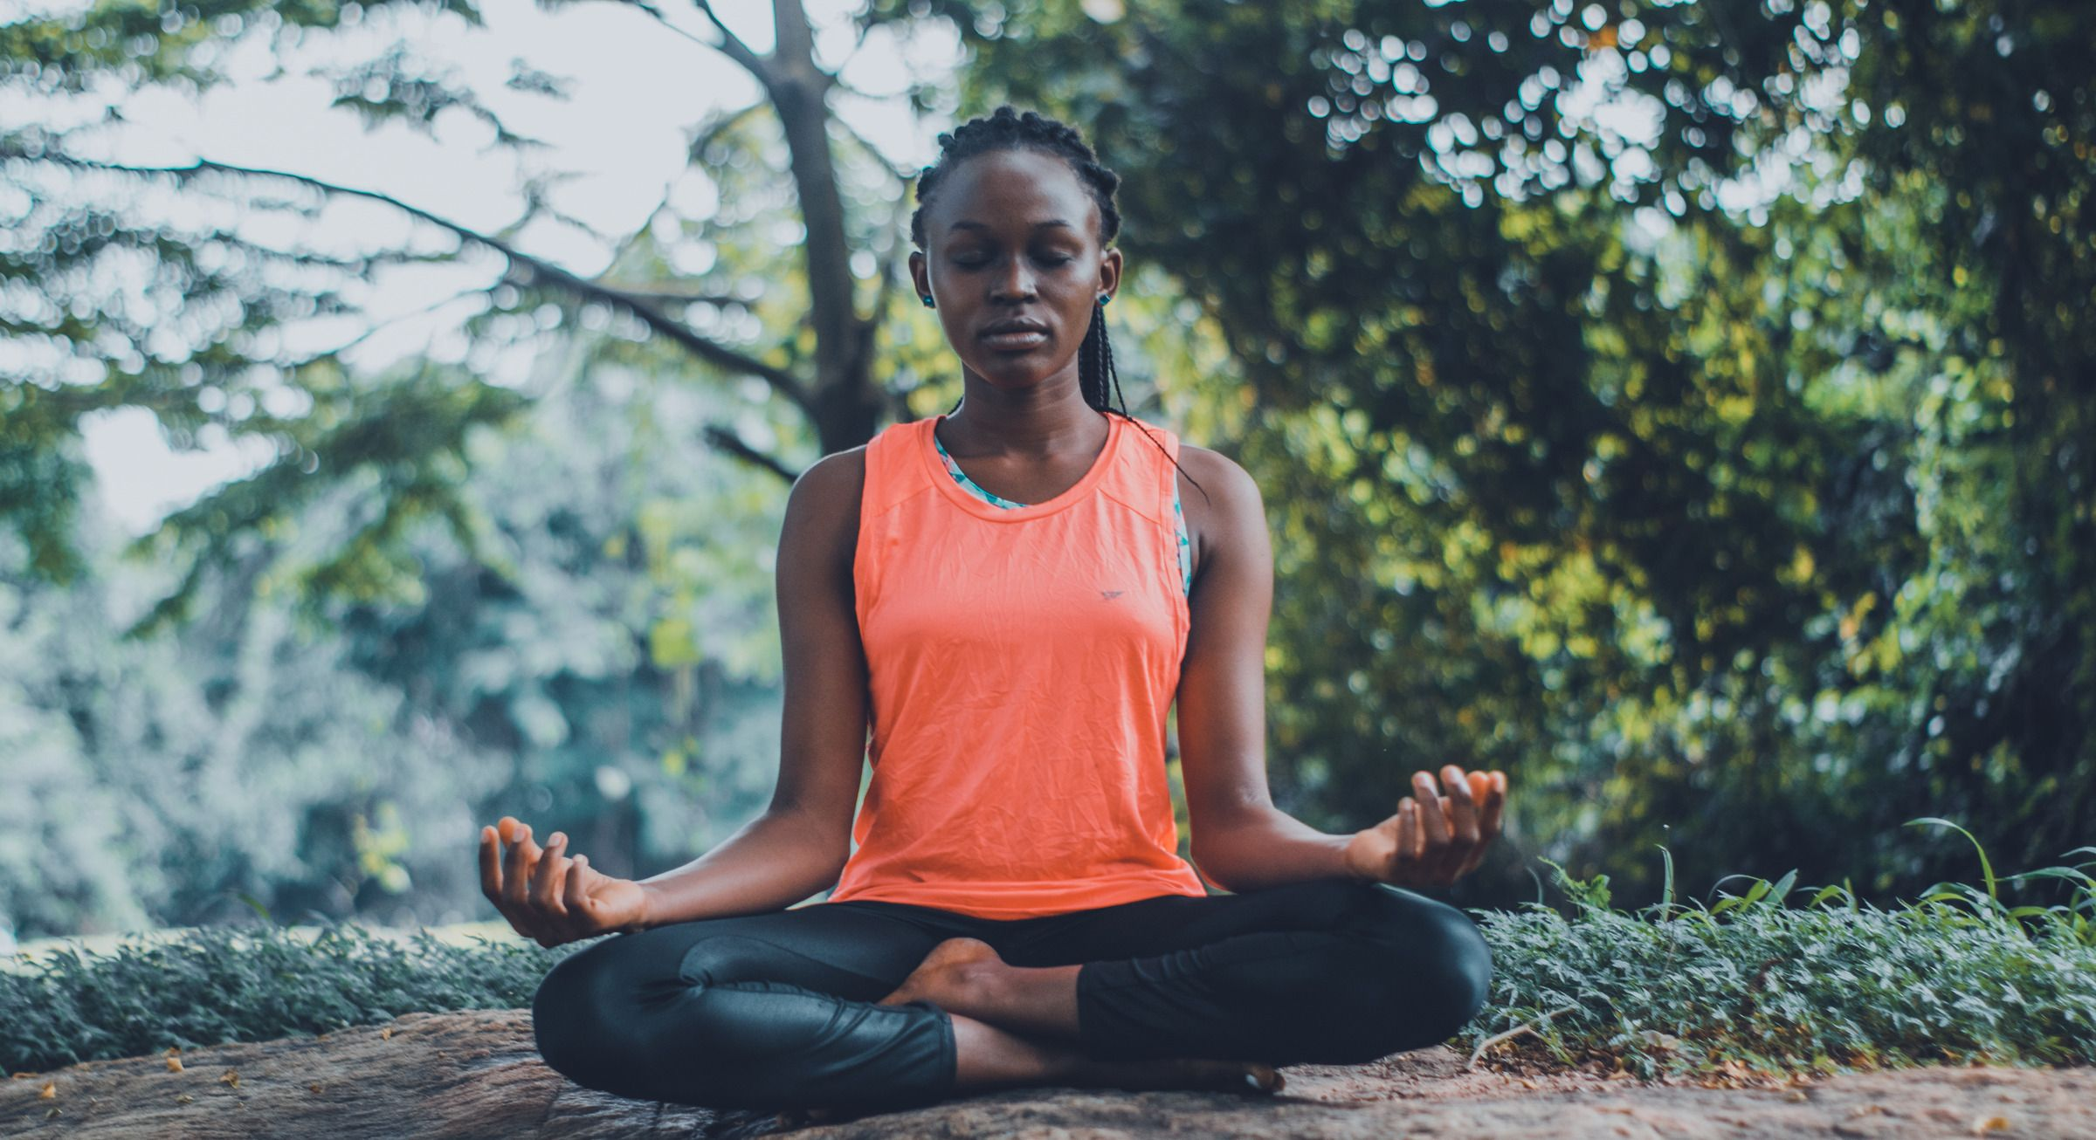
How can a college education impact my life?
Economics
Health & Wellbeing
Civic & Community Engagement
Parenting
Intellectual/Cognitive
Self-Development

Slide 7
Economics
Earn more money
Be better prepared to financially support self and family
Have better job opportunities
Gain access to better health care and related benefits
Have lower risk of unemployment

Slide 8
Health & Wellbeing
Live longer lives (on average)
Have an overall healthier lifestyle (exercise more, healthier diet, lower alcohol abuse, lower cholesterol levels, higher fiber intake, smoke less)
Are less overweight or obese
Have increased life satisfaction and overall happiness
Are more resilient and less depressed (better mental health)
Obtain more resources to pay for health insurance

Slide 9
Civic & Community Engagement
Participate substantially more in civic and community activities
Voting
Donating blood
Filling leadership roles
Be a more conscientious civic and community volunteer

Slide 10
Parenting
Provide healthier lifestyles for their children
Work higher paying, more flexible jobs
Have more college-educated children who can better provide for self and families

Slide 11
Intellectual/Cognitive
Increased ability to integrate ideas and concepts
Stronger writing and verbal skills
Higher critical and creative thinking, as well as decision making skills
Enhanced quantitative and analysis skills

Slide 12
Self-Development
Improved self-understanding
Greater independence and feelings of control in life
Superior leadership skills
Higher ethical and moral standards and reasoning
Stronger social skills
Better self-concept/self-esteem
Openness to diversity and racial understanding
Greater ability to make reasoned, reflective judgments
Stimulating occupations and increased quality of life

Slide 13
Benefits of Completing College Handout
Review the handout together as a group.
Reflect on these questions as a group and on your own.
What stood out to you?
Have you ever thought about how college affects your self-esteem?
How could you influence those in your home and community with a college degree?
An education increases not only your opportunities but your confidence, too!

Slide 14
Switch it Up Activity
What does it mean?
Teamwork
SWITCH!
Work together to create a sentence using the vocabulary word on the paper(s) in front of you.
Following the instructions given, find the definition of your vocabulary word and write it on your paper.

Slide 15
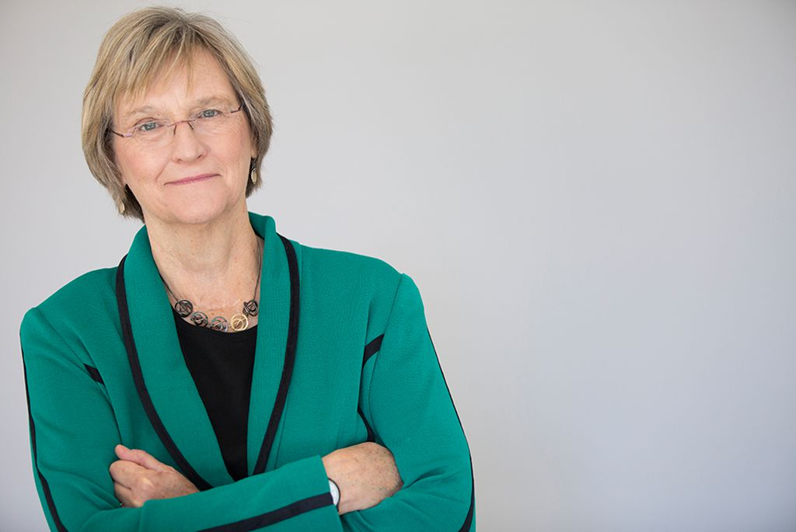
—Drew Faust Harvard’s First Woman President
“We educate women because it is smart. We educate women because it changes the world.”

Slide 16
Strengthening Your Impact Worksheet
Now that you know the benefits of completing college, fill out the worksheet to help organize your thoughts.
Think about the following:
Have you already made a commitment to yourself to obtain a degree?
Which benefits are most important to you?
What barriers can you identify?
What can you do now to prepare?

Slide 17
What We Are Learning About
1. Benefits
02.
2. Future
3. Goals
Dear Future Self…
4. Act
Write it down, make it happen.

Slide 18
Writing vs Typing
Don’t get us wrong – we love technology!
We also think it’s important to seek new ways to help us be more successful as we learn.
Researchers Pam A. Mueller of Princeton University and Daniel M. Oppenheimer of the University of California, Los Angeles, conducted an interesting study.
They showed research participants a TED Talk and asked them to take notes. They asked one half of the participants to use a laptop and one half to write by hand. When the lecture was over, the researchers tested them on the information in the lecture.
Here’s what they found: Even though the laptop users and hand writers remembered facts, such as dates, equally well, the hand writers had a much better understanding of conceptual questions.

Slide 19
Activity: Write a Letter To Your Future Self
Why is this a good idea?
Reality check. This letter will help you to raise some essential questions and help you move in the right direction.
Self-reflection. Practicing asking yourself meaningful questions is a great way to learn how to recognize what is important to you.
Reminder. The most important hopes and dreams can be forgotten when life gets busy and takes unexpected turns. This letter will be a great reminder.
Use what you have learned today to express your thoughts about your future educational and career goals.
Use the “Strengthening Your Impact” worksheet as a guide.

Slide 20
What We Are Learning About
1. Benefits
2. Future
3. Goals
4. Act
03.
Goals
Become a #GoalGetter! Set S.M.A.R.T. goals.

Slide 21
The Importance of Setting Goals
From Leading at a Higher Level by Ken Blanchard
“According to research, goal setting is the single most powerful motivational tool in a leader’s toolkit. Why? Because goal setting operates in ways that provide purpose, challenge, and meaning.
Goals are the guideposts along the road that make a compelling vision come alive. Goals energize people. Specific, clear,
challenging goals lead to greater effort and achievement than easy or vague goals do.”
Now, let’s talk about setting S.M.A.R.T. Goals!

Slide 22
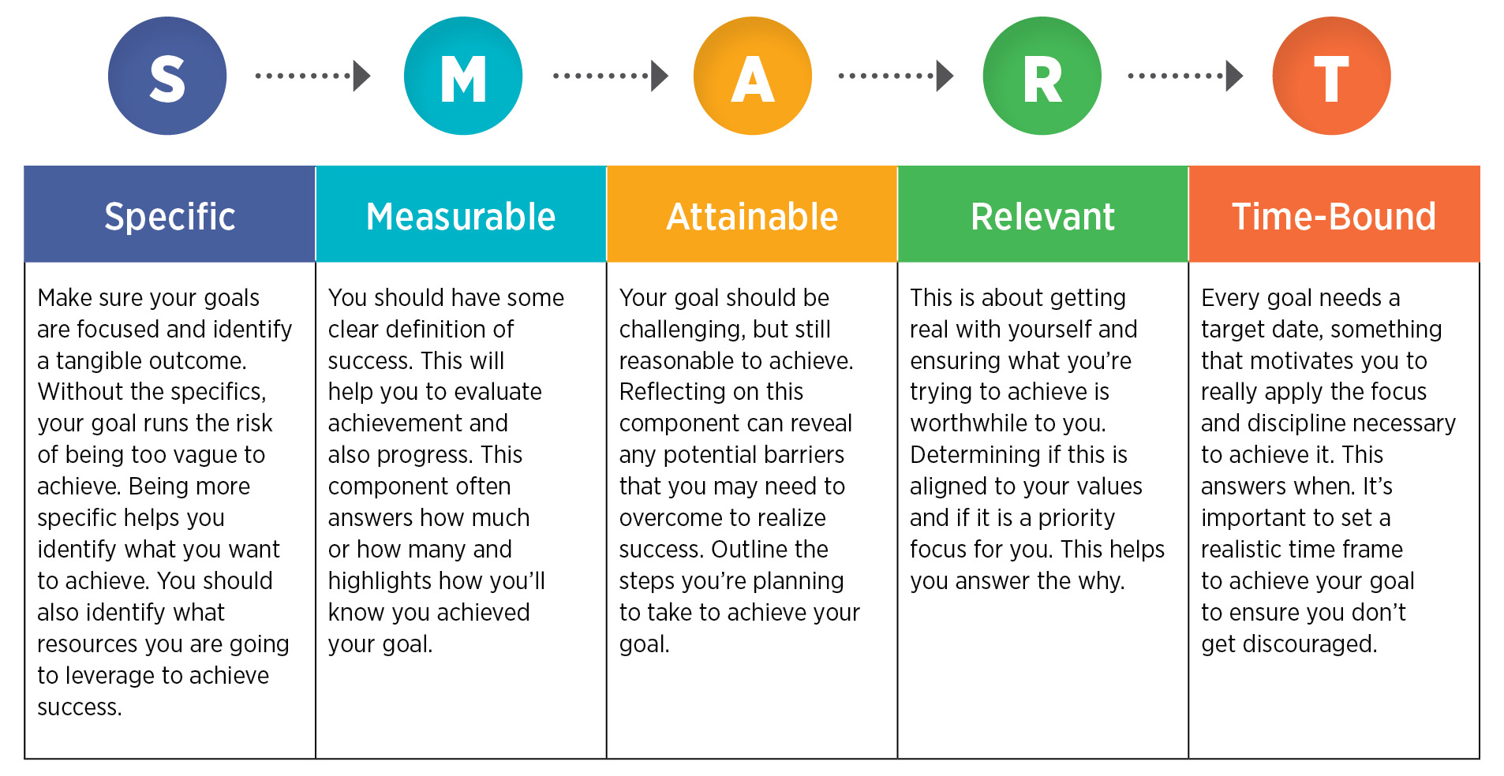

Slide 23
Specific
Measurable
Attainable
EXAMPLE
I want to create good study habits to sustain me through college.
I will set aside 30 minutes
Create 3 S.M.A.R.T. goals on the
S.M.A.R.T. Goals Worksheet
once a week
Realistic
to plan out the following week’s homework
Time-Bound
each term or semester.

Slide 24
What We Are Learning About
1. Benefits
2. Future
3. Goals
Act On What You’ve Learned !
Act
04.
Actions speak louder than words...especially in this activity!

Slide 25
It’s time to practice acting on (or acting out!) what you’ve learned

Slide 26
Charades
Let’s see how many benefits of higher education you can remember!
Acting out the ideas will help you remember and recall the benefits of higher education and apply them to scenarios in your own way. At the same time, you’ll be sharing what you’ve learned with others and helping them to expand their understanding, too!

Slide 27
Instructions for Charades
Decide if you want groups of 2 or single players
Draw a paper out of the bowl. Read the scenario - but don’t say anything.
Act out the scenario on the card without speaking
The rest of the group will guess what the actor is portraying and when they guess correctly the next actor can have a turn.
Most importantly…
Have fun!

Slide 28
Let’s Review What We’ve Learned
You’ve worked so hard!

Slide 29
Knowledge is Power
Completing college offers life-long benefits including increased confidence and sense of self.
Education can help to strengthen our impact on our family, community, and the world.
It is important to decide now to complete college and create a plan to do so.
Be a #GoalGetter By Setting S.M.A.R.T. Goals!

Slide 30
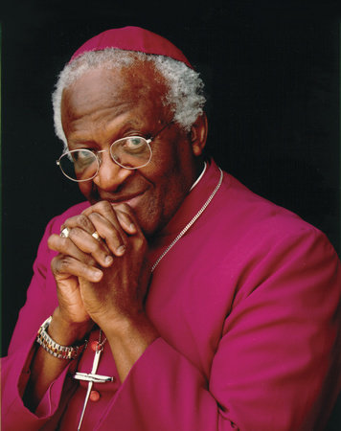
— Archbishop Desmond Tutu
“If we are going to see real development in the world then our best investment is WOMEN!”

Slide 31
This resource was created by the
Thanks to Wheeler Machinery Co. for their generous donation to fund this curriculum. For questions contact uwlp@usu.edu.
Copyright © 2020 Utah Women & Leadership Project & Bonnie Mortensen

